Slide 1
Unit 4
Did you go to
the party?
Lesson 2

Slide 2
VOCABULARY

Slide 3
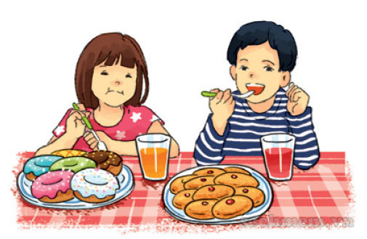
A. Vocabulary
Verb – (v)
have /hæv/ ăn
eat /ɪt/ ăn

Slide 4
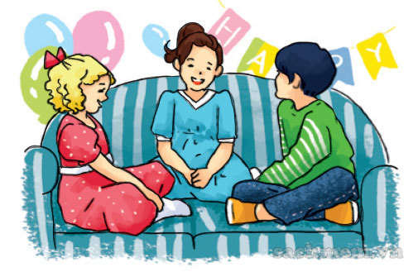
chat /tʃæt/ : nói chuyện

Slide 5
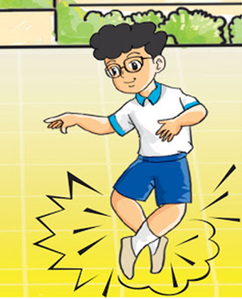
dance /dɑːns/ nhảy

Slide 6
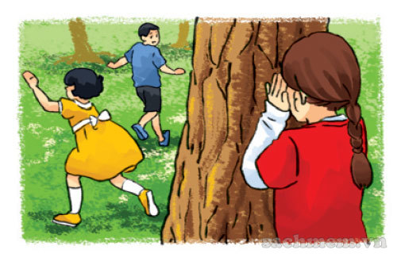
play /pleɪ/ chơi

Slide 7
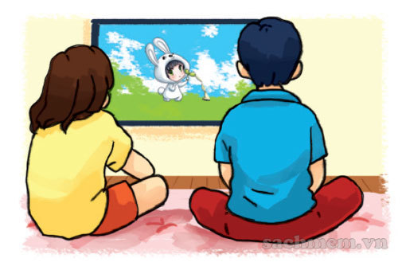
watch /wɒtʃ/ xem

Slide 8
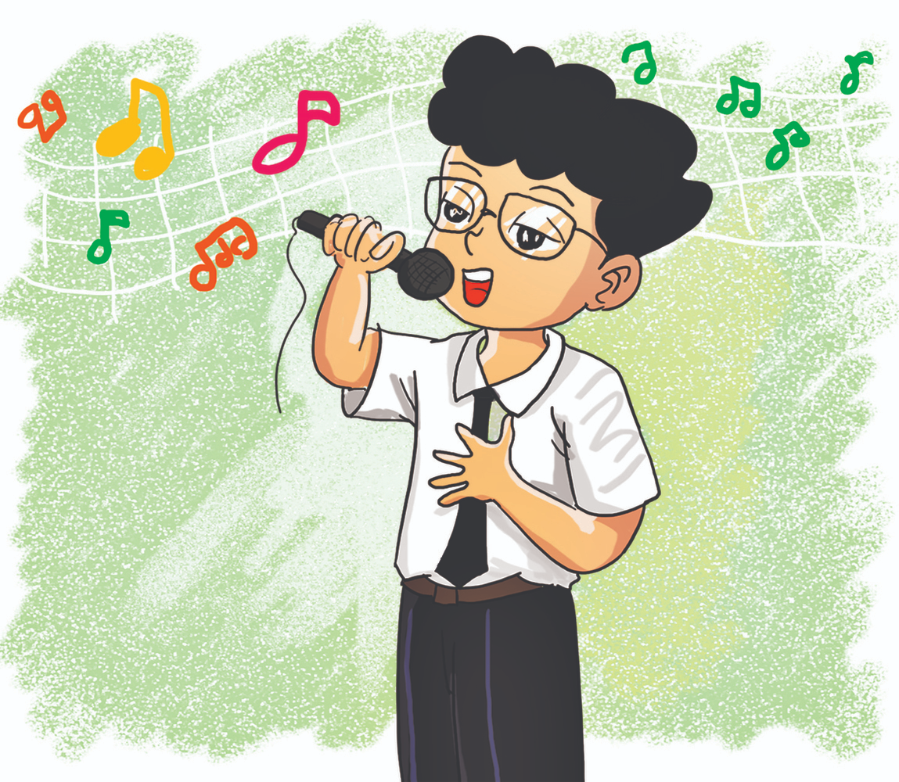
sing /sɪŋ/ hát

Slide 9
A. Vocabulary
Verb – (v)
eat
- have
chat
dance
ăn
nói chuyện
nhảy
play
watch
sing
chơi
xem
hát

Slide 10
GRAMMAR

Slide 11
B. Grammar
Cách nói đã làm một hoạt động (Ved/V2):
chat
play
watch
dance
eat / have
sing
nói chuyện
chơi
xem
nhảy
ăn
hát
chatted
played
watched
danced
ate / had
sang
đã nói chuyện
đã chơi
đã xem
đã nhảy
đã ăn
đã hát

Slide 12
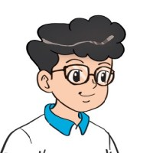
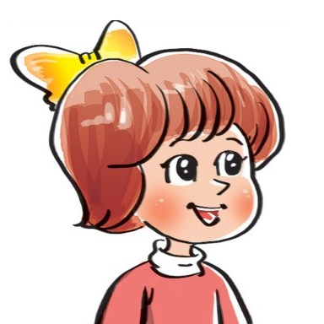
2. Point and say.
What did you do at the party?
We ___________.
had nice
food and drink
watched cartoons
played
hide-and-seek
chatted
with friends

Slide 13
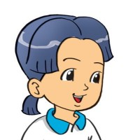
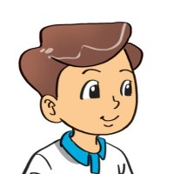
B. Grammar
Hỏi và đáp các bạn đã làm gì ở bữa tiệc:
What did you do at the party?
+ Ved/V2
We ________________.
Hỏi và đáp bữa tiệc đã như thế nào?
How was the party (it)?
It was _______.
+ adj

Slide 14
3. Let’s talk.
Did you ________?
Yes. I did.
No, I didn't.
How was it?
It was________.
What did you do there?
I/We ____________.

Slide 15
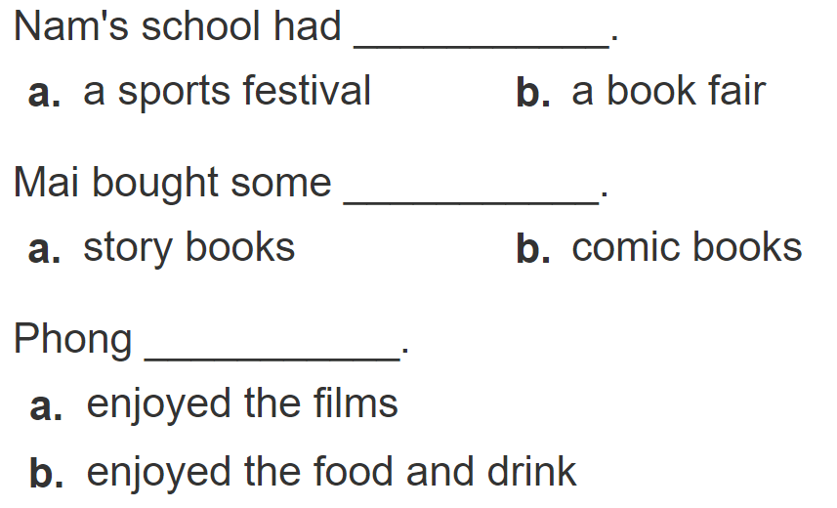
4. Listen and circle.
1
2
3

Slide 16
5. Write about you.
Where were you yesterday?
__________________________________.
2. What did you do there?
__________________________________.
3. Did you enjoy it?
__________________________________.

Slide 17
6. Let’s play.
Tic-tac-toe

Slide 18
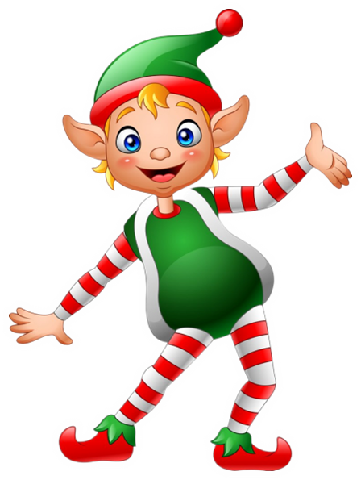
THANK YOU!
Welcome to join with me!
MsPham Powerpoint
Mspham

