Slide 1
Unit 17
What would you like to eat
Lesson 1

Slide 2
VOCABULARY

Slide 3
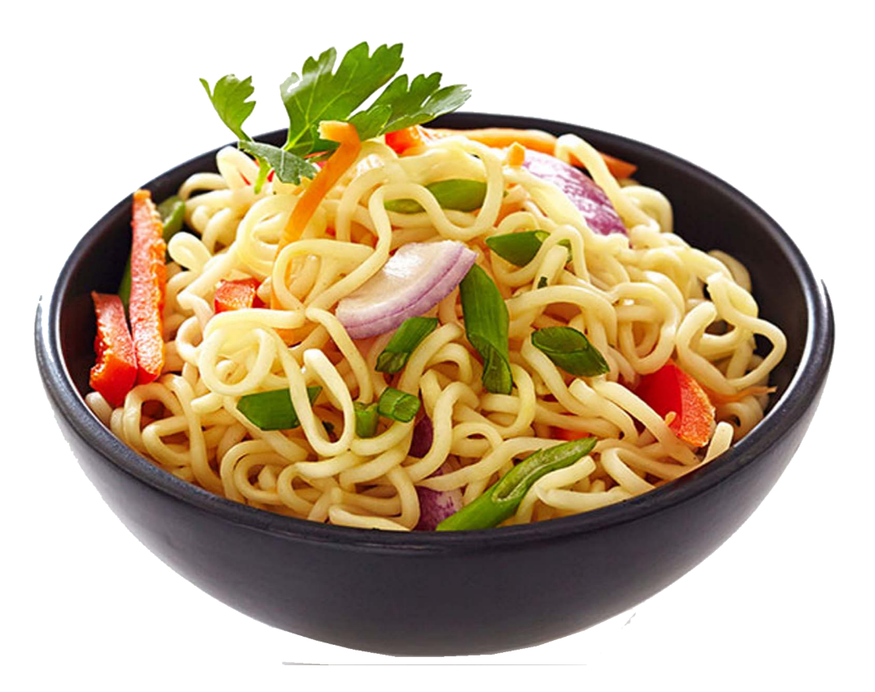
Vocabulary
noodle
s
/ˈnuːdlz/

Slide 4
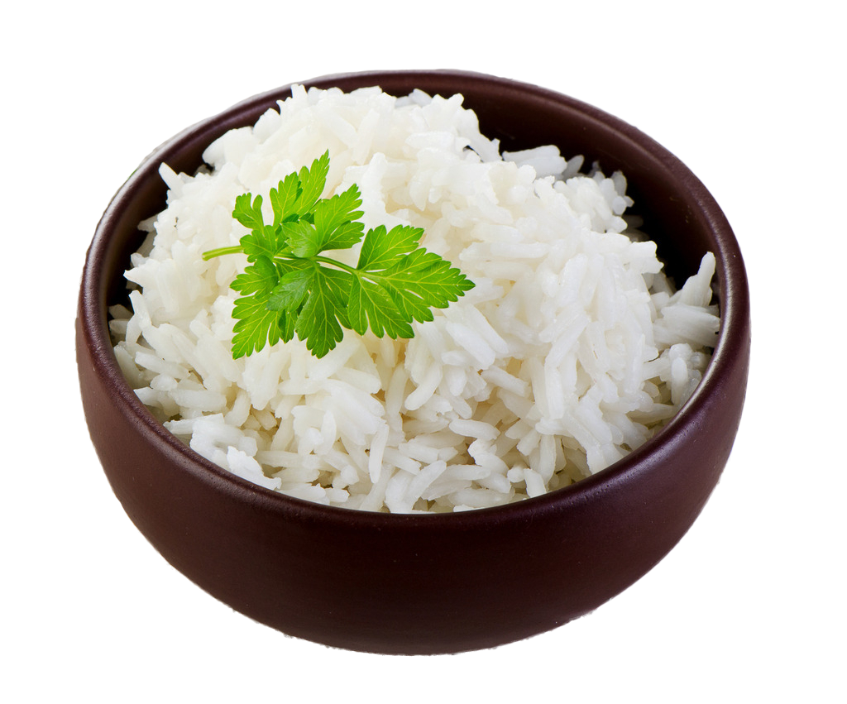
Vocabulary
rice
/raɪs/

Slide 5
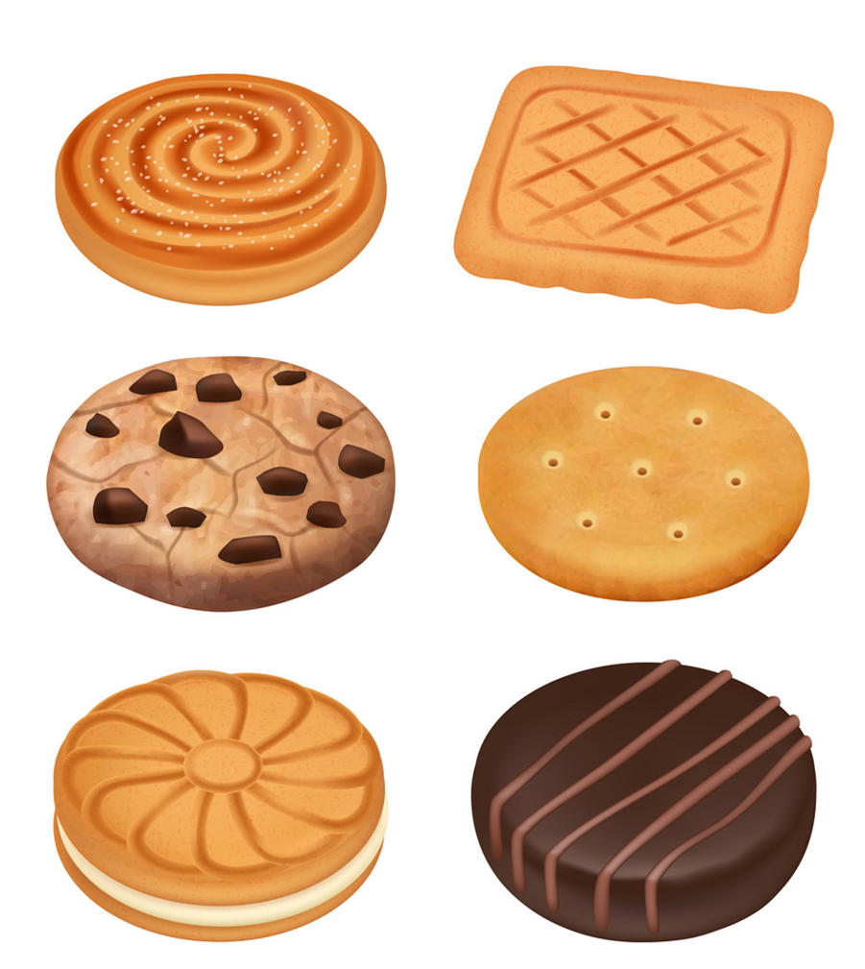
Vocabulary
biscuit
s
/ˈbɪskɪts/

Slide 6
Vocabulary
lemonade
/ˌleməˈneɪd/

Slide 7
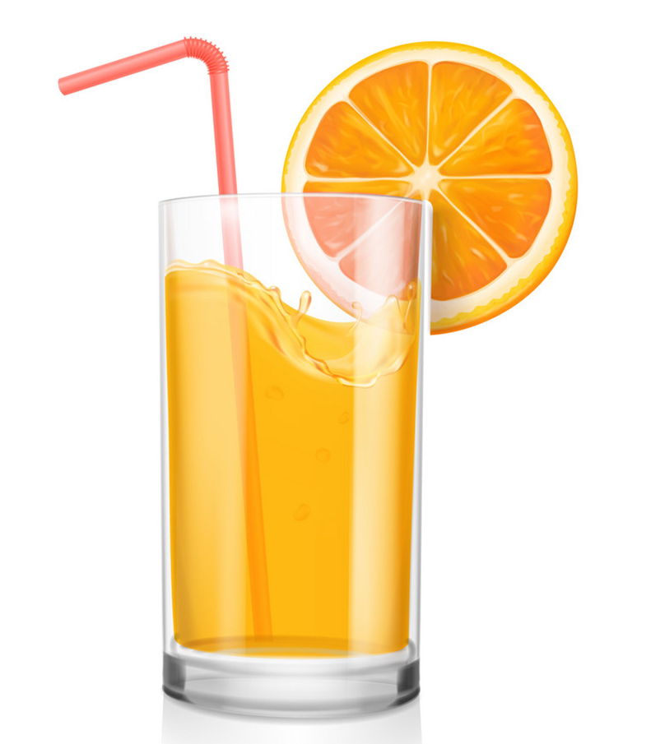
Vocabulary
orange juice
/ˈɔːrɪndʒ dʒuːs/

Slide 8
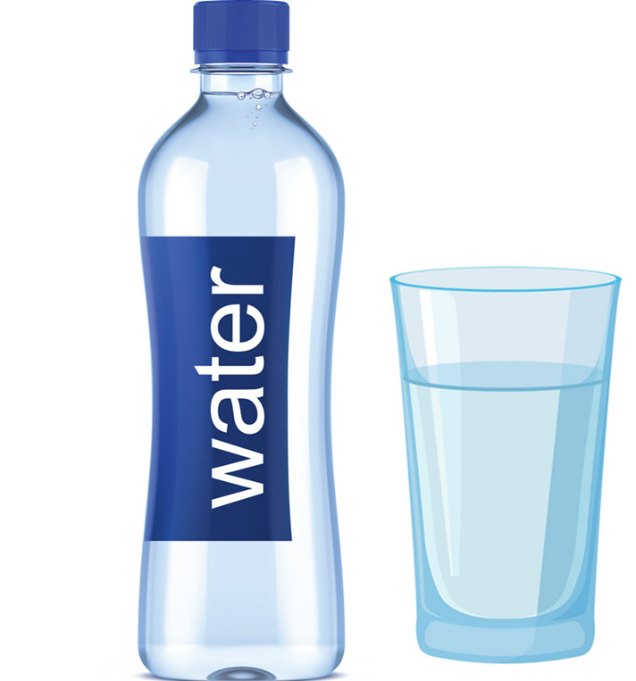
Vocabulary
water
/ˈwɔːtər/

Slide 9
Vocabulary
bar
/bɑːr/

Slide 10
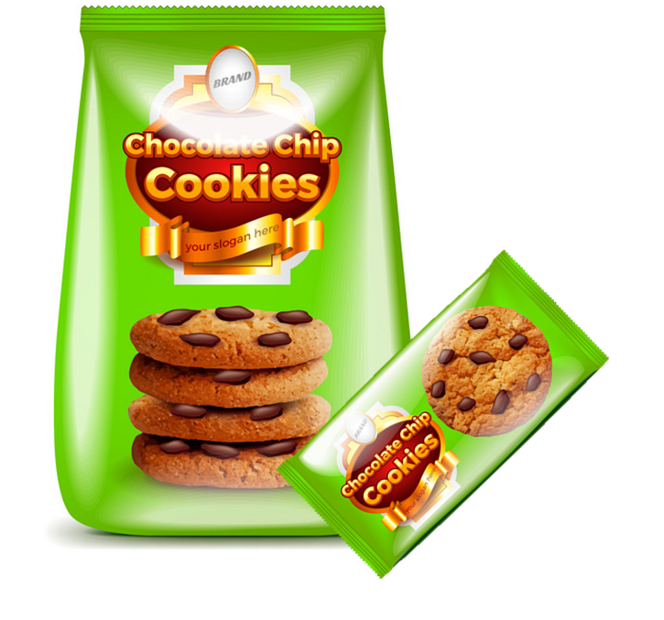
Vocabulary
packet
/ˈpækɪt/

Slide 11
Vocabulary
carton
/ˈkɑːrtn/

Slide 12
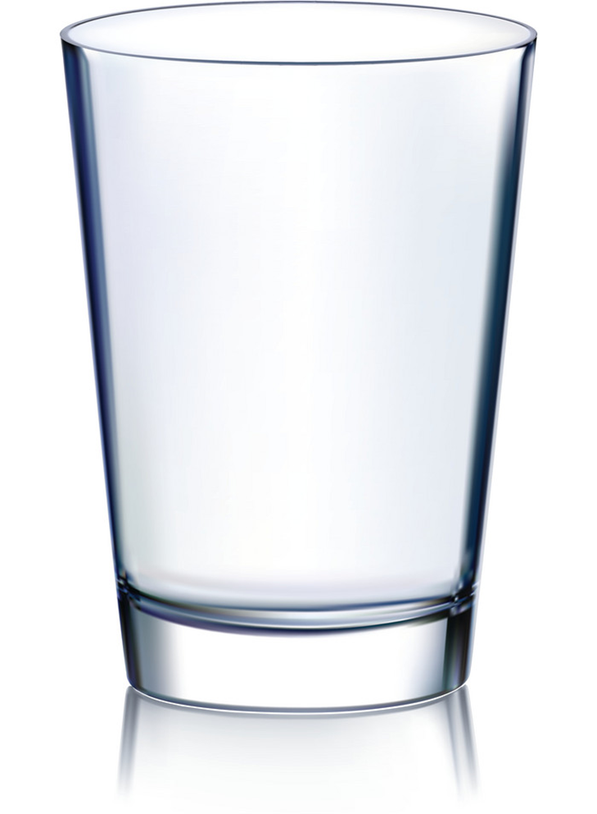
Vocabulary
glass
/ɡlæs/
glasses
/ɡlæsɪz/

Slide 13
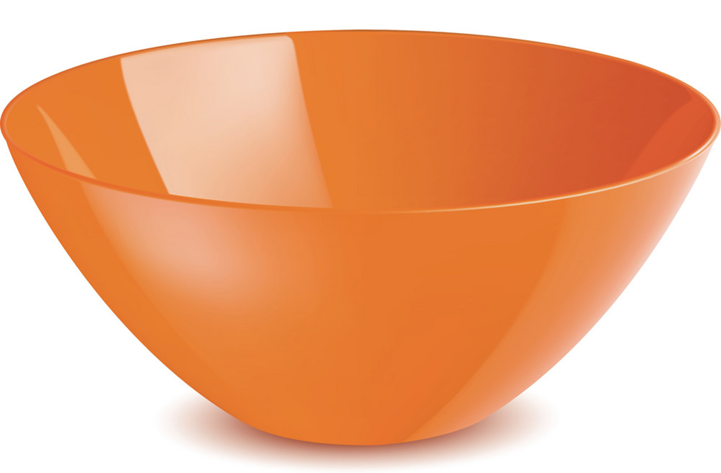
Vocabulary
bowl
/bəʊl/

Slide 14
Vocabulary
a bar
a bowl
a carton
a packet
a glass

Slide 15
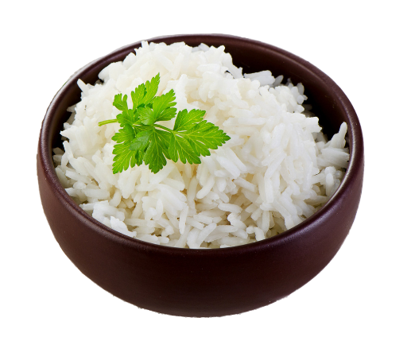
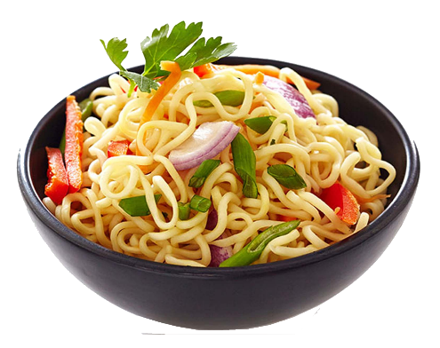
Vocabulary
water
lemonade
orange juice
rice
a biscuit
noodles

Slide 16
GRAMMAR

Slide 17
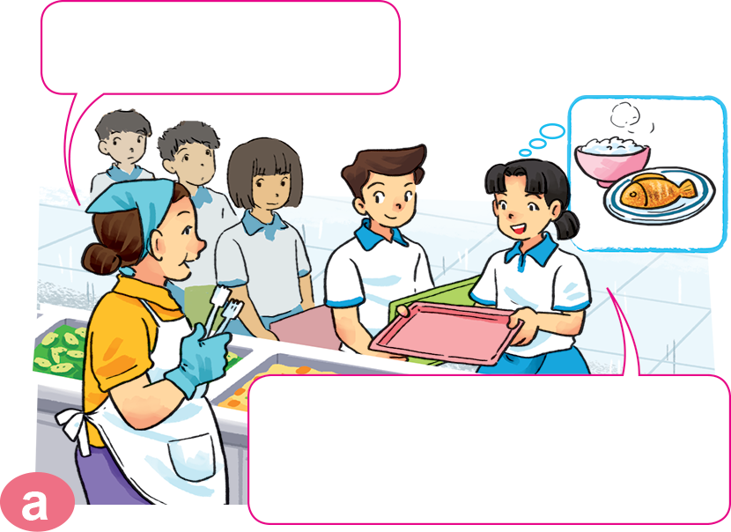
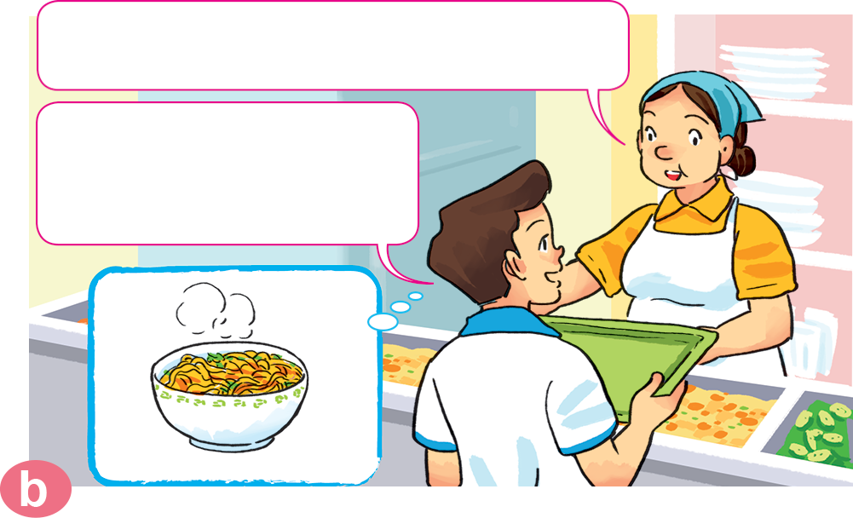
1. Look, listen and repeat.
Can I help you?
What would you like to eat?
I'd like a bowl of noodles, please.
Yes. I'd like some rice with fish, please.

Slide 18
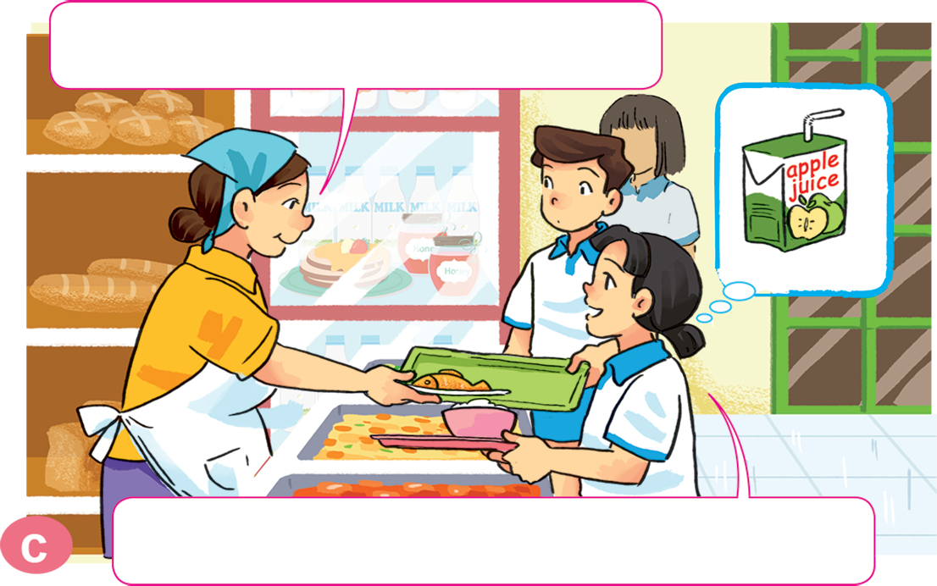
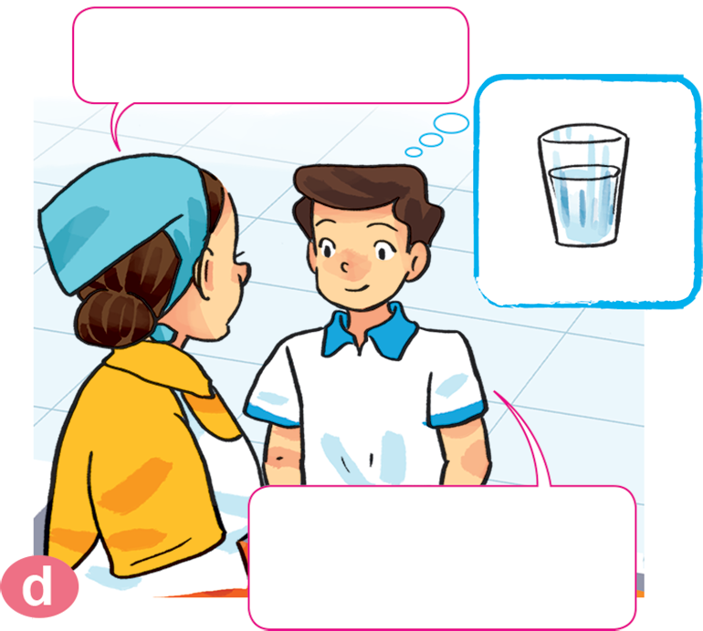
1. Look, listen and repeat.
What would you like to drink?
How about you?
I'd like a glass of water, please.
I'd like a carton of apple juice, please.

Slide 19
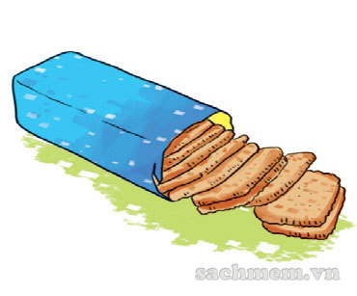
2. Point and say.
What would you like to eat?
I'd like ______________________, please.
a packet of biscuits

Slide 20
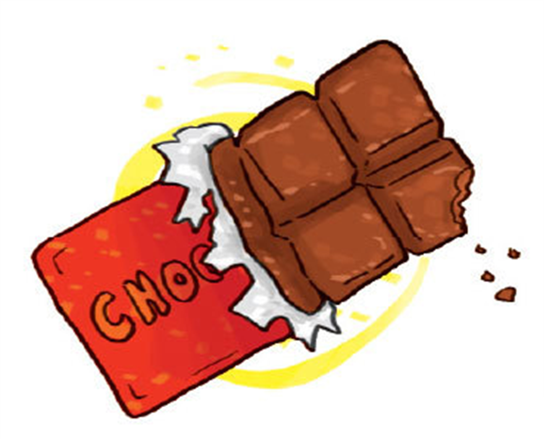
2. Point and say.
What would you like to eat?
I'd like ______________________, please.
a bar of chocolate

Slide 21
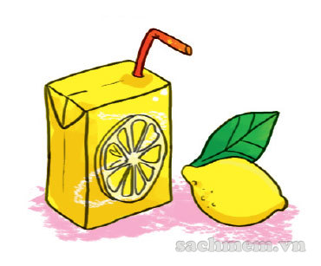
2. Point and say.
What would you like to drink?
I'd like ______________________, please.
a carton of lemonate

Slide 22
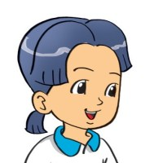
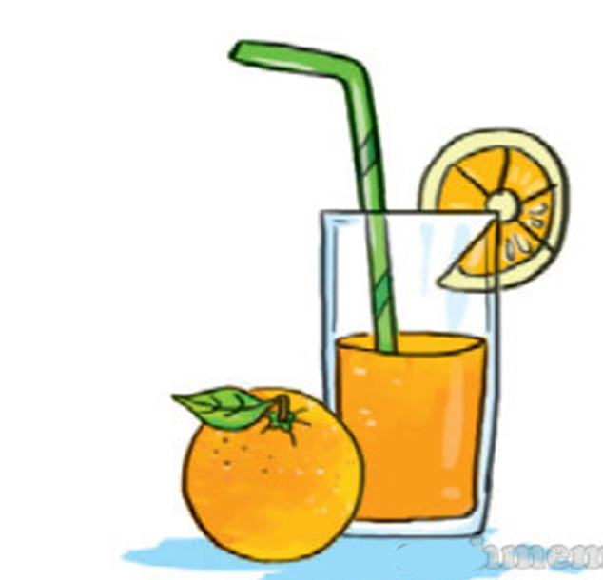
2. Point and say.
What would you like to drink?
I'd like ______________________, please.
a glass of orange juice

Slide 23
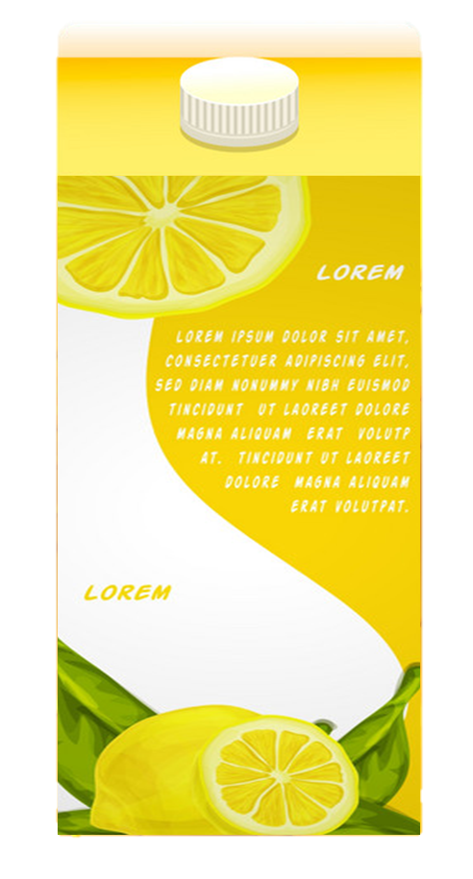
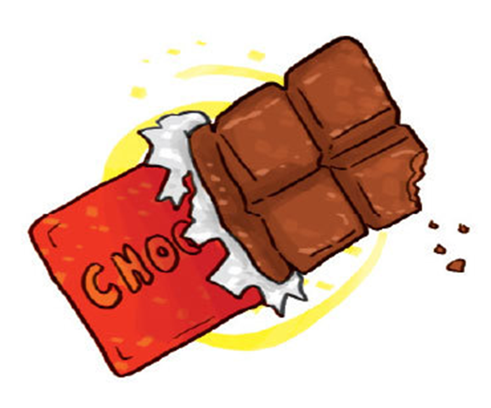
What would you like to eat/drink?
I'd like__________, please.
a packet of biscuits
a carton of lemonade
a bar of
chocolate
a glass of
orange juice
Ms.Phạm English

Slide 24
3. Let’s talk.
What would you like to eat/drink?
I'd like __________, please.

Slide 25
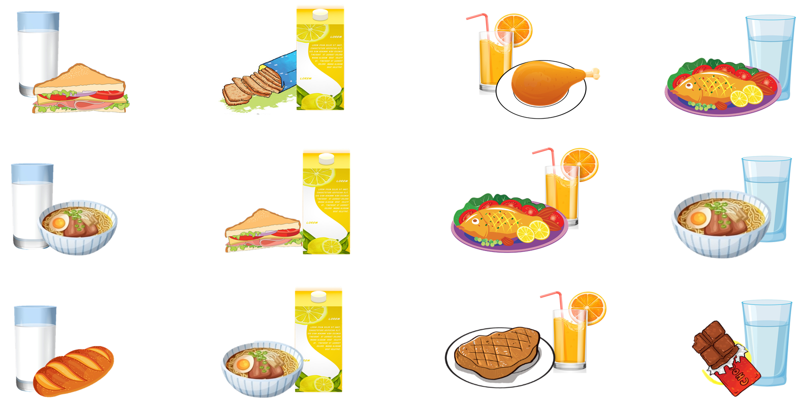
4. Listen and tick.
1.
2.
3.
4.
a
a
a
a
b
b
b
b
c
c
c
c

Slide 26
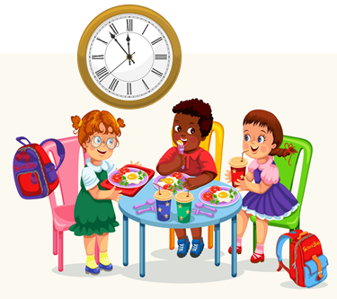
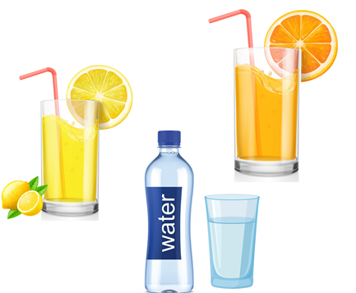
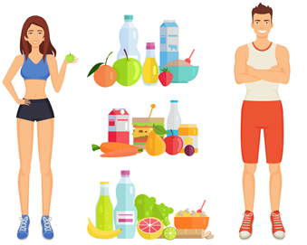
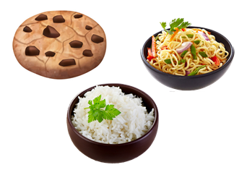
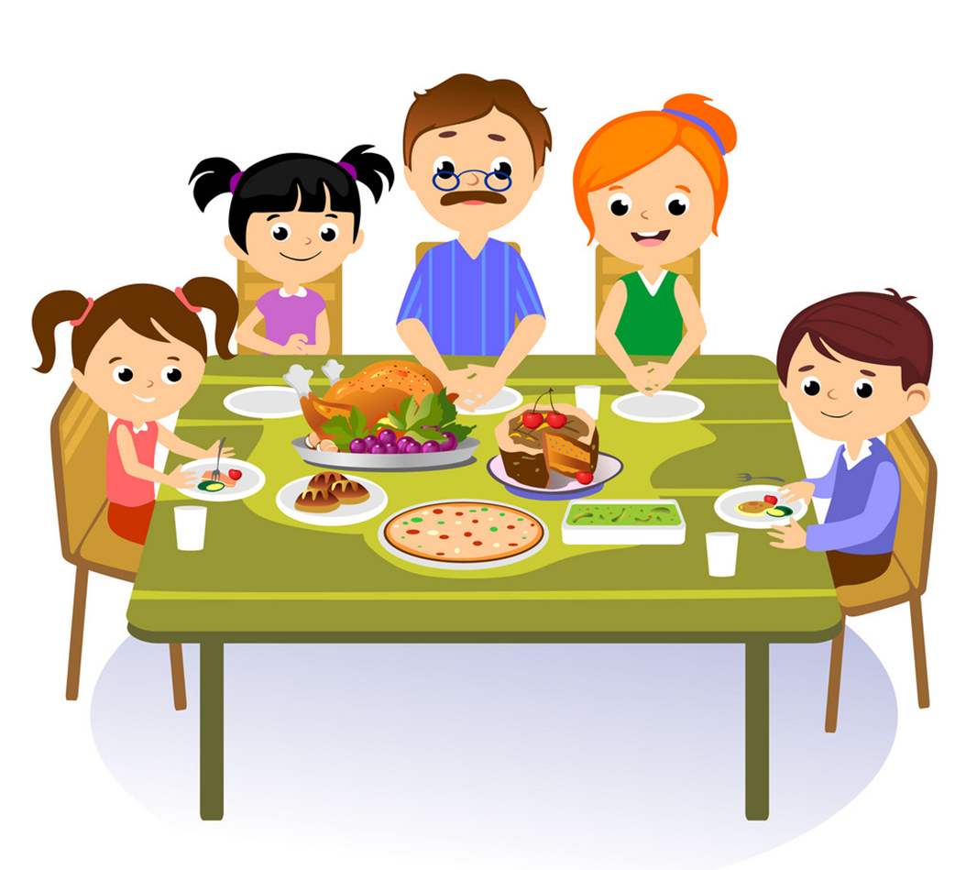
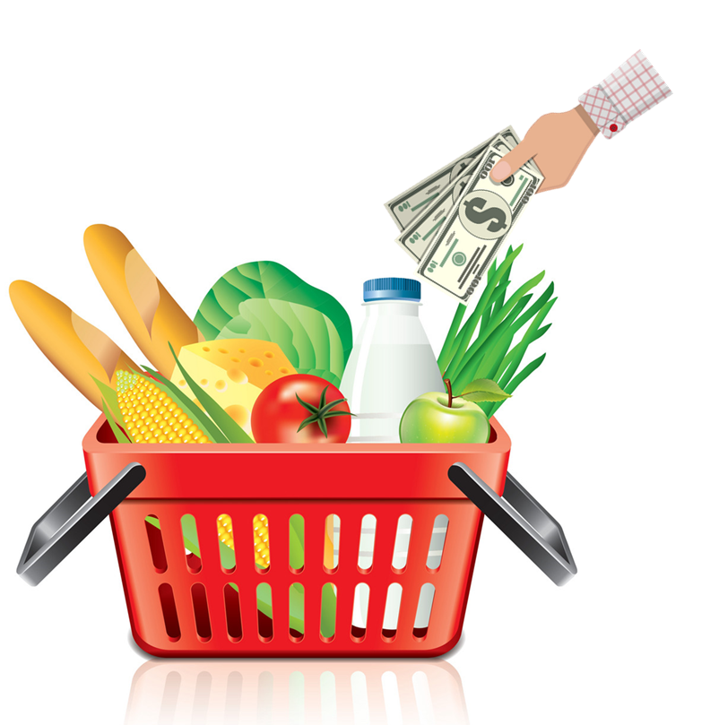
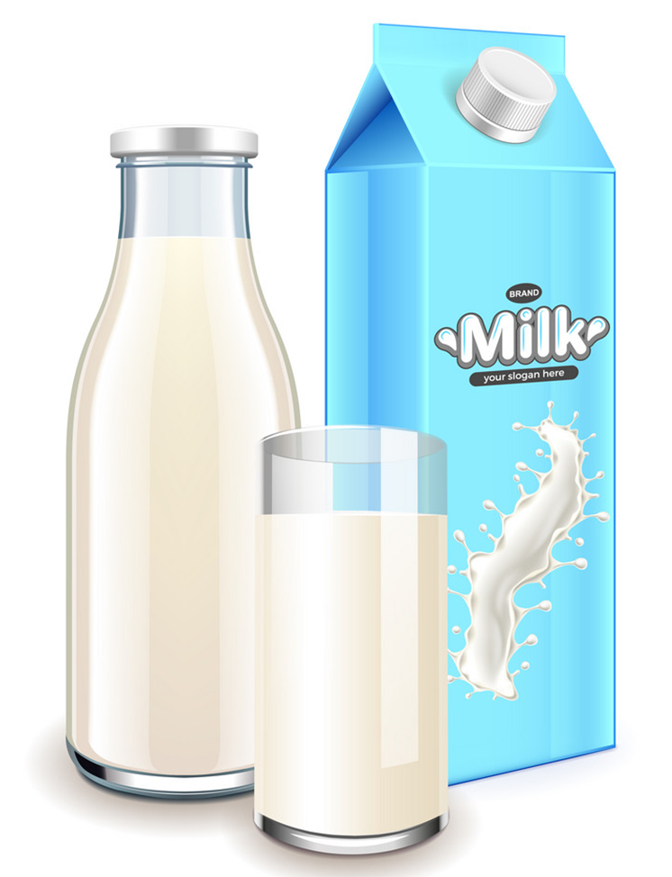
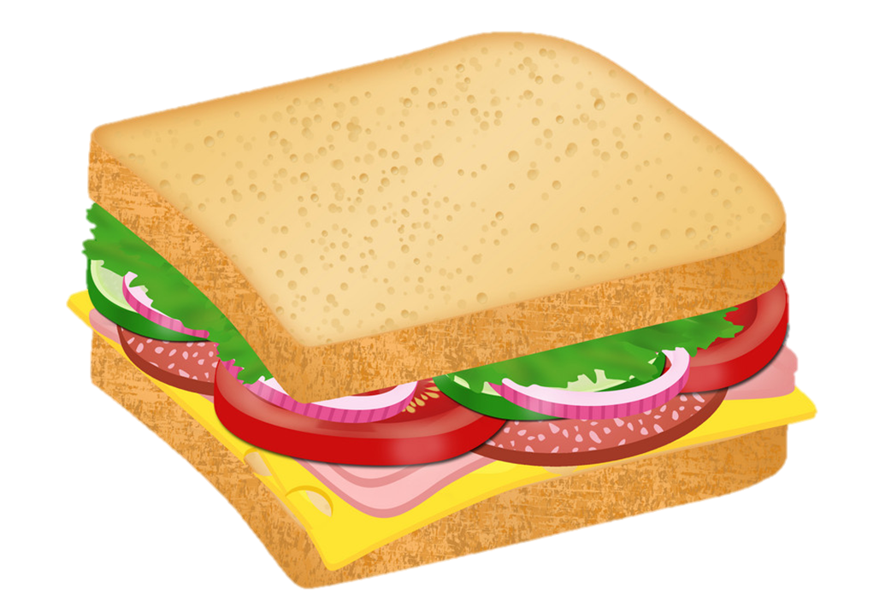
Vocabulary
lunch
food
drink
Healthy
/lʌntʃ/
/fuːd/
/drɪŋk/
/ˈhelθi/
milk
sandwich
meal
buy
/mɪlk/
/ˈsænwɪtʃ/
/miːl/
/baɪ/

Slide 27
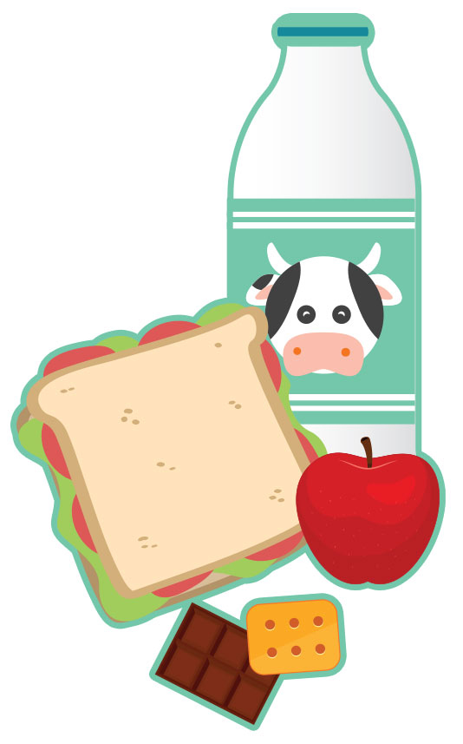
5. Read and complete.
What do English children usually eat nowadays? At (1) ________, Jim goes to a shop and buys a (2) ________, some chocolate and some milk. Some of his friends buy (3) ________ at the shop, too. Some of the sandwiches are (4) ________, but some aren't. School meals are healthier, but Jim and his friends never (5) ______ at the school canteen.
healthy
lunch
eat
sandwich
lunch
food
sandwich
healthy
food
eat

