Slide 1

Unit 3: School
Lesson 4.1
Page 47

Slide 2

WARM UP

Slide 3
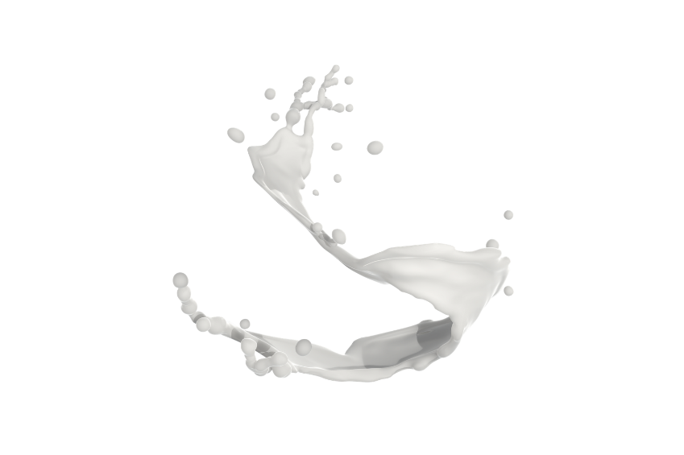
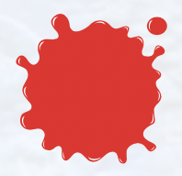
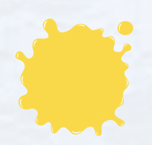

What color is it?

Slide 4

It’s time to learn …

Slide 5
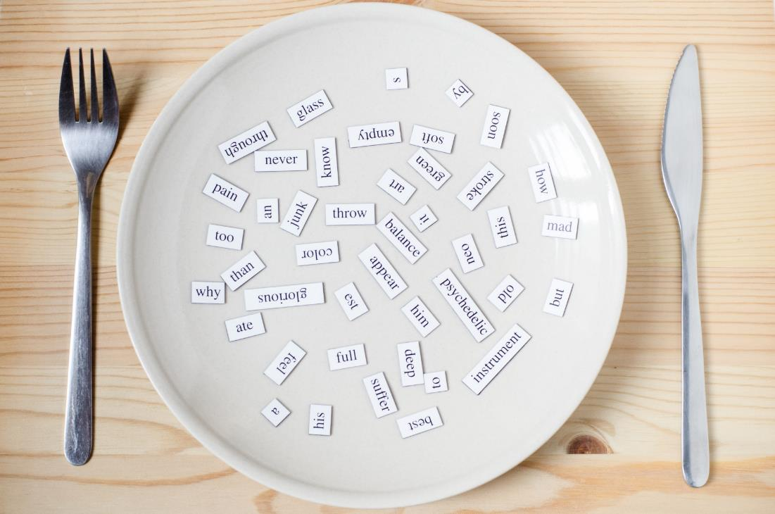
New words
green,
orange,
pink,
purple,
gray,
favorite

Slide 6

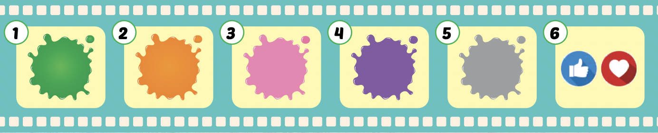
Listen and point.
Click the icon to hear the sound.

Slide 7
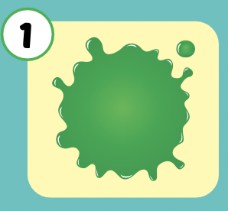
Listen and repeat.
Click each picture to hear the sound.
green
/ɡriːn/
màu xanh lá

Slide 8
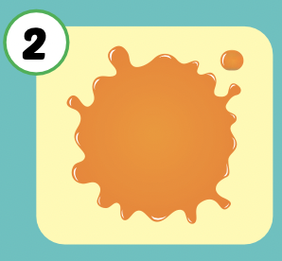
Listen and repeat.
Click each picture to hear the sound.
orange
/ˈɔːrɪndʒ/
màu cam

Slide 9
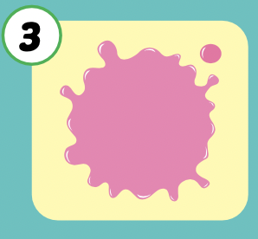
Listen and repeat.
Click each picture to hear the sound.
pink
/pɪŋk/
màu hồng

Slide 10
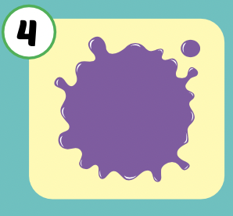
Listen and repeat.
Click each picture to hear the sound.
purple
/ˈpɜːrpl/
màu tím

Slide 11
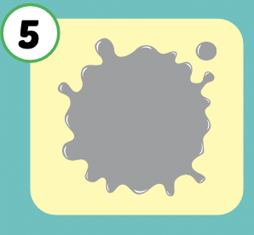
Listen and repeat.
Click each picture to hear the sound.
gray
/ɡreɪ/
màu xám

Slide 12
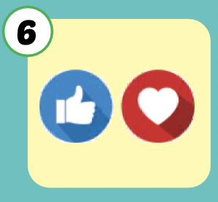
Listen and repeat.
Click each picture to hear the sound.
favorite
/ˈfeɪvərɪt/
yêu thích

Slide 13

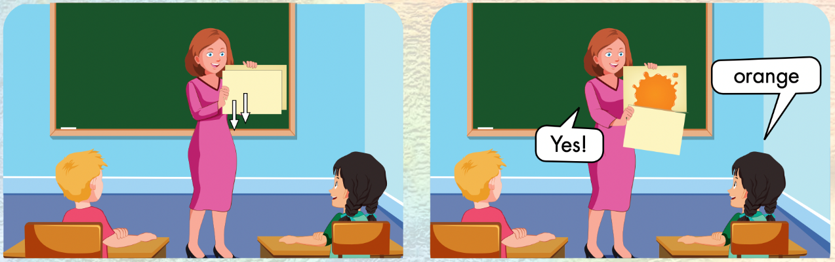

Slide 14
Let’s play!

Slide 15

What color is this?
green
Well done !
blue
orange

Slide 16

What color is this?
red
Well done !
orange
brown

Slide 17

What color is this?
red
Well done !
pink
purple

Slide 18

What color is this?
purple
Well done !
pink
blue

Slide 19

What color is this?
white
Well done !
gray
blue

Slide 20
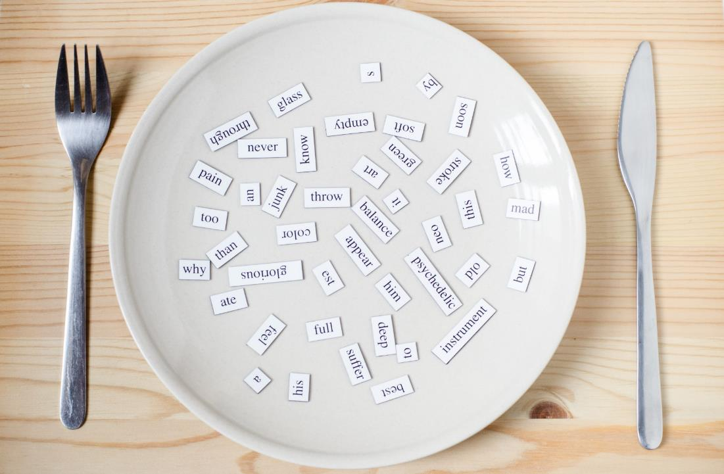
Structures
What's your favorite color?
- My favorite color is orange.
I can make orange
with yellow and red.

Slide 21
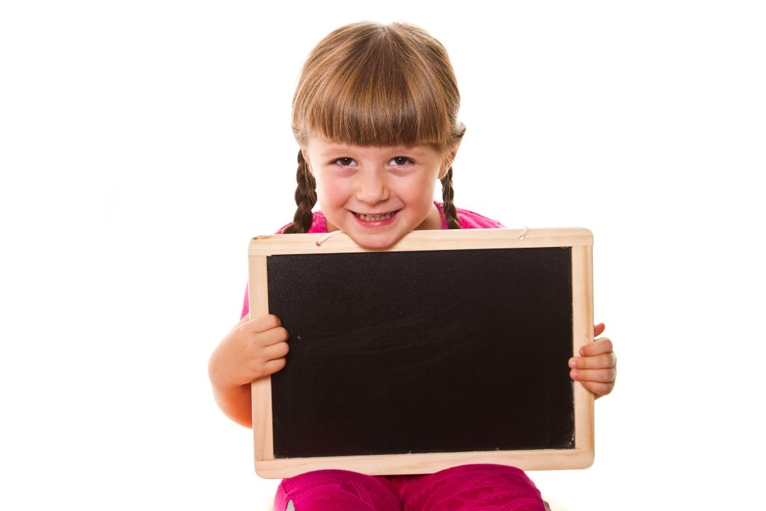
Presentation

Slide 22


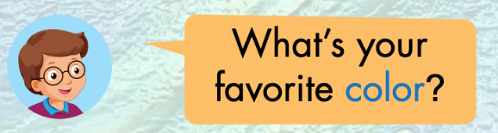

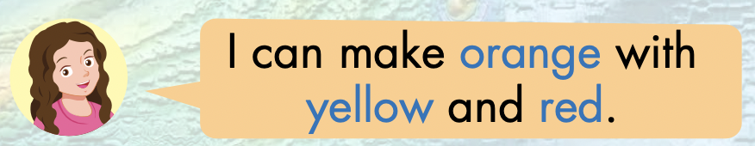


Slide 23
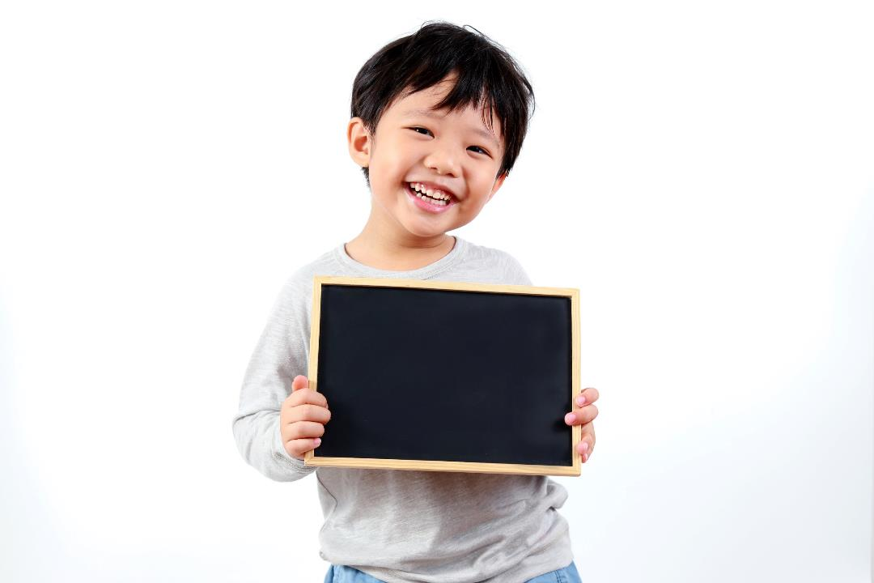
Practice

Slide 24

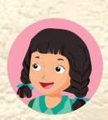
What’s your favorite color?
My favorite color is………..

Slide 25
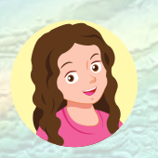
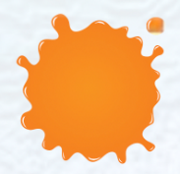

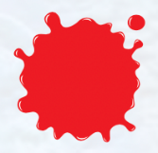
I can make ……………with ………… and …………

Slide 26
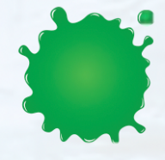


I can make ……………with ………… and …………

Slide 27

Production

Slide 28

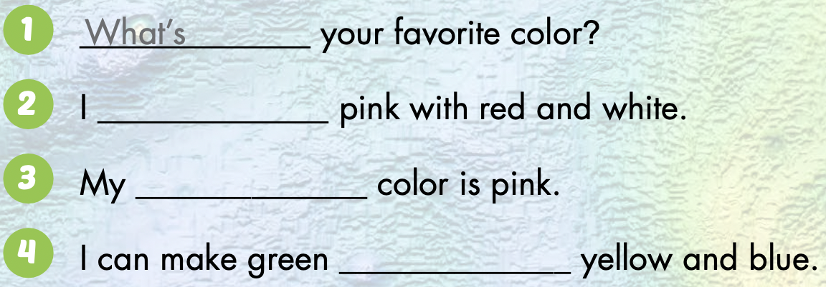
can make
favorite
with
Notes:
Demonstrate the activity using the example.
Have students fill in the blanks.
Divide the class into pairs. Have pairs check each other's work.
Check the answers as a whole class.
Have pairs practice saying the sentences.

Slide 29

CONSOLIDATION

Slide 30
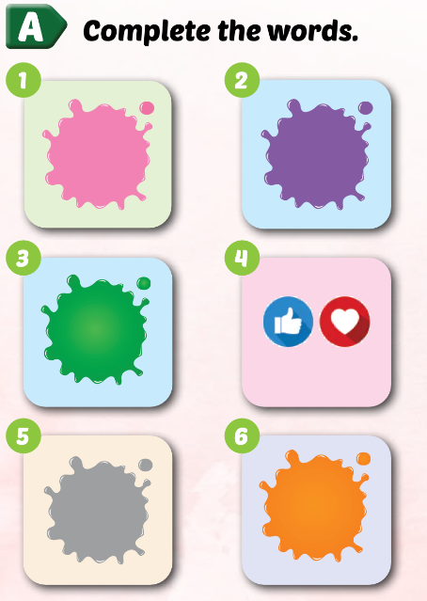
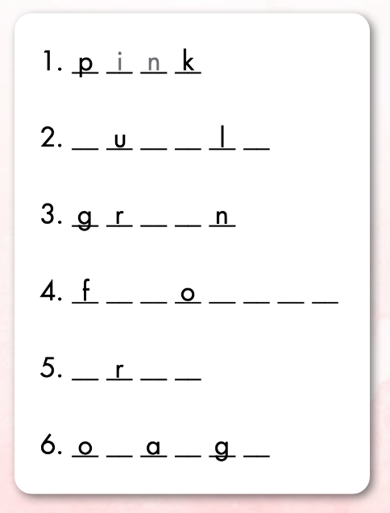
Extra Practice
WB p. 28
p
r
p
e
e
e
a
v
r
i
t
e
g
a
y
r
n
e

Slide 31
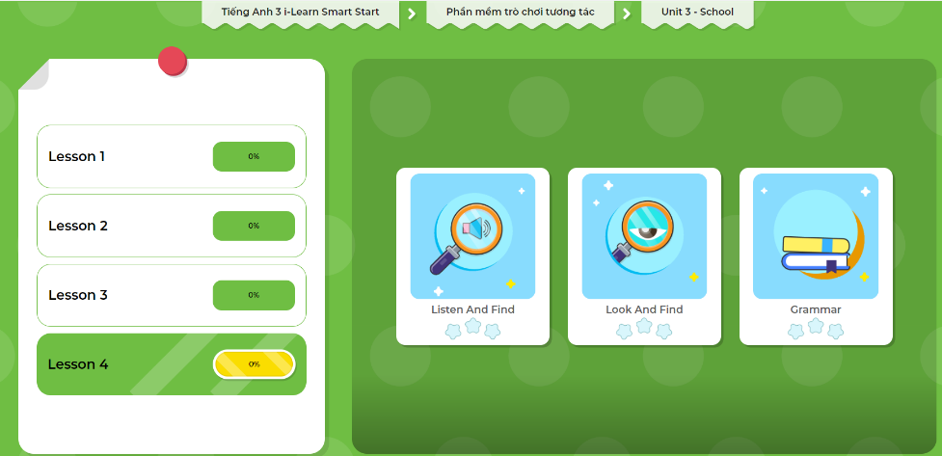
Extra Practice
DHA App
Let’s play!
Click here to play the game.

Slide 32
Let’s color!
My favorite color is……………

Slide 33

WRAP-UP

Slide 34
Lesson 3
Today’s lesson
Vocabularies
green, orange, pink, purple, gray, favorite
Structures/ Sentence patterns
What's your favorite color?
- My favorite color is orange.
I can make orange with yellow and red.

Slide 35
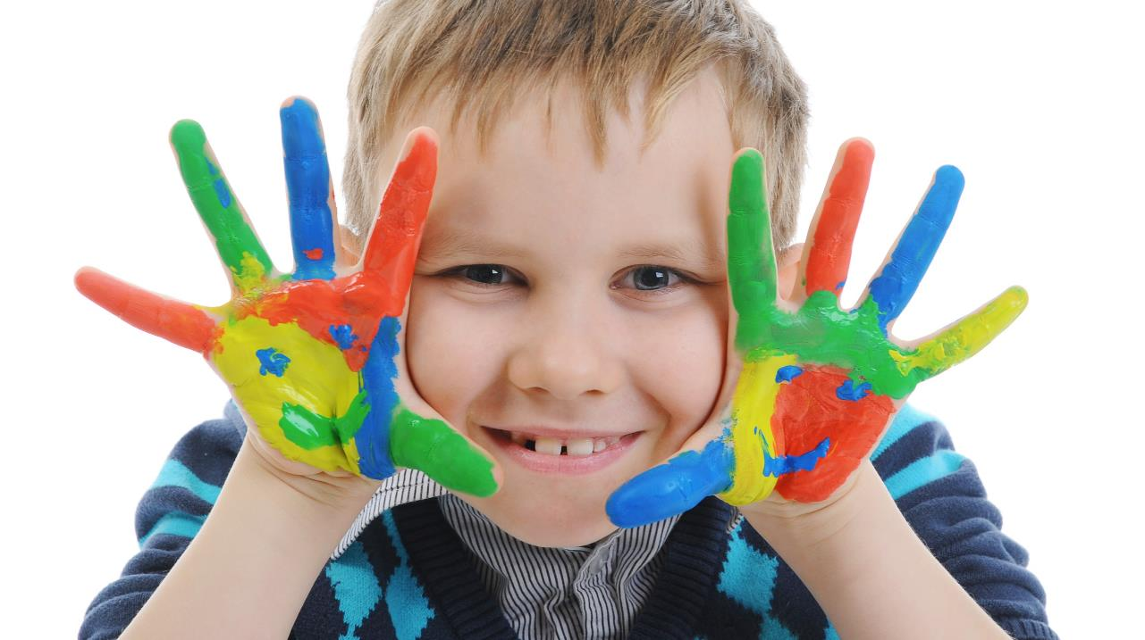
Enjoy your day!

