Slide 1
Finding Game
Letter Qq

Slide 2
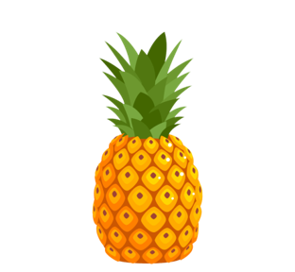
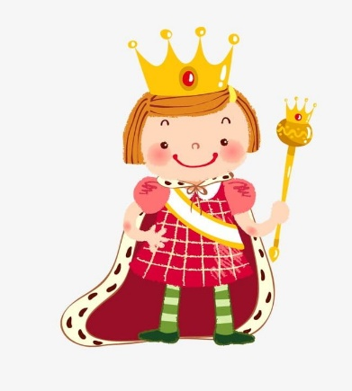
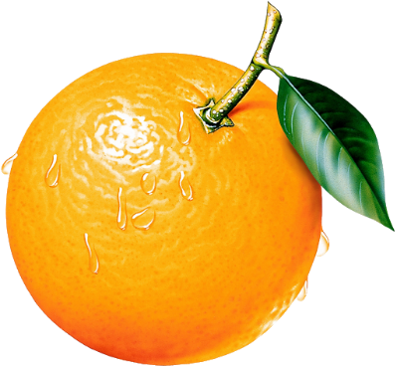
Find the words beginning with the letter Q
question
apple
quiz
pineapple
quiet
panda
orange
queen
quilt

