Slide 1
Unit 9
What are they doing?
Lesson 3

Slide 2
REVIEW

Slide 3
1
1
ant
2
mouse
3
elephant
4
dog
5
fish
6
iguana
7
hen
8
pet
9
Notes:
Ms Huyền Phạm - 0936.082.789 – YOUTUBE: MsPham. Facebook: Dạy và học cùng công nghệ.

Slide 4
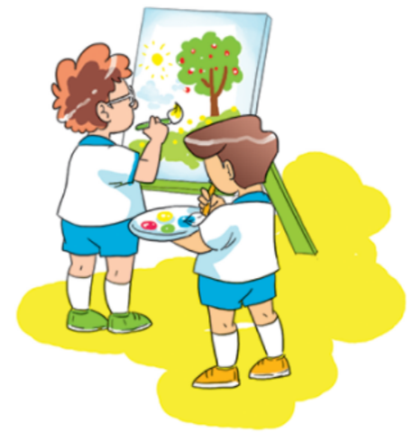
Question
1
2
3
4
5
6
7
8
9
10
What ___ they doing?
Time’s up
are
Answer
Back
Notes:
Ms Huyền Phạm - 0936.082.789 – YOUTUBE: MsPham. Facebook: Dạy và học cùng công nghệ.

Slide 5
Question
What are they doing?
_____ making puppets.
1
2
3
4
5
6
7
8
9
10
Time’s up
They’re
Answer
Back
Notes:
Ms Huyền Phạm - 0936.082.789 – YOUTUBE: MsPham. Facebook: Dạy và học cùng công nghệ.

Slide 6
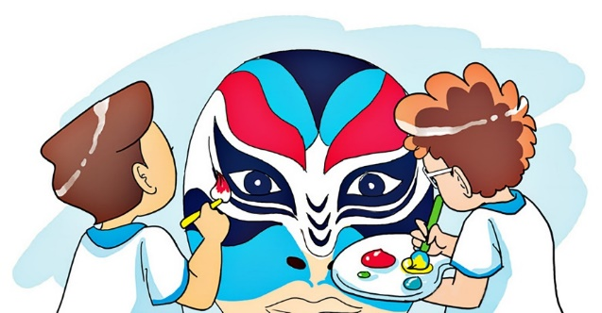
Question
1
2
3
4
5
6
7
8
9
10
Time’s up
They’re painting a mask.
What are they doing?
Answer
Back
Notes:
Ms Huyền Phạm - 0936.082.789 – YOUTUBE: MsPham. Facebook: Dạy và học cùng công nghệ.

Slide 7
Question
______________?
He is reading book.
1
2
3
4
5
6
7
8
9
10
Time’s up
What is he doing.
Answer
Back
Notes:
Ms Huyền Phạm - 0936.082.789 – YOUTUBE: MsPham. Facebook: Dạy và học cùng công nghệ.

Slide 8
Question
What is she doing?
1
2
3
4
5
6
7
8
9
10
Time’s up
She is writing a dictation.
Answer
Back
Notes:
Ms Huyền Phạm - 0936.082.789 – YOUTUBE: MsPham. Facebook: Dạy và học cùng công nghệ.

Slide 9
Question
What ___ he doing?
1
2
3
4
5
6
7
8
9
10
Time’s up
is
Answer
Back
Notes:
Ms Huyền Phạm - 0936.082.789 – YOUTUBE: MsPham. Facebook: Dạy và học cùng công nghệ.

Slide 10
Question
1
2
3
4
5
6
7
8
9
10
Time’s up
is
What ___ she doing?
Answer
Back
Notes:
Ms Huyền Phạm - 0936.082.789 – YOUTUBE: MsPham. Facebook: Dạy và học cùng công nghệ.

Slide 11
Question
1
2
3
4
5
6
7
8
9
10
Time’s up
are
What _____ you doing?
I’m playing football with
my friends.
Answer
Back
Notes:
Ms Huyền Phạm - 0936.082.789 – YOUTUBE: MsPham. Facebook: Dạy và học cùng công nghệ.

Slide 12
Question
1
2
3
4
5
6
7
8
9
10
Time’s up
I’m
What are you doing?
______ taking photos.
Answer
Back
Notes:
Ms Huyền Phạm - 0936.082.789 – YOUTUBE: MsPham. Facebook: Dạy và học cùng công nghệ.

Slide 13
PRONUNCIATION

Slide 14
1. Listen and repeat.

Slide 15
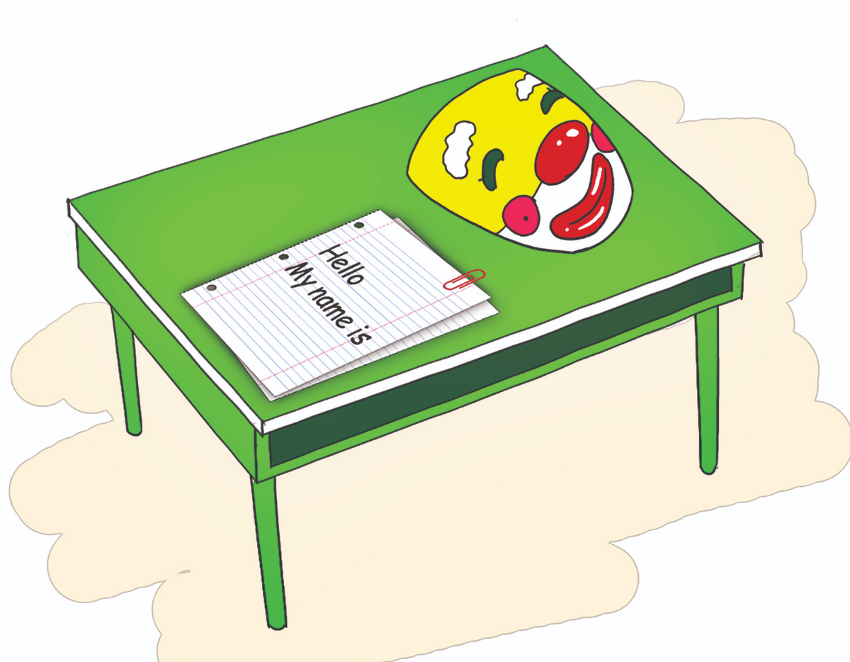
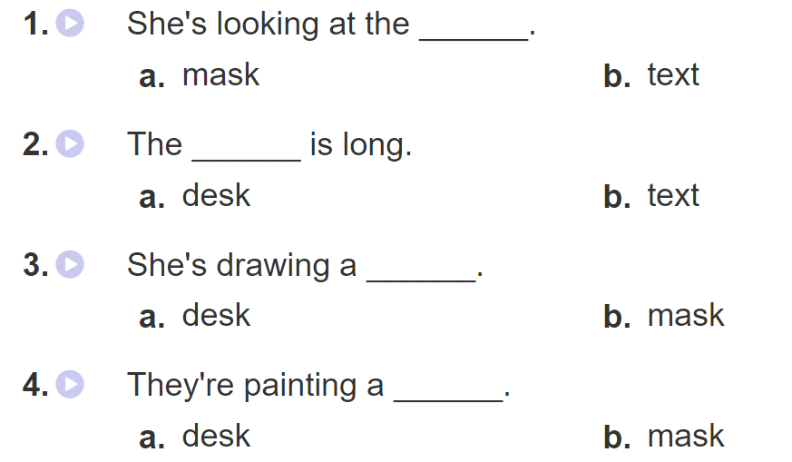
2. Listen and tick. Then write and say aloud

Slide 16
PRACTISE

Slide 17
3. Let’s chant

Slide 18
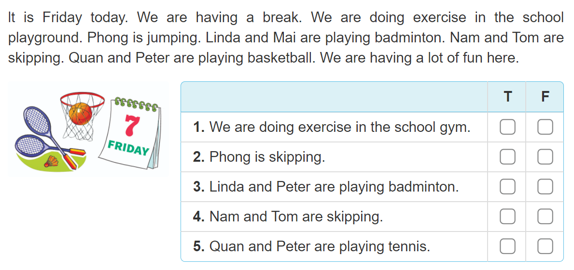
4. Read and tick

Slide 19
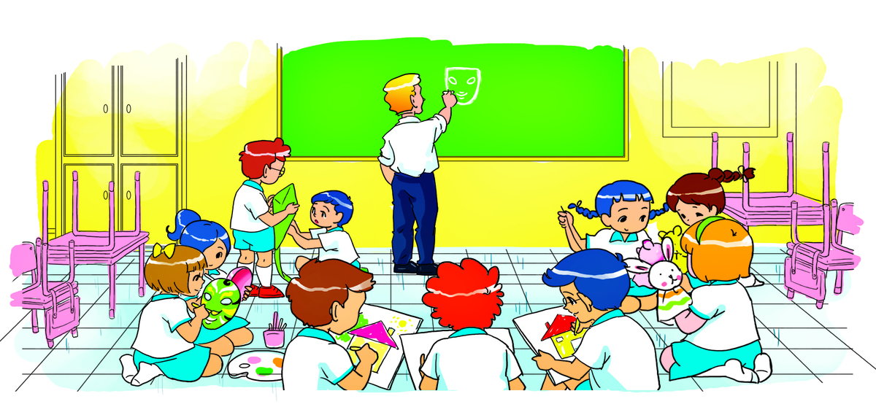
5. Write about the picture
___________________________________________
________________________
______________________
____________________
______________________

Slide 20
6. Project
Add a photo of your family. Then tell the class what your family members are doing in the photo.

