Slide 1
Unit 6: where’s your school?
Lesson 3
I. Objectives: After the lesson, students are able to:
- Pronounce the sound of letter sch, sk and str in the words school, skipping and street respectively
II. Language contents:
- Vocabulary: about school
- Sentence patterns : Review sentence patterns in lesson 1 and 2
III. Resources:
- Recording, tape and active board, student’s book , Workbook
IV. Procedure

Slide 2



Slide 3

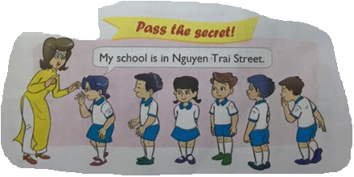
Warm up

Slide 4

Thursday, November 5th2015
Unit 6: Where’s your school?
Lesson3

Slide 5



Track 51
sch
school
This is our school
sk
skipping
Mai likes skipping
str
street
My school is in Nguyen Du street

Slide 6
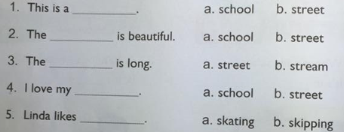
Track 51

Slide 7
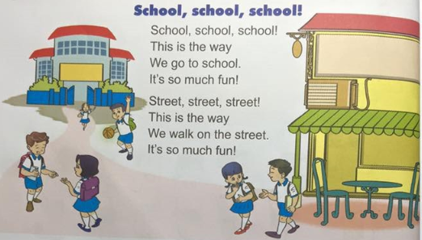
Track 42

Slide 8
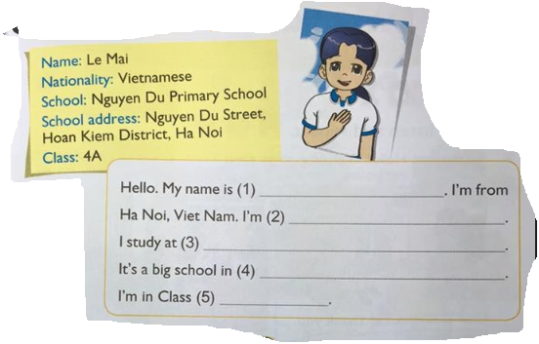

Slide 9

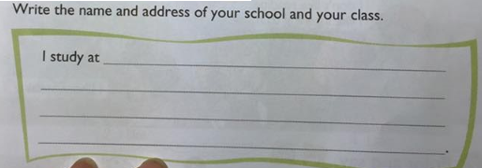

Slide 10

Goodbye

