Slide 1

Unit 2
Review and Practice
Page 37
Notes:
By the end of this lesson, students will be able to review introducing family members, asking who someone is, and following simple instructions.
Vocabulary:
friend, cousin, brother, sister, uncle, aunt, father, grandfather, grandmother
Structures:
What’s his name?/ Go to bed!/ This is my friend, Alfie.

Slide 2

WARM UP

Slide 3



Listen and circle.
A
B
Keys

Slide 4

Listen and circle.
A
B
Keys

Slide 5
Listen and circle.
A
B
Keys

Slide 6

Listen and circle.
A
B
Keys

Slide 7

It’s time to learn …

Slide 8

Speaking

Slide 9
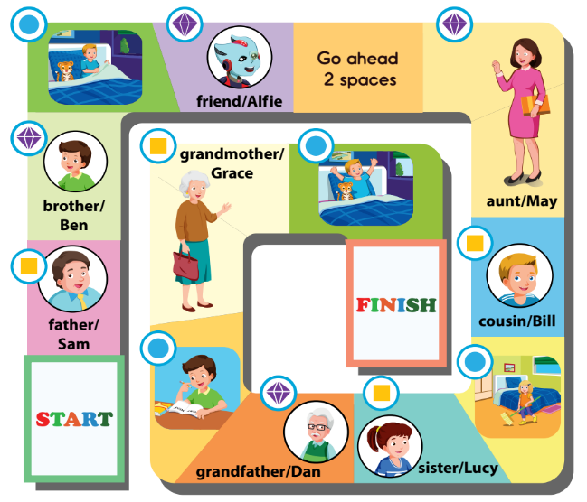



A
Play the board game.
This is my friend, Alfie.
Hello, Alfie.
Go to bed!
Who’s he?
He’s my father.
What’s his name?
His name’s Sam.

Slide 10
What can you do
?
I can talk about my family.
I can ask who someone is.
I can follow instructions.

Slide 11

WORKBOOK
Page 27

Slide 12
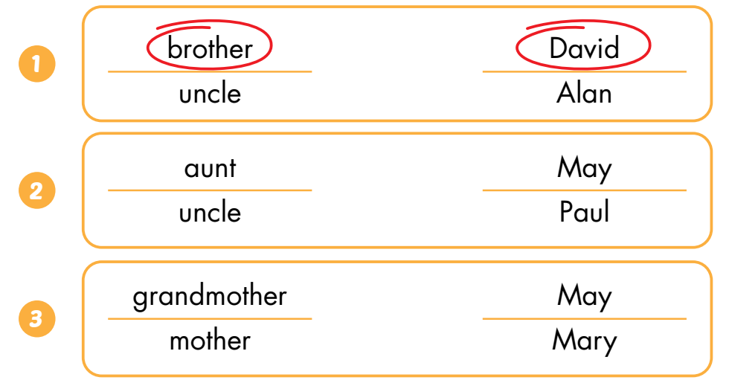
WB p 27
B
Listen and circle.
Keys

Slide 13
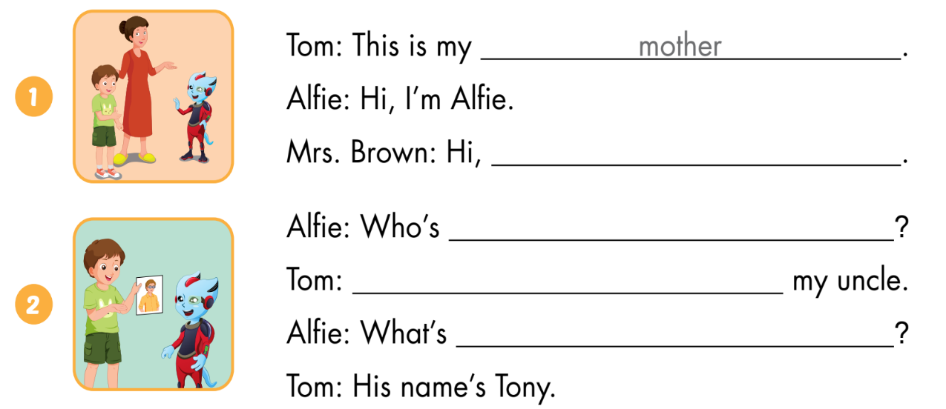
C
Look and write.
I’m Mrs. Brown
he
He’s
his name

Slide 14
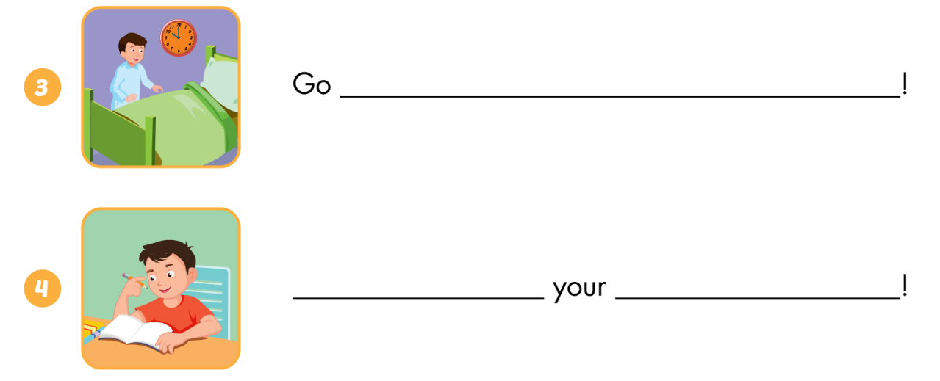
C
Look and write.
to bed
Do
homework

Slide 15
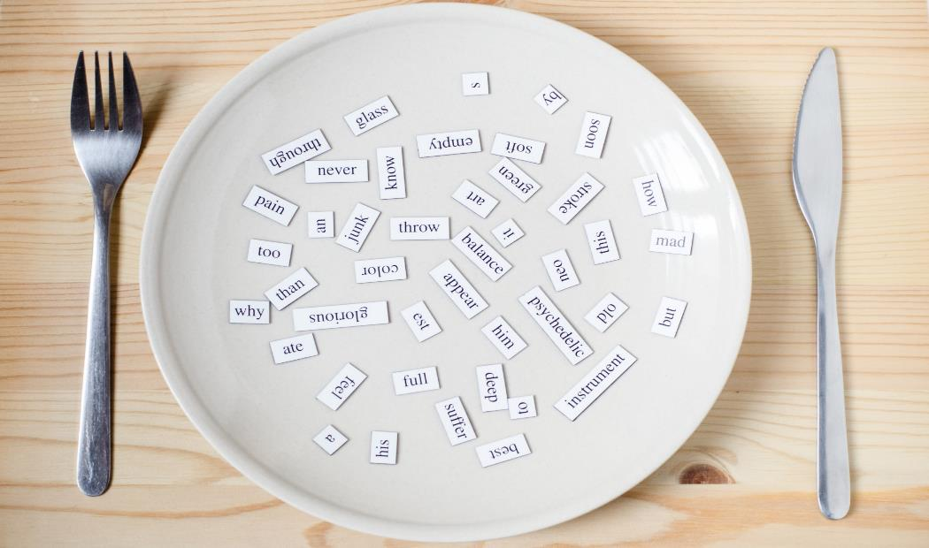
Consolidation

Slide 16
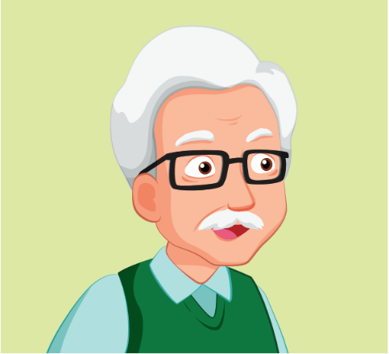
Who is he?

Slide 17

Who is he?

Slide 18
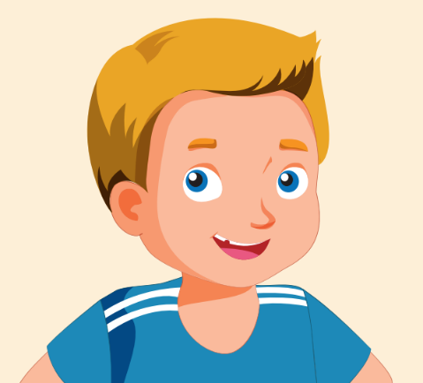
Who is he?

Slide 19

Who is she?

Slide 20

do ______ ______

Slide 21

clean ______ ______

Slide 22
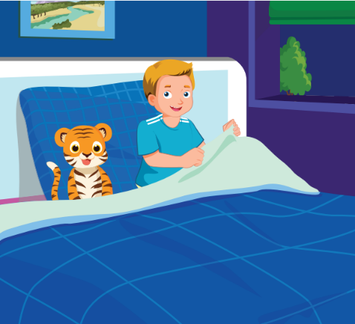
go ______ ______

