Slide 1
Unit 3: School
Lesson 3.3
Page 46

Slide 2
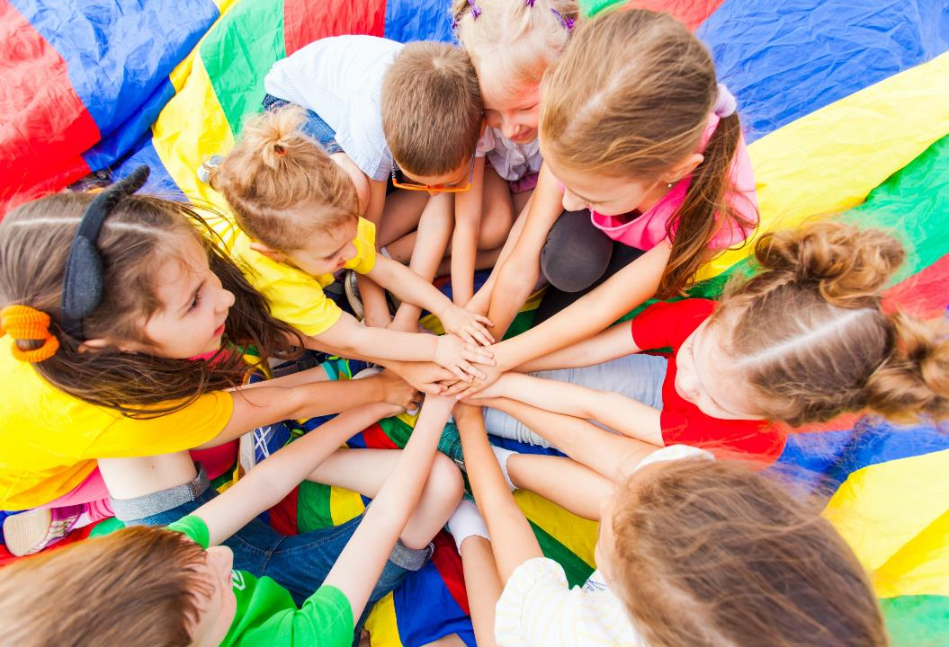
WARM UP

Slide 3
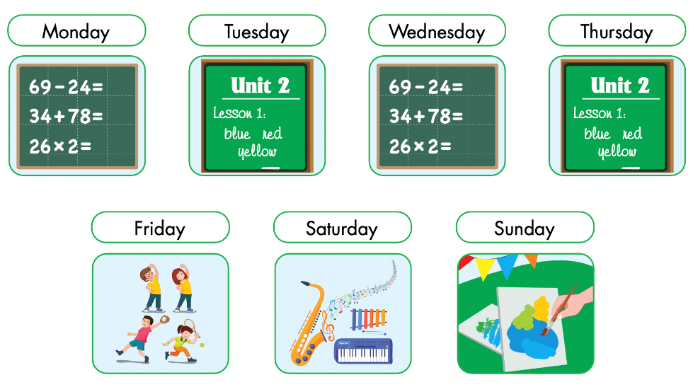
Slap the board

Slide 4
It’s time to learn …

Slide 5
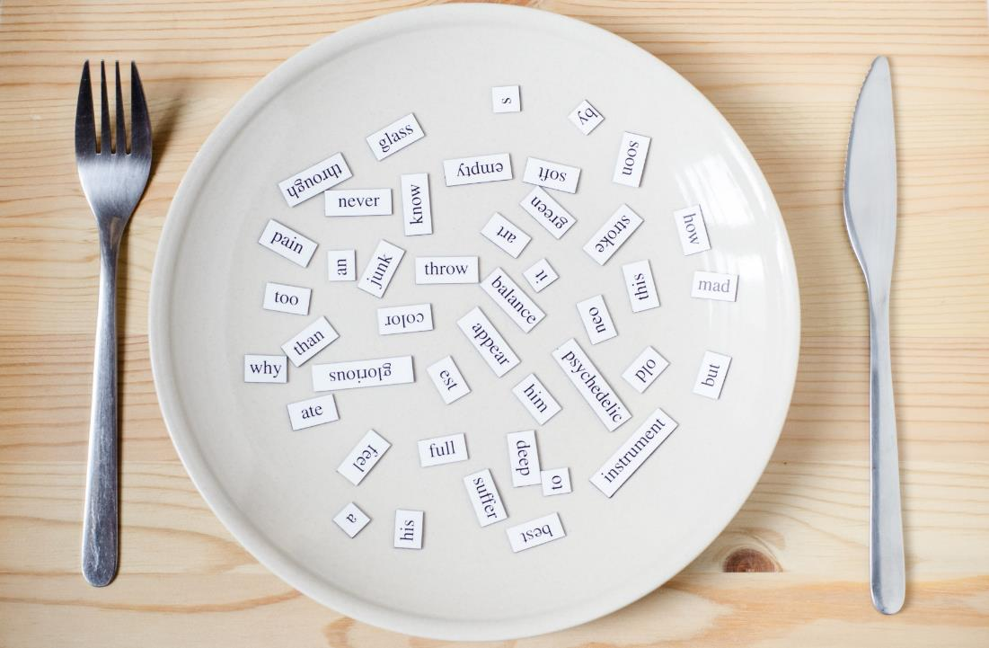
Structures
When do you have English?
- I have English on Wednesdays and Fridays.

Slide 6
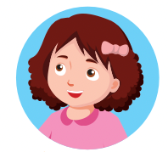

Slide 7
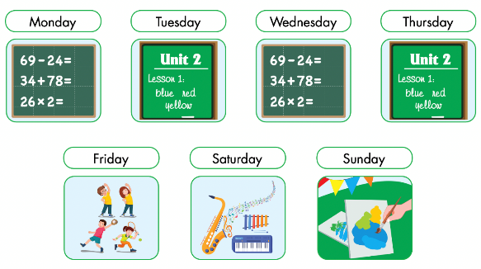
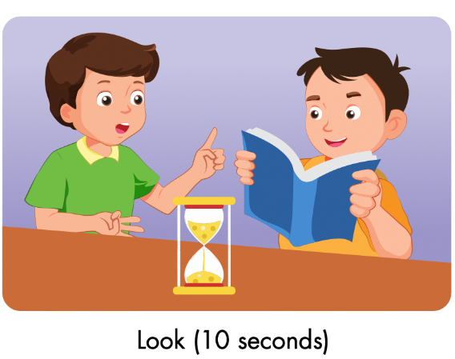
Notes:
Divide the class into pairs.
Have Student A look at Part E for ten seconds, then close their book.

Slide 8
Notes:
Have Student B ask questions about Part E using the useful language from the lesson and have Student A answer.
Have students swap roles and repeat.
Afterwards, have some pairs demonstrate the activity in front of the class.

Slide 9
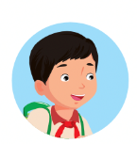
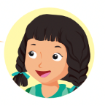
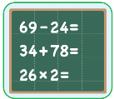
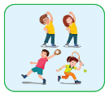
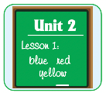
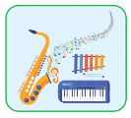
When do you have ____?
I have ____ on ________.
Monday | Tuesday | Wednesday | Thursday | Friday

Slide 10
Lesson 3
Today’s lesson
Structures/ Sentence patterns
When do you have ………..?
- I have ……… on ………..
When do you have art?
- I have art on Mondays.

