Slide 1

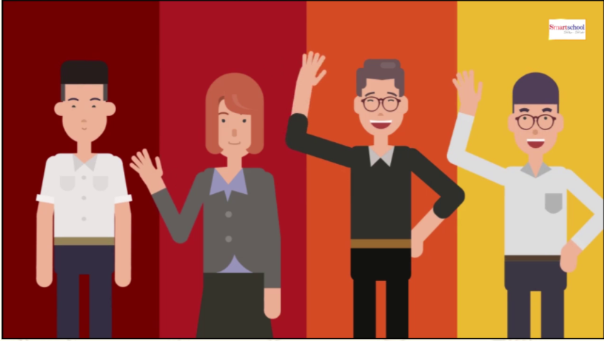
REVIEW (Skill 1)

Slide 2





Who's a milionaire?
Pele was born on ………….
500:5
50:50
A. October 21, 1490
B. October 21, 1940
B. October 21, 1940
C. October 21,1956
D. October 12,1958
L
F

Slide 3
Who's a milionaire?
Pele is from………..
50:50
50:50
A. a city of Brazil
B. America
C. A countryside of Brazil
C. A countryside of Brazil
D. A countryside of America
L
F

Slide 4
Who's a milionaire?
How many World Cups did he win?
500:5
50:50
A. 1
B. 2
C. 3
D. 4
C. 3
L
F

Slide 5
Who's a milionaire?
When began his career when he was….
50:50
50:50
A. 15
A. 15
B. 17
C. 19
D. 22
L
F

Slide 6
Who's a milionaire?
Pele won his first World Cup in …..
50:50
50:50
A. 1940
B. 1956
C. 1958
C. 1958
D. 1999
L
F

Slide 7
Who's a milionaire?
How many goals did he score ?
50:50
50:50
A. 1208
B. 1821
C. 2181
D. 1281
D. 1281
L
F

Slide 8
Who's a milionaire?
Which statements is not about Pele?
50:50
50:50
A. The King of Football
B. An international hero
B. An international hero
C. Football player of
the Century
D. The best player
of all time
L
F

Slide 9
Who's a milionaire?
Why do people call him
“the King of Football”?
50:50
50:50
A. He was a hero
B. He was a King
C. He played football
for 22 years
D. He was a good player
D. He was a good player
L
F

Slide 10
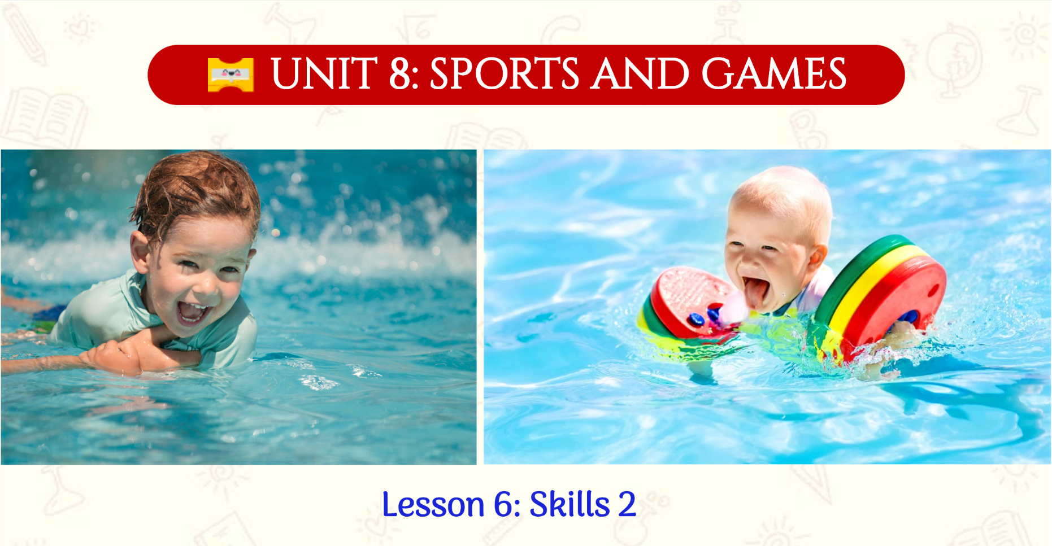
Lesson 6 – Skill 2

Slide 11

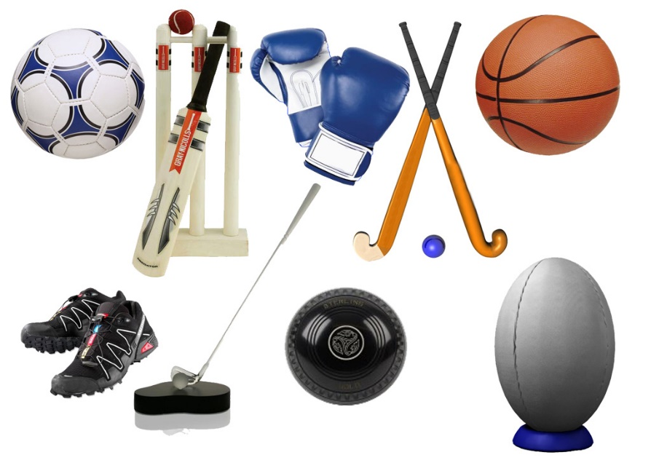
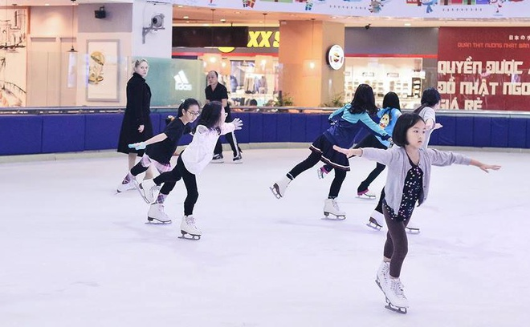

I. New words
ice skating (n):
/aɪsˈskeɪtɪŋ/
trượt băng
equipment (n)
/ɪˈkwɪpmənt/
dụng cụ
individual (n)
/ˌɪndɪˈvɪdʒuəl/
cá nhân

Slide 12
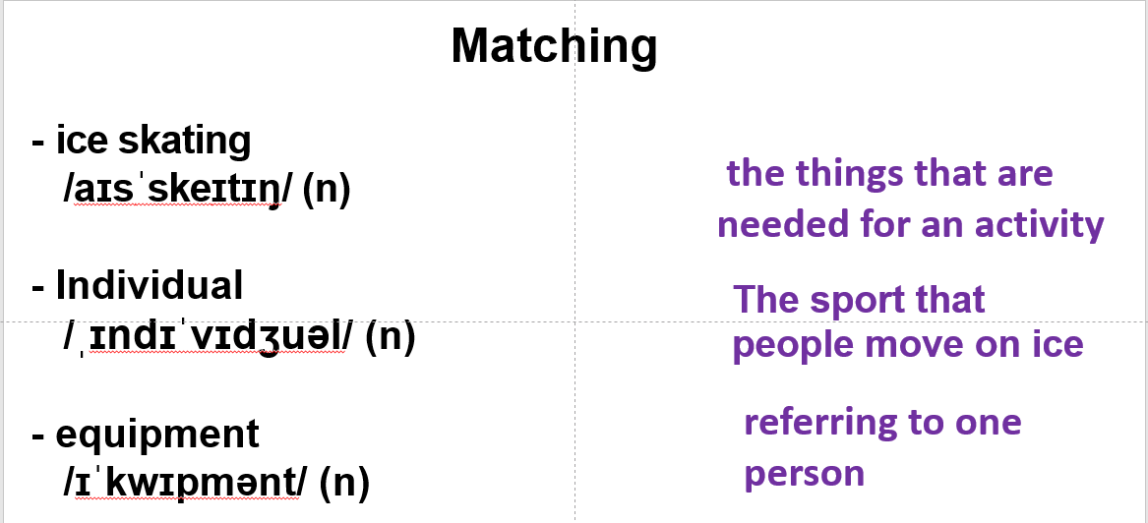
I. New words

Slide 13

II. Listening
Exercise 1 (p. 23) Listen to the passages. Who are they? What are they talking about?
They are different students talking about their favourite sports/ games.

Slide 14
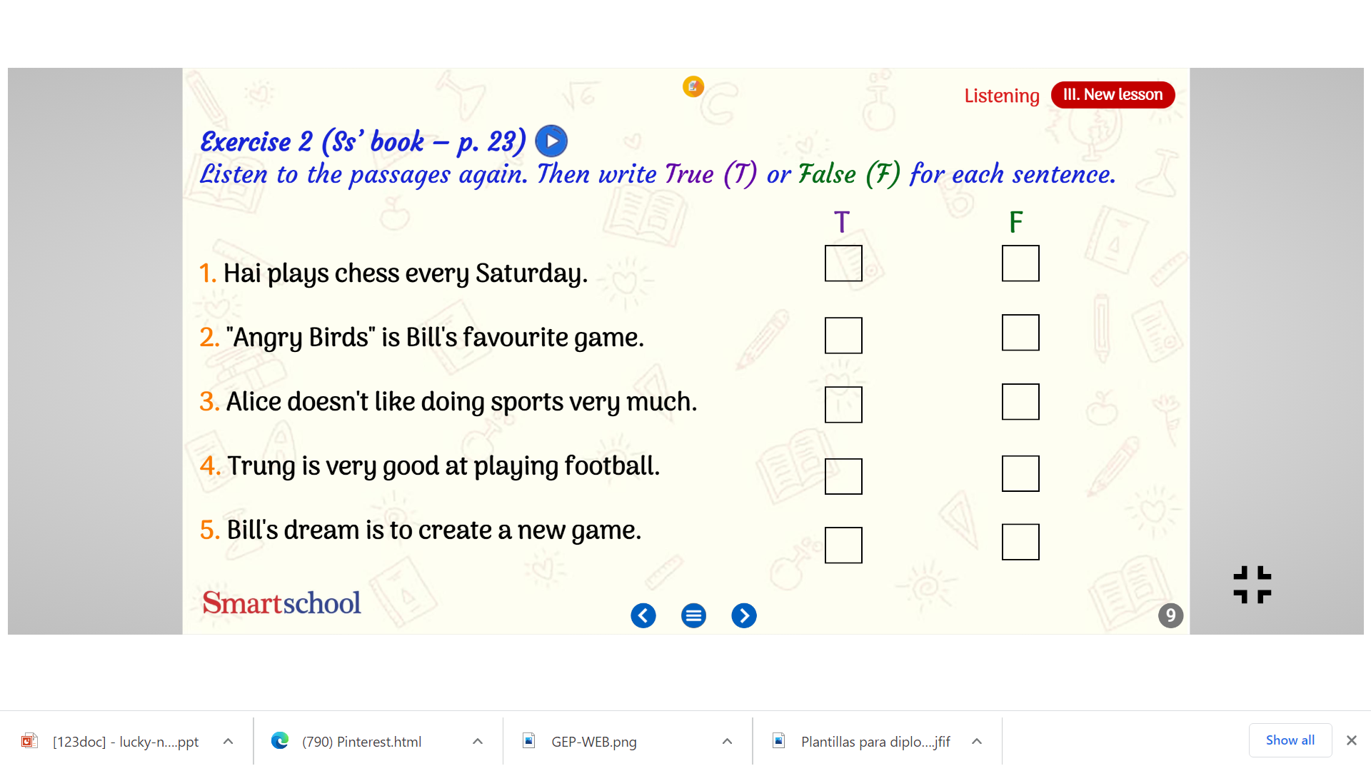
II. Listening
Exercise 2 (p. 23) Listen to the passages again. Then write True (T) or False (F) for each sentence.
4 students: Hai, Alice, Trung, Bill
✓
Alice
✓
✓
✓
doesn’t do much sport
✓

Slide 15
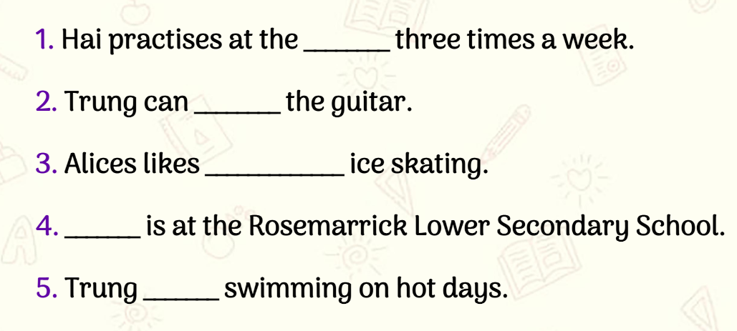
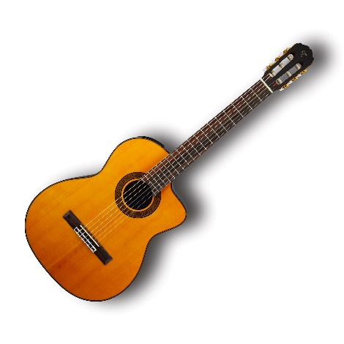
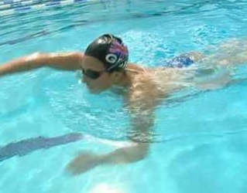
II. Listening
Exercise 3 (p. 23) Listen to the passages again. Fill in each blank to complete the sentences.
judo club
play
watching
Bill
goes

Slide 16


III. Writing
Write about a sport/ game you like

Slide 17

III. Writing
Write about a sport/game you like (at least 6 sentences in 7 minutes)
Outline:
Your name/age
Name of the sport/game.
Is it a team or an individual sport/game?
How long does it last?
How many players are there?
Does it need any equipment?

Slide 18
HOMEWORK
- Finish writing exercise
- Prepare U8-L7 Looking back

