Slide 2
GAME: Name the festivals Watch a video and remember the festivals you see
Notes:
Smartschool Unit 9 Lesson 1 (1st video)

Slide 3
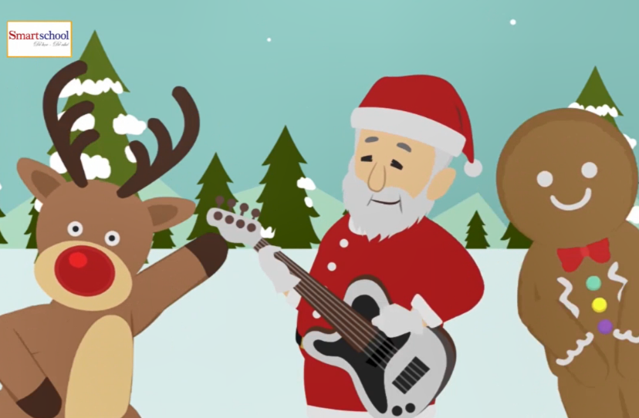
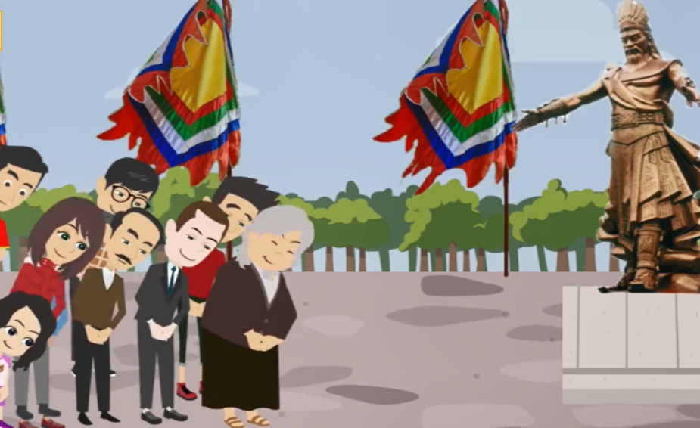
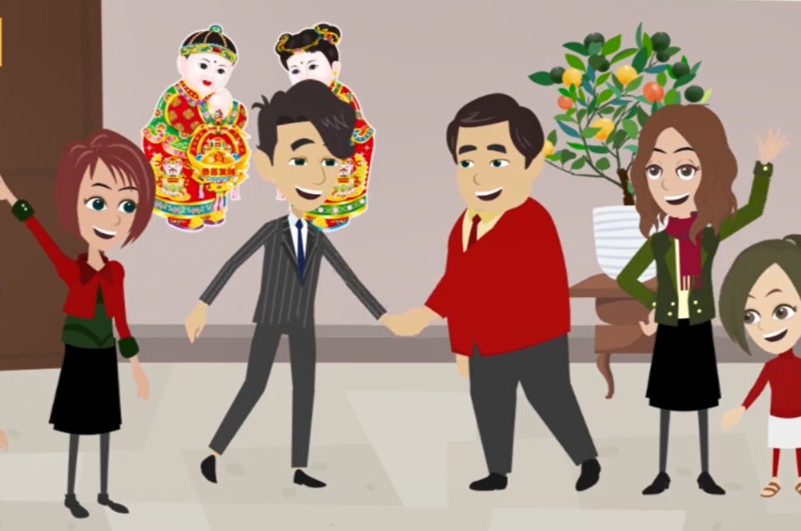
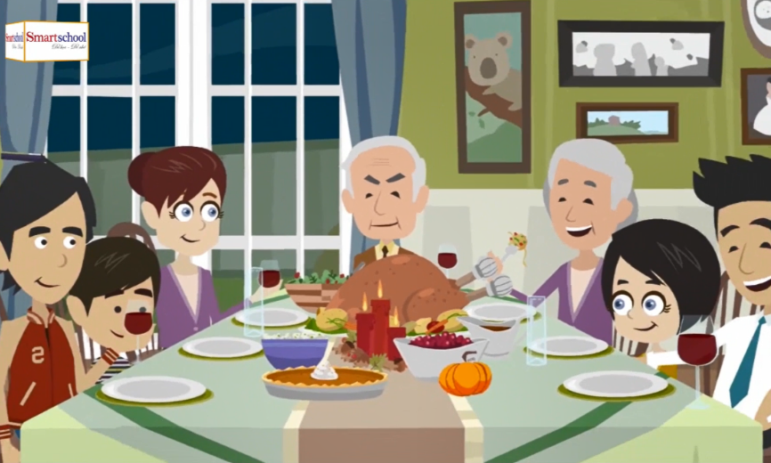
Mid - autumn
Hoi Lim Festival
Christmas
Thanksgiving
Tet Holiday
Hung King Festival

Slide 4
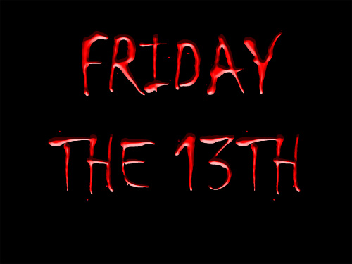
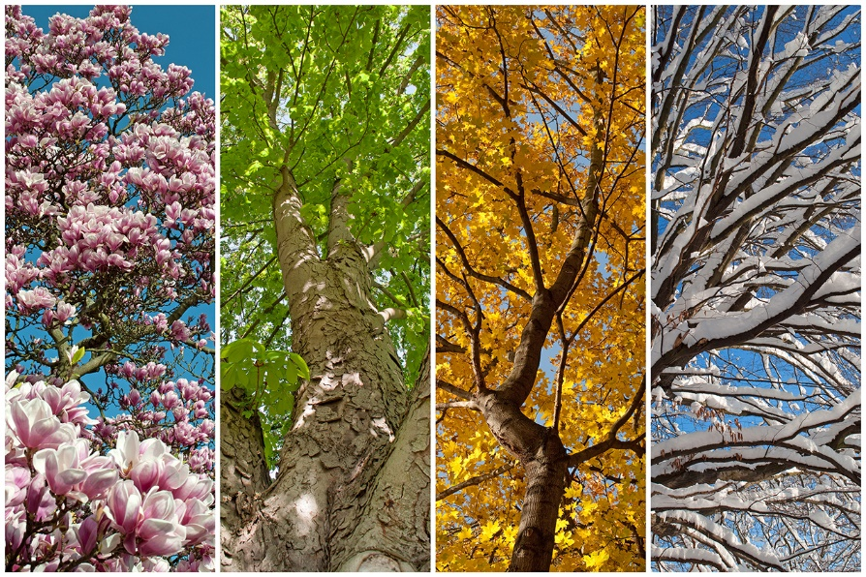
I. New words:
festival /ˈfestəvəl/ (n):
religious /rɪˈlɪdʒ.əs/ (a):
superstitious /ˌsuː.pəˈstɪʃ.əs/(a):
celebrate /ˈsel.ə.breɪt/ (v):
harvest/ˈhɑː.vɪst/ (n, v):
seasonal /ˈsēz(ə)nəl/ (a):
lễ hội
thuộc tôn giáo
mang tính mê tín
tổ chức lễ
thu hoạch
theo mùa

Slide 5
II. Listen and read The festival project
- Listen and answer the questions:
2. In which countries are the festivals held?
1. How many festivals are they talking about?

Slide 6
II. Listen and read

Slide 7
II. Listen and read
Exercise 1a (p. 27) Answer the following questions.
No, she didn’t because she said “Oh really?” to show her surprise..
People light candles and display / let off fireworks..
It’s La Tomatina.
to celebrate the festival
people go to the desert, make a camp,have a party.
They should write up reports and hand in them to the teacher.

Slide 8
II. Listen and read
Exercise 1b (p. 27) Tick (✔) True or False.
✓
✓
✓
for one hour
✓

Slide 9
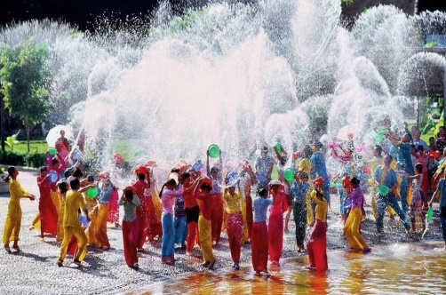
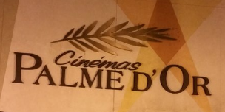
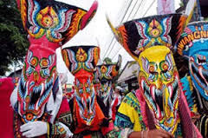
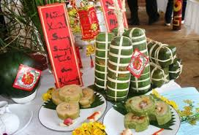
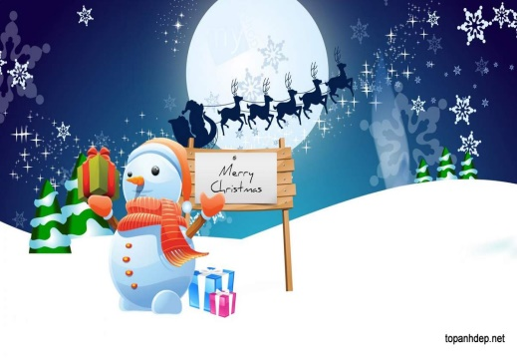
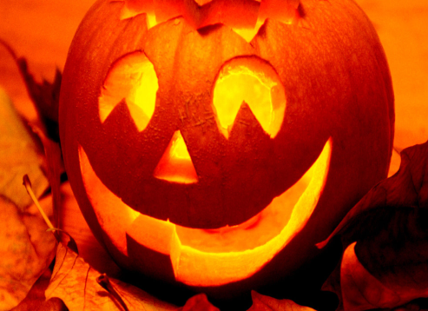
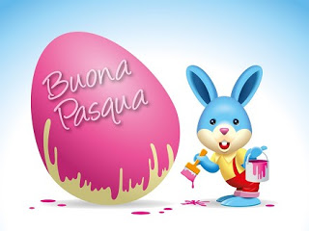
III. Practice
Ex 2 (p.27) Write the festivals
Halloween
Christmas
Cannes Film Festival
Tet
Easter
Ghost Day
Rock in Rio
Water Festival
1. __________ 2. ______________ 3. ________ 4. _______
5. __________ 6. __________ 7. _________ 8. _________

Slide 10
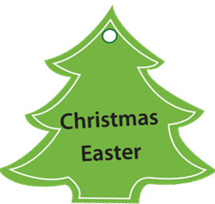
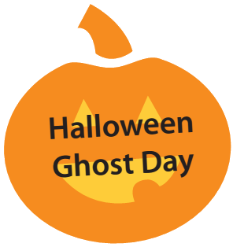
III. Practice
Ex.3 (p 27) Match the festivals with the reasons they are held.
religious seasonal music/arts superstitious

Slide 11
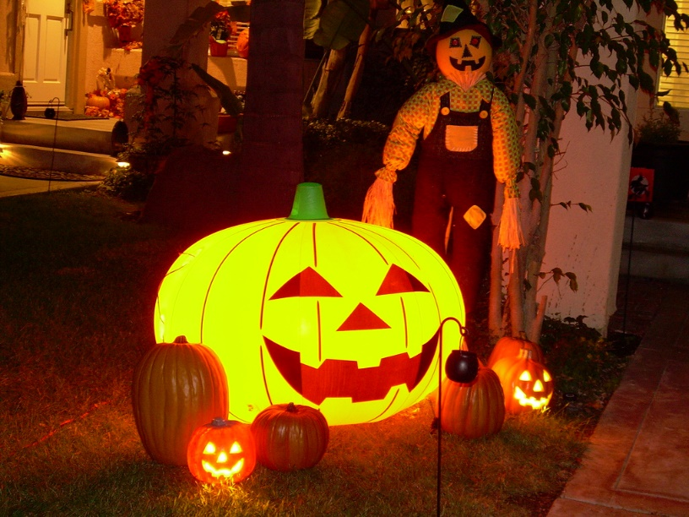
WRAP UP
-Name some festivals you learn in the lesson.
- What are some reasons that the festivals are held?

Slide 12
HOMEWORK - Learn new words - Prepare A closer look 1

