Slide 1

WELCOME TO CLASS 6
Teacher – Vu Thu Thuy

Slide 2
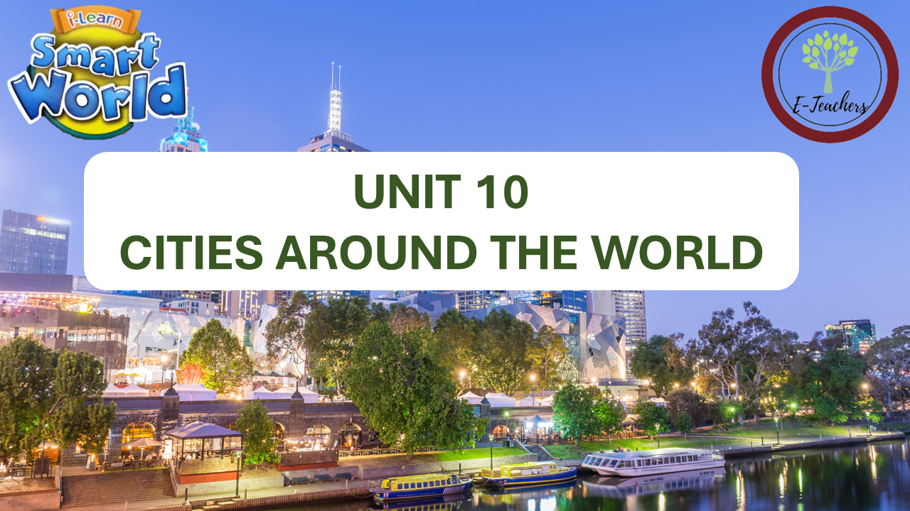
PERIOD 95-LESSON 1
GRAMMAR ( PAGE 79)

Slide 3
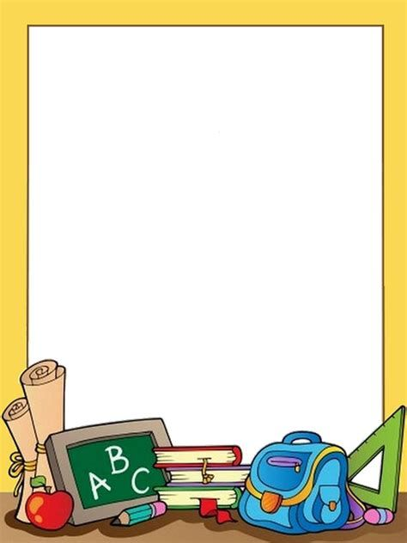
OBJECTIVES
-Students learn grammar about First condition (câu điều kiện loại 1)

Slide 4
WARM UP

Slide 5



LESSON 1
GRAMMAR

Slide 6


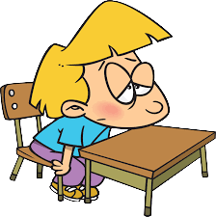
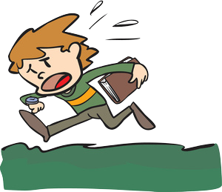
Think about yourself
1. If it rains , I will…………………………..
2. If I don’t study for the exam , I will……………
3. If I go to school late, my teacher will …………

Slide 7


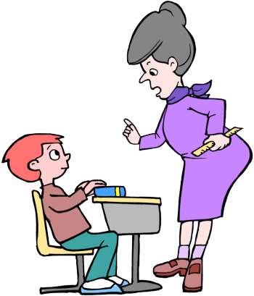
1. If it rains , I will stay at home.
2. If he doesn’t study for the exam , he will fail.
3. If I go to school late, my teacher will be angry.

Slide 8

1. If it rains , I will stay at home.
2. If he doesn’t study for the exam , he will fail
3. If I go to school late, my teacher will be angry.
Discussion
1. Can these situations happen at the present or in the future?
2. Which tense goes after “ if ’
3. Which tense is used in “ main clause”

Slide 9

FIRST CONDITION

Slide 10
Câu điều kiện loại 1
FIRST CONDITION
Nói về những khả năng có thể xảy ra ở hiện tại hoặc tương lai.
If clause ( mệnh đề If)
main clause ( Mệnh đề chính)
Present simple
future simple ( will + V(inf)
- can , may + V(inf)
FORM
If it rains
I will stay at home.
If my parent allow
I will go with you.
If I go to school late
my teacher will be angry.

Slide 11

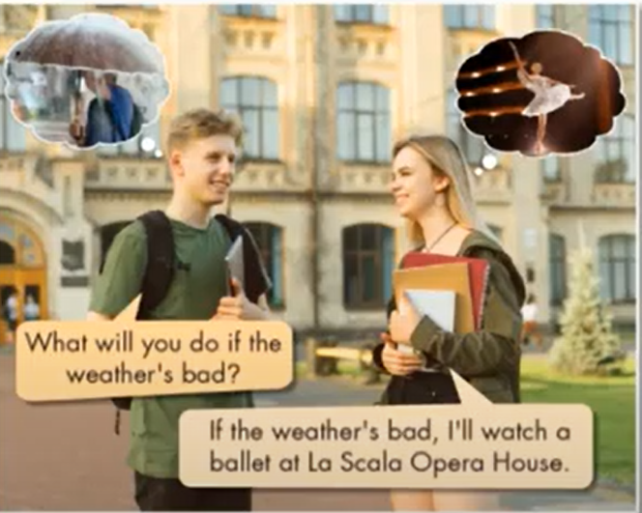
Grammar
a. Listen and repeat.
The First Condition
We use the First Condition to talk about real possibilities that might happen in the future.
If the weather’s bad, I will watch the ballet.
We will visit the palace if we have time.
If it snows, I will not go the the cathedral.
What will you do if the weather’s sunny?
What will you do if the weather is bad.
If the weather is bad, I’ll will watch a ballet at La Opera House.

Slide 12
b. Fill in the blanks with the correct forms of the verbs.
.
If I _________time, I ____________(go) to the opera house.
If the weather ________________(be) cold, I ____________watch kabuki at the Kabukiza Theater.
I___________( not go) to Ueno Park if it _________(be) freezing.
If I ____________(have) time, I __________(visit) the Imperial Palace.
If the museum _____________(be) closed, I ____________(visit) Sensoji Temple.
If I____________( not have) any money, I ___________( not go) to Tokyo Tower.
have time
will go
is
will watch
won’t go
is
have
will visit
is
will visit
don’t have
won’t go

Slide 13
c. Look at Mary’s plan and write sentences.
Vacation plan
1. ____________________________
If it rains, Mary will go to the cafe’.
If rain - cafe’
if museum(busy)-cathedral
tower - if opera house(closed)
if palace(busy) -won’t go
old bridge - if have time
2. ____________________________
If the museum is busy, Mary will go to the
cathedral.
3. ____________________________
Mary will go to the tower if opera house is closed.
4. __________________________________
If the palace is busy, Mary won’t go.
5. ___________________________________
Mary will go to the old bridge if she has time.
d. Now, practice saying the sentences with your partner.

Slide 14
EXTRA PRACTICE
Give the correct form of the verbs

Slide 15
go
1) If I _________(go) out tonight, I _________(go) to the cinema
2) If you _________ (get) back late, I _________ (be) angry.
3) If we _________ (not/see) each other tomorrow, we _________
(see) each other next week.
4) If we _________ (wait) here, we
_________(be) late
5) If the weather _______________ (not/improve) , we ____________
(not/have) a picnic
6) He _________ (not/get) a better job if he _________ (not/pass) that exam.
7) I _________ (buy) a new dress if I
_________(have) enough money.
8) She _________ (take) a taxi if it _________ (rain)
9) I _________ (not/go) if you _________ (not/come) with me
10) She _________ (cook) dinner if you _________ (go) to the supermarket
doesn’t get
will go
won’t pass
get
will be
will buy
don’t see
have
will see
will take
rains
wait
won't go
will be
don’t come
doesn’t improve
will cook
won’t have
go

Slide 16
WRAP UP

Slide 17

Unit 10
CITIES AROUND THE WORLD
Lesson 2: GRAMMAR
THE FIRST CONDITION ( Câu điều kiện loại 1)
Usage (cách sử dụng): Câu điều kiện loại 1 là câu điều kiện diễn tả những điều có thật, có thể xảy ra ở hiện tại và tương lai.
Form ( cấu trúc)
( Mệnh đề chính) ( Mệnh đề “ If”)
Hiện tại đơn Tương lai đơn
( S+ V(e,es) S + will + V(o)
Example ( Ví dụ)
If it rains, Mary will go to the supermarket.
Ms Phương
Zalo: 0966765064

Slide 18

HOMEWORK
- Do exercises on page 59 in workbook and get ready for the next lesson.
01
- Grammar: First Conditional Sentence
02
- Practice asking and answering with the First Conditional Sentence to talk about condition and result in the future correctly with a partner.
03
- Prepare for the new lesson – Pronunciation and Speaking on page 80 (SB).
04

Slide 19


