Slide 1
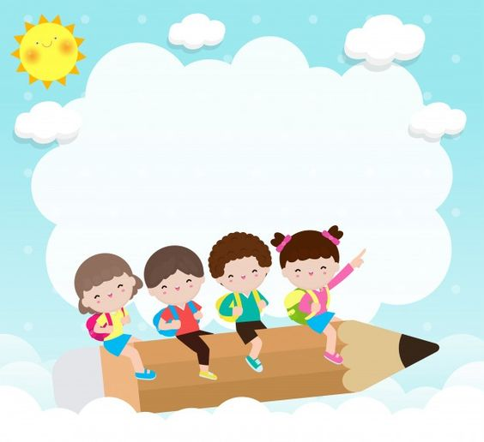
WELCOME TO CLASS 7A1
Teacher – Vu Thu Thuy

Slide 2
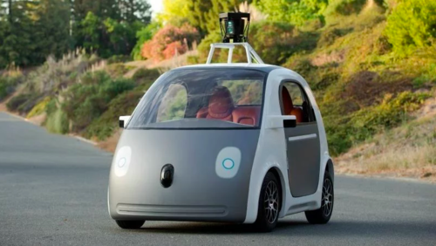
Period 93-Unit 11 Travelling in the future Looking back & Mini-test

Slide 3
OBJECTIVES
-Students are reviewed about vocabulary, grammar of unit 11.
-Can practice on exercises.

Slide 4
Warm up
How far is it from your house to your school?
How do you go to school everyday?
What types of transport will you travel in the future ?

Slide 5
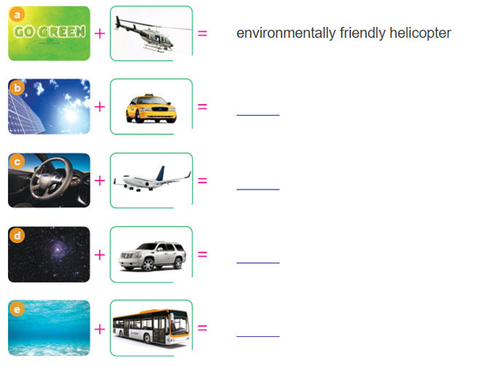
I, Vocabulary
1. Use the clues in the two pictures to form a phrase.
solar - powered taxi
driverless plane
space car
underwater bus

Slide 6
2 Complete this table.
TRANSPORT POSSIBILITIES IN THE FUTURE
 | Verb ( ride,...) | Energy used (solar,....) | Characteristics ( intelligent,flying....)
bicycle
car
train
airplane
ride, pedal
automated, high-speed
wind-powered
drive
water-powerless
flying, driverless
underwater, supersonic
drive
solar-powerless
fly, drive
solar-powerless
driverless

Slide 7
II, Grammar
3. Change the personal pronouns in brackets into suitable possessive pronouns.
This bicycle is (1.I)..................... .It’s parked next to (2.you).................. . Are Phuong and Dungat school today? .I can’t see (3.they)..................... . I really like Anna’s bike . I wish I had (4.she)................
mine
yours
theirs
hers

Slide 8
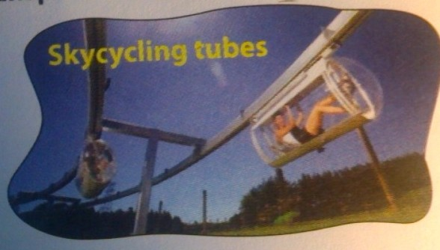
4. Look at the information about skycycling tubes. Then write a description of this means of transport using will and won’t .
easy –to- drive
+
slow ,
healthy
environmental friendly
driverless
_
cheap
high - speed
Eg: Travelling by plane will be clean. It won’t be cheap .

Slide 9
5. Match the sentences in A with those in B. Some sentences in A can be matched with more than onesentence in B.
A
1. Will we travel in driverless cars in the future?
2. Will we have high speed trains in the next five years?
3. I think we will have electric taxis very soon.
4. Will the Segway be environmentally friendly?
5. I hope it will be a lovely picnic.
B
A. Yes, of course.
B. Oh, I think we won't have them until the year 2030.
C. I don't know. Perhaps we won't travel in driverless cars in the future.
D. Yes, I just hope it won't rain.
E. Yes, maybe we will.

Slide 10
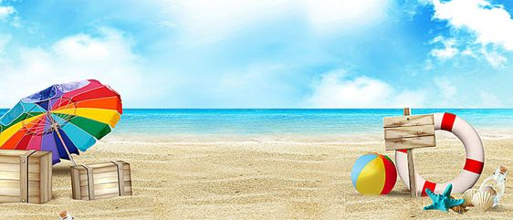
MINI-TEST

Slide 11
Fill in with right verb of simple future and future continuous:
A: If you need to contact me next week, I (stay) ____ at the Hoffman Hotel. B: I (call) _____ you if there are any problems. A: This is the first time I have ever been away from the kids. B: Don’t worry, they (be) ____ be fine.
will be staying
Will call
Will be

Slide 12
WRAP UP
-Students are reviewed about vocabulary, grammar of unit 11 corectly.
-Can practice on exercises well.

Slide 13
HOMEWORK
- Learn by heart new vocabulary,
- Review grammar and practice.
- Do exercises: 4, 5, 6/P 38 (WB)
- Prepare Unit 12. Getting started.

