Slide 1


Welcome to our class today!

Slide 2
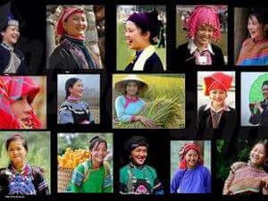

Slide 3
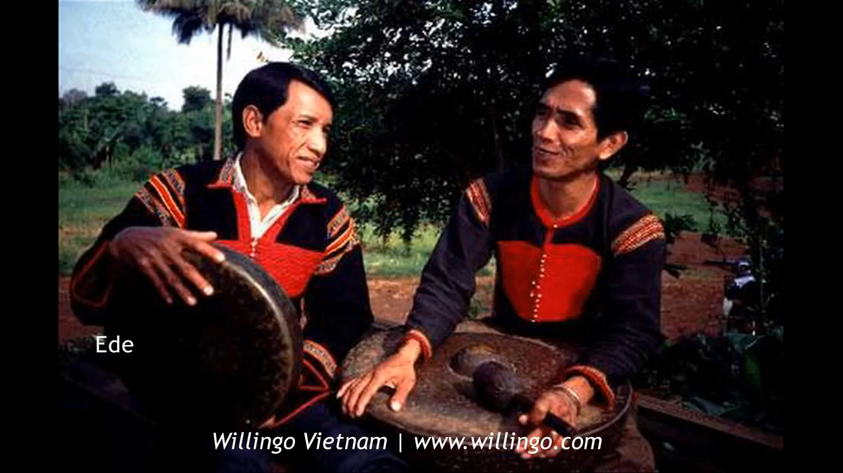

Slide 4
Êđê (Tây Nguyên)
H’mông (Hà Giang, Lào Cai, Sơn La…)
Khơ Mú (Nghệ An, Sơn La, Lai Châu…)
La Chí (Hà Giang)
La Hủ (Lai Châu)
Lự (Lai Châu)
Mạ (Lâm Đồng, Đak Lak, Đồng Nai)
Mảng (Lai Châu)
Mnong (Đak Lak, Đak Nông, Lâm Đồng…)
Mường (Thanh Hóa, Tây Nguyên…)
Si la (Lai Châu)
Xơ Đăng (Kon Tum)
Sán Chay (Tuyên Quang, Thái Nguyên…)

Slide 5

Unit 3: Peoples of Viet Nam
Lesson 2: A closer look 1

Slide 6



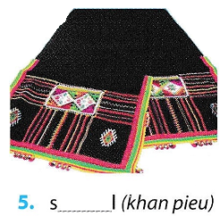
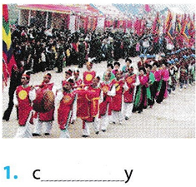
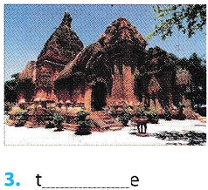
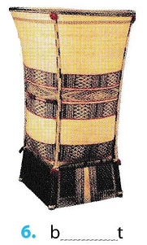
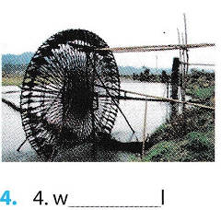
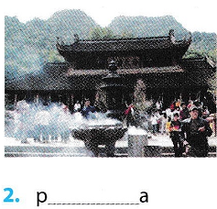
shawl
temple (My Son)
(of the Thai women)
ceremony
water wheel
pagoda
basket
(in the North)
(of the Sedang)

Slide 7
shawl
temple (My Son)
(of the Thai women)
ceremony
water wheel
pagoda
basket
(in the North)
(of the Sedang)

Slide 8
Vocabulary
1. Match the adjectives in A with their opposites in B .
1. major
><
a. written
2. simple
><
b. insignificant
3. modern
><
c. complicated
4. spoken
><
d. minor
5. rich
><
e. basic
6. developed
><
f. poor
7. important
g. traditional
><

Slide 9

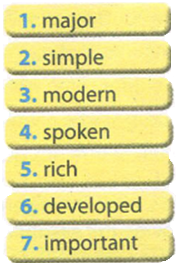
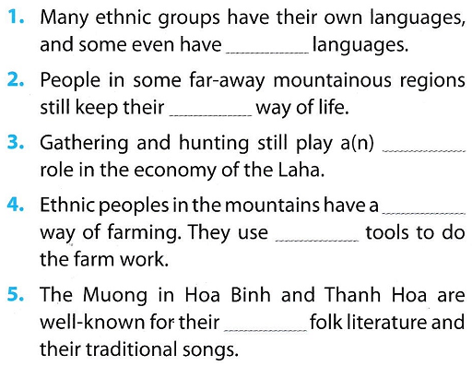
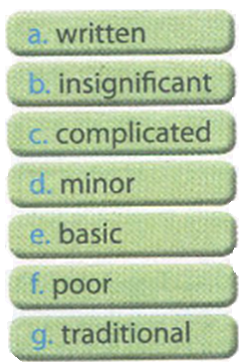
written
traditional
important
simple
basic
rich

Slide 10






Slide 11

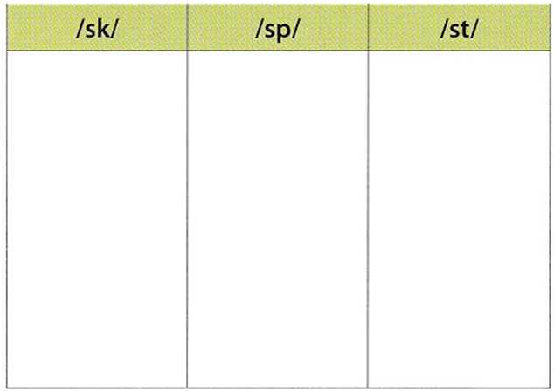
skateboard
speech
stamp
school
display
first
basket
crisp
station
task
space
instead

Slide 12
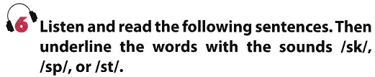
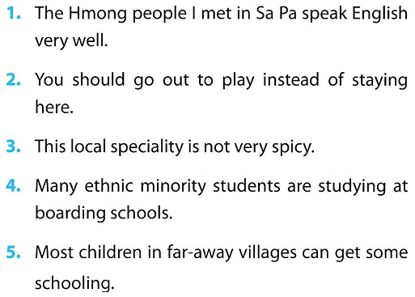
/sp/
/st/
/st/
/sp/
/sp/
/st/
/st/
/sk/
/st/
/sk/

Slide 13
Homework
Learn by heart the new words.
Speak with your friends
Prepare for the next..

