Slide 1
UNIT 8: TOURISM
LESSON 3: A CLOSER LOOK 2
TEACHER: NGUYEN THU HANG

Slide 2
GRAMMAR
ARTICLE: OTHER USES

Slide 3
Articles (Mạo từ)
1. A/an
A/an dùng để nói về thứ mà người nghe chưa biết hoặc để miêu tả người hoặc vật.
Ex: There was an earthquake this afternoon in Indonesia. – Really? I haven’t heard about it / My mother is a kind person.
2. The: The được dùng khi:
Người nghe hoặc người đọc biết người nói hoặc người viết đang nói cái gì.
Người nói đưa ra các đặc điểm về điều đang nói. (Ex: Give me the black coat!)
Với những thứ tồn tại duy nhất xung quanh chúng ta. (Ex: the moon, the sun)
Khi ám chỉ thế giới xung quanh mà mọi người đề biết. (Ex: I want to go to the city centre to see the festival.)
3. Zero article (không có mạo từ)
Với danh từ số nhiều hoặc không đếm được khi chúng ta nói về những thứ chung chung. (Ex: Family is the most important thing of one’s life.)
Với bữa ăn, ngày, tháng, năm hoặc những thời điểm đặc biệt trong năm.
Với tên của người hoặc vật.
Với tên các địa danh.

Slide 4
1. Complete the text with a/an, the, or zero article (Ø).
The Dominican Republic is (1) _____ country on the island of Hispaniola, in (2)_____ Caribbean region. It is (3)______ second largest Caribbean nation after Cuba, with nearly 10 million people, one million of whom live in (4)_______ capital city Santo Domingo. (5)____ second largest city is (6)____Santiago. The geography of (7) ____ country is varied, and ranges from (8)____ semi- desert plains to (9) ___ lush valleys of tropical rainforest. (10)_______ economy depends largely on (11)_______ agriculture, with (12)_____ sugar as (13)_______ main crop. Tourism is (14)________ important industry.
a
the
the
the
The
ɸ
the
ɸ
ɸ
The
ɸ
ɸ
the
a

Slide 5
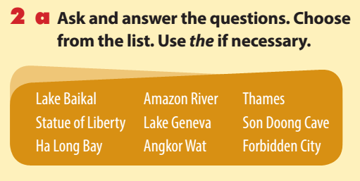
1. Which one is an imperial palace?
2. Which river runs through London?
3. Which one is the deepest lake in the world?
4. Which one is considered one of the New7Wonders of Nature?
5. Which one is the largest cave in the world?
6. Which one is a tourist attraction in New York?
- The Forbidden City
- The Thames
- Lake Baikal
- Ha Long Bay
- Son Doong Cave
-The Statue of Liberty

Slide 6
b. Choose one item above and say what you know about it as a tourist attraction.
Ha Long Bay is located in Quang Ninh province, in northern Vietnam, 170 km from East of Hanoi. “Ha Long” means “Bay of Descending Dragon”. It is famous for scenic ocean and is recognized as one of natural wonder of the world. In Ha Long Bay, tourists can experience diverse natural landscape, varying from long sandy beach to thousand-year-old-lime karst. Ha Long Bay includes nearly 1900 islets of different size, some very large such as Thien Cung Cave or Surprise Cave; others as small as a few meters wide. Besides the natural scenes, Ha Long also has many of man-made attractions, such as: Sunworld Park, cinema or water park. When coming home, tourists can buy some interesting souvenirs there.

Slide 7
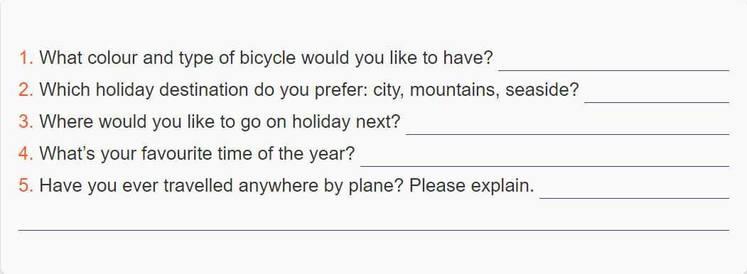
3.a Write answers to the questions, using a, an, the or zero article in each answer. Give three true answers, but two untrue ones.
A blue bike
Da Lat city.
The USA.
The spring.
Yes, I have. Da Nang city.

Slide 8
4. Make full sentences from the words/phrases, adding articles as needed. Then mark them as true (T) or false (F).
F
1. original name/of/Ha Noi/Phu Xuan
=> Thang Long is its original name. 2. most famous/Egyptian pyramids/found/at Giza/in/Cairo
3. there/city/called/ Kiev/in/America
=> Kiev is in Ukraina.
4. My Son/set of ruins/from/ancient Cham Empire/ UNESCO World Heritage Site
5. English/first language/in/many countries/outside/United Kingdom
- The original name of Ha Noi was Phu Xuan.
T
- The most famous Egyptian pyramids are found at Giza in Cairo.
F
- There is a city called Kiev in America.
T
My Son, a set of ruins from the ancient Cham Empire, is a UNESCO World Heritage Site.
T
English is the first language in many countries outside the United Kingdom.

Slide 9
REMEMBER WHAT HAVE YOU LEARNT TODAY!

Slide 10
HOMEWORK
Learn by heart : Articles and Zero Article
Do exercise B,C in WB.
- Prepare: Skills 1/p26

