Slide 1
Unit 8: English speaking countries
Lesson 5: Skills 1
TEACHER: NGUYEN THU HANG

Slide 2
WARM UP!

Slide 3
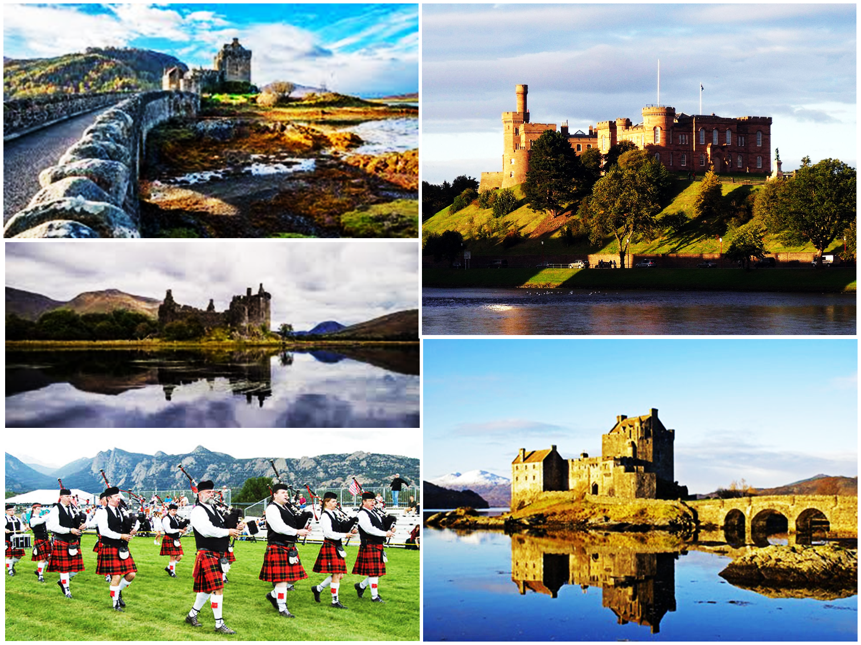
SCOTLAND

Slide 4
READING

Slide 5
NEW WORDS

Slide 6
Vocabulary:
haunted /ˈhɔːntɪd/ (a)
fire brigade /ˈfaɪə brɪɡeɪd/ (n)
explore /ɪkˈsplɔː(r)/ (v)
experience /ɪkˈspɪəriəns/ (v)
participate /pɑːˈtɪsɪpeɪt/ (v)
claim /kleɪm/ (v)
: bị (ma) ám
: đội chữa cháy
: thám hiểm
: trãi nghiệm
: tham gia
: tuyên bố

Slide 7
Checking vocabulary:
haunted /ˈhɔːntɪd/ (a)
fire brigade /ˈfaɪə brɪɡeɪd/ (n)
explore /ɪkˈsplɔː(r)/ (v)
experience /ɪkˈspɪəriəns/ (v)
participate /pɑːˈtɪsɪpeɪt/ (v)
claim /kleɪm/ (v)
: bị (ma) ám
: đội chữa cháy
: thám hiểm
: trãi nghiệm
: tham gia
: tuyên bố

Slide 8
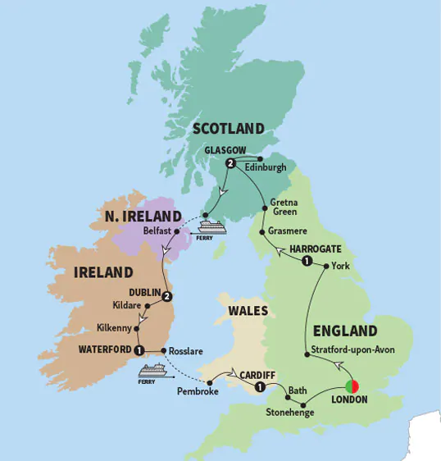
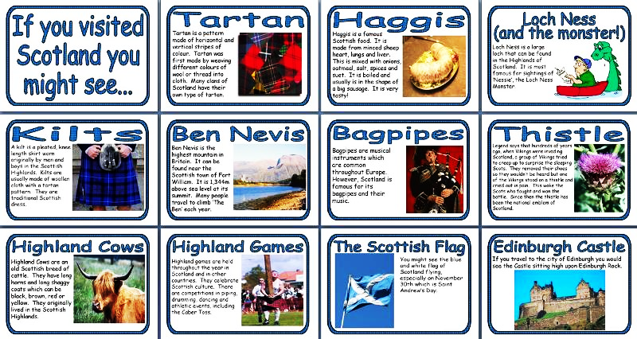
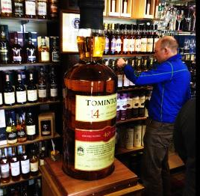
1. Discuss the questions. Then read the passage.
1. Where is Scotland?
It’s in the north of Great Britain..
2. What is this land famous for?
Any or all of the following: It’s famous for its rich and unique culture as well as its amazing natural beauty, its historic castles, its traditional festivals, and its whisky. It is also famous for various inventions.

Slide 9
SCOTLAND - THE LAND OF LEGENDS
Water pollution is the contamination of bodies of water such as lakes, rivers, oceans, and groundwater (the water beneath the Earth’s surface). It is one of the most serious types of pollution. Water pollution can have many diﬀerent causes. Factories dump industrial waste into lakes and rivers. Sewage from households is another cause. Farms using pesticides to kill insects and herbicides to kill weeds can also lead to water pollution. These factors cause ‘point source’ pollution while pollutants from storm water and the atmosphere result in ‘non-point source’ pollution.
Scotland is in the north of Great Britain. It is famous for its rich culture as well as its amazing natural beauty. Visitors to this land can spend endless days exploring its historic centuries-old castles. But be aware – legend says that some of them are haunted by ghosts. Fun-lovers can experience its world-famous festival, the Highland Games where they can enjoy unique Scottish activities such as the piping, drumming, and dancing. They can also see traditional sports, or drink whisky with the local people. Driving through vast green pastures, or boating on scenic lakes – or lochs – are other attractions that Scotland oﬀers.

Slide 10
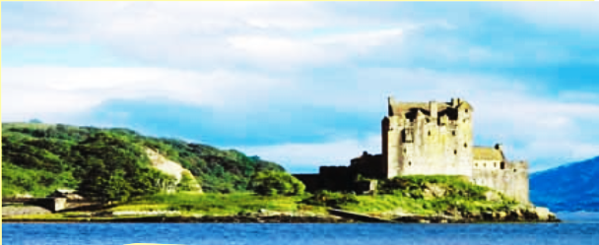
The great people of this legendary land have also given many of the world’s important inventions like the telephone, the television, penicillin and the raincoat. Edinburgh, the capital, was the first city in the world to have its own fire brigade in 1824. Edinburgh University welcomed the first female medical student in Great Britain in 1869.

Slide 11
2. Match each place or event with its two features.
Place | Feature
1. Edinburgh 2. Castles 3. Highland Games 4. lochs | a. haunted by ghosts b. piping and drumming c. centuries-old d. the world’s frst fre brigade e. scenic f. first female medical student g. boating h. traditional sports

Slide 12
3. Read the passage again and answer the questions.
1. Is Scotland famous for its rich culture?
Yes, it is.
2. What might you see while you are exploring a castle?
We might see a ghost.
3. What are some activities you can see at the Scottish Highland Games?
We can see piping, drumming, dancing.
4. What were some of the things invented by the Scots?
They are the telephone, television, penicillin, the rain coat.
5. When was the first fire brigade in the world created?
It was created in 1824.

Slide 13
SPEAKING

Slide 14
4. Work in pairs. Talk about the thing(s) you like most about Scotland. Give reasons.
Example:
- What do you like about Scotland?
- I like the castles.
- Why?
- Because I want to see a ghost!

Slide 15
Model talk 1
A: What do you like about Scotland?
B: I like Isle of Skye
A: Why?
B: Because it is one of the most beautiful places in all the world.
Model talk 2
C: What do you like about Scotland?
D: I like the Scottish people.
C: Why?
D: Because they are kind, generous, and not afraid to speak their minds.

Slide 16
Model talk 3
E: What do you like about Scotland?
F: I like Men in Kilts.
E: Why?
F: Because a male in full Scottish dress and kilt is a fantastic thing to see.
Model talk 4
G: What do you like about Scotland?
H: I like Scotch Whisky.
G: Why?
H: Because it is among the world's most revered spirits.

Slide 17
5. Work in groups. Read and discuss these interesting facts about Australia. Prepare a short introduction of Australia. Then present it to the class.
AUSTRALIA - Interesting facts
- world’s only country which covers an entire continent
- world’s capital of sports and outdoor activities (70% of the population regularly participate)
- world’s longest fence (5,400 km); built to protect world’s largest population of sheep (about 175 million); claimed to be seen from outer space
- world’s largest cattle station (Anna Creek station); larger than Belgium

Slide 18
Model presentation 1
It is the world's only country which covers an entire continent. It is the world's capital of sports and outdoor activities (70% of population regularly participate). It is the longest fence (5,400 km) which was built to protect the world's largest population of sheep (about 175 million) and is claimed to be seen from outer space. It has the world's largest cattle station (Anna Creek station) and larger than Belgium.

Slide 19
Model presentation 2
What do you think of when Australia is mentioned? Crocodile Dundee, Nicole Kidman, Hugh Jackman, kangaroos, the Great Barrier Reef, Sydney Opera House, Aborigines, wine, or vegemite? Australia is much more than this. So much more to offer! The sports capital of the world has 70 percent of its total population participating at least once a week in a particular recreational activity or sport. The largest cattle station in the world is Anna Creek Station in South Australia at over 34,000 square kilometers. It is even larger than Belgium. Australia is the biggest island and the smallest continent in the world. The Dingo Fence of south-east Australia, 5,614 km is the longest fence in the world. It starts at Jimbour in Queensland and continuing on to the Great Australian Bight in South Australia. The fence is built to protect world's largest population of sheep (about 175 million); claimed to be seen from outer space.

Slide 20
HOMEWORK
- Learn the new words by heart.
- Read the text on page 22 again.
- Do exercises D1, 2 in workbook (page 15, 16, 17)
- Prepare for Unit 8: Skills 2

