Slide 1
Long Bien Secondary School
Warmly welcome!
ENGHLISH 7

Slide 2
WARM - UP
GAME

Slide 3
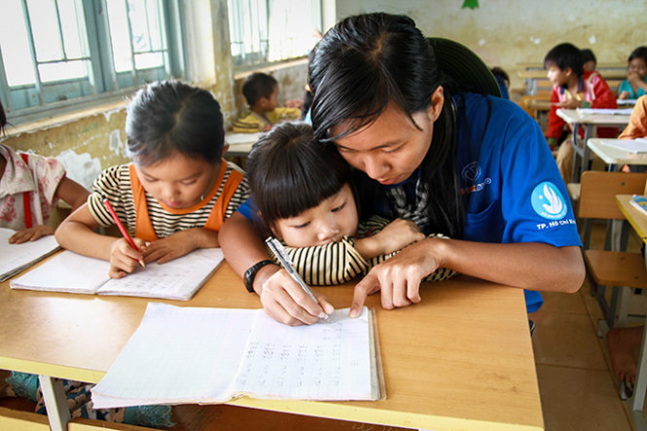
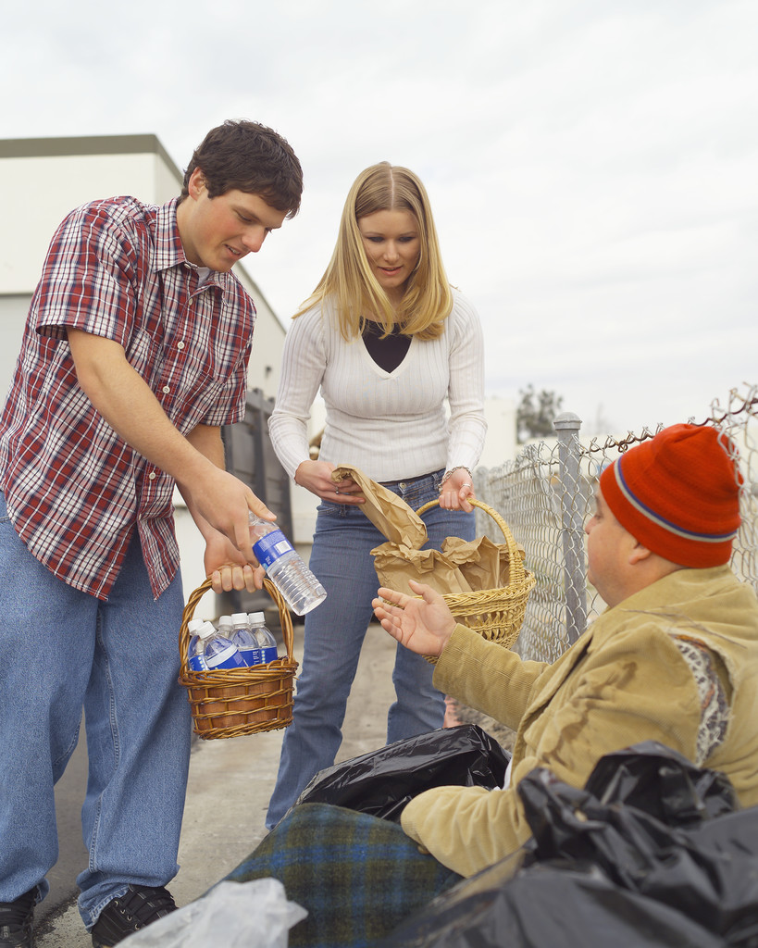
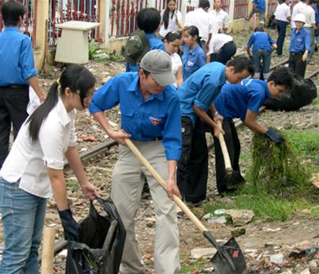
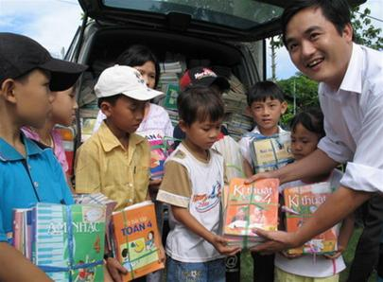
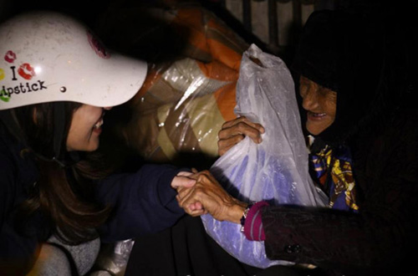
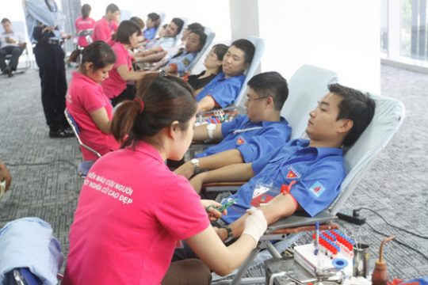
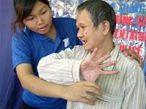

Slide 4
Provide education
Provide food
Help homeless people
Help community
Donate/ provide books
Help the elderly
Donate blood
Help the disabled

Slide 5
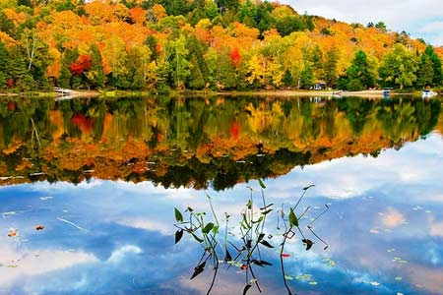

Monday, October 25th, 2021
UNIT 3:
COMMUNITY SERVICE
Period 22: LOOKING BACK.

Slide 6
UNIT 3: COMMUNITY SERVICE
Period 22: Looking back
I. Vocabulary
- kind – hearted (adj) tốt bụng
- lantern (n) đèn lồng
pay attention (v) chú ý
blood (n) máu
play (n) vở kịch
(v) chơi
- swap (v) trao đổi, đổi

Slide 7
1. Match the verbs in blue with the correct words in the box
evening classes
food
food
care
the community
books
education
books
homeless people
clothing
clothing
attention
the elderly
blood
the disabled
donate
provide
help

Slide 8
II. Grammar
2. Circle the best answer
1. Because Minh has (ever, never, ago) worked for a charity shop, he really wants to do it.
2. (Already, Last week, So far) we visited sick children in Viet Due Hospital.
3. Nhung has (already, many times, ever) finished all the homework.
4. Have you read that book (yet, ever, never)?
5. Yes, I finished it (three times, so far, yesterday).

Slide 9
3. Put the verbs in the past simple or the present perfect
1. He thinks she's the most kind-hearted girl he ______ever (meet) _____.
2. She (visit) _______Hue when she was a child.
3. She (visit) ____________ Hue once.
4. How many plays ______Shakespeare (write) _______?
5. How many plays ______ she (write) _______ so far?
has
met.
visited
has visited
did
write
has
written

Slide 10
GIVING REASONS
Using “because” to give reasons for your ideas and opinions makes your speaking and writing more interesting and convincing .
*Clause 1 + because + Clause 2 (reason ) .
*Because + Clause 2 (reason ) , Clause 1 .

Slide 11
4. Choose the best answers to finish the sentences below
They’ve decided to buy that car because _ ______________________________
the engine is very good.
2. Put on your warm coat because_____________________
It is going to be cold this evening .
3. We like her because ________________________.
She’s kind-hearted
4. Let’s help the street children because _____________________________.
they are not as lucky as we are
5. Because she loves her students, _______________________________.
She works very hard to improve her teaching .

Slide 12
III. Communication
5. Role-play. Student A is a reporter and student B is a volunteer. Student A asks the questions and writes down student B’s answers. Then swap your roles. Use the following questions as prompts.
When did you start working for your organisation?
Why did you decide to volunteer?
What have you done so far with (name of organisation)?
4 .Was there anything that made you happy with your work last month?

Slide 13
STUDENT A
You joined Our Town 6 months ago because you wanted to introduce Vietnamese culture to foreigners , and to practise English .You have given tours in English , and helped visitors to play traditional Vietnamese games .Last month you felt happy when you received a thank-you letter from two Australian visitors who liked the tours very much .
STUDENT B
You joined Big Heart 2 years ago because you wanted to help people in hospital .You have donated blood twice , and given presents to sick children .Last month you felt happy when you made a Mid-Autumn Festival lantern yourself and gave it to a little girl in hospital who loved it so much .

Slide 14
STUDENT A
STUDENT B
+ Joined Our Town:
6 months ago
+ Joined Big Heart:
2 years ago
+ reason:
wanted to introduce Vietnamese culture
to foreigners, and to practise English.
+ reason:
wanted to help people in hospital.
+ volunteer work:
have given tours in English,
helped visitors to play
traditional Vietnamese games.
+ volunteer work:
have donated blood twice, given presents to sick children.
+ happy when:
made a Mid-Autumn Festival lantern and gave it to a little girl in hospital.
+ happy when:
received a thank-you letter from two Australian visitors .
.

Slide 15
Model the interview with student A
R: Hi Mai. You are from Our Town – A programme that helps tourists, aren’t you?
M: Yes, I am.
R: Why did you decide to volunteer?
M: Because I wanted to introduce Vietnamese culture to foreigners, and to practise English.
R: What have you done so far with Our Town?
M: I have given tours in English, and helped visitors to play traditional Vietnamese games.
R: Was there anything that made you happy with your work last month?
M: Last month I felt happy when I received a thank-you letter from two Australian visitors who liked the tours very much.
R: Thank you very much for joining our interview, Mai

Slide 16
Model the interview with student B
R: Hi Phong. You are from Big Heart – A programme that helps sick people in hospital, aren’t you?
P: Yes, I am.
R: Why did you decide to volunteer?
P: Because I wanted to help people in hospital.
R: What have you done so far with Big Heart?
P: I have donated blood twice, and given presents to sick children.
R: Was there anything that made you happy with your work last month?
P: Last month I felt happy when I made a Mid-Autumn Festival lantern myself and gave it to a little girl in hospital who loved it so much.
R: Thank you very much for joining our interview, Phong

Slide 17
Homework
-Do excercises in the work book.
- Make more projects about your volunteer work.
- Prepare : Review 1

Slide 18



