Slide 1


Write the negative feeling.
sadness
…………
NEGATIVE FEELINGS
………..
…………..
………….
…………

Slide 2
Welcome all of teachers and students
UNIT 3: TEEN STRESS AND PRESSURE
Lesson 2: A closer look 1
Lesson plan for English 9
Teacher: Bui Thi Chin
Tien Lu secondary school

Slide 3
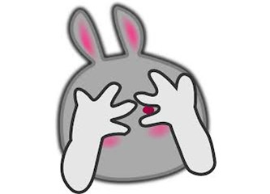


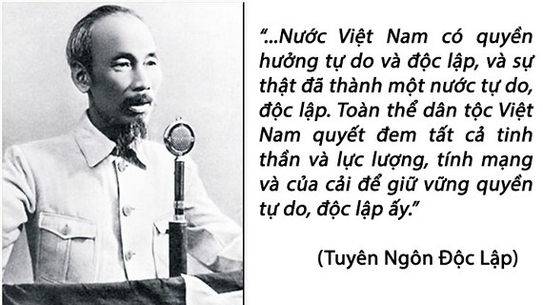
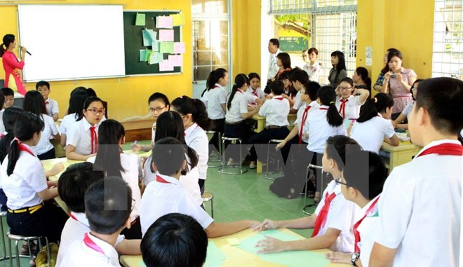
I.VOCABULARY
adolescence (n):
giai đoạn vị thành niên
independence (n) :
sự độc lập, tự lập
self-aware (adj) :
tự nhận thức, ngộ ra
reasoning skills (n):
kỹ năng thuyết phục
informed (adj) :
có suy nghĩ, có cân nhắc
embarrassed (adj) :
xấu hổ

Slide 4
1. Complete the paragraph with the words in the box. There is one word that you don't need.
independence informed shape and height
embarrassed delighted self–aware reasoning skills
Adolescence is the period between childhood and young adulthood. Your body will change in (1)_______________. Your brain will grow and you'll have improved self-control and (2) _______________ . Physical changes are different for everyone, so you don't need to feel (3) _______________ or frustrated! You'll experience emotional changes as well. You'll feel you want more (4) _______________ and responsibility. You may become more (5) _______________ and care about other people's opinions, especially those of your friends. But remember you'll need adult support and guidance to make (6) _______________ decisions and overcome stress.
shape and height
reasoning skills
embarrassed
independence
self - aware
informed

Slide 5
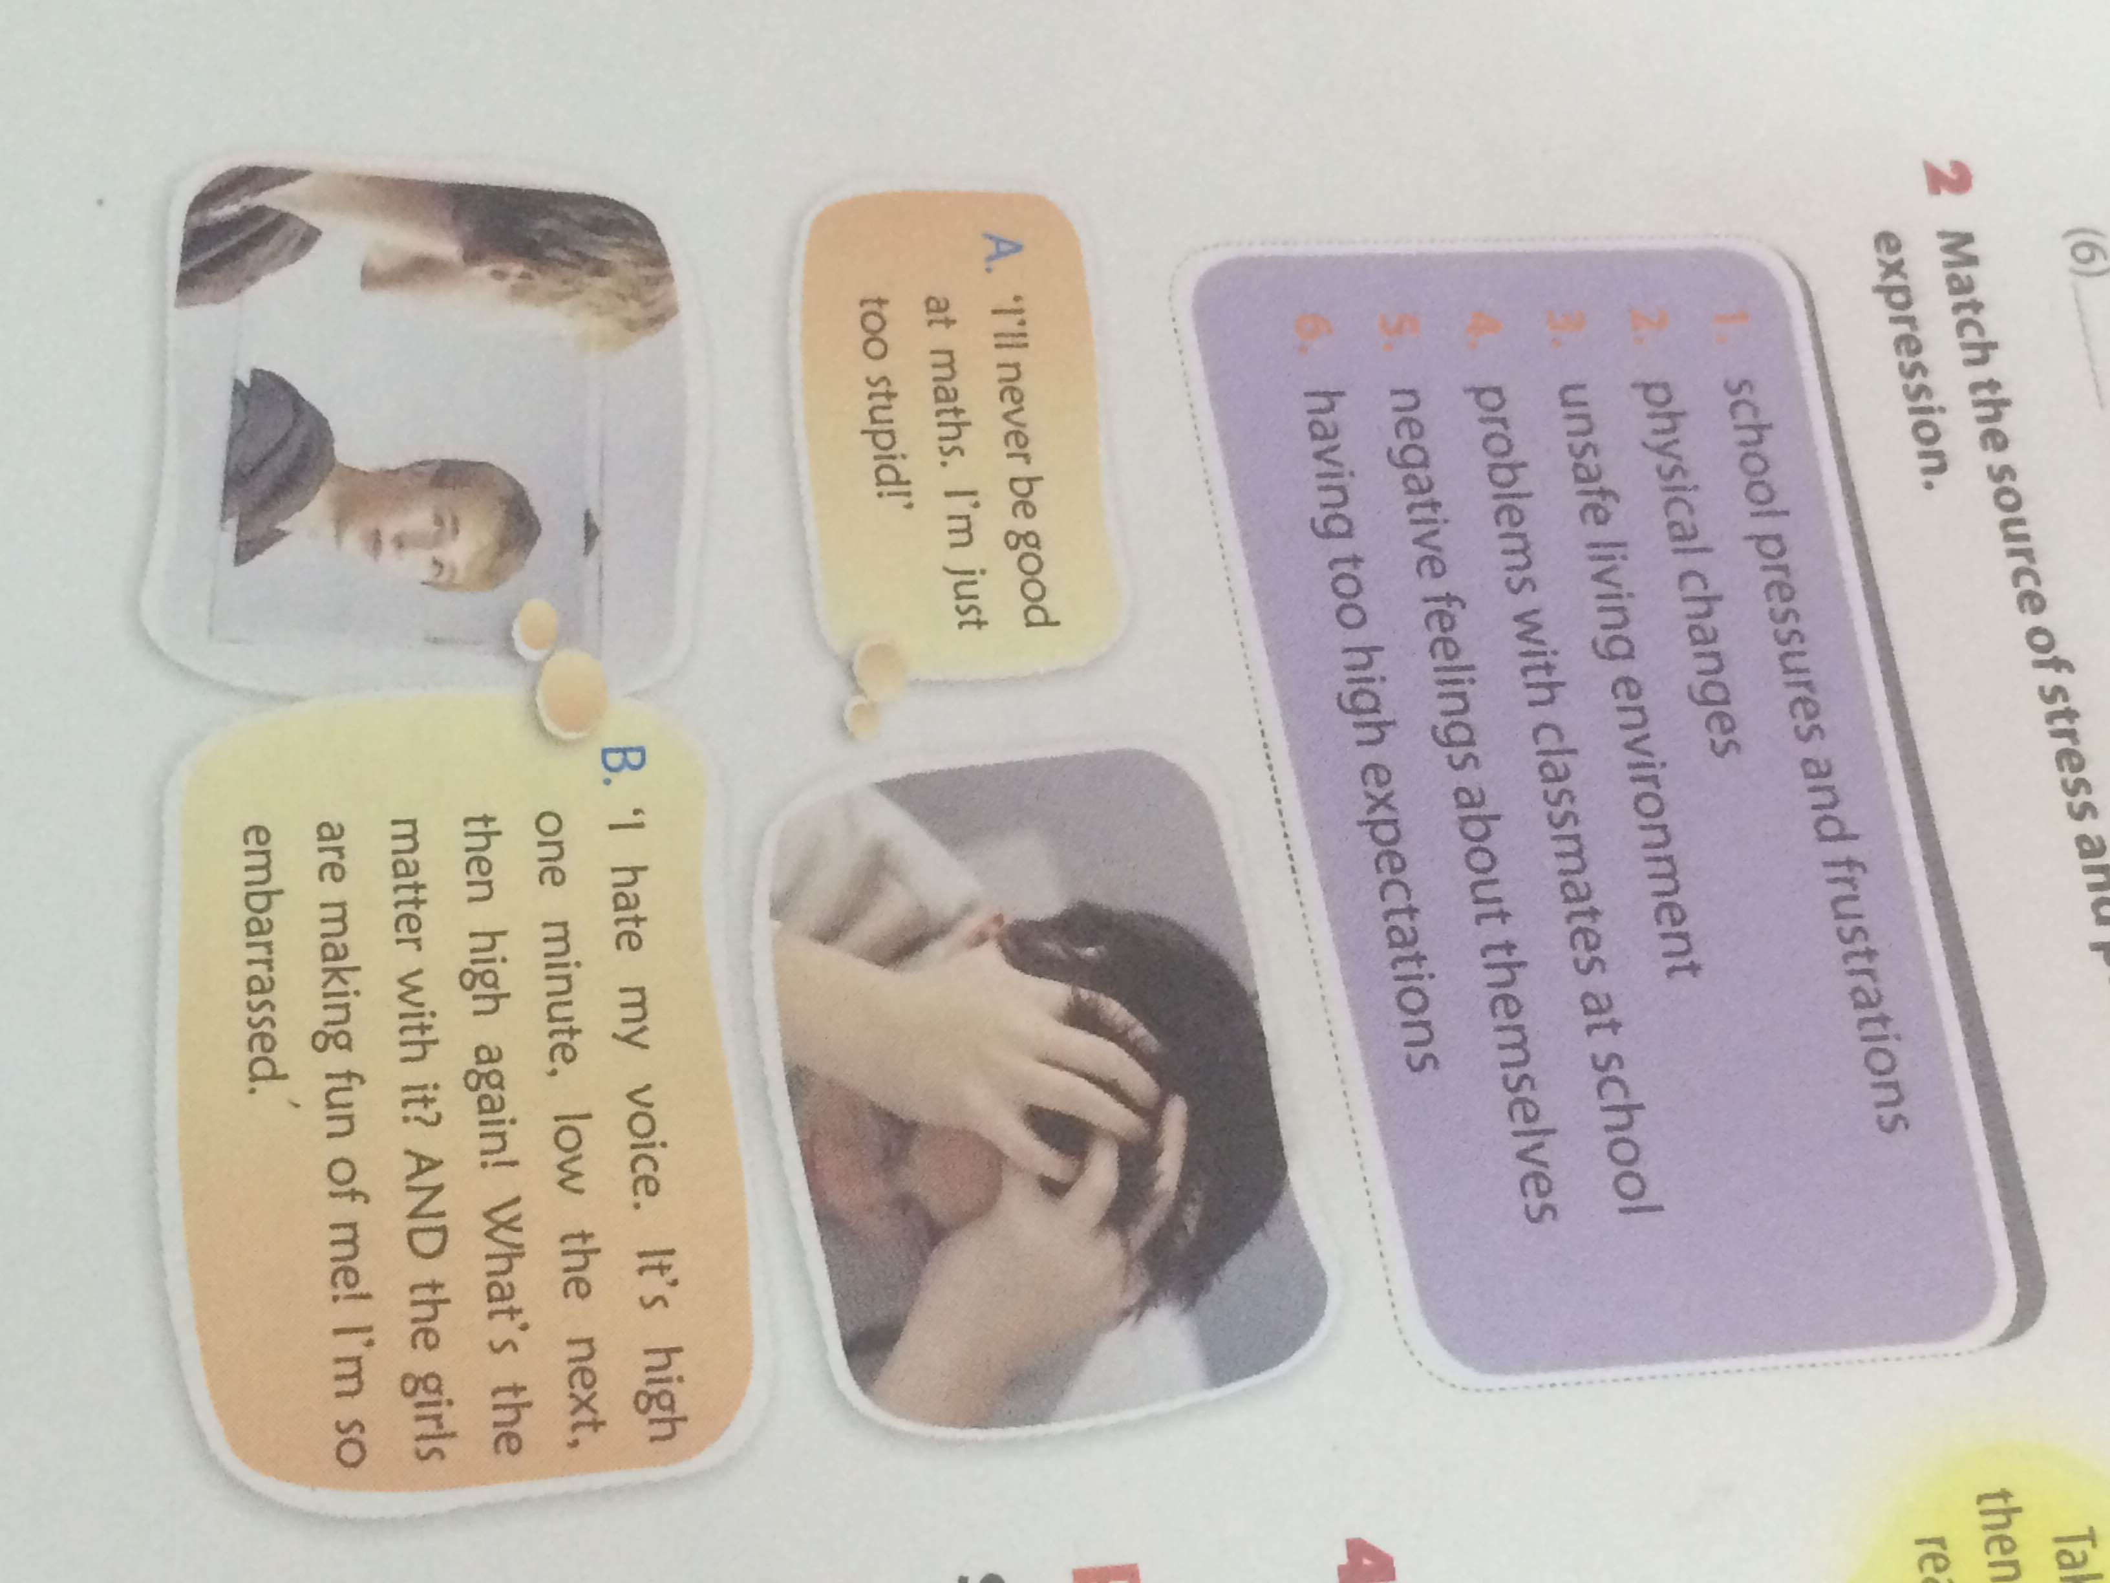
2. Match the source of stress and pressure to the expression.
1. school pressures and frustrations 2. physical changes
3. unsafe living environment 4. problems with classmates at school
5. negative feelings about themselves
6. having too high expectations
A. I’ll never be good at maths. I’m just too stupid.
B. 'I hate my voice. It's high one minute. low the next, then high again! What's the matter with it? AND the girls are making fun of me! I'm so
embarrassed.'
5. negative feelings about themselves
2. physical changes

Slide 6
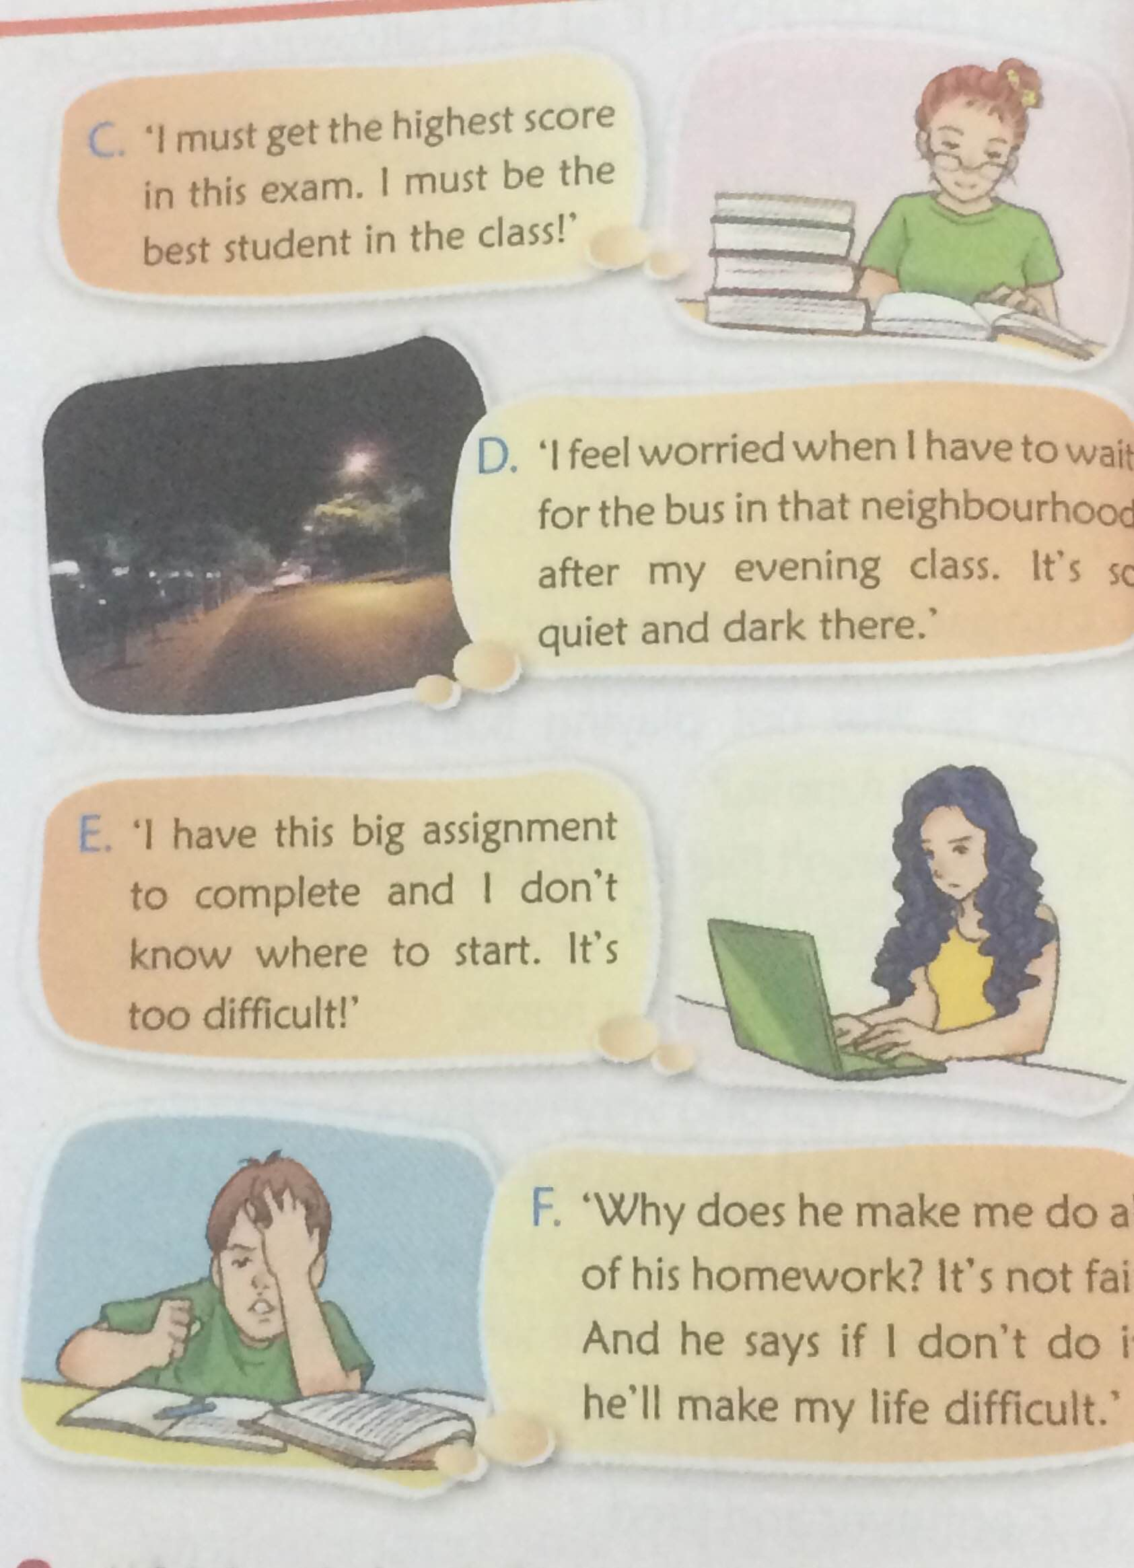
2. Match the source of stress and pressure to the expression.
1. school pressures and frustrations 2. physical changes
3. unsafe living environment 4. problems with classmates at school
5. negative feelings about themselves
6. having too high expectations
D. 'I feel worried when I have to wait for the bus in that neighborhood after my evening class. It’s so quiet and dark there.'
C. 'I must get the highest score in this exam. I must be the best student in the class!'
6. having too high expectations
3. unsafe living environment

Slide 7
2. Match the source of stress and pressure to the expression.
1. school pressures and frustrations 2. physical changes
3. unsafe living environment 4. problems with classmates at school
5. negative feelings about themselves
6. having too high expectations
F. 'Why does he make me do all of his homework? It's not fair. And he says if I don't do it, he'll make my life difficult.'
E. 'l have this big assignment to complete and l don't know where to start. It’s too difficult!'
1. school pressures and frustrations
4. problems with classmates at school

Slide 8
2. Which of the following can be done in the above situations? Discuss with your partner. (More than one solution can be suitable for one situation.)
A. I’ll never be good at maths. I’m just too stupid.
B. 'I hate my voice. It's high one minute. low the next, then high again! What's the matter with it? AND the girls are making fun of me! I'm so embarrassed.'
A. 1;3;4
C. 'I must get the highest score in this exam. I must be the best student in the class!'
B. 4
C. 1
1.Take a break, then you will feel ready to start again
D. 'I feel worried when I have to wait for the bus in that neighborhood after my evening class. It’s so quiet and dark there.'
2.Break a large task into smaller tasks
D. 4
E. 'l have this big assignment to complete and l don't know where to start. It’s too difficult!'
3. Focus on your strong points.
E. 1; 2
F. 'Why does he make me do all of his homework? It's not fair. And he says if I don't do it, he'll make my life difficult.'
4. Talk to someone about this and/or ask them for help
F. 4

Slide 9
4. Have you ever been in any of these situations?
-If so, what did you do to deal with them?
A. I’ll never be good at maths. I’m just too stupid.
E. 'l have this big assignment to complete and l don't know where to start. It’s too difficult!'
B. 'I hate my voice. It's high one minute. low the next, then high again! What's the matter with it? AND the girls are making fun of me! I'm so embarrassed.'
F. 'Why does he make me do all of his homework? It's not fair. And he says if I don't do it, he'll make my life difficult.'
Yes, I do. I experienced the first situation, which means I did think that I’m totally stupid because I was not good at Maths, I dealt with it by talking to my mom and my teacher. They helped me to improve my performance in Math and to be more confident.
C. 'I must get the highest score in this exam. I must be the best student in the class!'
D. 'I feel worried when I have to wait for the bus in that neighborhood after my evening class. It’s so quiet and dark there.'

Slide 10

II. PRONUNCIATION
5. Listen to the recording and practice saying the sentences.
1. - Where are you? You aren't at the bus stop.
- I am at the bus stop, but I can't see you.
2. - Are you busy right now?
- Yes, I am. Sorry, could you wait for a minute?
3. - Is Ronia?
- No, she's out ice-skating.
- But it's so cold!
- It is. But she's got all her warm clothes on.
4. - Wasn't Bill disappointed about the exam result?
- He was. But he was hiding it well.
⇒ Some verbs are stressed while others are not. It depends on the what the speaker want to emphasize in the sentence.

Slide 11

6. Look at the following sentences and underline the verb forms of be which should be stressed. Then listen to the recording to check and practice.
1. - You aren't worried about the exam? Good for you!
- I am worried! But I try not to show it.
2. - Do you think Jack is good at Japanese?
- He is. But he's a bit shy to speak it.
3. - Isn't badminton her favorite sport?
- Yes, it is.
4. - Who's he?
5. - Sorry - we're late!
- Actually, you aren't. We haven't started yet.
6. - Is she happy at the new school?
- Yes, she is. She likes it a lot.

Slide 12


HOMEWORK
Learn by heart the new words
-Prepare : A closer look 2

