Slide 1

WELCOME TO OUR CLASS 9
Unit 1: LOCAL ENVIRONMENT
Communication

Slide 2
      UNIT 1: LOCAL ENVIRONMENT
      LESSON 4: COMMUNICATION
*.Vocabulary:
1. team-building (adj): (adj) /tiːm-ˈbɪldɪŋ/ xây dựng đội ngũ.
Team-building activities develop friendships between participants.
2. turn up (ph.v) /tɜːn ʌp/ xuất hiện, đến
She invited a lot of people to the party but half of them didn't turn up.
3. set off (ph.v) /set ɒf/ khởi hành
She will set off for Da Lat at 5 a.m. tomorrow.

Slide 3
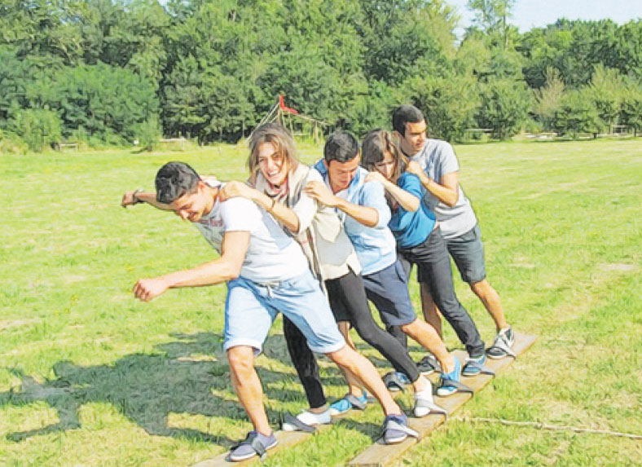
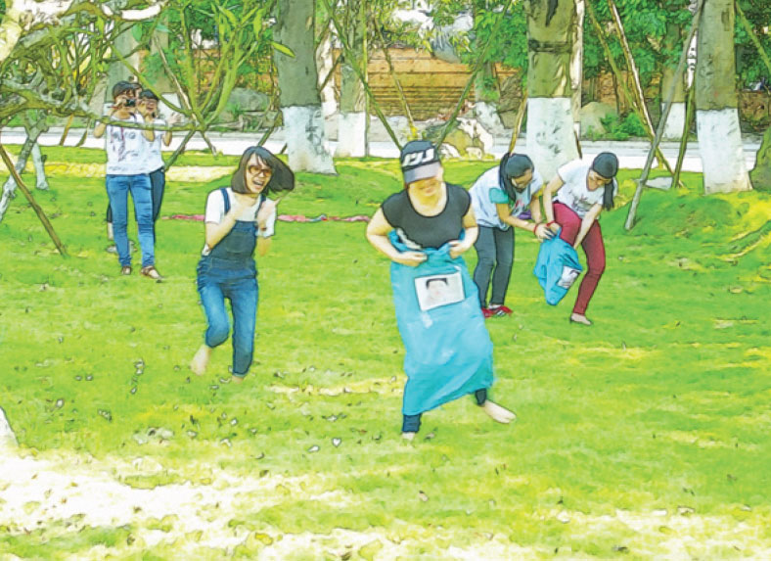
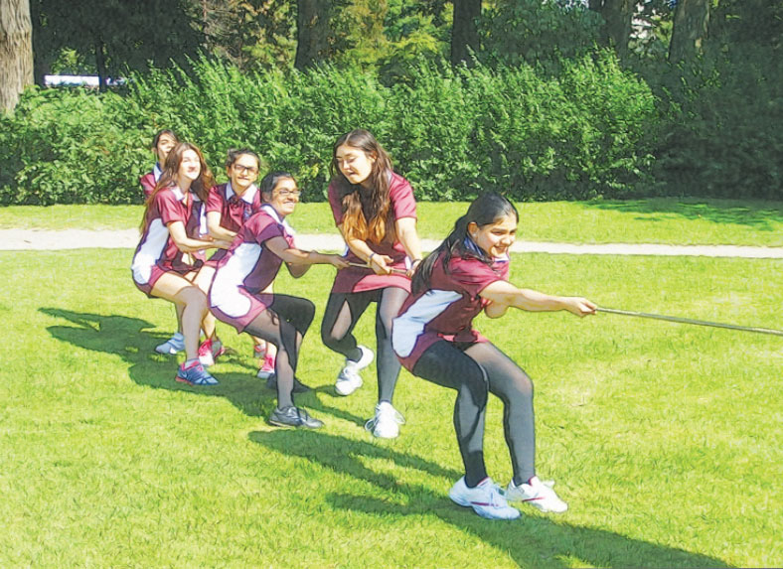
1. Nick, Mi , Duong and Mai are playing a day out to a place of interest for their class. Listen to the conversation and complete their plan..

Slide 4

1. Nick, Mi , Duong and Mai are playing a day out to a place of interest for their class. Listen to the conversation and complete their plan..
 | Details | Who to prepare
Place | (1) ……………………………
Means of transport | (2) …………………….
Time to set off | (3) ………………………… | Mai: stick a notice
Food | (4) bring…………………
Drinks | For everyone | Nga: buy in (5)…………………
Activities | Morning: (6) …………………..games and quizzes Lunch: 11.30 Afternoon: go to traditional (8) ………………… at .30; (9)…………………. their own paintings | Nick: prepare games Thanh: prepare (7)………………..
Time to come back | (10) ………………….
Green Park
bus
8 a.m.
own lunch
supermarket
team-building
painting village
quizzes
make
5 p.m

Slide 5
2. Imagine that your class is going to a place of interest in your area
Work in groups to discuss the plan for this day out. Make the note in the table
A DAY OUT
 | Details | Who to prepare
Place
Means of transport
Time to set off
Food
Drinks
Activities
Time to come back

Slide 6

3. Present your plan to the class. Which group has the best plan?

Slide 7
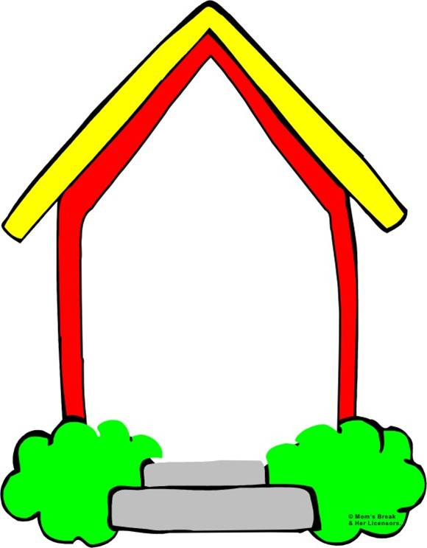

homework
- Learn by heart vocabulary - Prepare: Skills 1

