Slide 1
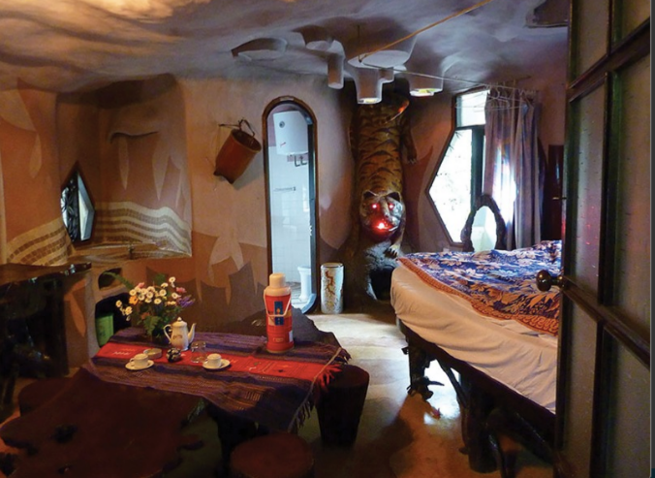

Slide 2
1
What is the name of Nick's room? | How many rooms are there in the Crazy House Hotel? | Where is the Crazy House Hotel? (City/Province)
Is there a cupboard in Nick's room? | Why is the room called the Tiger room? | Where is Nick's bag?
Is there a window in Nick's room? | Who is Nick staying with? | Is there a lamp in Nick's room?
2
3
4
5
7
6
8
9

Slide 3
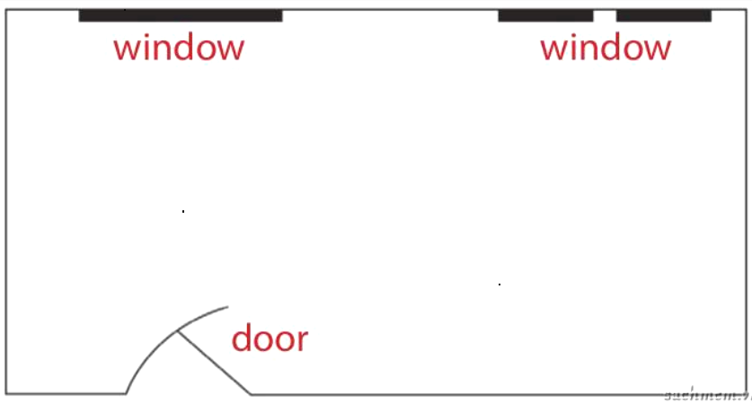
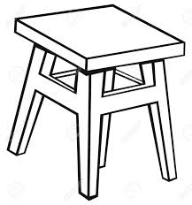
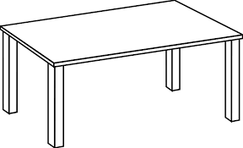
fireplace
wardrobe
stool
sofa
table
shelf
bed

Slide 4
1. SUBJECT
2. GREETING
AN E-MAIL
3. INTRODUCTION
4. BODY
5. CONCLUSION

Slide 5
Writing tips – How to write an email to a friend
1. In the subject line, write briefly what the e-mail is about.
2. Begin the e-mail with e greeting (Dear / Hi/ Hello ……,)
Introduction is the first paragraph:
- ask about his/her health,
- thanks his/her about the previous e-mail,
- or write the reasons.
In the body, - write the subject(s) of the e-mail.
- Write each subject in a new paragraph.
Conclusion is the last paragraph:
It include the closing remarks:
- saying goodbye,
- asking your friend to write back,
- ending your regards to his/ her family.

Slide 6
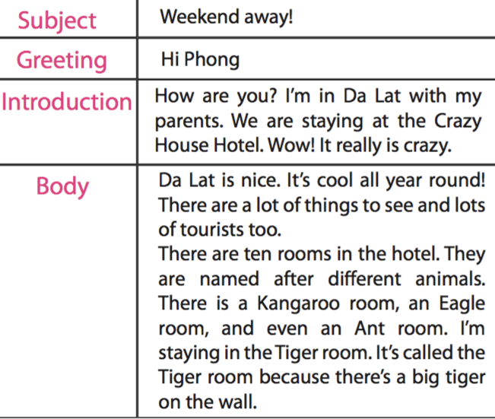
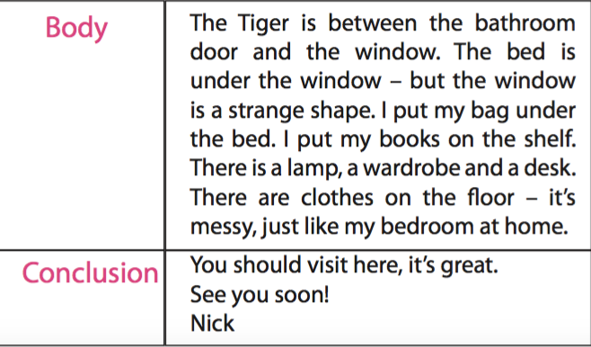

Slide 7
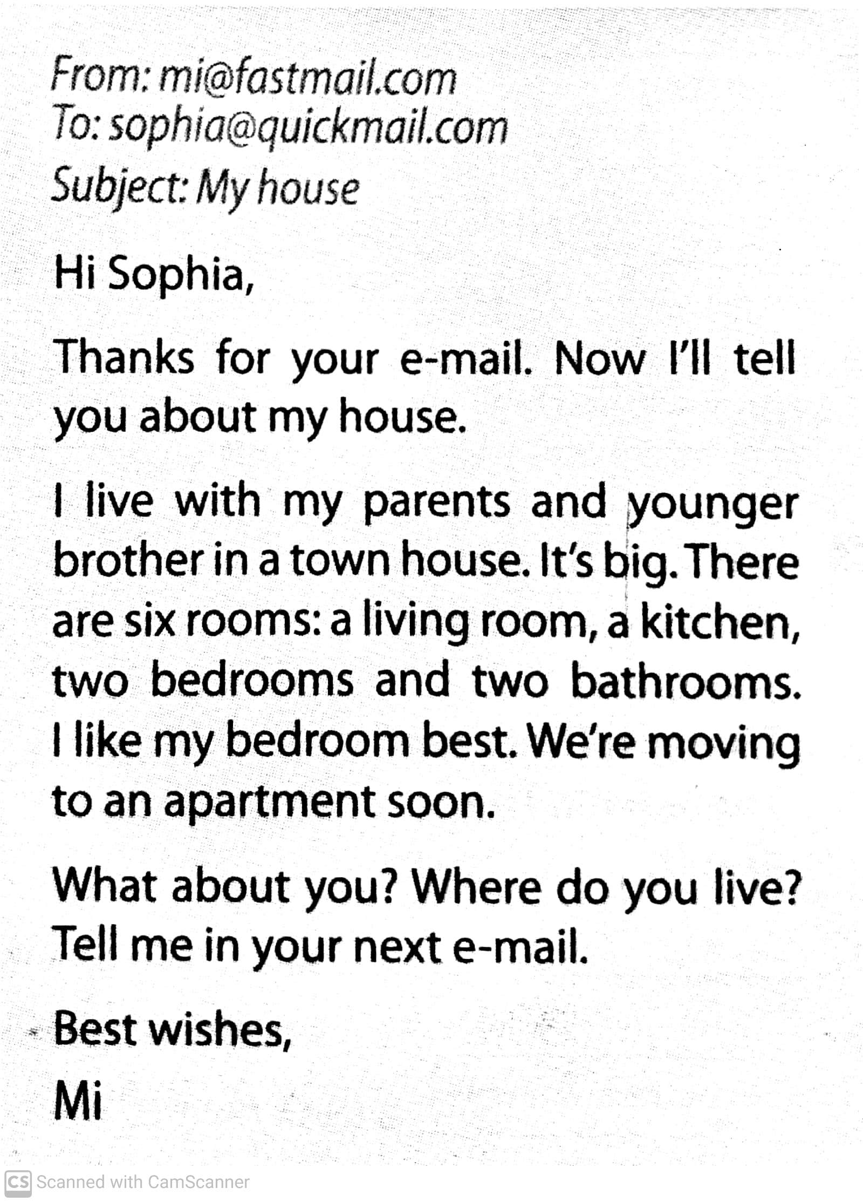

Slide 8
Write an e-mail to Nick. Tell him about your idea for the new room of the Crazy House Hotel
Plan
Brainstorm vocabulary about your room.
Draft
Write a draft.
Check
Check your draft: is the functuation correct?
Is the capitalisation correct?
Does it have all necessary parts?

Slide 9
From: honganhdang141@gmail.com
To: nick@gmail.com
Subject: My room
1. SUBJECT
2. GREETING
Dear Nick,
Thank you for your e-mail. I am writing to tell you about my idea for the new room of the Crazy House Hotel.
3. INTRODUCTION
It is a Cat room. There is a big picture of a cat on the wall. In the middle of the room, there is a sofa, a table and two armchairs. Next to the table, there is a fridge. There is a bed opposite the bed. There is a shelf and a wardrobe behind the bed. I like this room so much.
4. BODY
What about you? Please tell me about your new room in the next e-mail.
Love,
Hong Anh
5. CONCLUSION

Slide 10
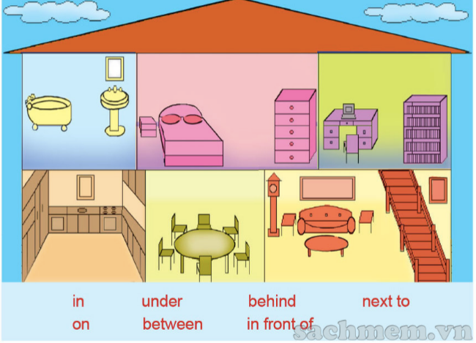

Slide 11
HOMEWORK
1. Rewrite the email.
2. Prepare: Looking back + Project

