Slide 1


Tuesday, March 15th, 2022
REVIEW 3
Period 76 - Language

Slide 2
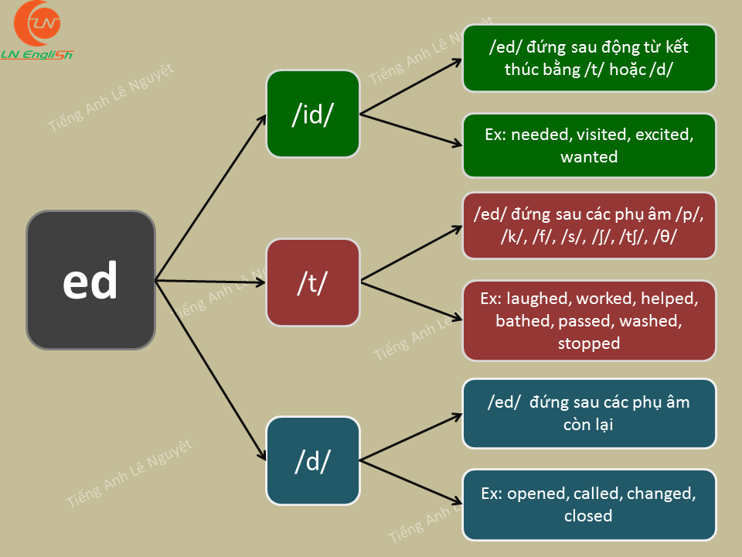

Slide 3




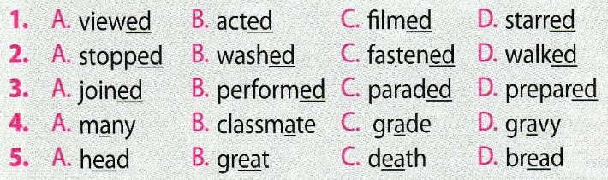
/e/
/ei/
/ei/
/ei/
/e/
/ei/
/e/
/e/

Slide 4

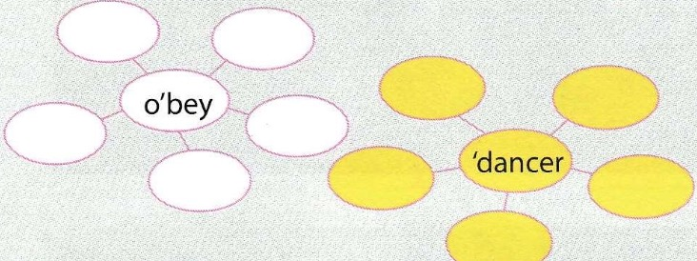
receive
polite
beauty
copy
perform
parade
prepare
teacher
classmate
actor

Slide 5





Vocabulary
3 Write the phrases from the box under the road signs.
Ahead only Railway crossing No crossing
No right turn Right turn only
Ahead only
No crossing
1. ___________
2. ____________
No right turn
Right turn only
Railway crossing
3. ____________
4. ______________
5. _______________

Slide 6
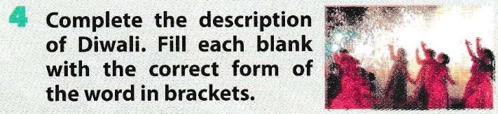
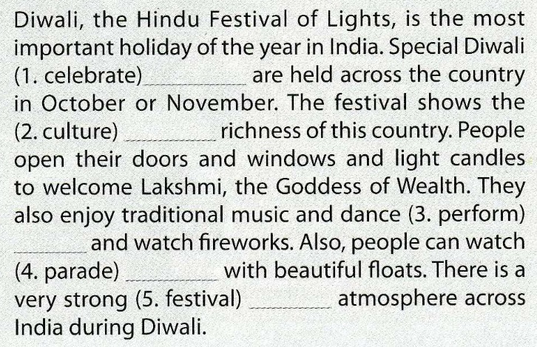
celebrations
cultural
performances
parades
festive

Slide 7
5 Solve the crossword puzzle.
1
2
3
d
h
b
o
i
o
c
4
t
h
r
i
l
l
e
r
Down
u
a
i
5
m
o
v
e
d
r
n
1. A type of film showing real people and events.
e
i
g
6
a
n
i
m
a
t
i
o
o
n
hilarious
2. Comedies are usually _________.
t
u
boring
3. ________ films make me sleepy.
a
s
Across
r
y
4. A type of film about murder or crime.
5. She was ________ to tears by the film.
moved
6. A type of film featuring animated characters.

Slide 8


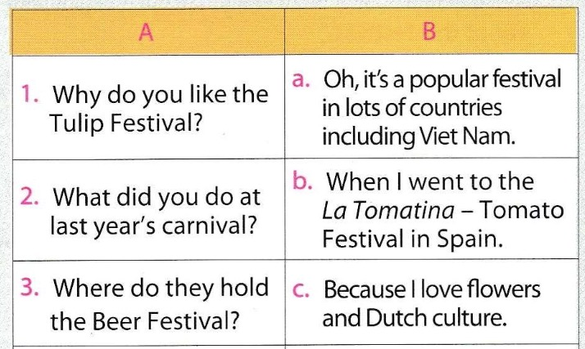
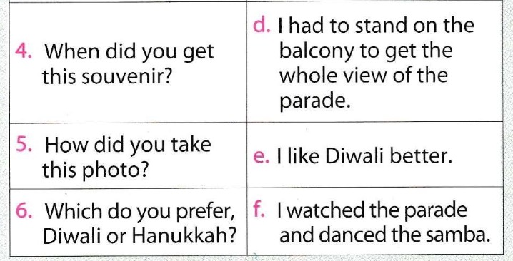

Slide 9

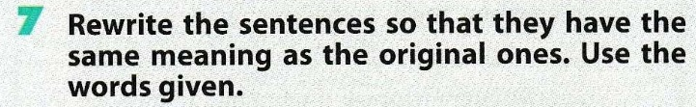
1. The distance from Ha Noi to Can Tho is about 1,877 kilometres. IT
-->
2. What is the distance between Hue and Da Nang? HOW
-->
3. There wasn't much traffic when I was small. USE TO
-->
It’s about 1,877 kilometres from Ha Noi to Can Tho.
How far is it from Hue to Da Nang?
There didn’t use to be many traffic jams/ much traffics when I was small.

Slide 10

4. Although they were tired, they wanted to watch the film. IN SPITE OF
-->
5. The festival took place in a remote area. However, a lot of people attended it. ALTHOUGH
-->
In spite of being tired/ their tiredness, they wanted to watch the film. / .
-They wanted to watch the film in spite of being tired their tiredness.
Although the festival took place in a remote area, a lot of people attended it. / A lot of people attended the festival although it took place in a remote area.

Slide 11

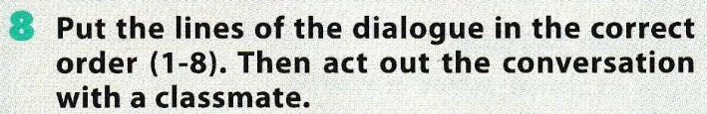
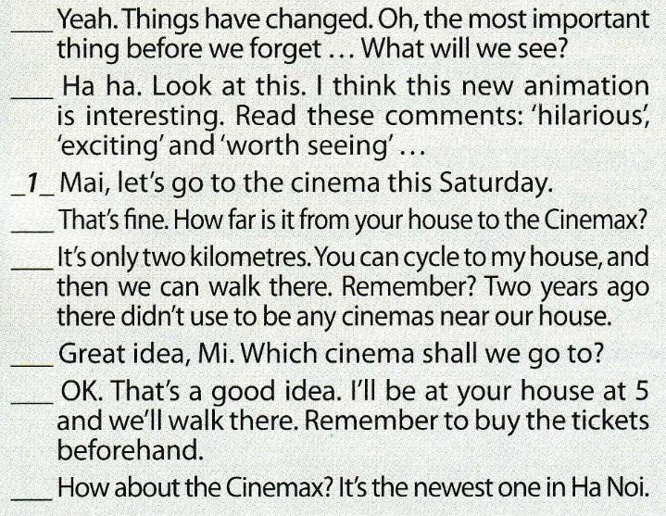
6
7
4
5
2
8
3

Slide 12
Homework
Learn by heart the new words.
Prepare for the next lesson

