Slide 1
I. Wram up and review
Hoàn thành các từ sau.
1.Play ……minton
chess
bad
2.Play ……………
and
with
3.Play hide ……….seek
4.Chat ……………friends

Slide 2
Unit 10. Our break time.
Lesson 2
1. Listen and repeat.
Break Play

Slide 3
Unit 10. Our break time.
Lesson 2
1. Listen and repeat.
Break time! Break time! Break time !
What do you do at …………time?
I play ………. And you ?
I chat . And you ?
I play ………….
Ok ! Ok !
Let’s ………… football.
At break time .
break
chess
football
play

Slide 4
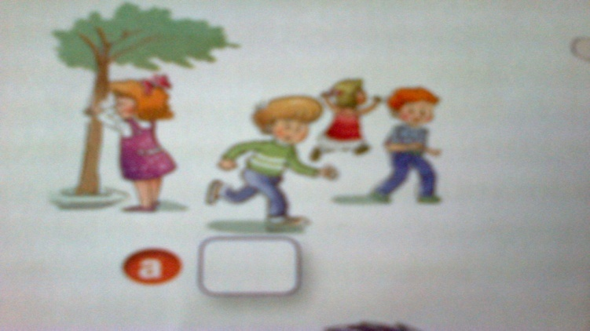
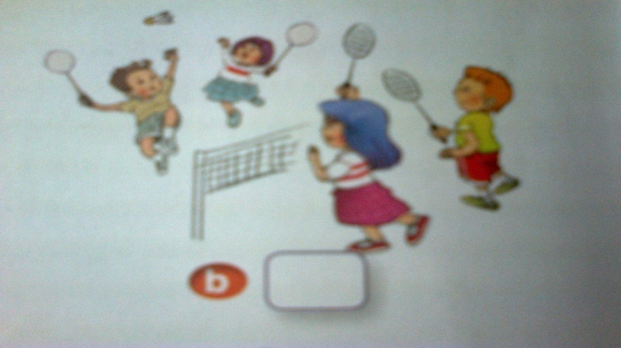
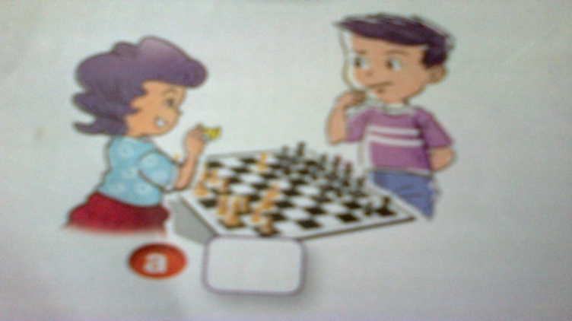
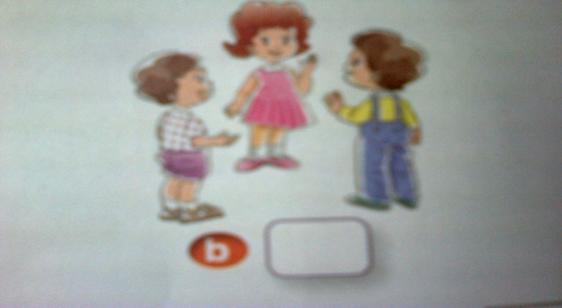
Unit 10. Our break time.
Lesson 2
2. Listen and tick
1
Play hide and seek
Play badminton
2
Play chess
Chat with friends

Slide 5
Unit 10. Our break time.
Lesson 2
2. Listen and tick
1. What do you do at break time?
I play hide and seek.
You play hide and seek?
Yes, I do. (a)
2. What do you do at break time?
I chat with my friends.
You chat with your friends?
Yes, I do. (b)

