Slide 1

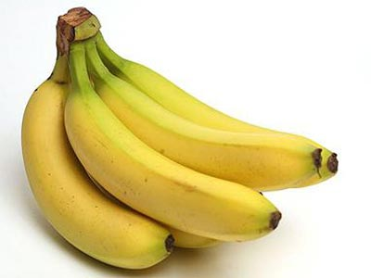
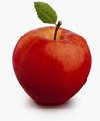
bananas
flowers
apple
1
2
3
4
5
6
8
9
7

Slide 2

RINGING THE GOLDEN BELL
Question1
When________ you born?
A. was
B. were
C. are

Slide 3
RINGING THE GOLDEN BELL
Question 2
When _______ your birthday?
A. am
B. are
C. is

Slide 4
Matching games
A | B
1.How are you? 2.Nice to meet you. 3.Hello 4.What’s your name? | a.Hi b.My name’s Ha. c.I’m fine. d.Nice to meet you, too.

Slide 5
Matching games
A | B
1.How are you? 2.Nice to meet you. 3.Hello 4.What’s your name? | a.Hi b.My name’s Ha. c.I’m fine. d.Nice to meet you, too.

Slide 6
LUCKY NUMBERS
1
2
3
Gr A
Gr B
4
5
6
7
8
9
MARK
MARK

Slide 7
WHAT AND WHERE
RAINY
WINDY
CLOUDY
SUNNY
WEATHER

