Slide 1


Welcome

Slide 2


Warm up and review
Play " Guessing Game"

Slide 3


Congratulation!

Slide 4
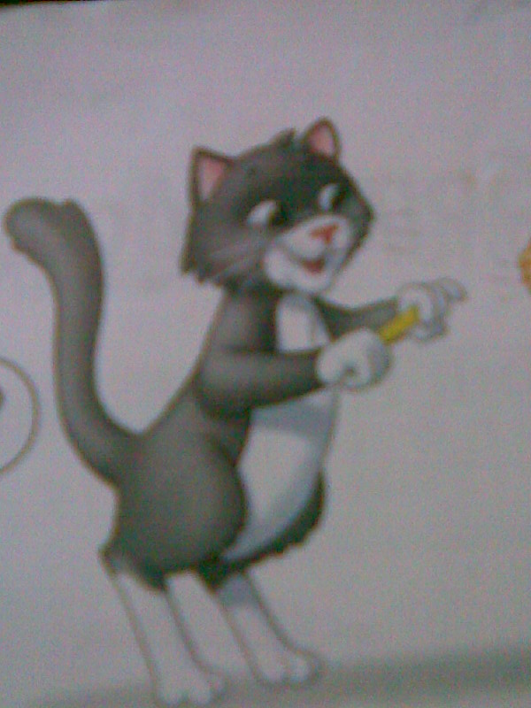

Asking for and responding about the health

Slide 5
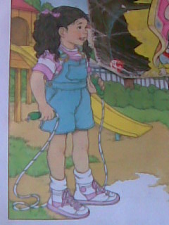
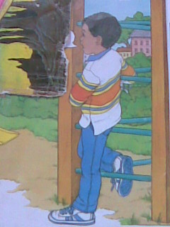

Slide 6

Lesson 18: Let’s talk
Open your books, page 10
Listen the dialogue and look at your book

Slide 7

Listen and repeat

Slide 8
Hi, Andy. How are you?
I’m fine.
How are you?
I’m fine. Thank you.

Slide 9

Introduce the sentence pattern
How are you?
I’m fine. Thank you.

Slide 10
I'm fine
I’m
=
I am
Write down in your notebook

Slide 11
Work in pair.
Practice the dialogue using your real name.

Slide 12

Play a game
Game rules:
There are two groups:
A and B
Each group : Five students
Rearrange the order of words so that we have right sentences.
Which group finishes exactly and quickly is the win

Slide 13


10
9
8
7
6
5
4
3
2
1
TIME UP!

Slide 14
Very good!

Slide 15
Homework
LEARN THE LESSON BY HEART.
PRACTICE TALKING

Slide 16
The End

