Slide 1

Unit 2: My friends
Lesson 4.2
Page 20

Slide 2
Lesson Outline
Warm-up
Practice
Speaking
Consolidation
Wrap-up

Slide 3
Objectives
By the end of this lesson, ﻿students will be able to use polite greetings.
Vocabulary: hi, great, good.
Sentence patterns:
1. How are you?
=> I’m good.
2. It’s nice to meet you.
=> It’s nice to meet you, too.
﻿3. Thank you.
=> You're welcome.

Slide 4

WARM UP

Slide 5
Look and read. Then write the correct sentences.
Click each heart shape to give the question.
1
2
3
4
5
6
Click each question to show the answer.
Click each “NO” icon to hide showed answer.
It’s
how
you?
you?
great,
Do
to
Hi,
and
like
you.
are
you?
I’m
your
meet
How
nice
your
Do
like
are
friends
singing?
friends
drawing?
like
drawing?
Do
you?
Hi,
your
like
you?
It’s
How
singing?
I’m
nice
are
to
and
Do
your
great,
friends
meet
you?
how
friends
are
you.
Notes:
- Click “no” icon to hide showed question and answer.
- divide class into 3-4 groups. Ask ss write the correct sentences on their A4 papers or boards

Slide 6

It’s time to learn …

Slide 7
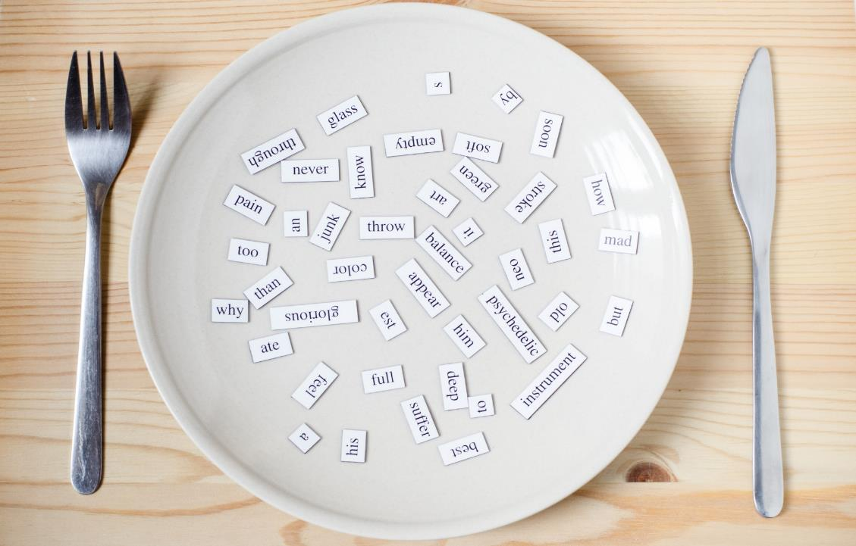
Structures
How are you?
I’m good, and you?
It’s nice to meet you.
It’s nice to meet you, too.
Thank you.
You’re welcome.

Slide 8

Practice

Slide 9

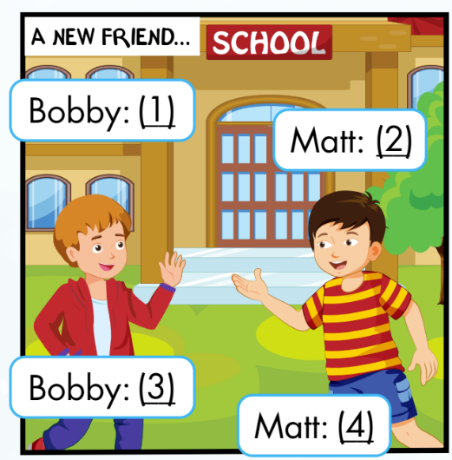
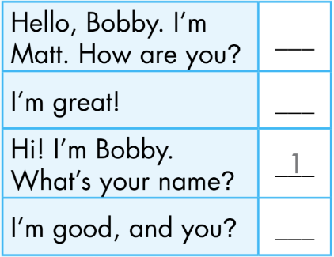
Activity 1
Click the numbers to show the answer
Hi! I’m Bobby.
What’s your name?
Hello, Bobby.
I’m Matt. How are you?
1
2
2
4
Matt
3
I’m good, and you?
I’m great!
4
3
Bobby
Notes:
Set context. Analyze picture.
Ask ss to guess ”what will say next?” and “what will he say?”
Show answer, practice with the whole class.
Explain the using of sentence patterns.
Ask ss practice in pairs and do the roleplay

Slide 10
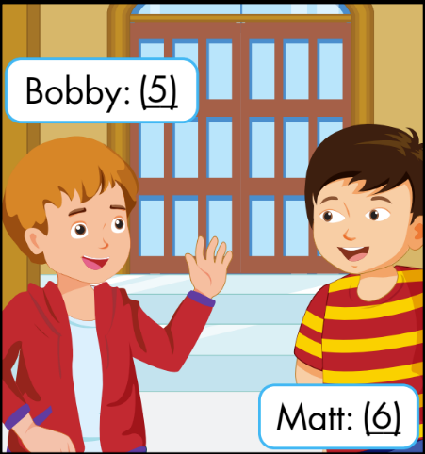
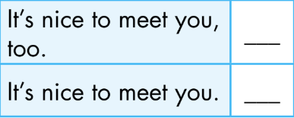
Activity 1
Click the numbers to show the answer
5
It’s nice to meet you.
6
It’s nice to meet you, too.
5
6
Notes:
Set context. Analyze picture.
Ask ss to guess ”what will say next?” and “what will he say?”
Show answer, practice with the whole class.
Explain the using of sentence patterns.
Ask ss practice in pairs and do the roleplay

Slide 11
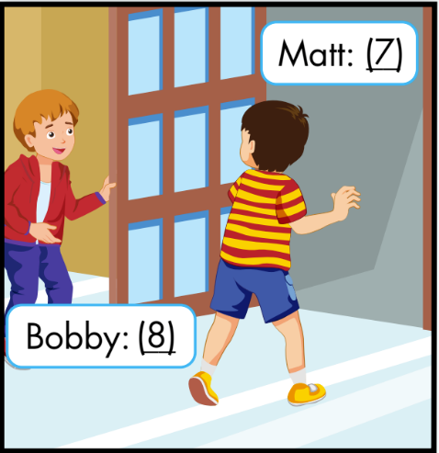

Activity 1
Click the numbers to show the answer
7
Thank you.
You’re welcome.
8
8
7
Notes:
Set context. Analyze picture.
Ask ss to guess ”what will say next?” and “what will he say?”
Show answer, practice with the whole class.
Explain the using of sentence patterns.
Ask ss practice in pairs and do the roleplay

Slide 12


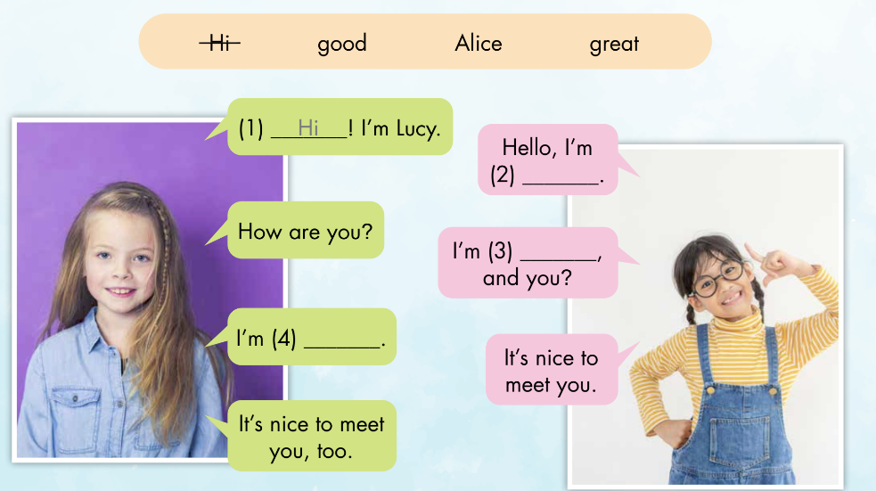
Activity 2
Alice
great
good
Notes:
Analyze pictures
Ask ss guess the words
Listen and check

Slide 13
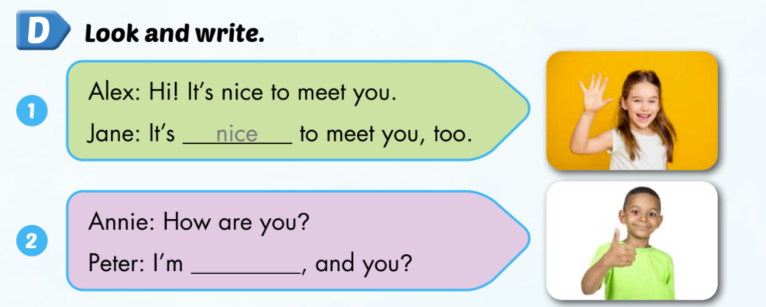
Extra activity
WB P. 15
good

Slide 14
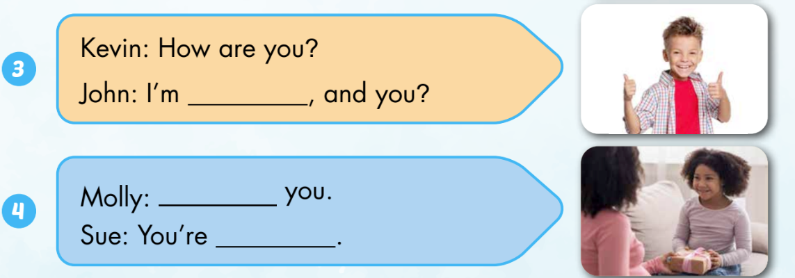
Extra activity
WB P. 15
great
Thank
welcome

Slide 15
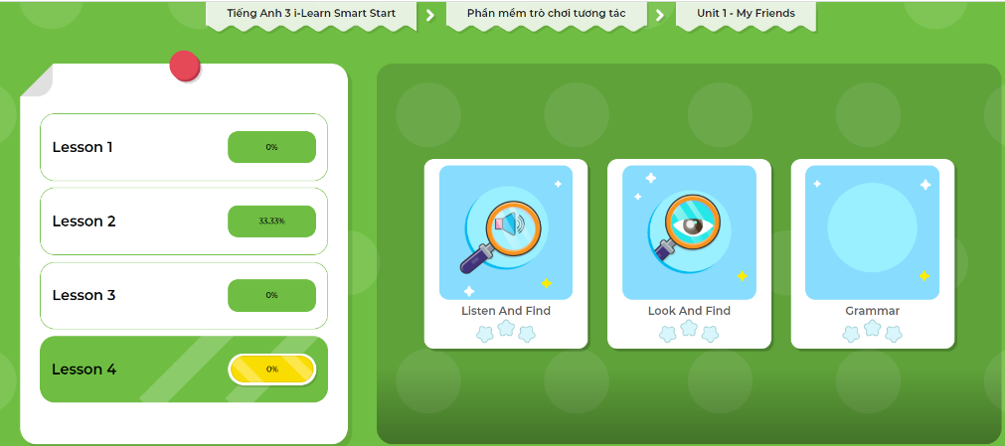
Extra Practice
DHA App
LET’S PLAY!
Click on the picture below

Slide 16

Production

Slide 17



Activity 1
Look and read. Then say the correct answer
How are you?
I’m good, and you?
Tom
Alfie
Notes:
Divide class into groups (depends on T)
Show the question and hint for answering
Ss in groups tic-tac-toe or raise hands (fastest) to get the chance to give the answer

Slide 18
Activity 1
Look and read. Then say the correct answer
It’s nice to meet you.
It’s nice to meet you, too.
Tom
Alfie
Notes:
Divide class into groups (depends on T)
Show the question and hint for answering
Ss in groups tic-tac-toe or raise hands (fastest) to get the chance to give the answer

Slide 19

Activity 1
Look and read. Then say the correct answer
Where are you from?
I’m from the USA.
Tom
Alfie
Notes:
Divide class into groups (depends on T)
Show the question and hint for answering
Ss in groups tic-tac-toe or raise hands (fastest) to get the chance to give the answer

Slide 20
Activity 1
Look and read. Then say the correct answer
Thank you.
You’re welcome.
Tom
Alfie
Notes:
Divide class into groups (depends on T)
Show the question and hint for answering
Ss in groups tic-tac-toe or raise hands (fastest) to get the chance to give the answer

Slide 21

Activity 1
Look and read. Then say the correct answer
Do your friends like singing?
Yes, they do.
Tom
Alfie
Notes:
Divide class into groups (depends on T)
Show the question and hint for answering
Ss in groups tic-tac-toe or raise hands (fastest) to get the chance to give the answer

Slide 22

Activity 1
Look and read. Then say the correct answer
How are you?
I’m great, and you?
Tom
Alfie
Notes:
Divide class into groups (depends on T)
Show the question and hint for answering
Ss in groups tic-tac-toe or raise hands (fastest) to get the chance to give the answer

Slide 23
Activity 2
Speaking: Joining a school play.
Scene 1: Imagine you go to a campsite and meet new friends.
Student A
Student B
1. Hi! I’m … .
What’s your name?
1. Hello, … .
I’m … . How are you?
2. I’m …, and you?
2. I’m … .
It’s nice to meet you.
3. It’s nice to meet you, too.
Notes:
Pairs work

Slide 24
Activity 2
Speaking: Joining a school play.
Scene 2: Imagine someone helps you with your bags/ open the door.
Student A
Student B
Thank you.
You’re welcome.
Notes:
Pairs work

Slide 25

CONSOLIDATION

Slide 26
Extra Practice
DHA App
LET’S PLAY!
Click on the picture below

Slide 27
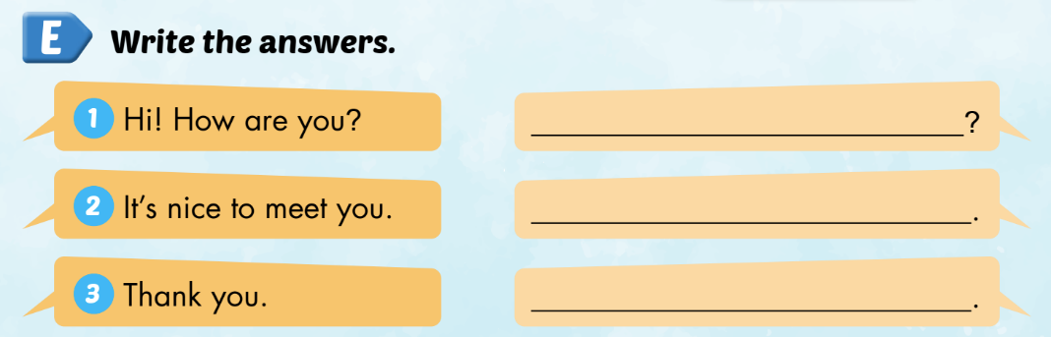
Let students write their own answers on their notebooks.

Slide 28

WRAP-UP

Slide 29

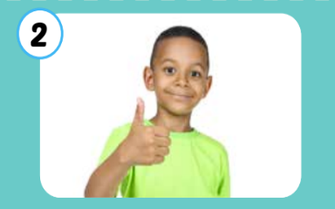

Vocabulary
hi
good
great

Slide 30
Sentence patterns
How are you?
I’m good, and you?
It’s nice to meet you.
It’s nice to meet you, too.
Thank you.
You’re welcome.

Slide 31
Lesson 3
Homework
Practice vocabularies and structure. Make sentences using them.
Do the exercises in Tiếng Anh 3 i-Learn Smart Start Workbook (page 15)
Practice the vocabulary and structure in Tiếng Anh 3 i-Learn Smart Start Notebook (page 13)
Play the consolidation games in Tiếng Anh 3 i-Learn Smart Start DHA App on www.eduhome.com.vn
Prepare the next lesson (page 21)

Slide 32
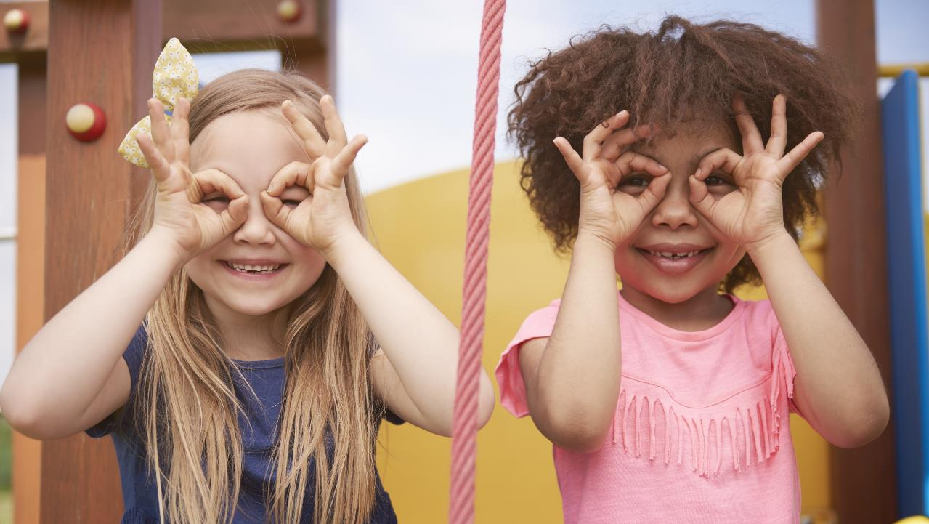
Enjoy your day!

