Slide 1
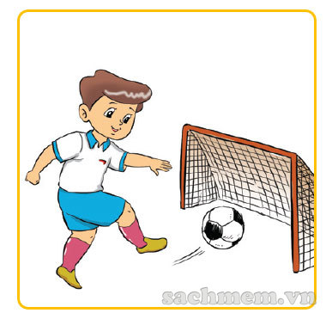
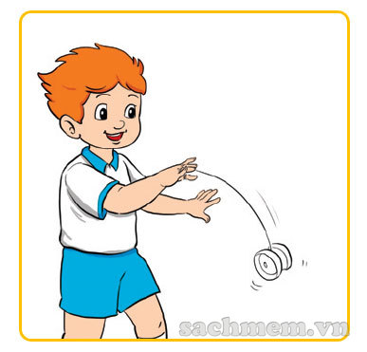
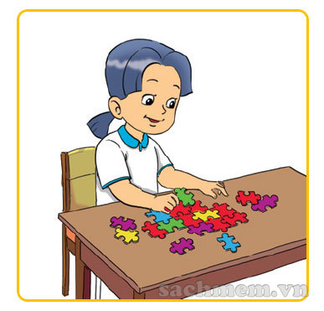
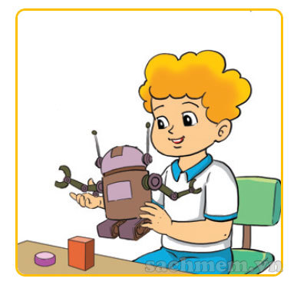
4. LISTEN AND NUMBER
1
3
4
2
3
1
2
4
C
D

Slide 2
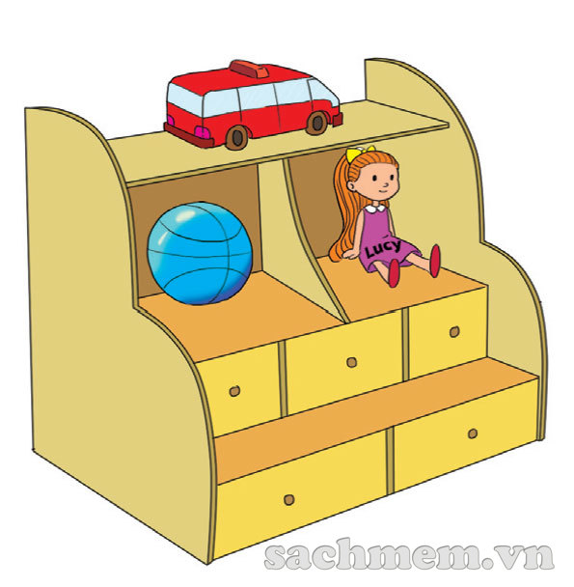
5. READ & WRITE
My toys These are my toys on the shelf.
I have a (1) . It is red.
I have a (2) ball. It is blue.
And I have a pretty (3) .
It is Lucy. I like my toys
very much. (4) you have
any toys? What are (5) ?
car
doll
Do
they

Slide 3
Wednesday, March 9th, 2022
Unit 15: Do you have any toys?
Lesson 1
New words:
A doll: 1 con búp bê
A car: 1 cái xe ô tô
A robot: 1 con rô bốt
A puzzle: 1 bộ xếp hình
Teddy bear: con gấu bông
Toys: những thứ đồ chơi
2. Model sentences:
A: Do you have any toys?
B: Yes, I do. / No, I don’t.
A: Do you have a car?
B: Yes, I do. / No, I don’t.

Slide 4
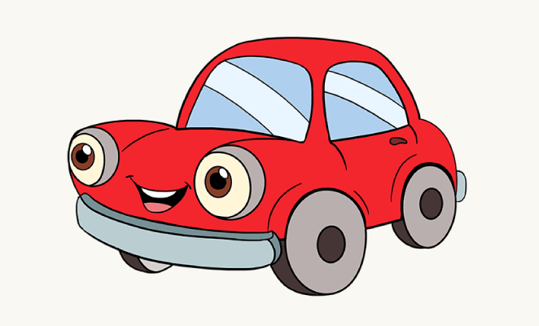
LET’S WRITE
1. Do you have a doll/ car/ teddy bear?
→
2. What colours are your toys?
→
3. Where’s your doll/ car/ teddy bear?
→
Yes, I do or No, I don’t
They’re red/ blue/ yellow …
It’s …

Slide 5
LET’S PLAY!

Slide 6
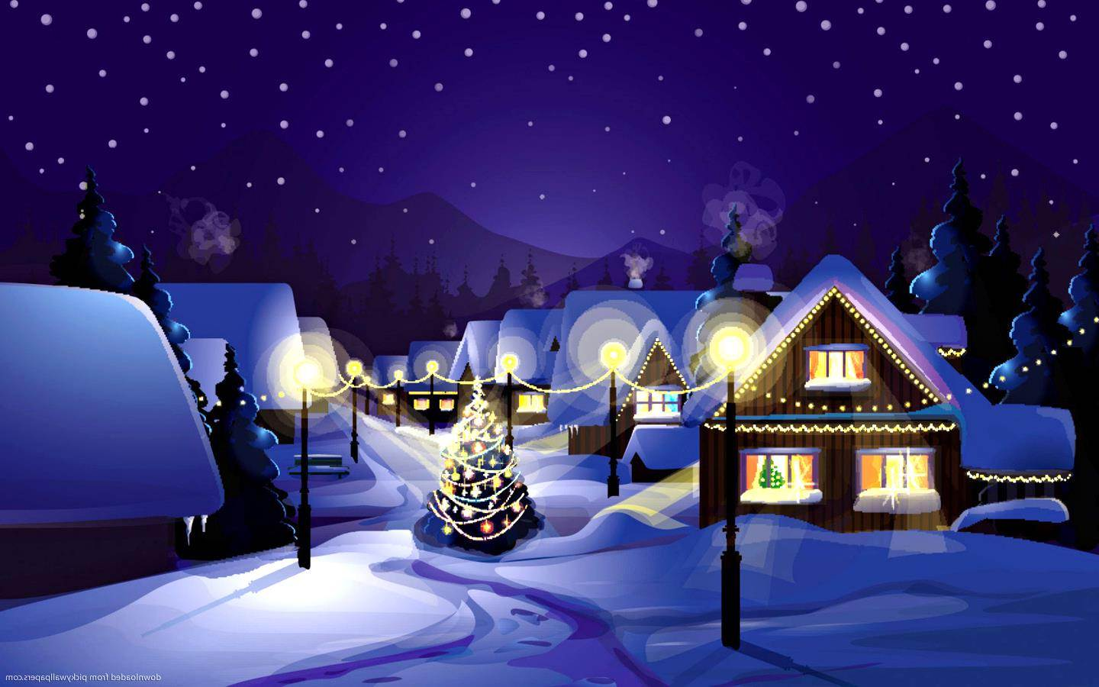
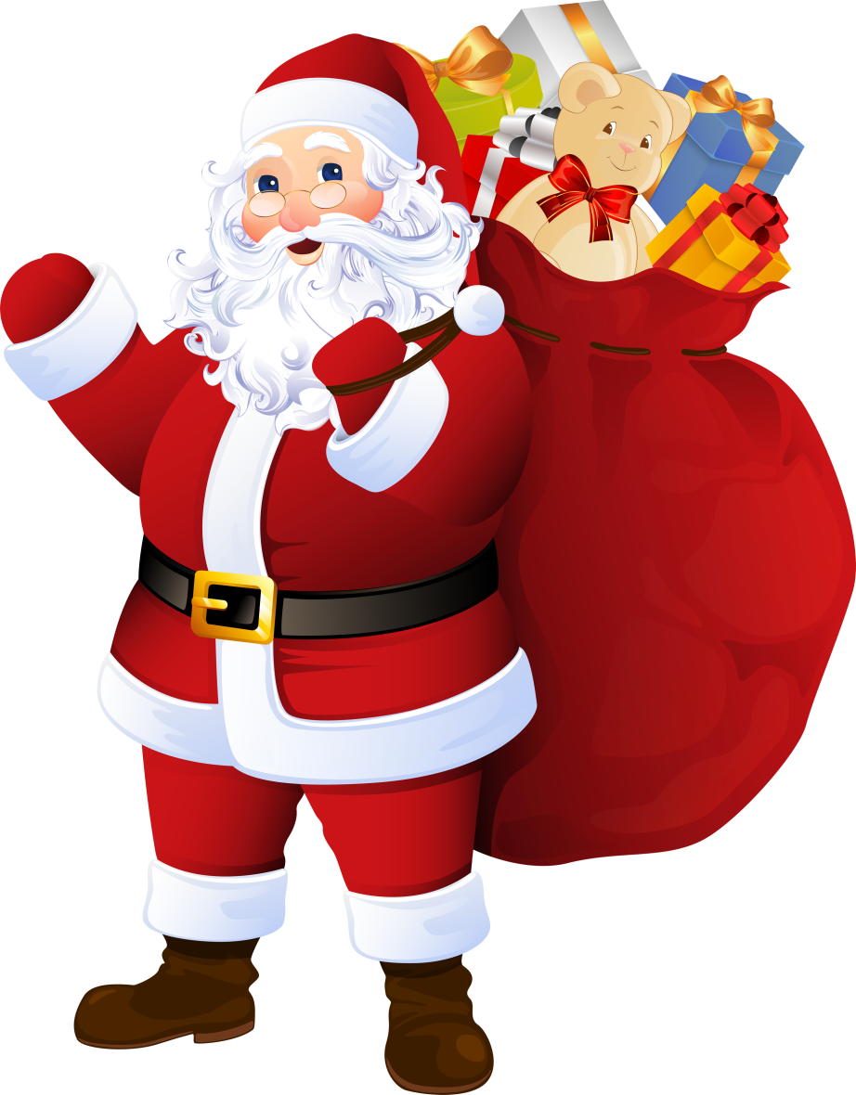

Slide 7
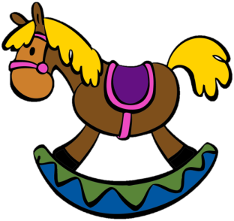
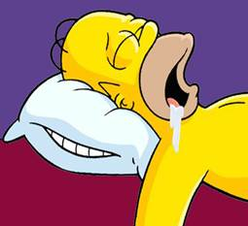
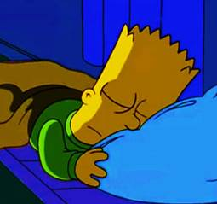
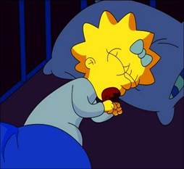
CAR
Homer
Bart
Maggie
NEXT

Slide 8
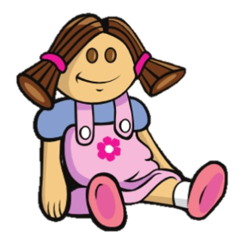
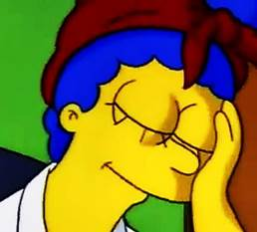
DOLL
Lisa
Marge
Maggie
NEXT

Slide 9
TEDDY BEAR
Homer
Bart
Maggie
NEXT

Slide 10
ROBOT
Maggie
Homer
Lisa
NEXT

Slide 11
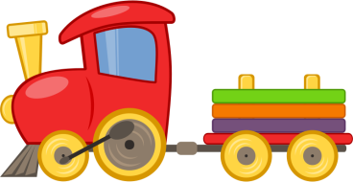
BALL
Homer
Bart
Marge
NEXT

Slide 12
PUZZLE
Homer
Bart
Maggie
NEXT

Slide 13
DOLL
Lisa
Marge
Maggie
NEXT

Slide 14
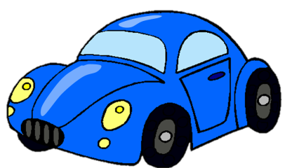
TEDDY BEAR
Homer
Bart
Maggie
NEXT

Slide 15
ROBOT
Homer
Bart
Marge
NEXT

Slide 16
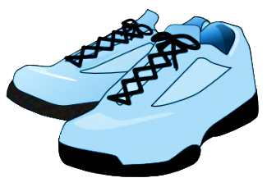
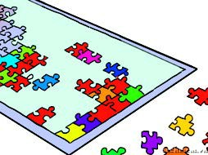
PUZZLE
Homer
Bart
Maggie
NEXT

Slide 17
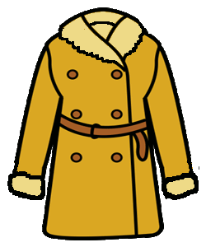
TEDDY BEAR
Lisa
Marge
Maggie
NEXT

Slide 18
BALL
NEXT
Homer
Bart
Maggie

Slide 19
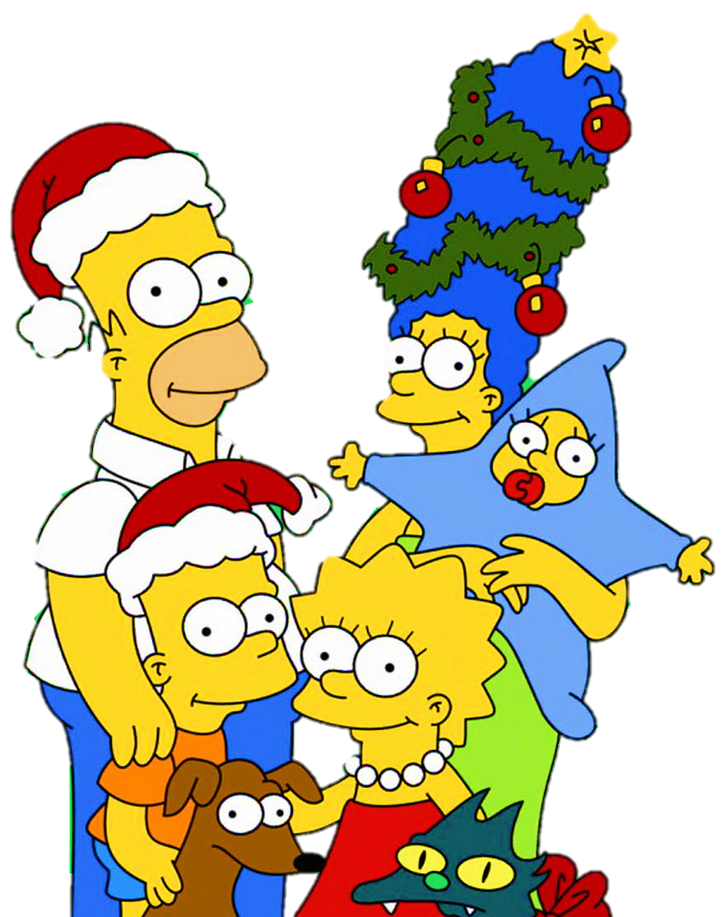

Slide 20
