Slide 1
Unit 10
What do you do at break time?
Lesson 1

Slide 2
VOCABULARY

Slide 3
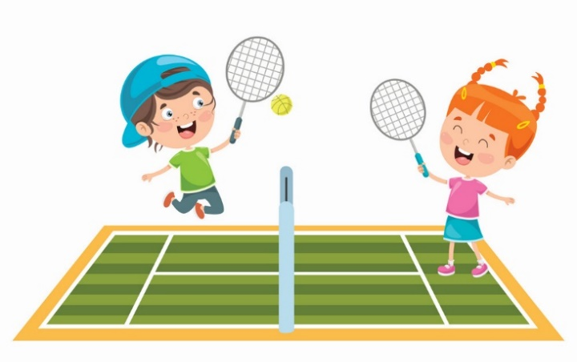
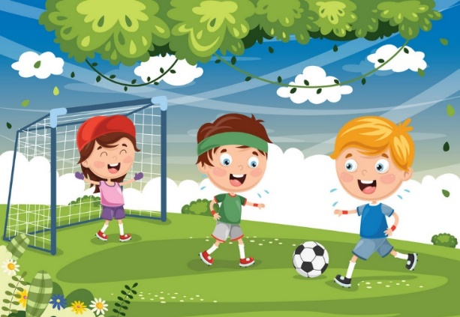
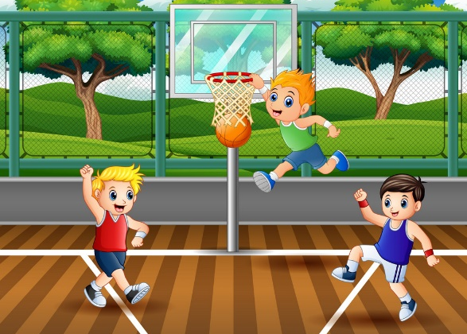
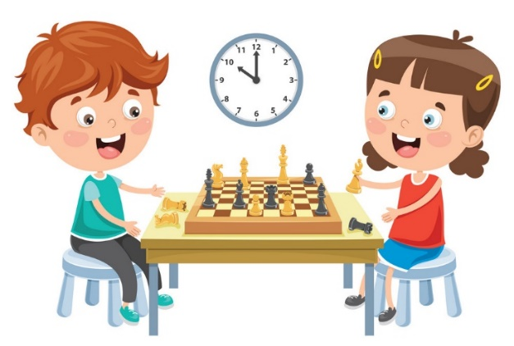
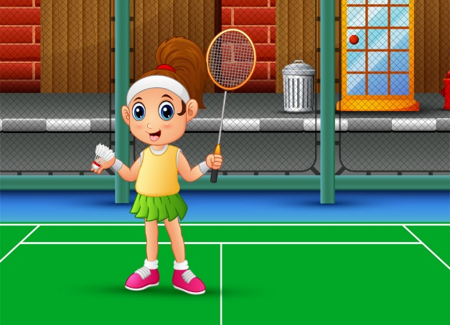
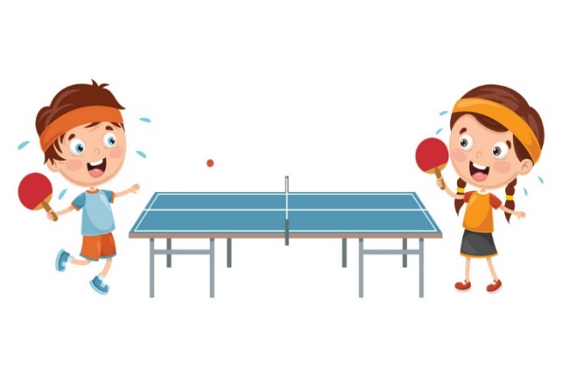
Vocabulary
tennis
football
basketball
chess
badminton
table tennis

Slide 4
GRAMMAR

Slide 5
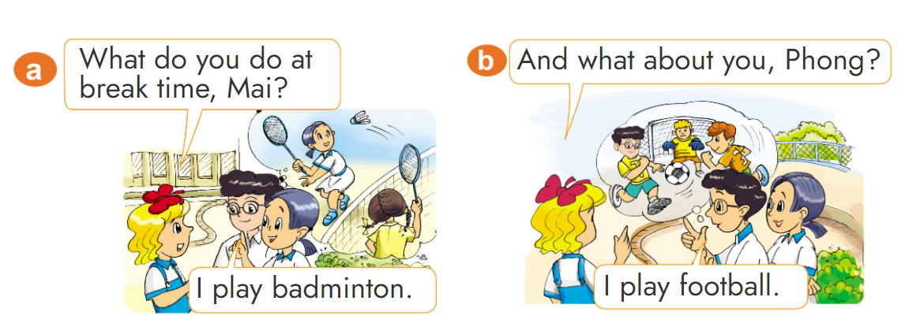
1. Look, listen and repeat.

Slide 6
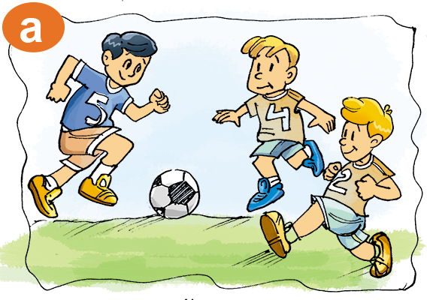
2. Point and say
What do you do at break time?
I play football.

Slide 7
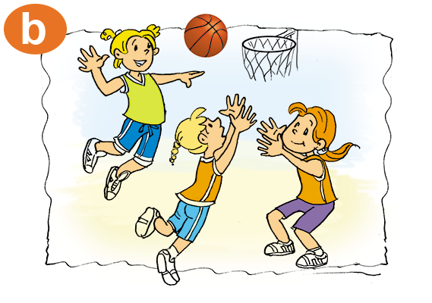
2. Point and say
What do you do at break time?
I play basketball.

Slide 8
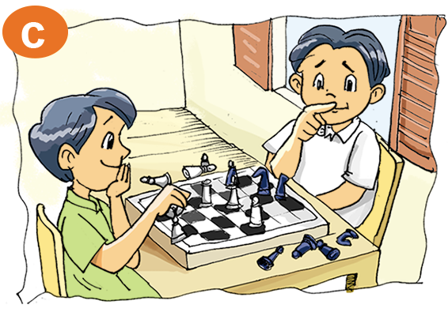
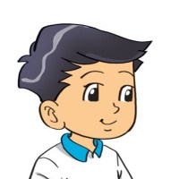
2. Point and say
What do you do at break time?
I play chess.

Slide 9
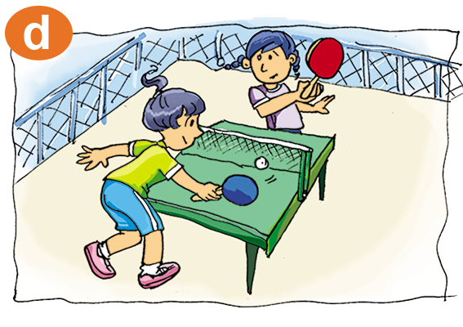
2. Point and say
What do you do at break time?
I play table tennis.

Slide 10
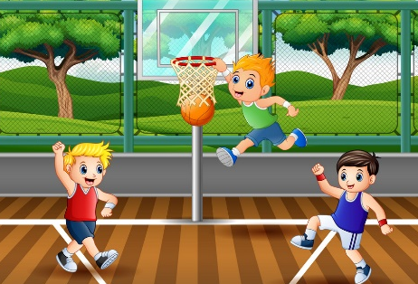
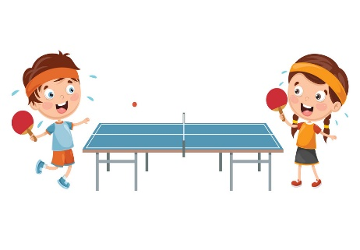
Structure
What do you do at break time?
(Bạn làm gì vào giờ ra chơi?)
I play _______.
(Tớ chơi _____.)
basketball
chess
tennis
badminton
table tennis
football

Slide 11
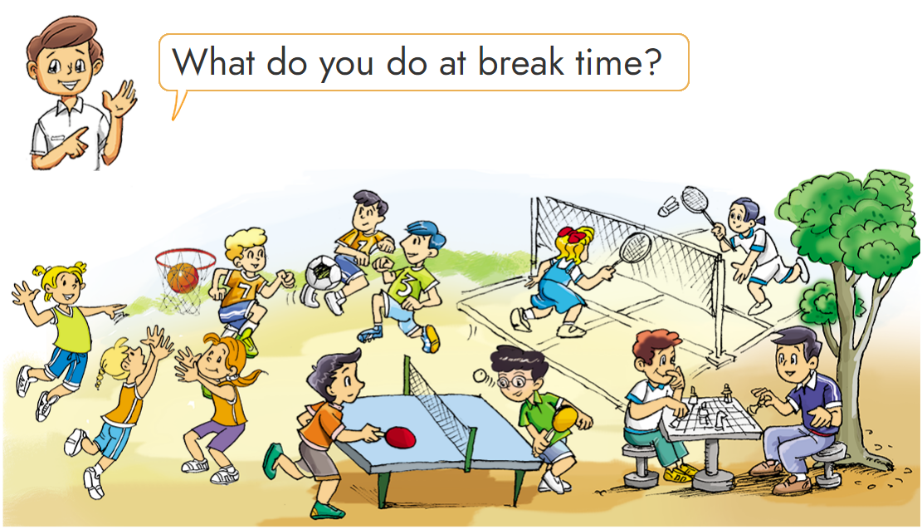
3. Let’s talk
4
1
2
5
3

Slide 12
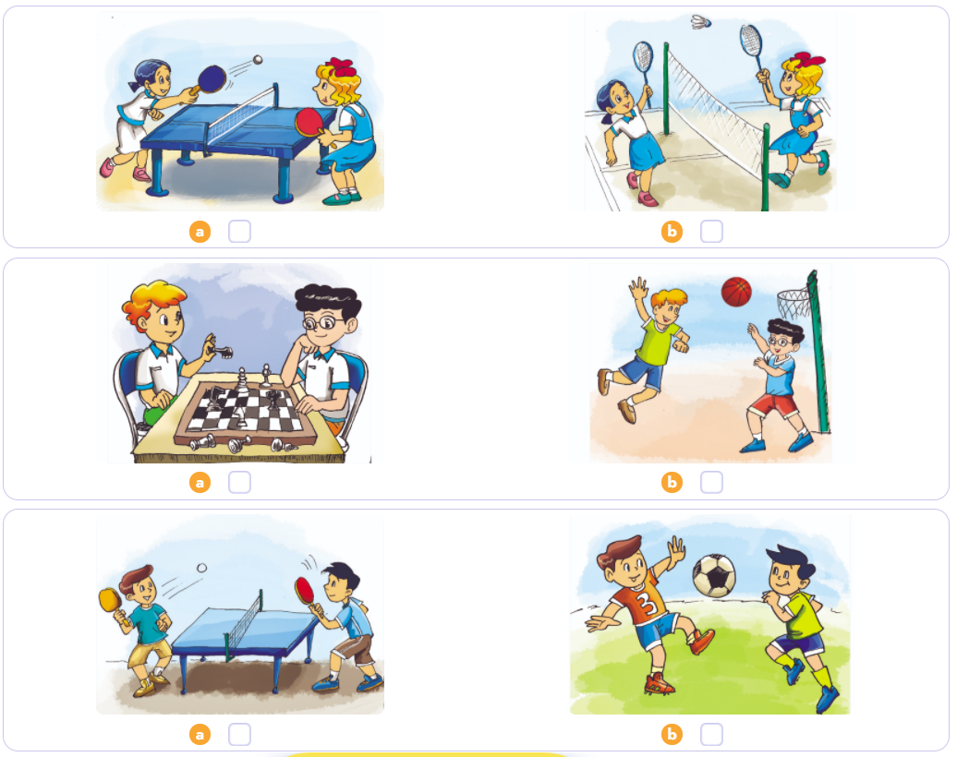
4. Listen and tick
1
2
3

Slide 13
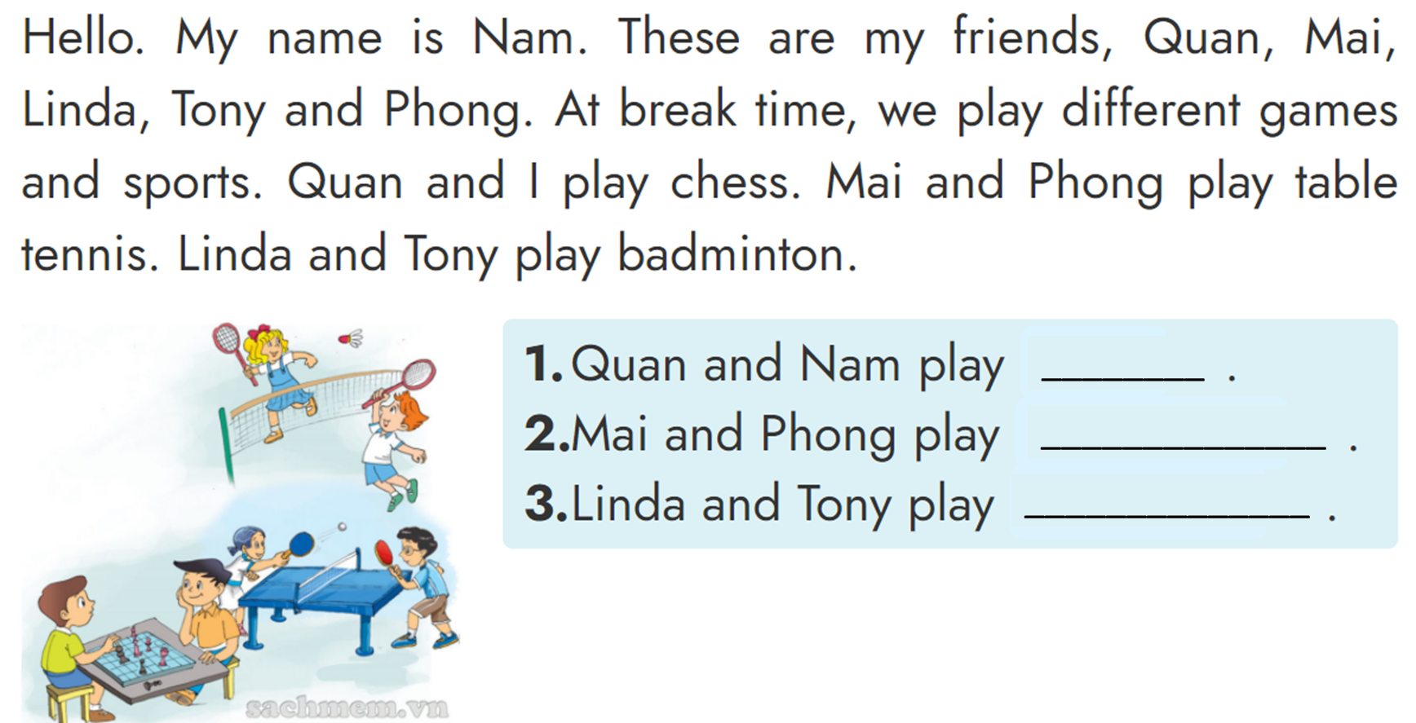
5. Look, read and write.
chess
table tennis
badminton

Slide 14
6. Let's write
What do you play at break time? I play __________________.

