Slide 1
Unit 13
WHAT DO YOU DO
IN YOUR FREE TIME?
Lesson 1

Slide 2
Vocabulary

Slide 3
Vocabulary
surf the Internet
/sɜːf ði: ˈɪntəˌnɛt/

Slide 4
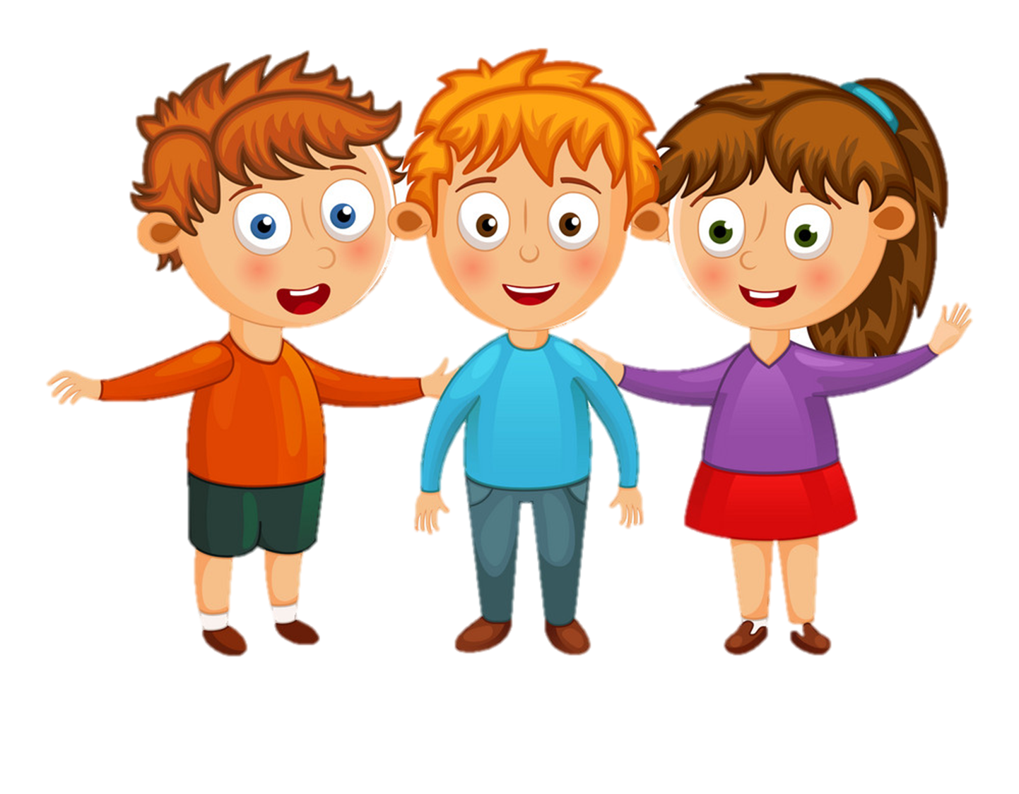
Vocabulary
go to the cinema
/gəʊ tə ðə ˈsɪnəmə/

Slide 5
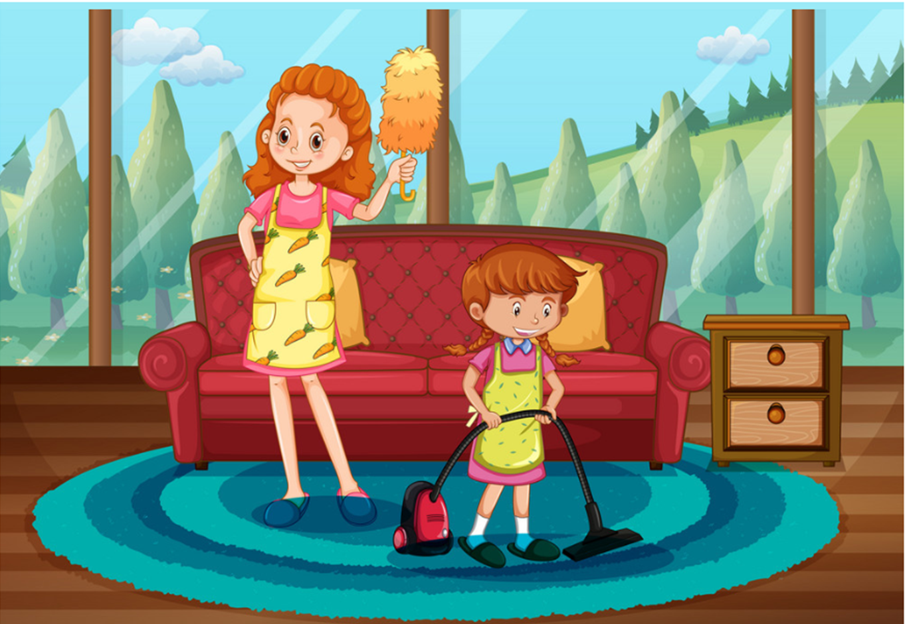
Vocabulary
clean the house
/kliːn ðə haʊs/

Slide 6
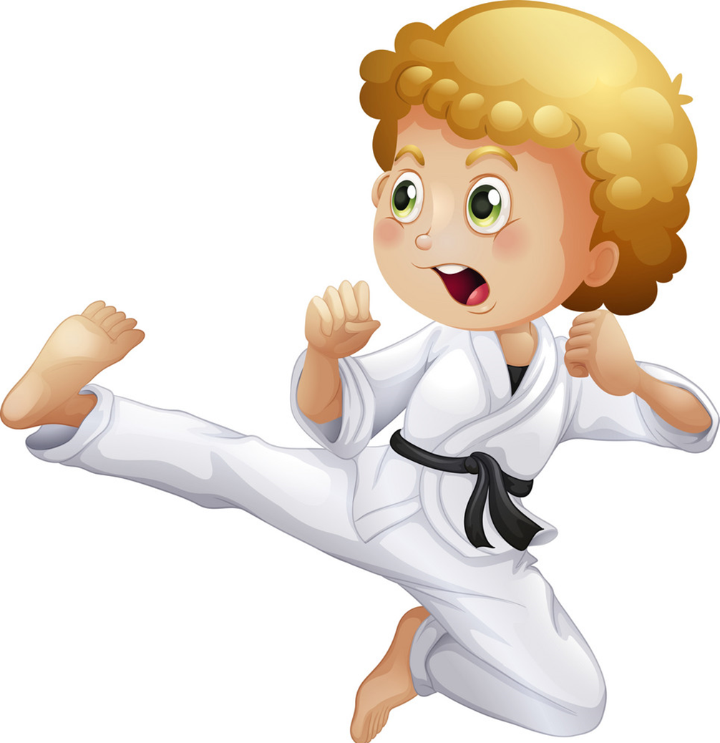
Vocabulary
do karate
/dʊ kəˈrɑːti/

Slide 7
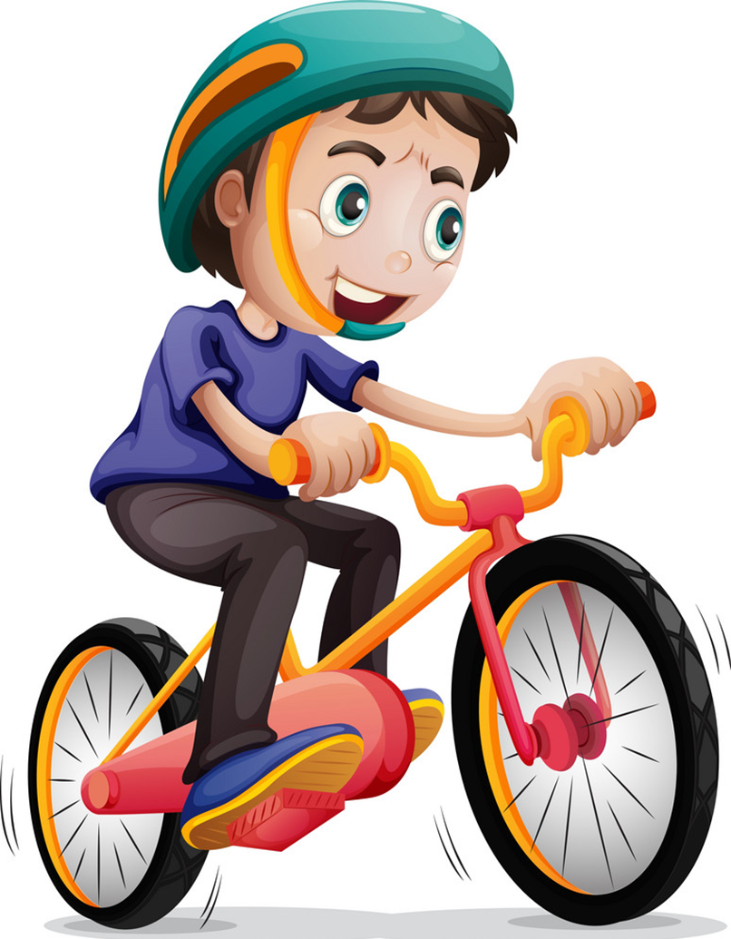
Vocabulary
ride my bike
/raɪd maɪ baɪk/

Slide 8
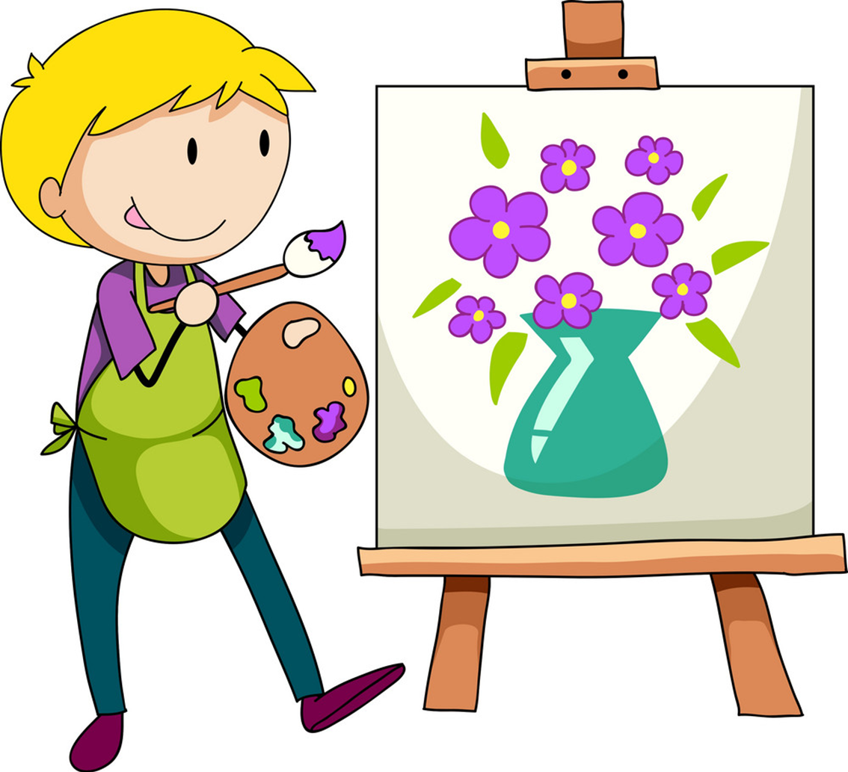
Vocabulary
draw pictures
/drɔ ˈpɪkʧərz/

Slide 9
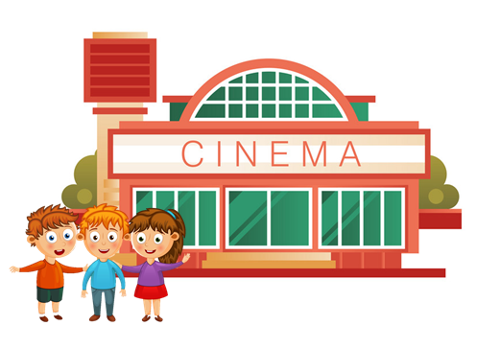
Vocabulary
surf the Internet
clean the house
ride my bike
do karate
go to the cinema
draw pictures

Slide 10
Grammar

Slide 11
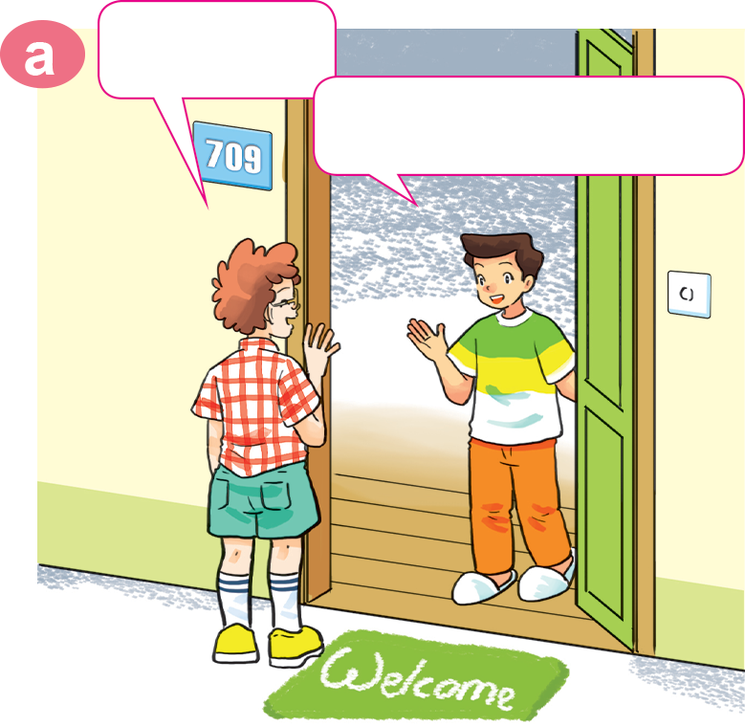
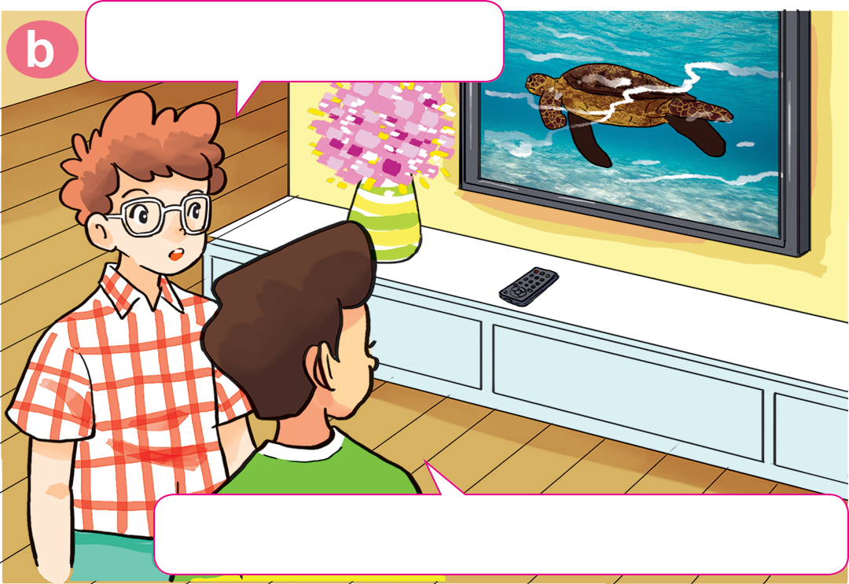
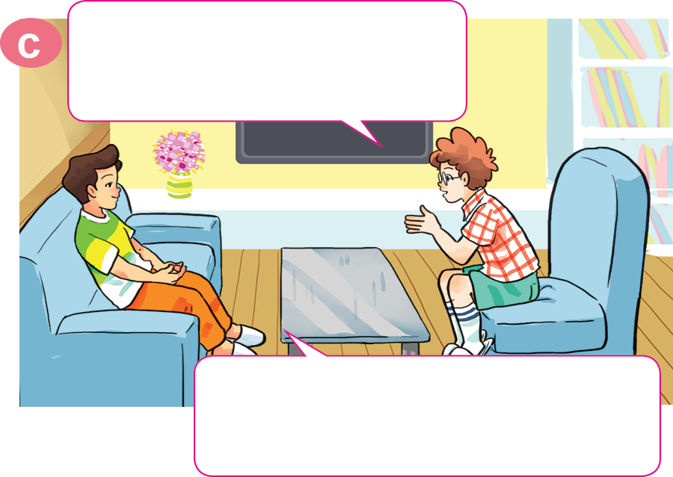
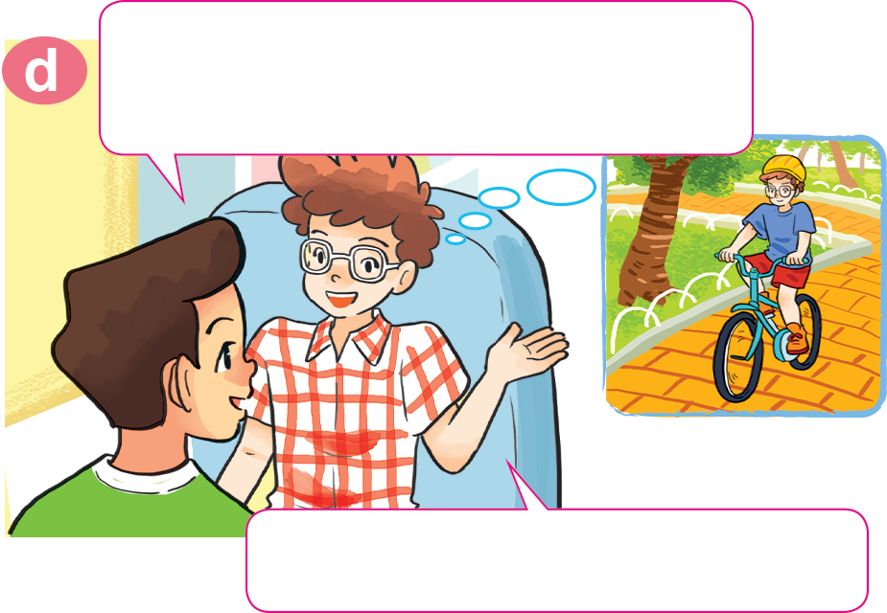
1. Look, listen and repeat
Hi, Nam.
What are you doing?
Hi, Tom. Come in.
I'm watching The World of Animals.
Do you like watching animal programmes?
What about you? What do you do in your free time?
Yes. I often watch them in my free time.
I ride my bike in the park.

Slide 12
Model sentence
What do you do in your free time?
I ______________________.
ride my bike
surf the Internet
do karate
draw pictures
clean the house
go to the cinema

Slide 13
2. Point and say.
What do you do in your free time?
surf the Internet
I ______________________.

Slide 14
2. Point and say.
What do you do in your free time?
go to the cinema
I ______________________.

Slide 15
2. Point and say.
What do you do in your free time?
clean the house
I ______________________.

Slide 16
2. Point and say.
What do you do in your free time?
do karate
I ______________________.

Slide 17
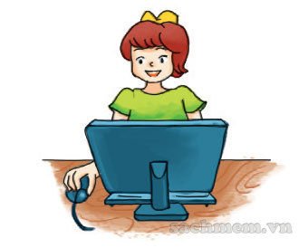
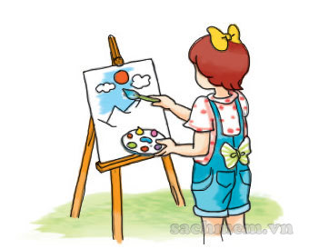
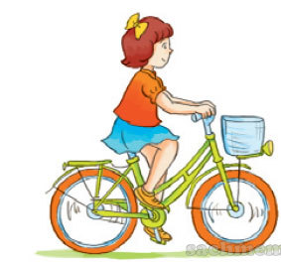
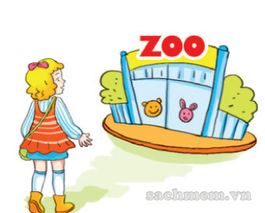
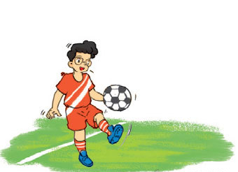
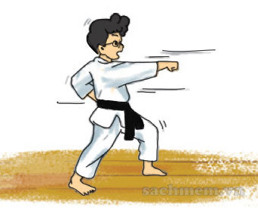
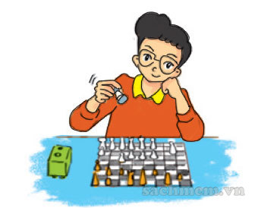
4. Listen and tick.
a
b
c
✓
a
b
c
✓
a
b
c
✓

Slide 18
5. Read and complete
Twice
songs
free
go
watch
Hoa: What do you do in your (1) ______ time, Quan?
Quan: I often (2) ______ sports programmes on TV.
What about you, Hoa?
Hoa: I (3) ______ to the music club with my friends.
Quan: How often do you go to the music club?
Hoa: (4) ______ a week.
Quan: What do you do there?
Hoa: I dance and sing (5) ______.
free
watch
go
Twice
songs

Slide 19
6. Let’s play.

Slide 20
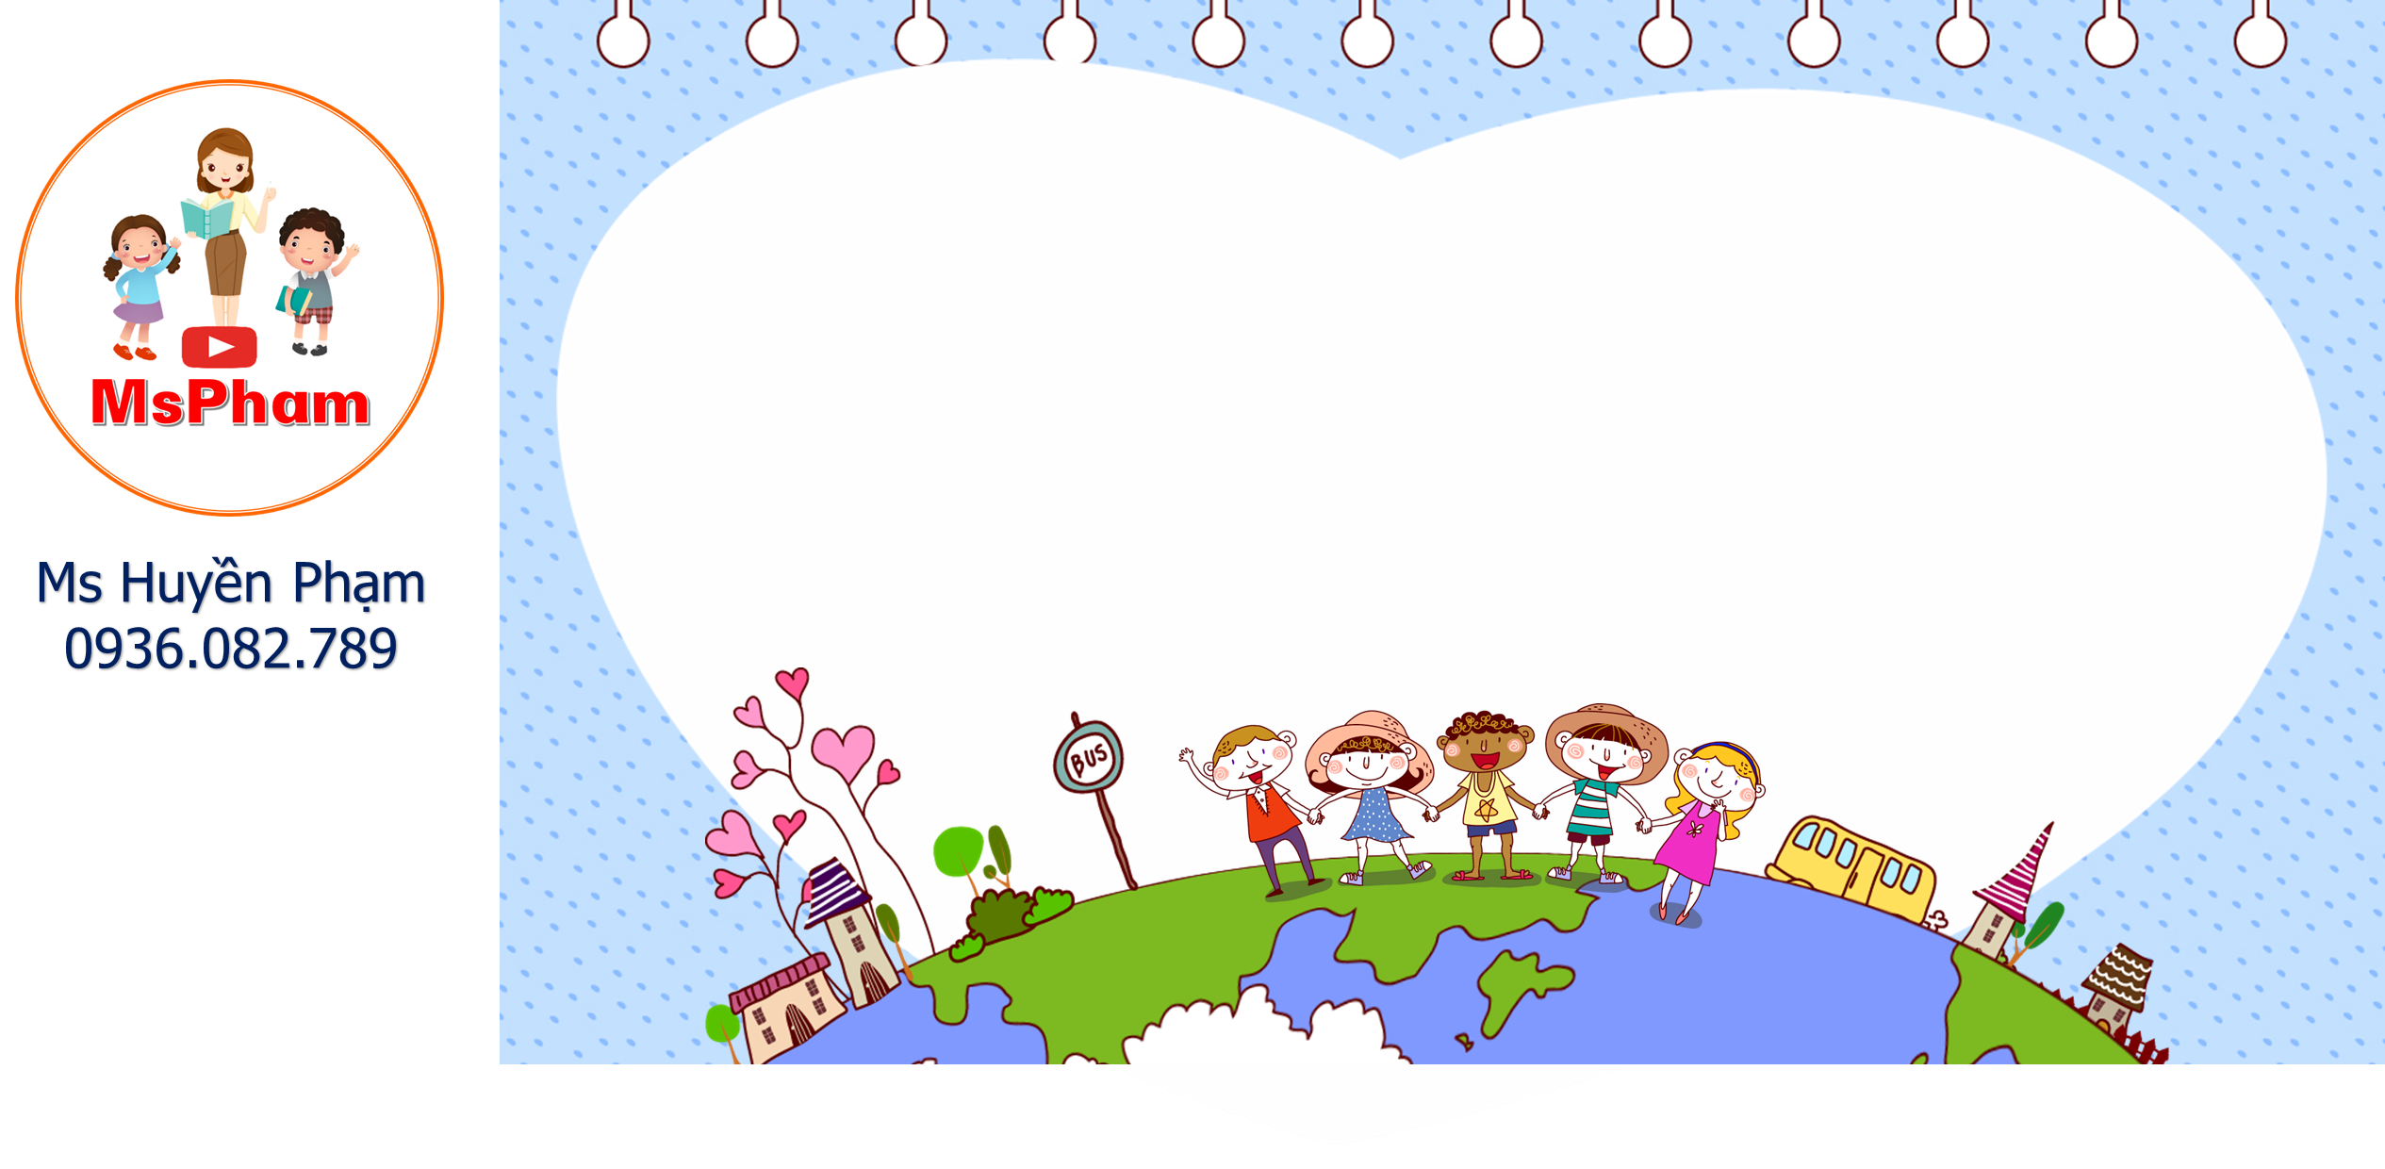
_{Green} Earth
PLAY

Slide 21
What do you do in your free time?
surf the Internet
Go to the cinema
Go to the zoo

Slide 22
What do you do in your free time?
Go to the cinema
Go to the library
Go to the zoo

Slide 23
What do you do in your free time?
Surf the Internet
Ride my bike
Do karate

Slide 24
What do you do in your free time?
do karate
draw pictures
clean the house

Slide 25
What do you do in your free time?
surf the Internet
draw pictures
do karate

Slide 26
What do you do in your free time?
go to the cinema
do karate
clean the house

Slide 27
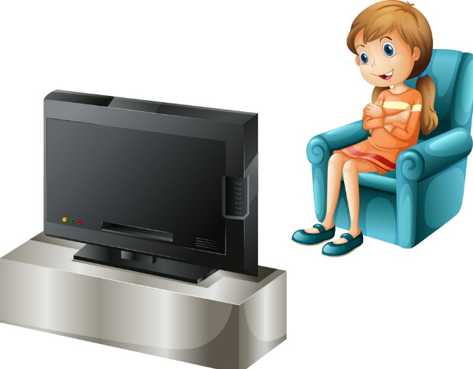
What do you do in ____ free time?
I watch TV.
his
your
her

Slide 28
What ____ you do in your free time?
I surf the Internet.
are
does
do

