Slide 1
UNIT 12. DON’T RIDE YOUR BIKE TOO FAST!
LESSON 1

Slide 2
Play with the knife

Slide 3
Play with matches

Slide 4
Ride your bike too fast

Slide 5
Climb the tree

Slide 6
Run down the stairs

Slide 8
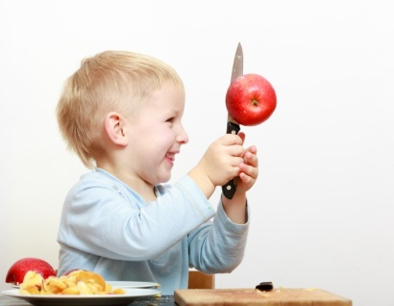
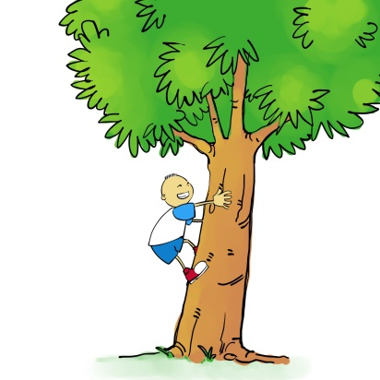
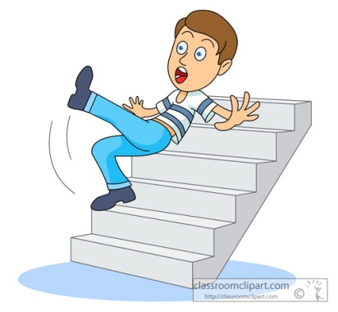
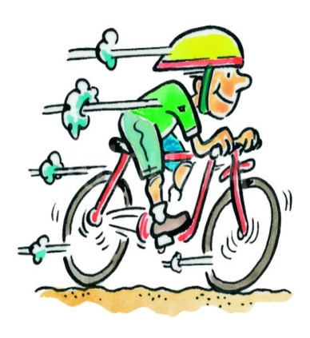
1. Vocabulary
- play with the knife
- play with matches
- ride your bike too fast
- climb the tree
- run down the stairs
2. Model sentence
Don’t ride your bike too fast.
OK, I won’t.

