Slide 1
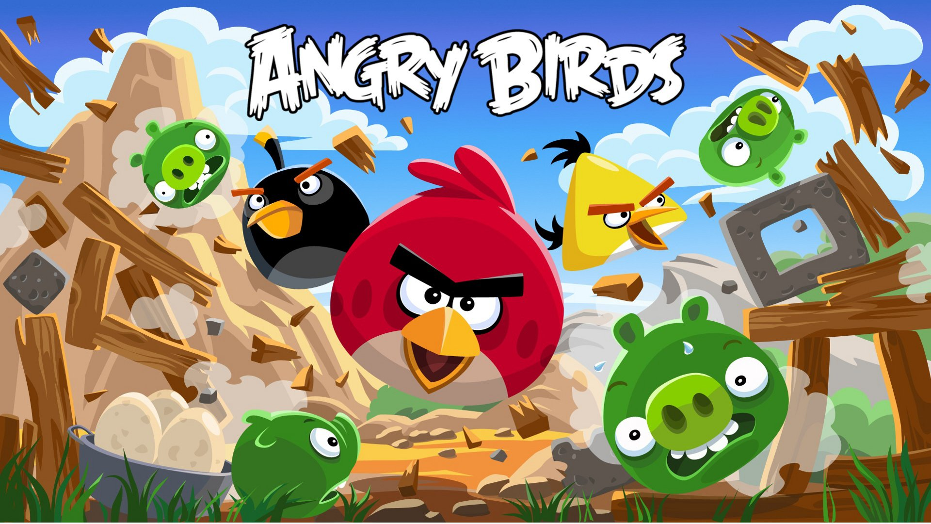

Slide 2
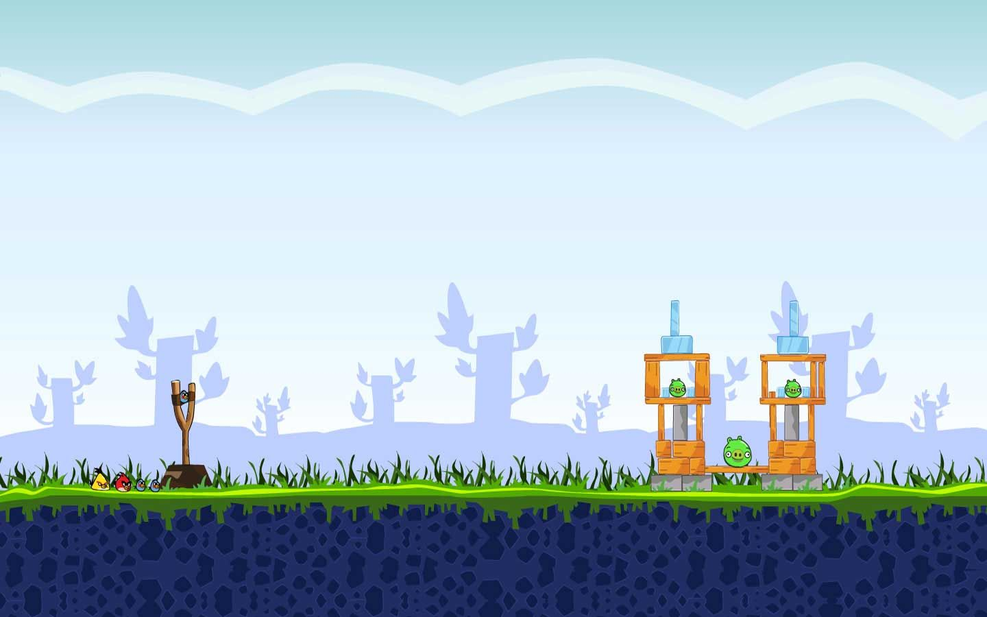
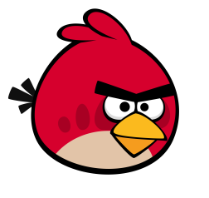
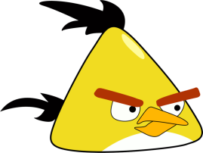




1
2
3
4
5
6
7
8
9
10

Slide 3





2. I haven’t got ___ dog
D
A. a
B. an
C. some
D. any

Slide 4

1. I want _____ watermelon.
C
A. some
B. any
C. a
D. an

Slide 5



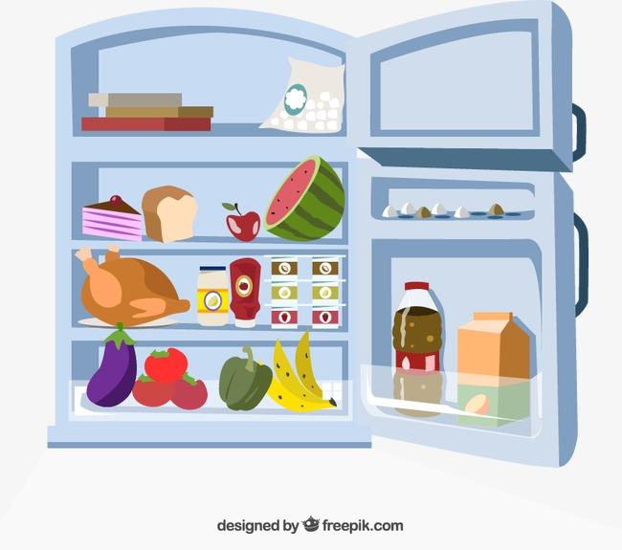
3. Find the WRONG sentence.
B
A. There are some tomatoes
B. There is a cake
C. There aren’t any chickens
D. There is an apple

Slide 6






4. is looking for ____
B
A. any
B. some
C. a
D. an

Slide 7
5. Here are any letters for you.
any => some
Correct
Incorrect

Slide 8
6. Can I have _____ apples, please?
B
A. any
B. some
C. an
D. a

Slide 9

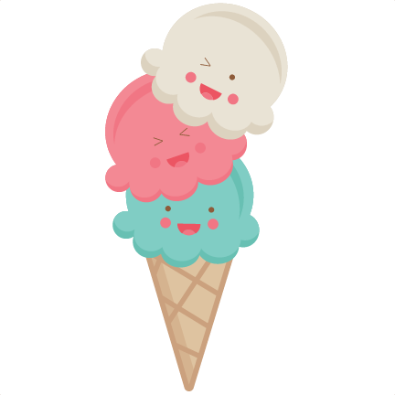
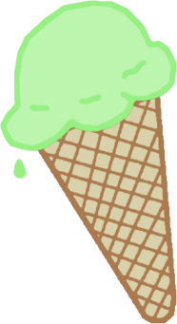


7. Make a sentence
want/ice-creams
She wants some ice-creams.

Slide 10
8. Is there ____ orange juice?
D
A. some
B. an
C. a
D. any

Slide 11
9. There’s __ egg in the fridge
C
A. a
B. some
C. an
D. any

Slide 12
10. We’ve got ____ sandwiches for lunch.
A
A. some
B. a
C. any
D. an

