Slide 1
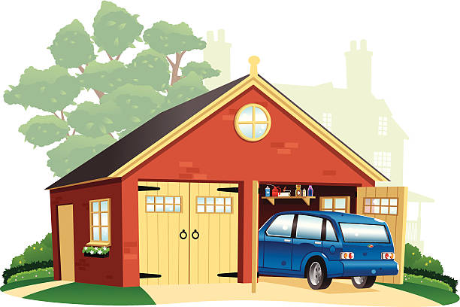
GARAGE
SHOW

Slide 2
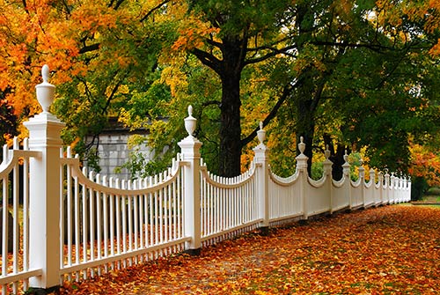
FENCE
SHOW

Slide 3
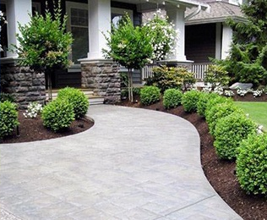
YARD
SHOW

Slide 4
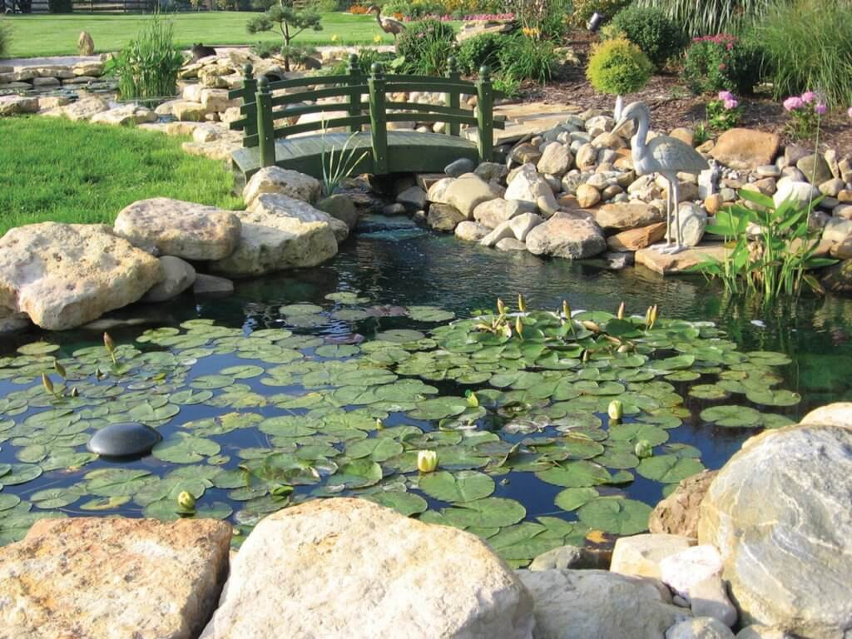
POND
SHOW

Slide 5
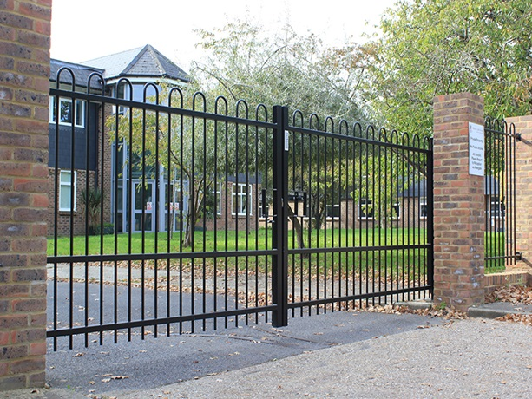
GATE
SHOW

