Slide 1

Unit 1: My friends
Lesson 1.1
Page 10

Slide 2

WARM UP

Slide 3

It’s time to learn …

Slide 4
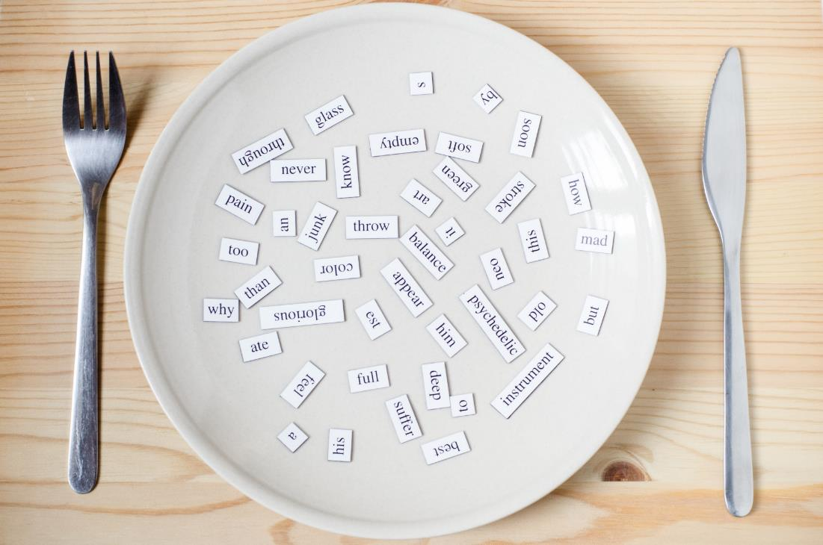
New words
The alphabet
A B C...
New words
The alphabet
A B C...

Slide 5

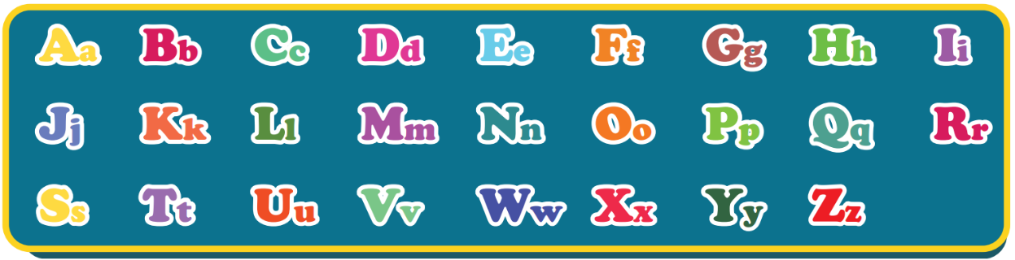
The Alphabet Song

Slide 6
Act1. Heads up. What’s missing?
Aa
Bb
Cc
Dd
Ee
Ff
Gg
Hh
Ii
Jj
Kk
Ll
Mm
Nn
Oo
Pp
Qq
Rr
Ss
Tt
Uu
Vv
Ww
Xx
Yy
Zz

Slide 7

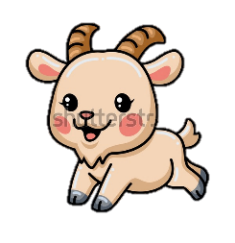

Act2. Look and write.
Aa
Bb
Cc
Dd
Ee
Ff
Gg
Cat
_all
_at
Ball
Apple
Dog
_lephant
Fish
_oat
_pple
_og
Elephant
_ish
Goat

Slide 8
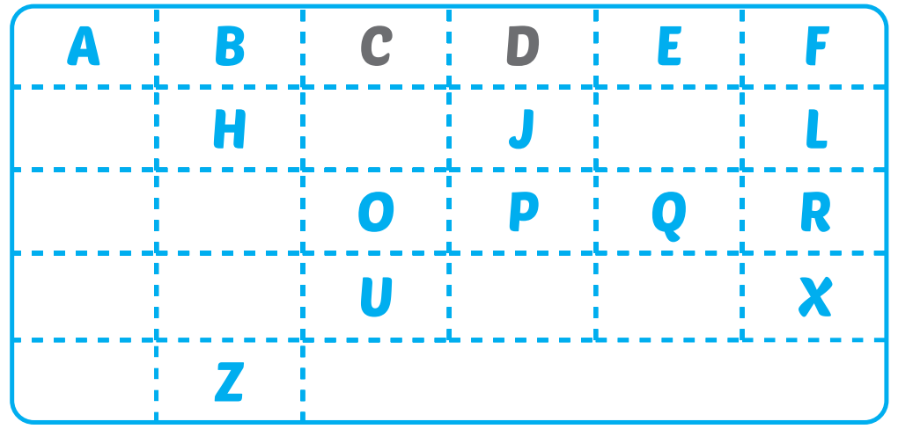
Extra-Act1 - WBp8. Write missing letters.
G
I
K
M
N
S
T
V
W
Y

Slide 9
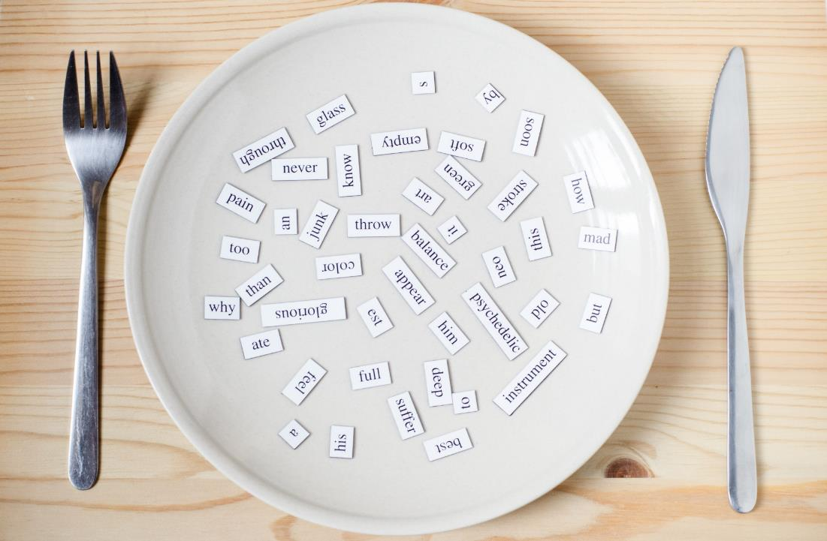
Structures
How do you spell “Alfie”?
A-L-F-I-E.

Slide 10

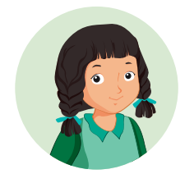
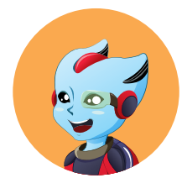
How do you spell “Alfie”?
A-L-F-I-E.
Mai
Alfie

Slide 11
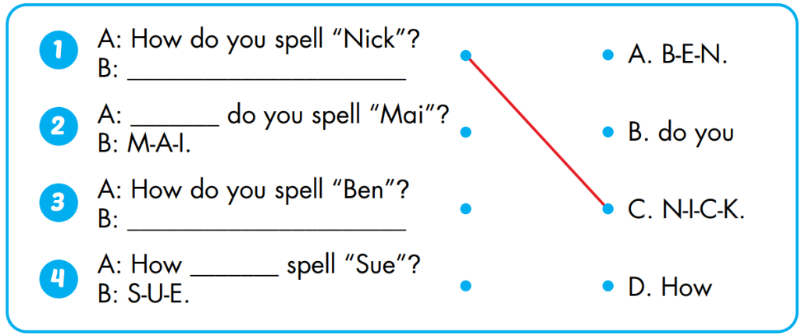
Act1. Look and match. Practice.

Slide 12

Act2. Guess your friends’ names.
N-I-C-K.
NICK?

Slide 13
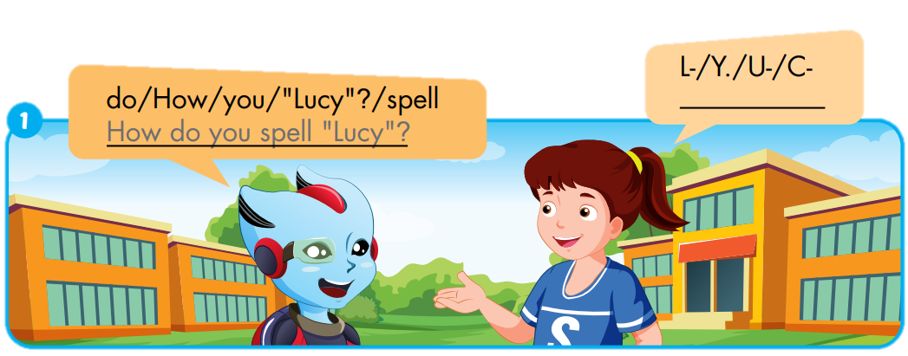
Extra-Act1 - WBp8. Unscramble and write.
L-
U-
C-
Y.

Slide 14
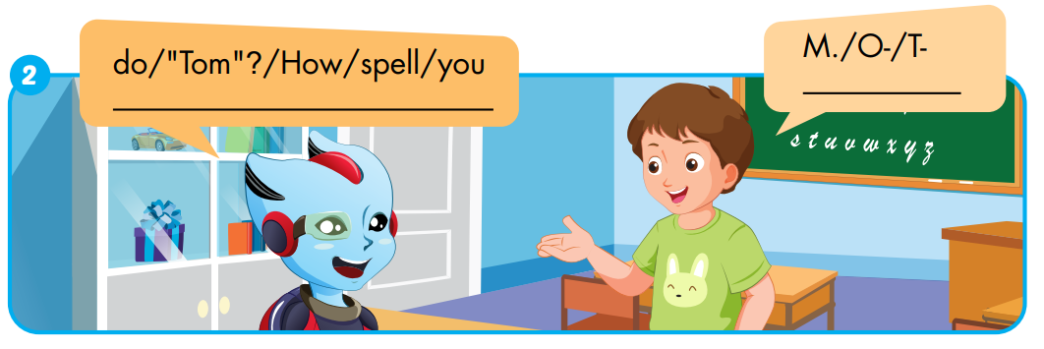
Extra-Act1 - WBp8. Unscramble and write.
T-
O-
M.
How
do
you
spell
“Tom”?

Slide 15
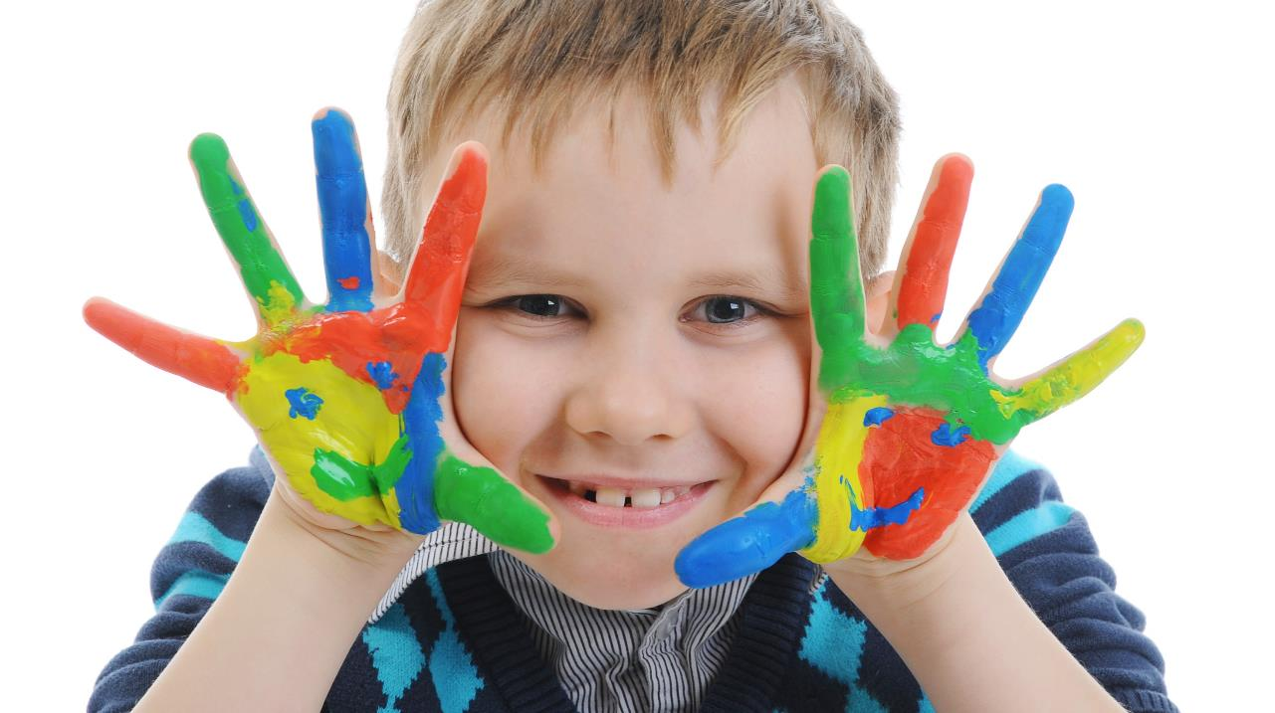

WRAP-UP
Enjoy your day!

