Slide 1

UNIT 15. WHAT WOULD YOU LIKE
TO BE IN THE FUTURE?
LESSON 1

Slide 2



Slide 3



Slide 4

pilot

Slide 5

doctor

Slide 6
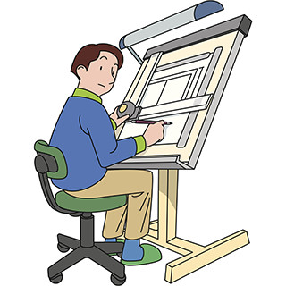
architect

Slide 7

writer

Slide 8
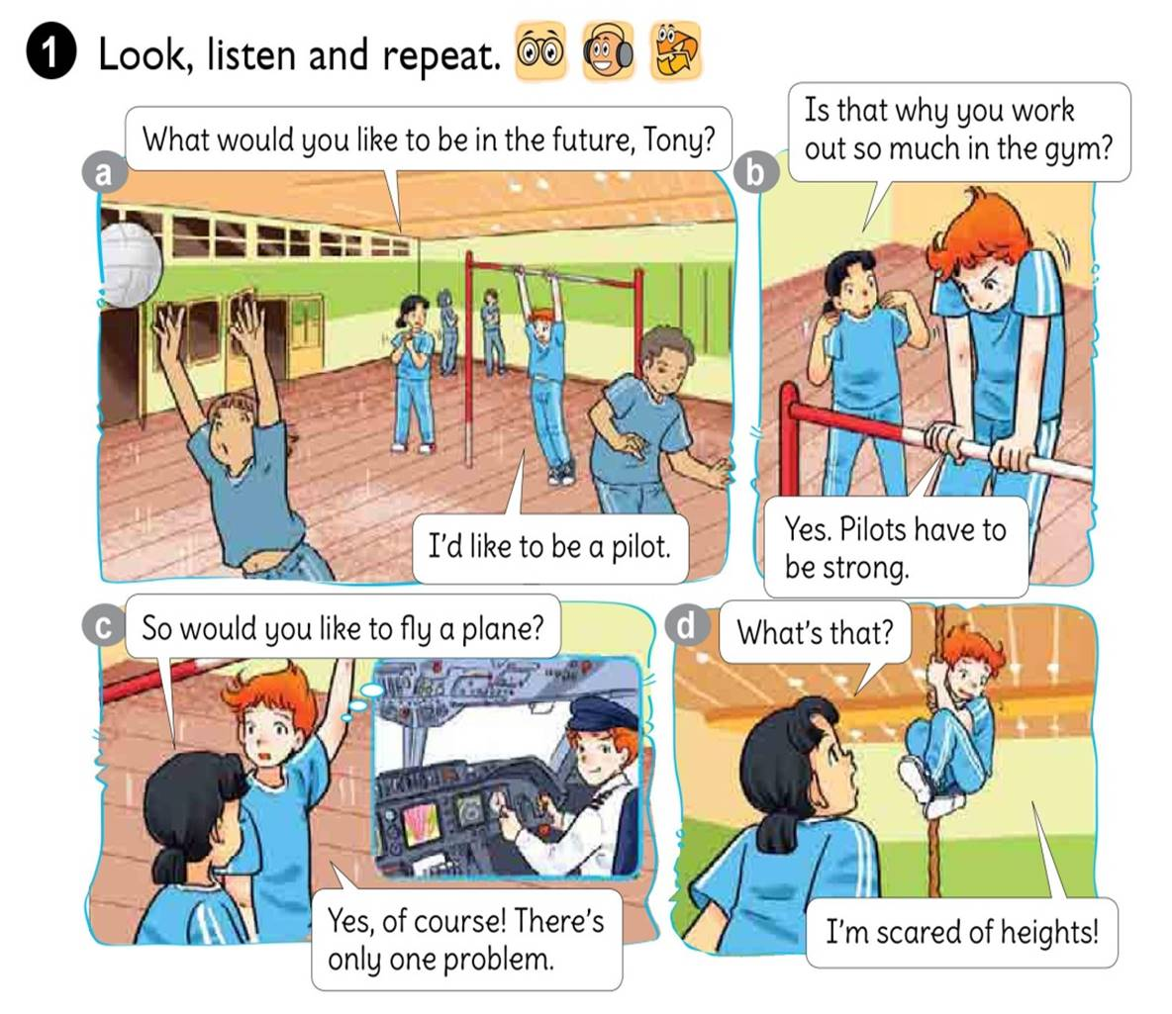




Slide 9
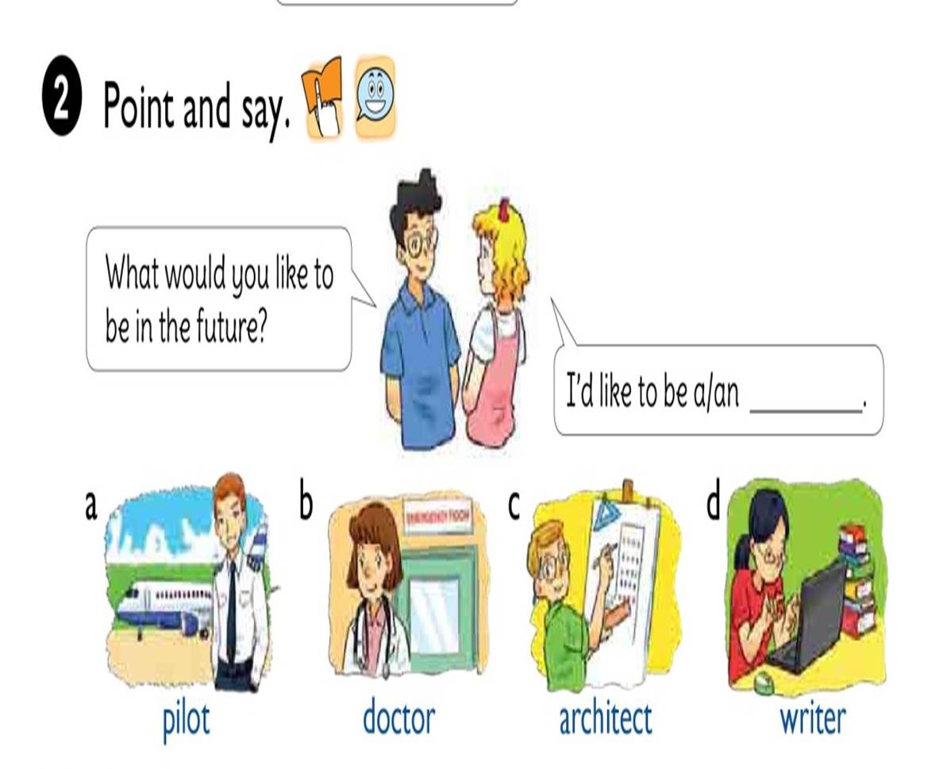

Slide 10




1. Vocabulary
- future
- pilot
- doctor
- architect
- writer
2. Model sentence
What would you like to be in the future?
I’d like to be a writer.

Slide 11

What woul you like to be in the future?
I’d like to be a
pilot.

Slide 12

What woul you like to be in the future?
I’d like to be a
doctor.

Slide 13
What woul you like to be in the future?
I’d like to be an
architect.

Slide 14
What woul you like to be in the future?
I’d like to be a
writer.

Slide 15


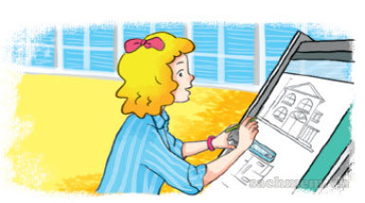
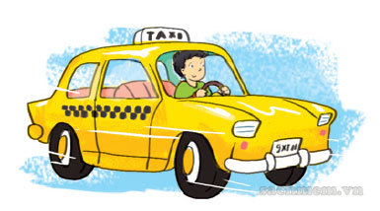


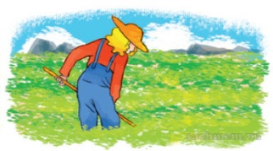
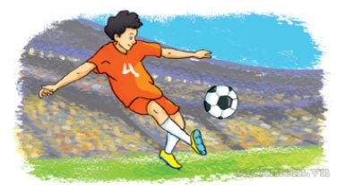
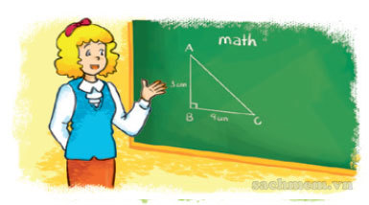
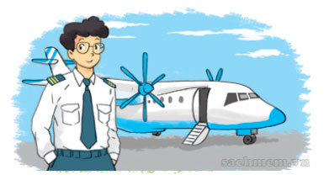

LISTEN AND TICK
1
2
3

Slide 16
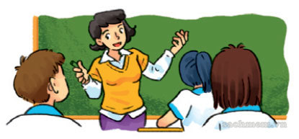
Look and write
1
A: What would you like to be in the future, Hoa?
B: I’d
like to be a teacher.

Slide 17
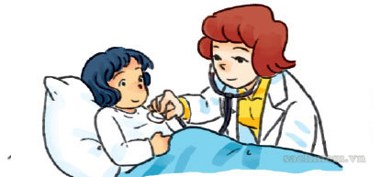
Look and write
2
A: What would she like to be when she grows up?
B: She’d
like to be a doctor.

Slide 18
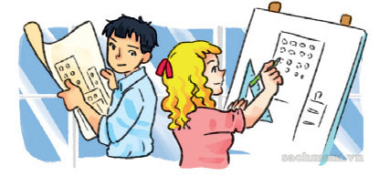
Look and write
3
A: What would Linda and Trung like to do when the leave school?
B: They’d
like to be architects.

Slide 19


Slide 20



Slide 21












LUCKY STARS

Slide 22

+5

Slide 23


QUESTION 01
I’d like to be a/ an … in the future.
writer
A
pilot
B
doctor
C
nurse
D

Slide 24

QUESTION 02
I’d like to be a/ an … in the future.
doctor
A
nurse
B
architect
C
farmer
D

Slide 25
QUESTION 03
I’d like to be a/ an … in the future.
pilot
A
doctor
B
Football player
C
driver
D

Slide 26

-5

Slide 27

QUESTION 04
I’d like to be a/ an … in the future.
writer
A
doctor
B
farmer
C
teacher
D

Slide 28
QUESTION 05
I’d like to be a/ an … in the future.
writer
A
nurse
B
teacher
C
teacher
D

Slide 29
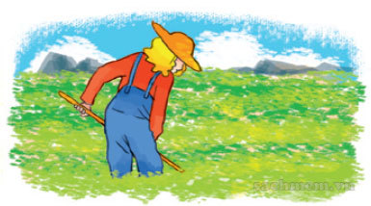
QUESTION 06
I’d like to be a/ an … in the future.
doctor
A
architect
B
farmer
C
writer
D

Slide 30
QUESTION 07
I’d like to be a/ an … in the future.
writer
A
doctor
B
farmer
C
teacher
D

Slide 31

QUESTION 08
I’d like to be a/ an … in the future.
teacher
A
writer
B
farmer
C
nurse
D

Slide 32




