Slide 1

Getting Started
Lesson 1
Page 5

Slide 2

WARM UP

Slide 3

Name Chain
Hello, my name is ______.
He/She is______.
Example:
Student 1: Hello, my name is Nina.
Student 2: Hello, my name is Lan.
She is Nina.
Notes:
Name Chain
Ask the class to introduce their names.
Demonstrate the activity in front of the class.
Require the class to stand up and make a circle.
Introduce your name and pass a ball a student on your left. Ask him/her to use the structures: “Hello, my name is ____. He/She is ___.” to introduce their name and friends’ names.
Have them continue the activity with another student.

Slide 4

It’s time to learn …

Slide 5
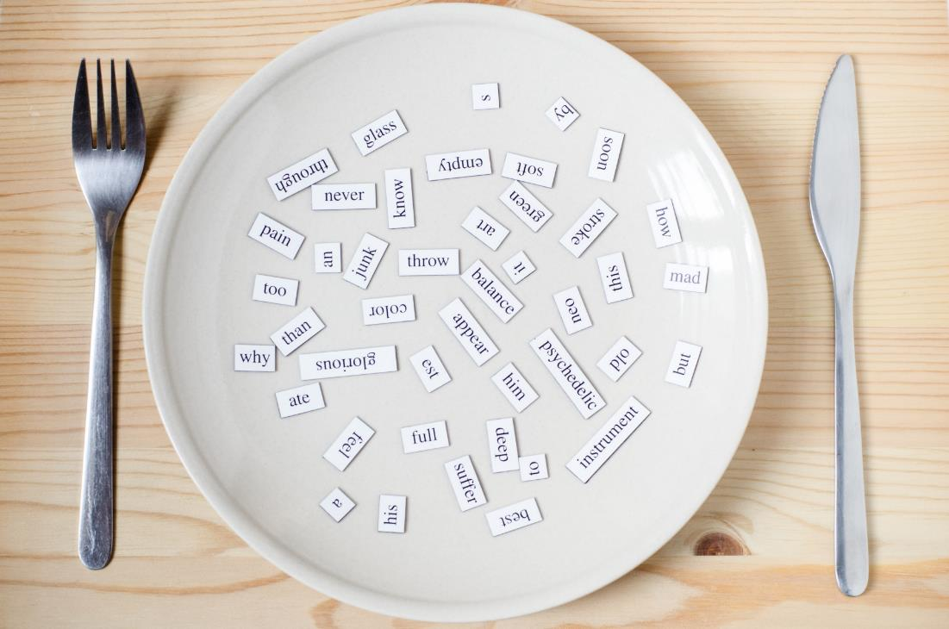
New words
stand up
sit down
hands up

Slide 6

Presentation

Slide 7
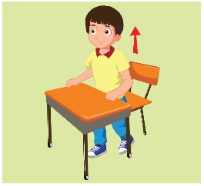
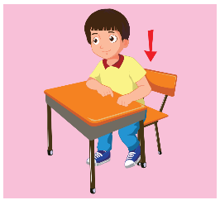


A
Listen and point. Repeat. (CD1 Track 02)
1
2
3
stand up
sit down
hands up
/stænd ʌp/
đứng lên
/sɪt daʊn/
ngồi xuống
/hændz ʌp/
giơ tay lên
Click on each English word to hear the sound.

Slide 8

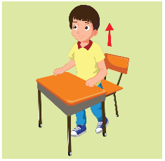


Look at the numbers and say the words.
2
1
3
2
3
1
1
2
3
1
1
2
3
3
2
1
1
3
2
3
2
3
2
1

Slide 9
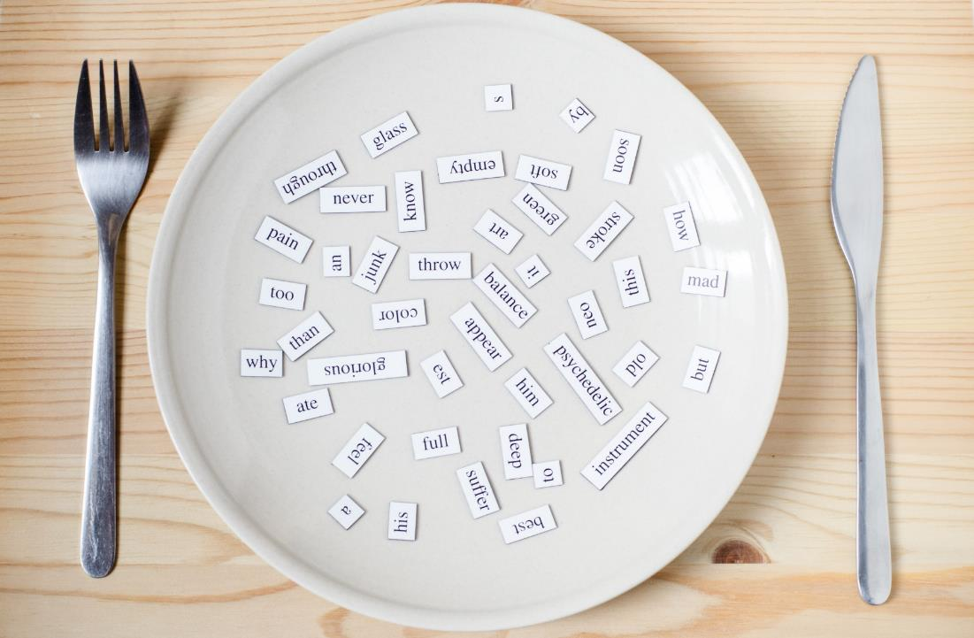
Structures
Stand up, please.
Sit down, please.
Hands up, please.

Slide 10
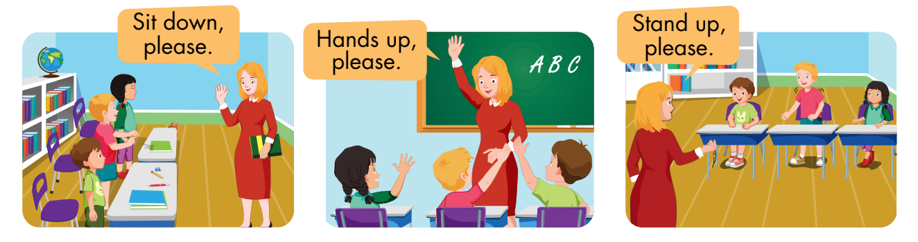
B
Listen and point. Repeat. Role-play. (CD1 Track 03)
Notes:
B. Listen and point. Repeat. Role-play. (CD1 Track 03)
Have students call out the things they can see in each picture.
Play the audio and have them point to the characters.
Play the audio again and have them repeat the new words.
Divide the class into pairs to role-play the dialogue.
Swap roles and repeat.
Invite some pairs to demonstrate the activity in front of the whole class.
Go around the class and support them if necessary.

Slide 11

Practice

Slide 12
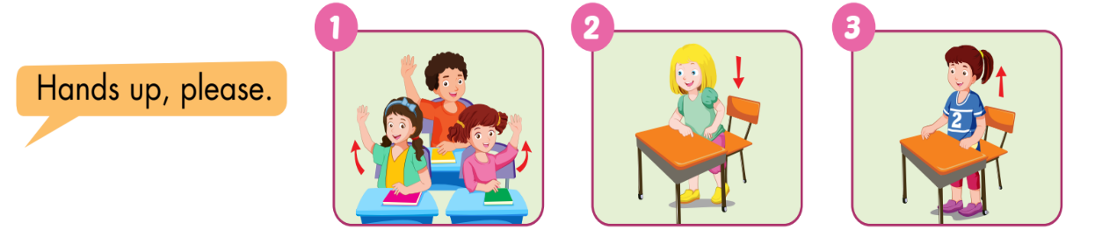
C
Point, say, and do.
Notes:
C. Point, say, and do.
Divide the class into two teams.
Show a flashcard to the class.
Have Team A call out the command and Team B do the action.
Swap roles and repeat.
Monitor the class and support if needed.

Slide 13
Speaking

Slide 14
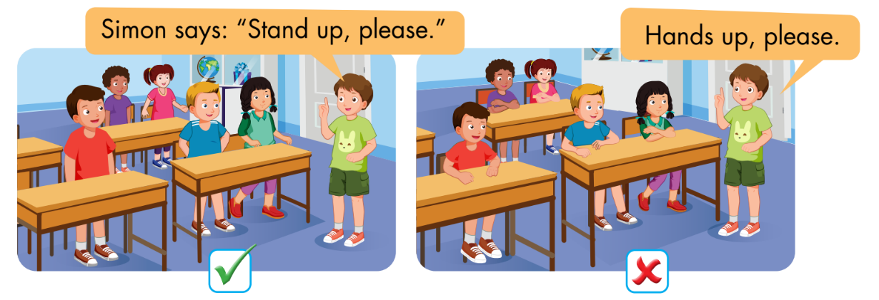
D
Play Simon says.

Slide 15
Further Practice

Slide 16
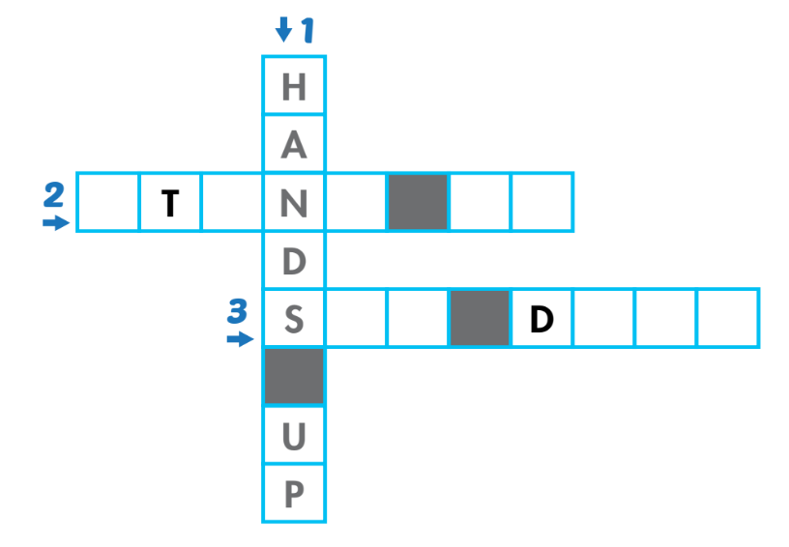
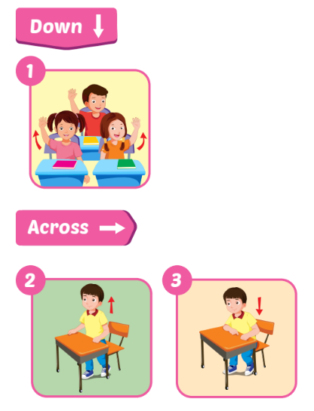
A
Look and write.
S
A
D
U
P
I
T
O
W
N

Slide 17
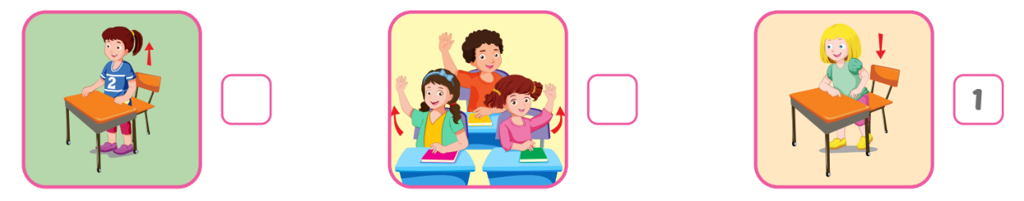
B
Listen and number. (WB Track 02)
3
2

Slide 18
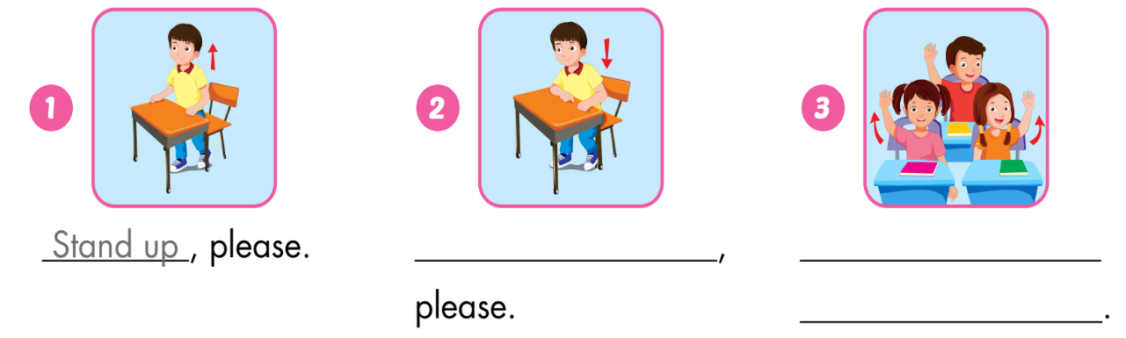
C
Look and write.
Sit down
Hands up,
please

Slide 19

Consolidation

Slide 20




Look, say, and act.
Notes:
Look, say, and act.
Ask the class to stand up to do this activity.
Demonstrate the activity in front of the class.
Have them look at the picture, say the vocabulary, and do the action in each picture.

Slide 21

WRAP-UP

Slide 22
Today’s lesson
Vocabulary:
stand up, sit down, hands up
Structures:
Stand up, please./ Sit down, please./ Hands up, please.

Slide 23

Enjoy your day!

