Slide 1
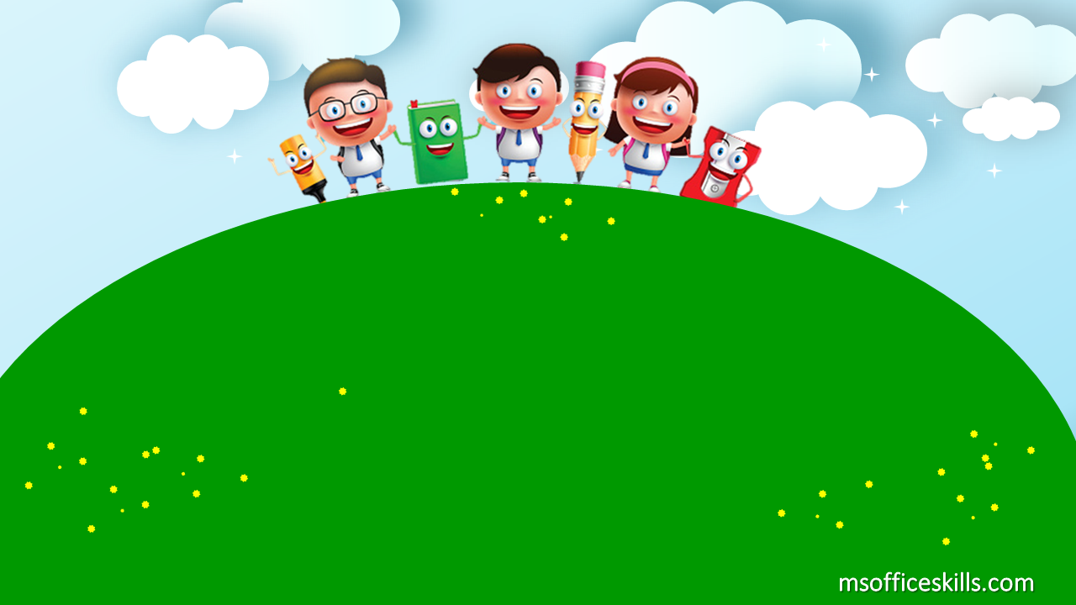
Welcome to our class 1A3

Slide 2
Bài 9: Học cách diễn đạt “I have…”

Slide 3
a crayon

Slide 4
a pencil

Slide 5
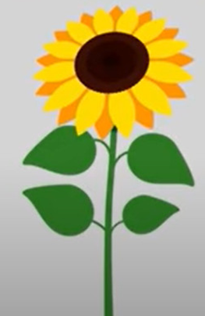
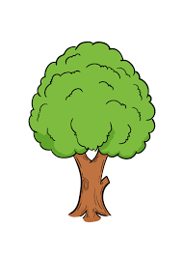
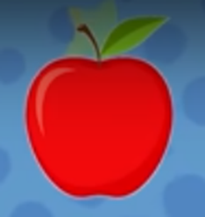
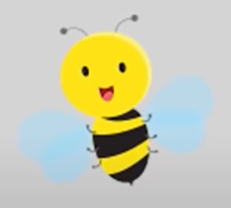
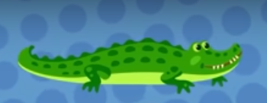
a flower
a bird
a tree
a bee
an alligator
an apple

Slide 6
I have a tree

Slide 7
I have a bird

Slide 8
I have a flower

Slide 9
I have a bee

Slide 10
I have an alligator

Slide 11
I have an apple

Slide 12
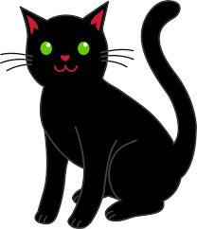
a red crayon
a black cat
a blue bird
I have ______
a yellow pencil
a red apple

Slide 13
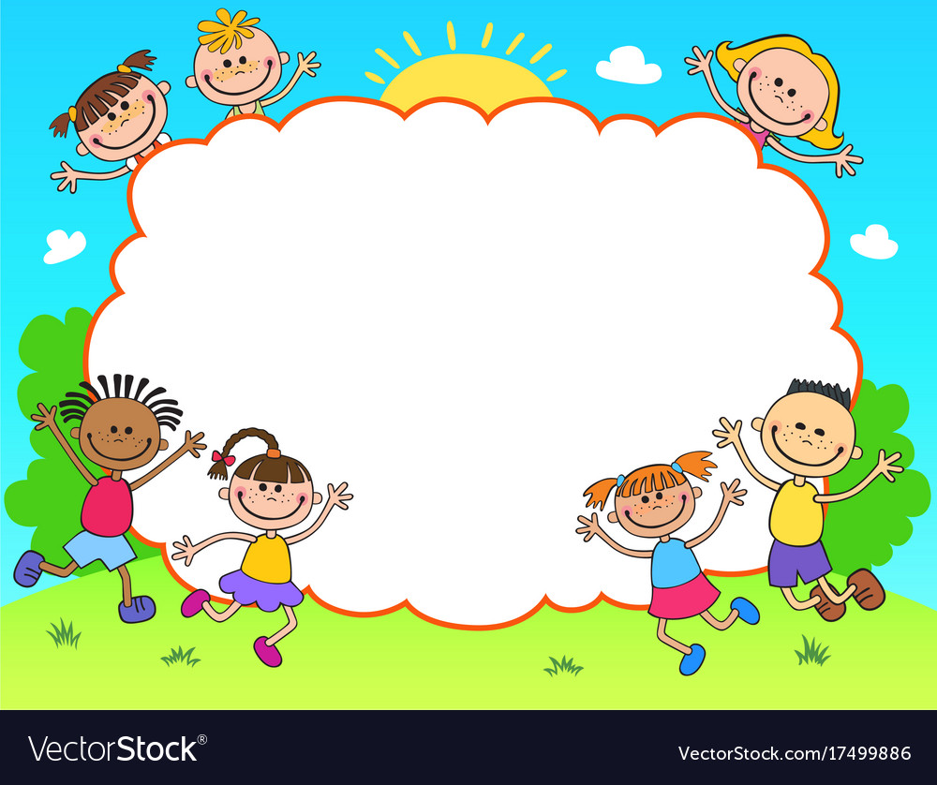
Fishing Game

Slide 14
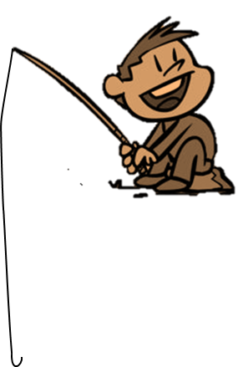
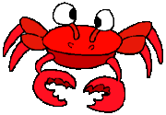
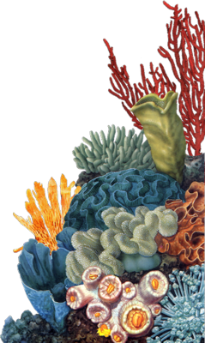
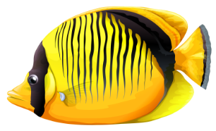
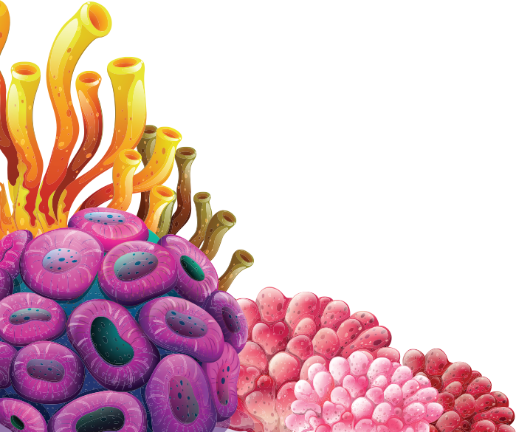
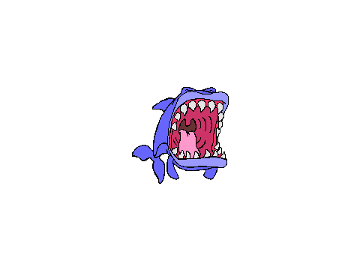
FISHING GAME
GO

Slide 15
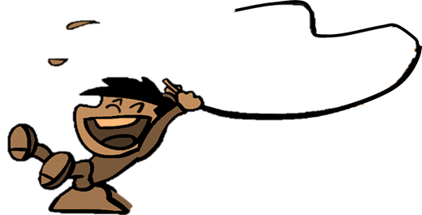
C. a red apple
NEXT
I have ______
A. a black cat
D. A green apple
B. A blue bird
C. a red apple

Slide 16
A. a yellow pencil
NEXT
I have ______
A. A yellow pencil
D. a blue pen
C. A pink pencil
B. a green pencil

Slide 17
B. A black cat
NEXT
A. A brown cat
I have ______
C. A black cow
B. A black cat
D. A white cow

Slide 18
NEXT
D. A red pencil
A. an orange crayon
I have ______
C. a purple crayon
D. a red crayon
B. a black crayon

Slide 19
C. a blue bird
NEXT
I have ______
A. a blue bee
D. A green bird
B. A yellow bee
C. a blue bird

