Slide 1
Unit 7: What do you like doing?
Lesson 2 (page 48+49)

Slide 2
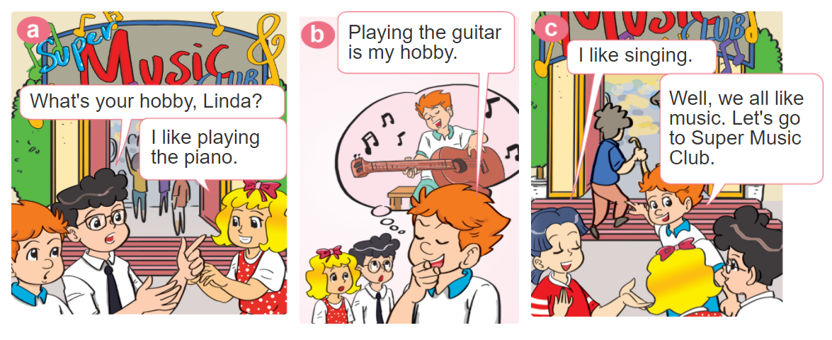
1. Look, listen and repeat.

Slide 3
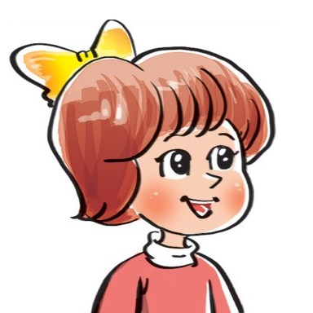
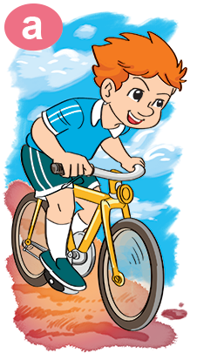
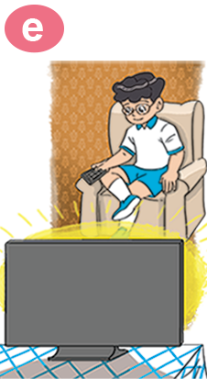
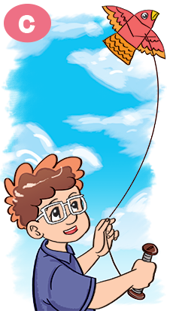
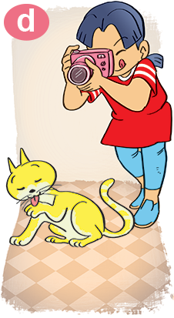
2. Point and say
What's your hobby?
I like ___________.
riding
a bike
watching TV
taking
photos
playing
badminton
flying a kite

Slide 4
3. Let’s talk.
What do you
like doing?
I like _________.
What's your hobby?
I like _________.

Slide 5
Notes:
Ms Huyền Phạm - 0936.082.789 – YOUTUBE: MsPham. Facebook: Dạy và học cùng công nghệ.

Slide 6
What ____ your hobby?
I like watching TV.
are
is
+5
-1
-1
-1
do
does
Notes:
Ms Huyền Phạm - 0936.082.789 – YOUTUBE: MsPham. Facebook: Dạy và học cùng công nghệ.

Slide 7
What is your hobby?
I like flying kites.
I like watching TV.
+5
-1
-1
-1
I like swimming.
I like riding the bike.
Notes:
Ms Huyền Phạm - 0936.082.789 – YOUTUBE: MsPham. Facebook: Dạy và học cùng công nghệ.

Slide 8
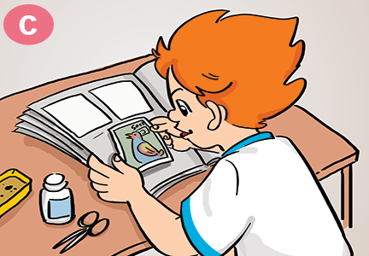
Câu hỏi 2
What is your hobby?
I like riding the bike.
I like dancing.
+5
-1
-1
-1
I like collecting stamps.
I like cooking.
Notes:
Ms Huyền Phạm - 0936.082.789 – YOUTUBE: MsPham. Facebook: Dạy và học cùng công nghệ.

Slide 9
What is your hobby?
I like collecting stamps.
I like playing with cats.
+5
-1
-1
-1
I like taking photos.
I like eating.
Notes:
Ms Huyền Phạm - 0936.082.789 – YOUTUBE: MsPham. Facebook: Dạy và học cùng công nghệ.

Slide 10
Great job!
Exit
8
13
Notes:
Ms Huyền Phạm - 0936.082.789 – YOUTUBE: MsPham. Facebook: Dạy và học cùng công nghệ.

Slide 11
4. Listen and number.
2
4
1
3
1
2
3
4

Slide 12
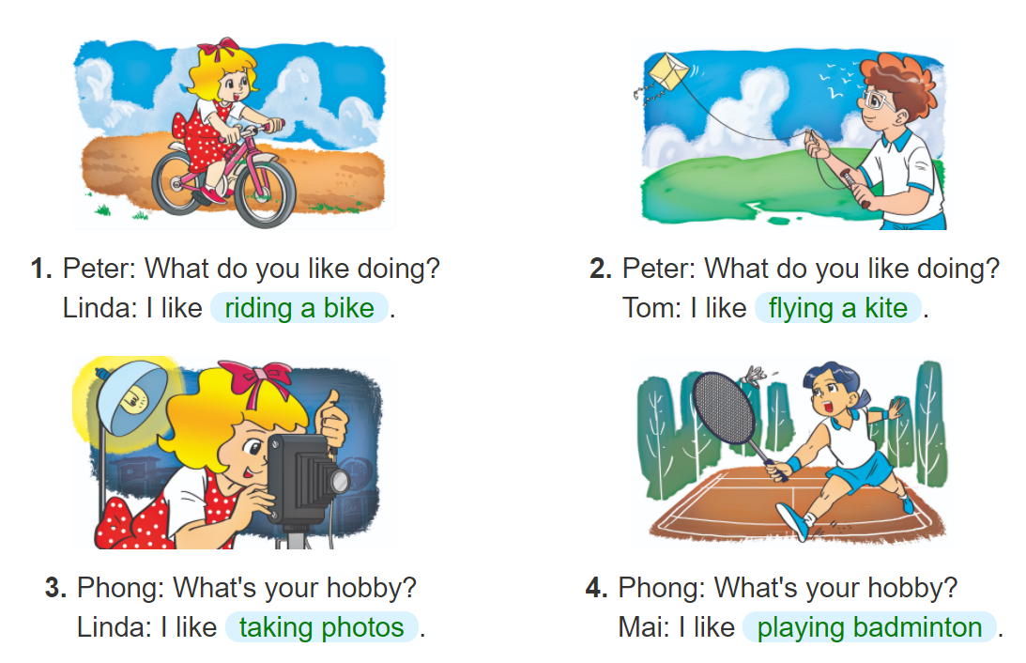
5. Look and write.

