Slide 1
Unit 3: School
Lesson 1.1
Page 38

Slide 2
Objectives
By the end of this lesson, students will be able to identify 5 school supplies and use them in questions.
Vocabulary: eraser, ruler, pencil, notebook, pencil case
Structure: Is this your eraser?
- Yes, it is./No, it isn't.
Are these your notebooks?
- Yes, they are./No, they aren't.

Slide 3
WARM UP

Slide 4
It’s time to learn …

Slide 5
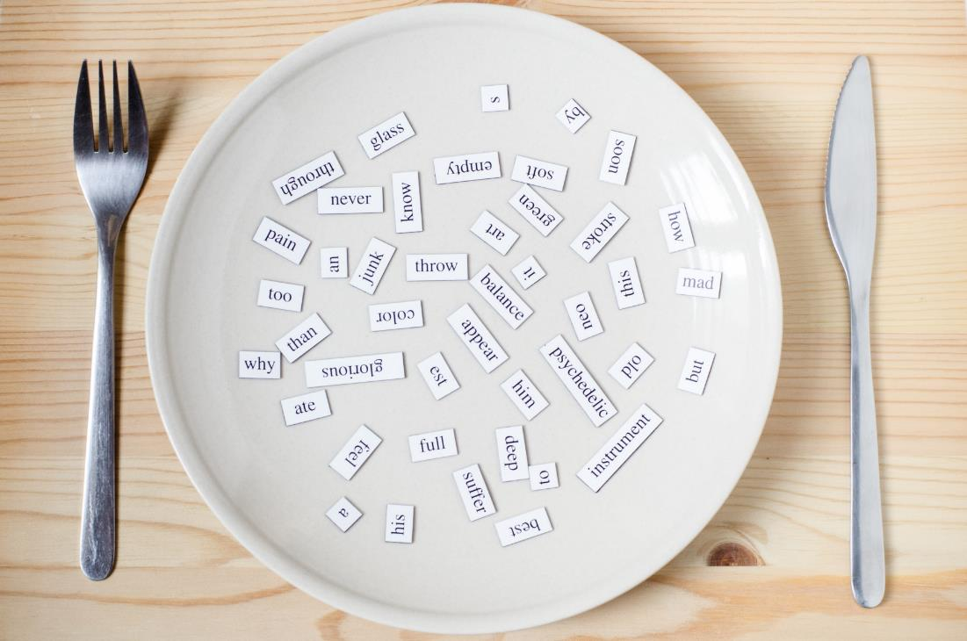
New words
eraser
ruler
pencil
notebook
pencil case

Slide 6
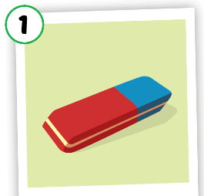
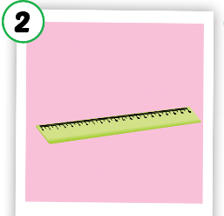
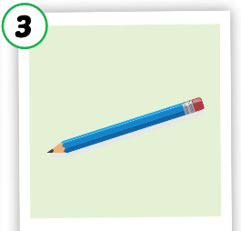
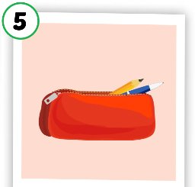
Listen and point.
Click the icon to hear the sound.

Slide 7
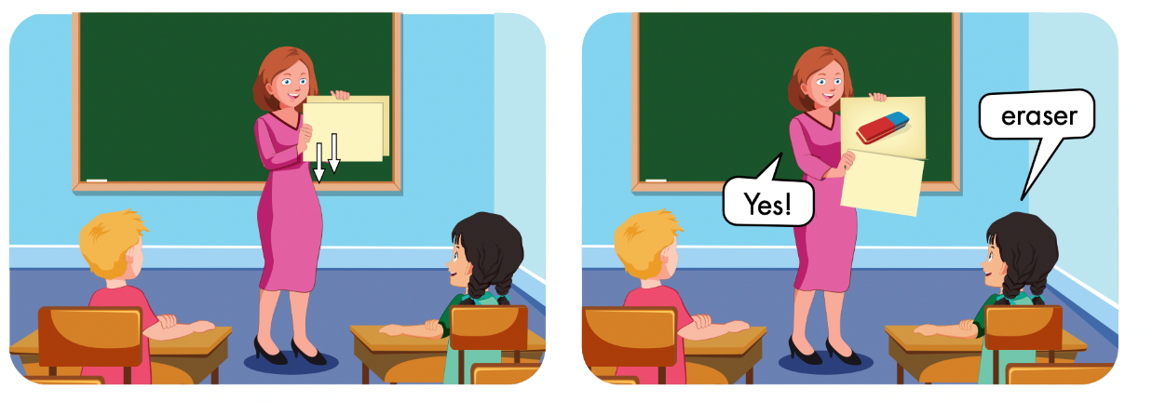

Slide 8
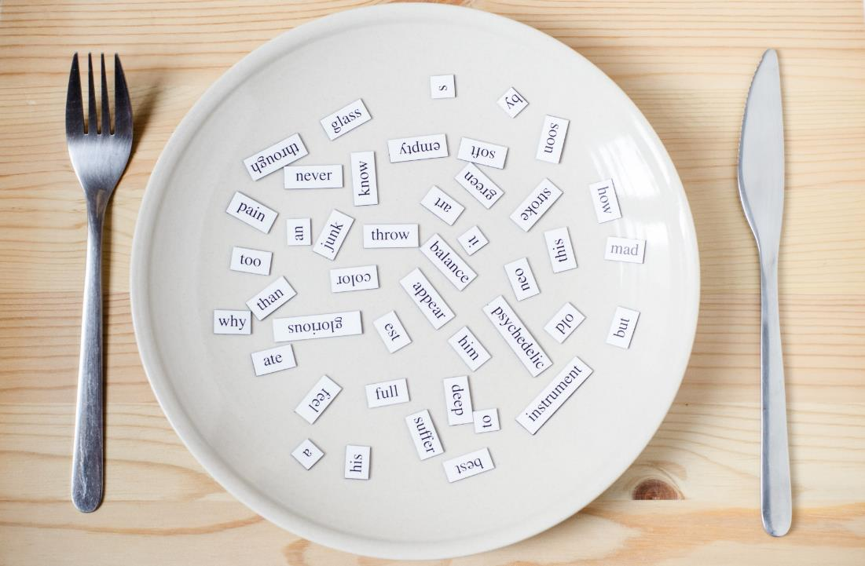
Structures
Is this your eraser?
Yes, it is./No, it isn’t.
Are these your notebooks?
Yes, they are./No, they aren't.

Slide 9
Click here to hear the sound.

Slide 11
CONSOLIDATION

Slide 12
Lesson 3
Homework
Learn by hearts vocabulary, the structures and make sentences using them.
Do the exercises on page 28 WB
Do the exercises in Tiếng Anh 3 i-Learn Smart Start Notebook on page 22.
Prepare the next lesson (page 39 SB)

Slide 13
Have a nice day!

