Slide 1
Unit 3
What day is it to day ?
Lesson 2

Slide 2
vocabulary

Slide 3

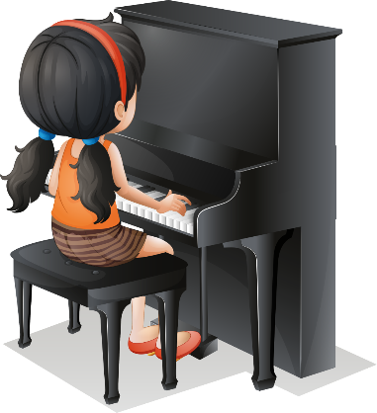
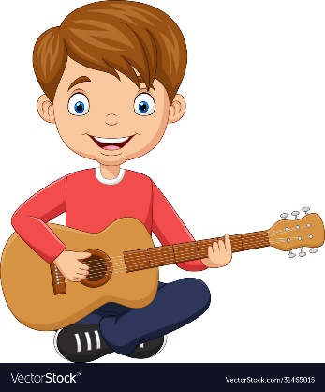

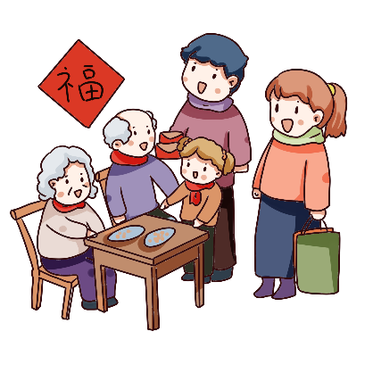


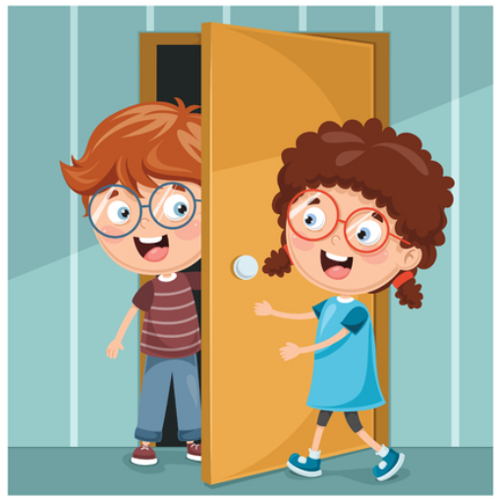
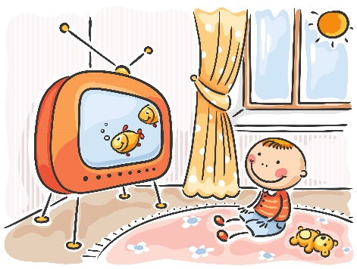
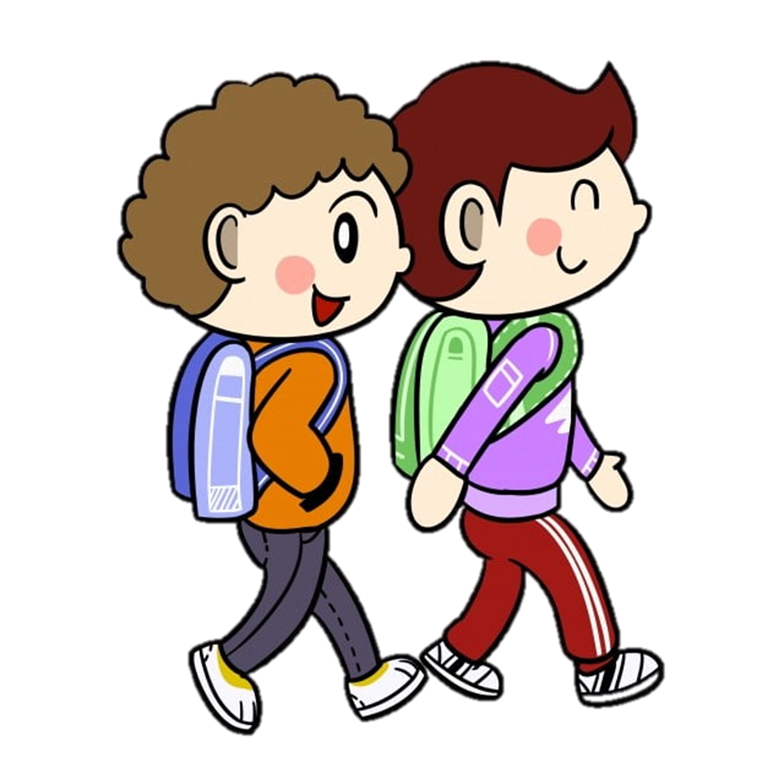
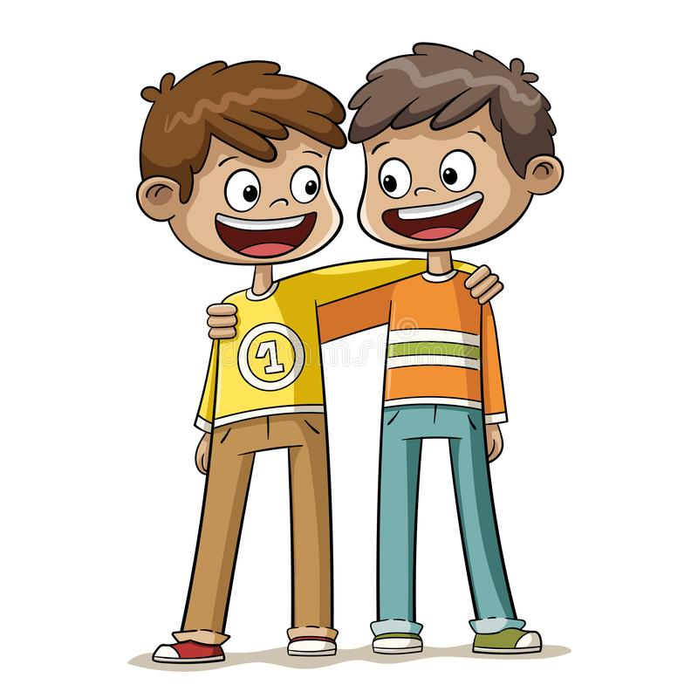
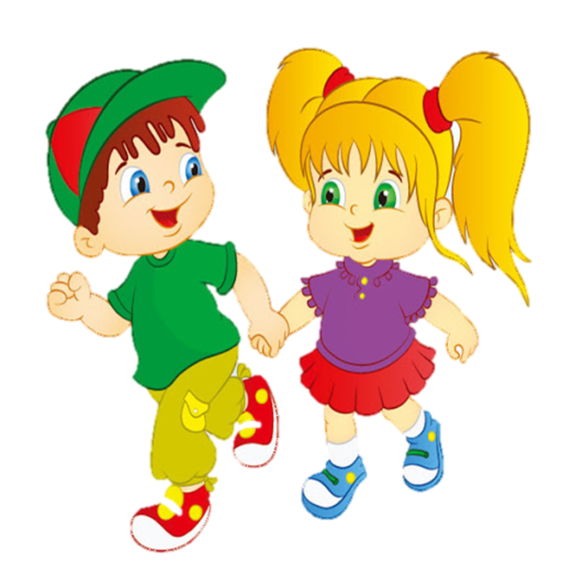
Vocabulary
Go to school
Play the piano
Play the guitar
Listen to music
Visit my grandparents
Go swimming
Go to the zoo
Visit my friend
Watch TV

Slide 4


Choose the best answer
A
Go swimming
B
Visit my friend
C
Go the zoo
Next

Slide 5
Choose the best answer
A
Visit my grandparents
B
Listen to the music
C
Visit my friend
Next

Slide 6
Choose the best answer
A
Go to school
B
Watch TV
C
Play the piano
Next

Slide 7
Choose the best answer
A
Go to school
B
Visit my grandparents
C
Go the zoo
Next

Slide 8
Choose the best answer
A
Listen to the music
B
Go to the zoo
C
Watch TV
Next

Slide 9
Choose the best answer
A
Visit my grandparents
B
Visit my friend
C
Play the guitar
Next

Slide 10
Choose the best answer
A
Play the piano
B
Play the guitar
C
Play chess
Next

Slide 11
Choose the best answer
A
Play the piano
B
Visit my friend
C
Go swimming
Next

Slide 12
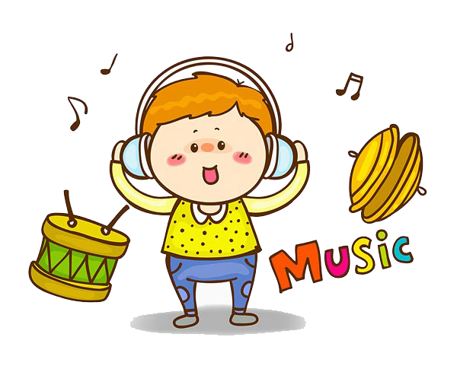
Choose the best answer
A
Play the guitar
B
Listen to the music
C
Play the music
Next

Slide 13
grammar

Slide 14
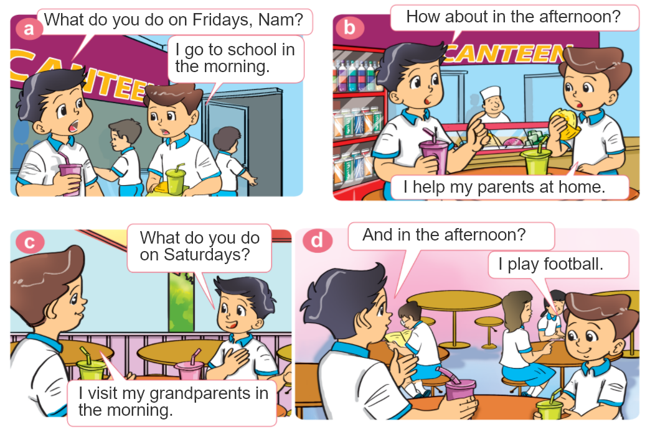

1. Look, listen and repeat.

Slide 15

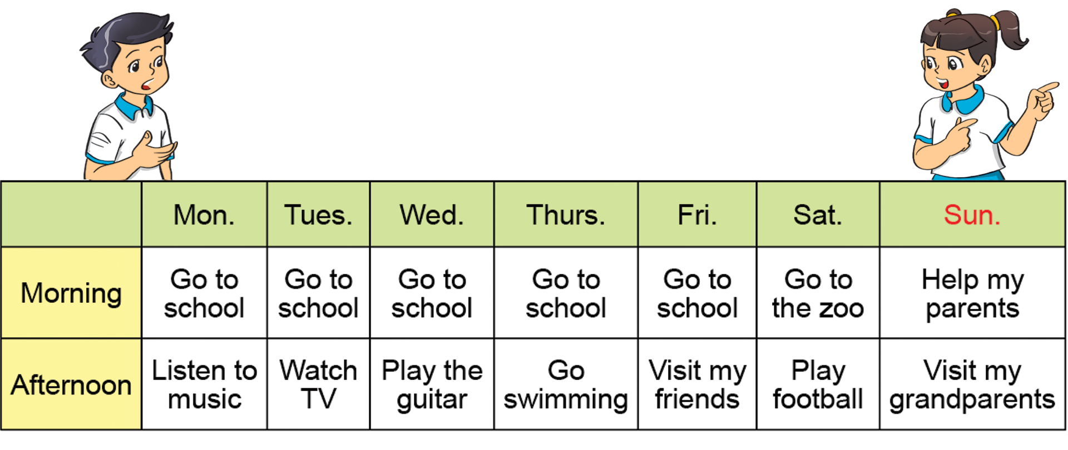
2. Point and say.
What do you do on ________ ?
I ___________.

Slide 16
2. Point and say.
What do you do on ________ ?
Mondays
I go to school in the morning and listen to music in the afternoon.
I'm ___________.

Slide 17
2. Point and say.
What do you do on ________ ?
I ___________.

Slide 18
What do you do on Monday?
What do you do on Wednesday?

Slide 19
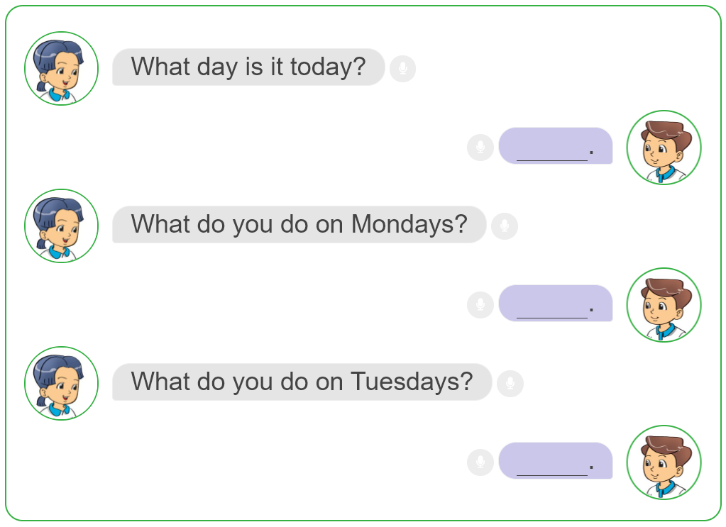
3. Let's talk.

Slide 20
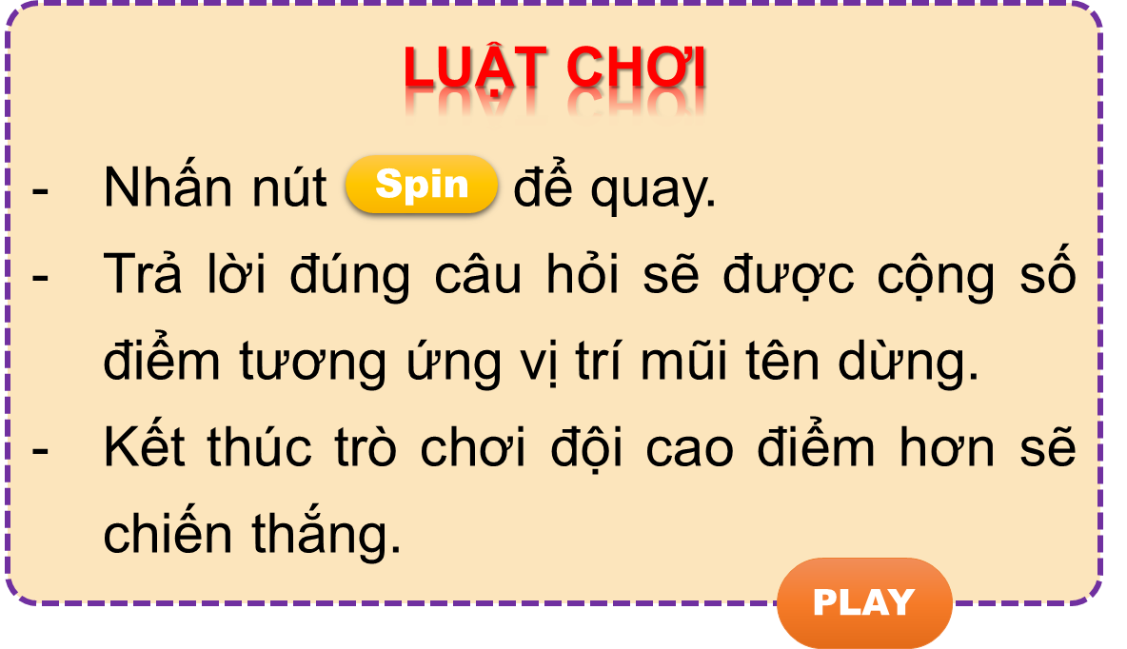


Vòng quay kì diệu
50
10
20
30
10
20
30
40
Spin
PLAY
LUẬT CHƠI
Nhấn nút để quay.
Trả lời đúng câu hỏi sẽ được cộng số điểm tương ứng vị trí mũi tên dừng.
Kết thúc trò chơi đội cao điểm hơn sẽ chiến thắng.
Spin
Notes:
Ms Huyền Phạm - 0936.082.789 – YOUTUBE: MsPham. Facebook: Dạy và học cùng công nghệ.

Slide 21
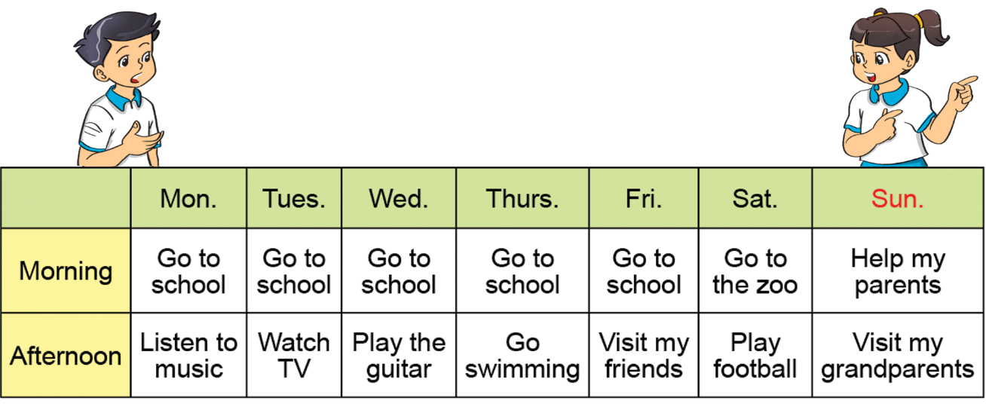
What do you do on Mondays?
________ in the morning
50
10
20
30
10
20
30
40
I go to school
Xem đáp án
Spin
Notes:
Ms Huyền Phạm - 0936.082.789 – YOUTUBE: MsPham. Facebook: Dạy và học cùng công nghệ.

Slide 22
What do you do on Tuesdays?
________ in the afternoon.
50
10
20
30
10
20
30
04
I watch TV
Xem đáp án
Spin
Notes:
Ms Huyền Phạm - 0936.082.789 – YOUTUBE: MsPham. Facebook: Dạy và học cùng công nghệ.

Slide 23
50
What do you do on Fridays?
I visit my friend ______.
10
20
30
10
20
30
04
in the afternoon
Xem đáp án
Spin
Notes:
Ms Huyền Phạm - 0936.082.789 – YOUTUBE: MsPham. Facebook: Dạy và học cùng công nghệ.

Slide 24
What do you do ______?
I play the guitar in the
afternoon.
50
10
20
30
10
20
30
40
On Wednesdays
Xem đáp án
Spin
Notes:
Ms Huyền Phạm - 0936.082.789 – YOUTUBE: MsPham. Facebook: Dạy và học cùng công nghệ.

Slide 25

50
__________ on Thursdays?
I go swimming.
10
20
30
10
20
30
40
What do you do
Xem đáp án
Spin
Notes:
Ms Huyền Phạm - 0936.082.789 – YOUTUBE: MsPham. Facebook: Dạy và học cùng công nghệ.

Slide 26
50
What do you do on Sundays?
______ in the morning.
10
20
30
10
20
30
40
I help my parents
Xem đáp án
Spin
Notes:
Ms Huyền Phạm - 0936.082.789 – YOUTUBE: MsPham. Facebook: Dạy và học cùng công nghệ.

Slide 27
50
10
____________
I go to the zoo.
20
30
10
20
30
40
What do you do on Saturdays?
Xem đáp án
Spin
Notes:
Ms Huyền Phạm - 0936.082.789 – YOUTUBE: MsPham. Facebook: Dạy và học cùng công nghệ.

Slide 28



50
10
20
30
10
20
30
40
EXIT
Notes:
Ms Huyền Phạm - 0936.082.789 – YOUTUBE: MsPham. Facebook: Dạy và học cùng công nghệ.

Slide 29
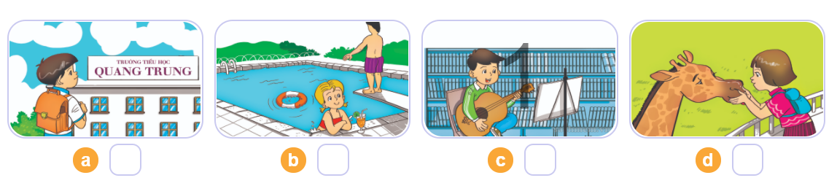
4. Listen and number.
3
2
4
1
1
2
3
4

Slide 30
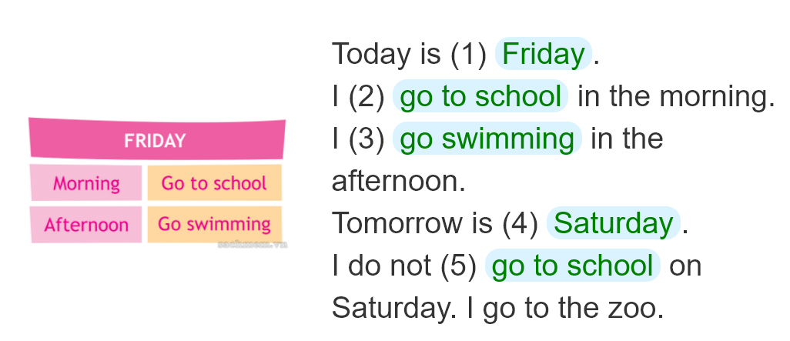
5. Look and write
_____________.
_____________________
______________________
___________________.
_____________________

Slide 31
6. Let's play

