Slide 1








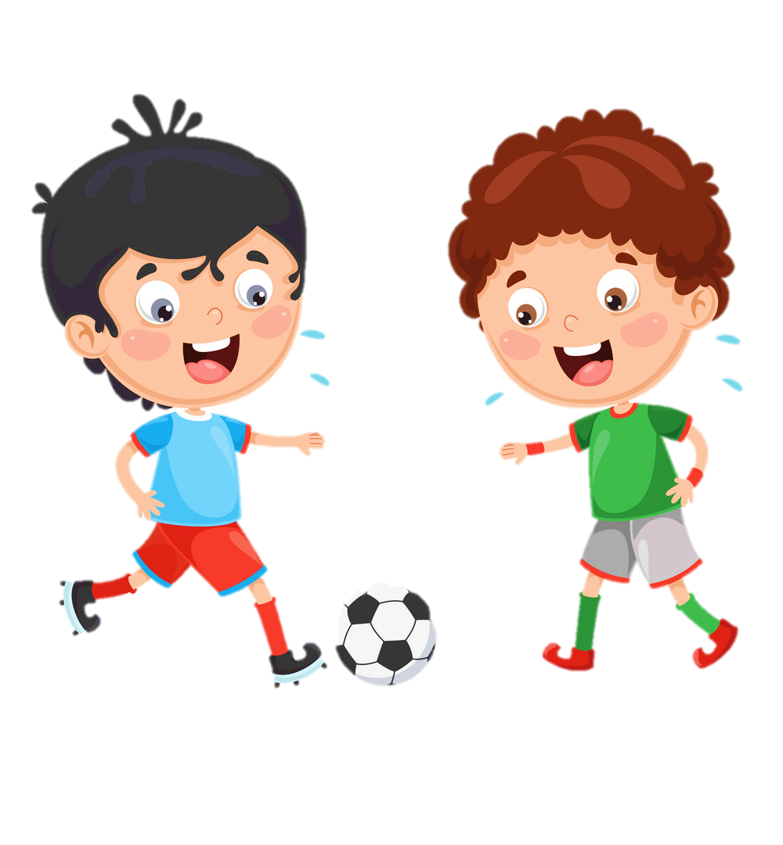











Notes:
Để nguyên trang bìa như này, chỉ thay đổi tên bài trong quá trình làm. Logo của sách Wonderful World

Slide 2




Slide 3
Warm-up
01

Slide 4

GAME:
SILENT BALL
Notes:
While the music plays, students pass the ball around the class. When the music stops, the student with the ball has to do something, such as answer a question from the teacher.

Slide 5






Notes:
watch the clip

Slide 6
GAME:
MATCHING
Match the picture with its word.
Notes:
-Divide class into 2 teams- Boys and girls
-Let the sts in each team take turn to choose the numbers to find the 2 matches picture and word

Slide 7







1
2
3
mum
4
5
6
dad
7
8
9
sister
grandpa
10
11
12
grandma
brother

Slide 8


Slide 9
02
Presentation
Task 1: Listen and point

Slide 10
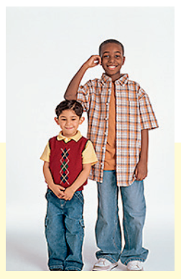
short-tall
Notes:
Let the sts look at the picture and repeat

Slide 11
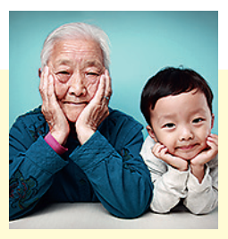
old-young
Notes:
Let the sts look at the picture and repeat

Slide 12
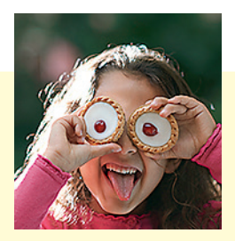
funny
Notes:
Let the sts look at the picture and repeat

Slide 13
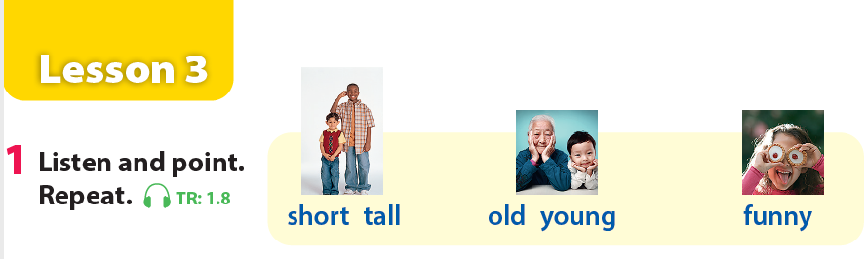
Notes:
Let the sts listen and point
Then repeat

Slide 14

03
Practice
Task 2: Listen and tick

Slide 15
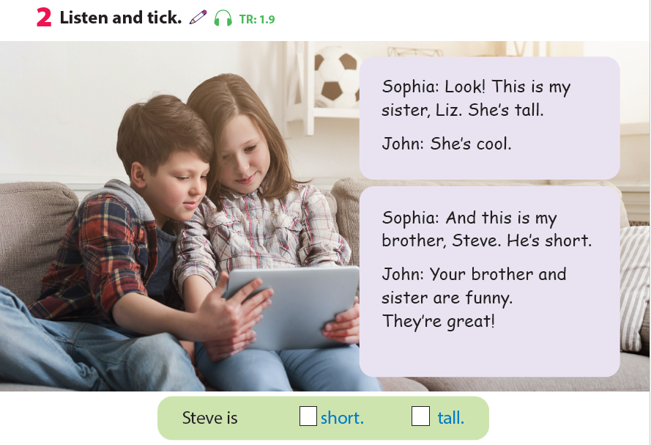
Notes:
Ask the sts some questions about the picture:
-Who are they?
-Where are they?
-What are they doing?
Let the sts listen for the first time

Slide 16
Notes:
Let the sts read the text and listen for the second time and find the word “short” and “tall” in the text

Slide 17


Notes:
Show the answer and ask some sts to read again the text

Slide 18




Game: Listen and tick
Notes:
THIÉT KẾ HOẠT ĐỘNG TƯƠNG TÁC TỪ SLIDE 19-23. Kèm file nghe ở mỗi câu
Divide the class into groups of 4 (each group has 4 sts).
Give cards with letter A,B,C for the groups.
Sts listen and choose the correct answer (A,B,C). Who can make it will get points.

Slide 19



Listen and tick the box
✓
A
B
C
Notes:
Divide the class into groups of 4 (each group has 4 sts).
Give cards with letter A,B,C for the groups.
Sts listen and choose the correct answer (A,B,C). Who can make it will get points.

Slide 20

Listen and tick the box
✓
A
B
C
Notes:
Divide the class into groups of 4 (each group has 4 sts).
Give cards with letter A,B,C for the groups.
Sts listen and choose the correct answer (A,B,C). Who can make it will get points.

Slide 21

Listen and tick the box
✓
A
B
C
Notes:
Divide the class into groups of 4 (each group has 4 sts).
Give cards with letter A,B,C for the groups.
Sts listen and choose the correct answer (A,B,C). Who can make it will get points.

Slide 22
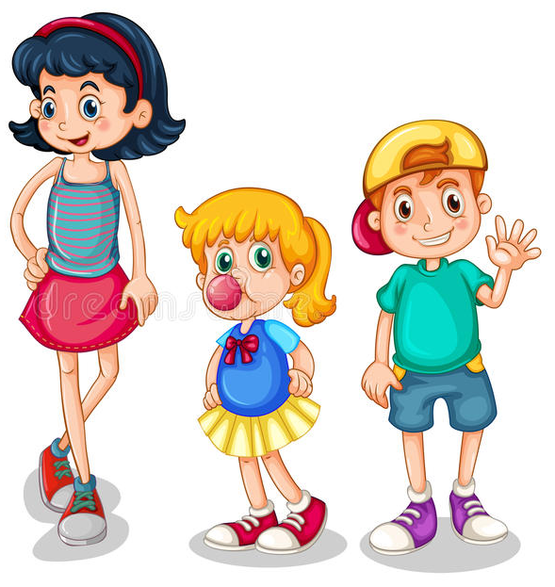

Listen and tick the box
✓
A
C
B
Notes:
Divide the class into groups of 4 (each group has 4 sts).
Give cards with letter A,B,C for the groups.
Sts listen and choose the correct answer (A,B,C). Who can make it will get points.

Slide 23
Listen and tick the box
✓
A
C
B
Notes:
Divide the class into groups of 4 (each group has 4 sts).
Give cards with letter A,B,C for the groups.
Sts listen and choose the correct answer (A,B,C). Who can make it will get points.

Slide 24
03
Practice
Task 3: Match and say

Slide 25
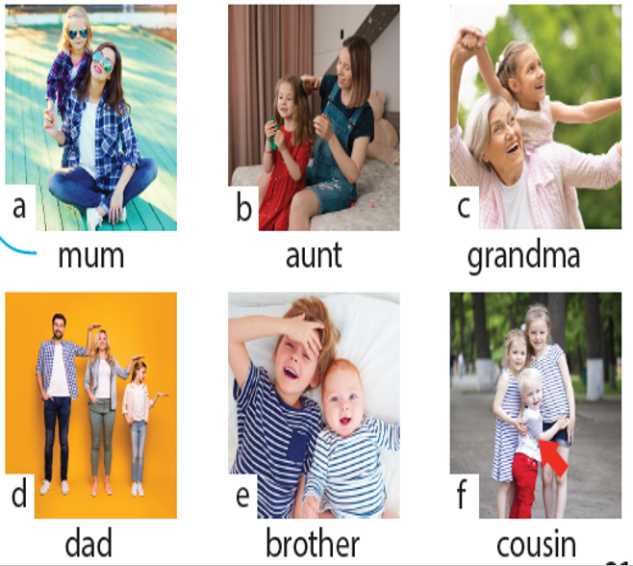
Notes:
Let the sts to say the names of family members from a to f

Slide 26
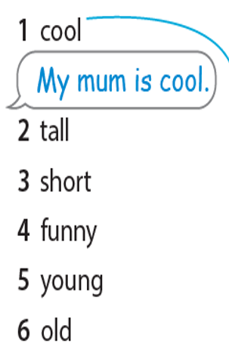
Notes:
Let the sts to read the words of adjectives from 1-6

Slide 27
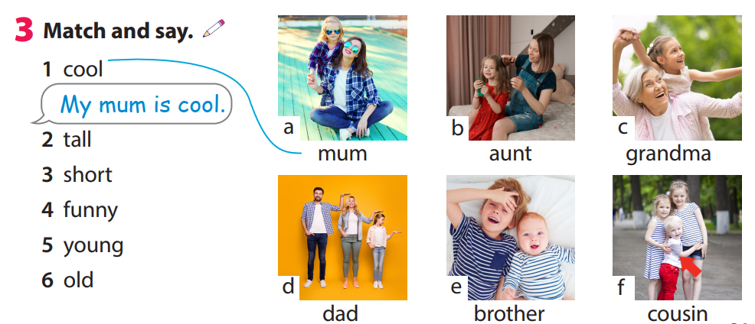
Notes:
Ask the sts to match the numbers with letters to talk about their family (choose freely)

Slide 28
Game time!
Choose and say.

Slide 29


d
b
f
a
c
e
Go
Notes:
This game can be played in groups/teams.
Each member of a group choose a letter talk about their family members.
Give points for the groups.

Slide 30

My mum is …..
tall/short/funny/great/cool/young/old
Well done!
Notes:
This game can be played in groups/teams.
Each member of a group choose a letter talk about their family members.
Give points for the groups.

Slide 31
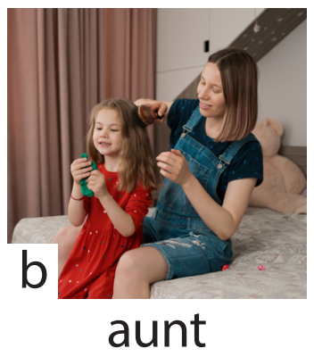
My aunt is …..
tall/short/funny/great/cool/young/old
Great job!
Notes:
This game can be played in groups/teams.
Each member of a group choose a letter talk about their family members.
Give points for the groups.

Slide 32
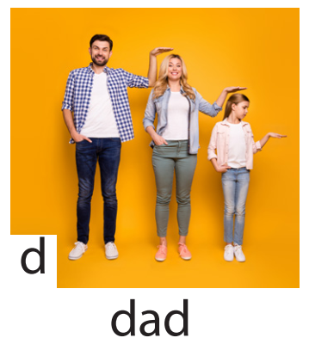
My dad is …..
tall/short/funny/great/cool/young/old
Amazing!
Notes:
This game can be played in groups/teams.
Each member of a group choose a letter talk about their family members.
Give points for the groups.

Slide 33
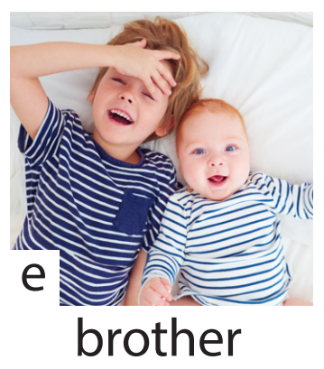
My brother is …..
tall/short/funny/great/cool/young/old
Good job!
Notes:
This game can be played in groups/teams.
Each member of a group choose a letter talk about their family members.
Give points for the groups.

Slide 34
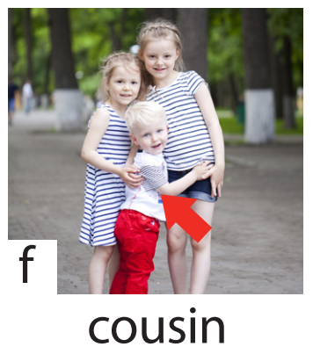
My cousin is …..
tall/short/funny/great/cool/young/old
Well done!
Notes:
This game can be played in groups/teams.
Each member of a group choose a letter talk about their family members.
Give points for the groups.

Slide 35
04
Production
Draw a picture and write a text about family

Slide 36
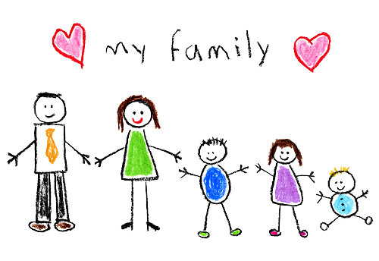
Example: This is my family. My mum is cool. My dad is tall. My sister is young. My baby brother is funny. I love my family.
Notes:
-Let the sts draw a picture of members in their family and write a text about them using adjectives. (read the example on the board)
-Call some sts to present their own work

Slide 37
05
Assessment

Slide 38
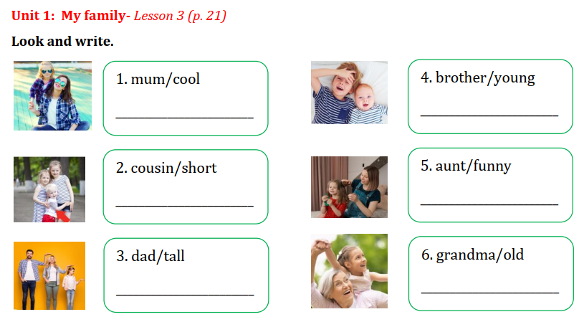
Notes:
Sts look at the picture and given words. Write the sentences on the board or on their notebooks.

Slide 39
My mum is cool.
My brother is young.
My cousin is short.
My aunt is funny.
My dad is tall.
My grandma is old.
Notes:
THIẾT KẾ HOẠT ĐỘNG TƯƠNG TÁC CHO 6 CÂU NÀY. TRẢ LỜI TỰ LUẬN
Sts look at the picture and given words. Write the sentences on the board or on their notebooks.

Slide 40
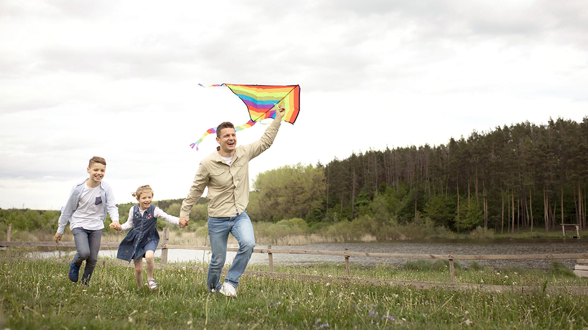
Goodbye

