Slide 1
Unit 9
What did you see
at the zoo?
Lesson 3

Slide 2

Wednesday, December 8th, 2021
Unit 9: What did you see at the zoo?
Lesson 3- 62,63

Slide 3

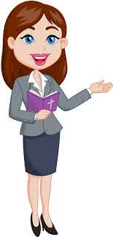
OBJECTIVES
(Mục tiêu của bài học hôm nay)
01
- Review the vocabularies and grammar in Lesson 1 and Lesson 2.
(Ôn tập từ vựng và cấu trúc ngữ pháp đã học trong Tiết 1 và 2)
- Identify the word stress of words in sentences
(Xác định được trọng âm của từ trong câu
02
- Practice speaking, listening and reading skills.
(Luyện tập các kĩ năng nói, nghe và đọc hiểu.)
03
Notes:
Thanh Yến Trần 0967 255 149 zalo/ FB https://www.facebook.com/thanhyentrananhngutaymy/

Slide 4
VOCABULARY

Slide 5













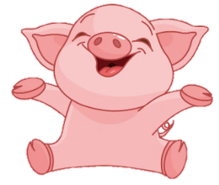

+2
-2
+5
+3
+5
-2
+4
-1

Slide 6
PRONUNCIATION

Slide 7

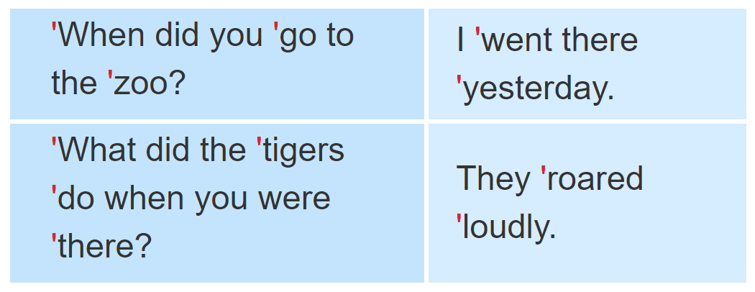
1. Listen and repeat.

Slide 8
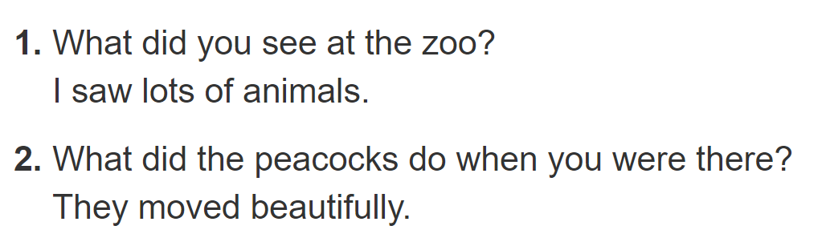

2. Listen and underline the stressed words. Then say the sentences aloud.

Slide 9
PRACTISE

Slide 10
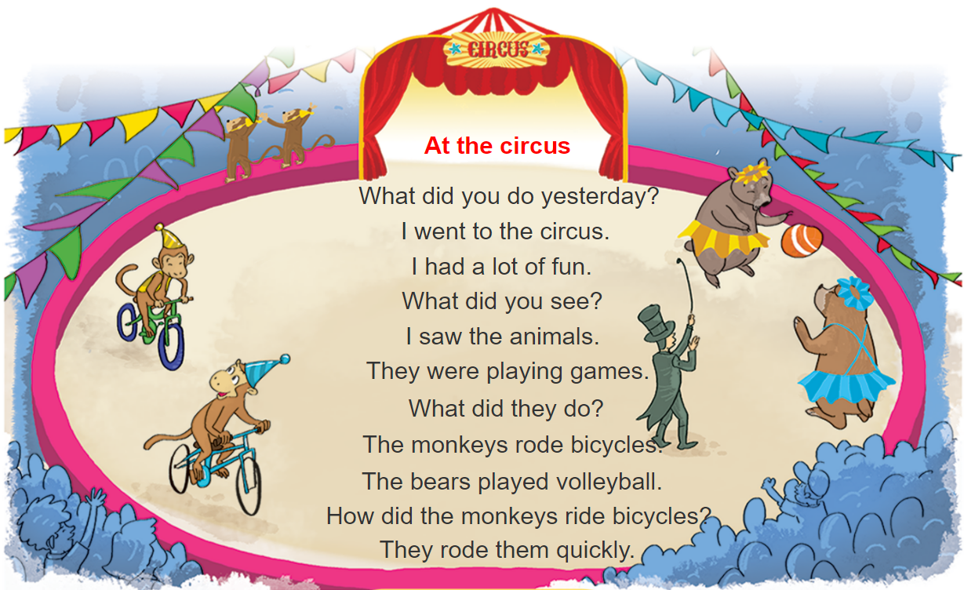



3. Let’s chant

Slide 11
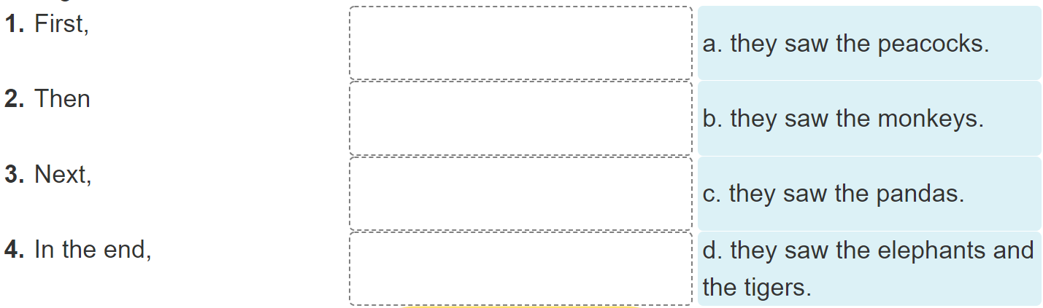
4. Read and complete

Slide 12
4. Read and complete
Dear Tuan,
I went to the zoo with my classmates last Friday. First, we saw the monkeys. They were fun to watch because they jumped up and down quickly. Then we went to see the elephants. They moved slowly and quietly. We also saw the tigers. I liked them very much because they were fast. Next, we saw the peacocks. My classmates liked them because they moved beautifully. In the end, we saw the pandas. They were very cute and did everything slowly. I had a really good time at the zoo.
See you soon.
Best wishes,
Phong

Slide 13
4. Read and complete

Slide 14
5. Write about your last visit to the zoo
I went to the zoo with_________last _________.
At the zoo, I saw ________________________.
The _________ and the _________.
I think the animals at the zoo are ____________.

Slide 15







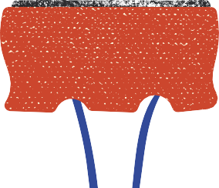
Let’s remember!
(Cùng ghi nhớ nhé!)
SB (SGK) 4,5 tr63
WB (SBT) tr39
Review the words, model sentences and dialogues in Unit 9.
(Ôn lại từ vựng và mẫu câu trong Bài 9)
PREVIEW
(Xem trước)
SB: Unit 10 – Lesson 1

Slide 16
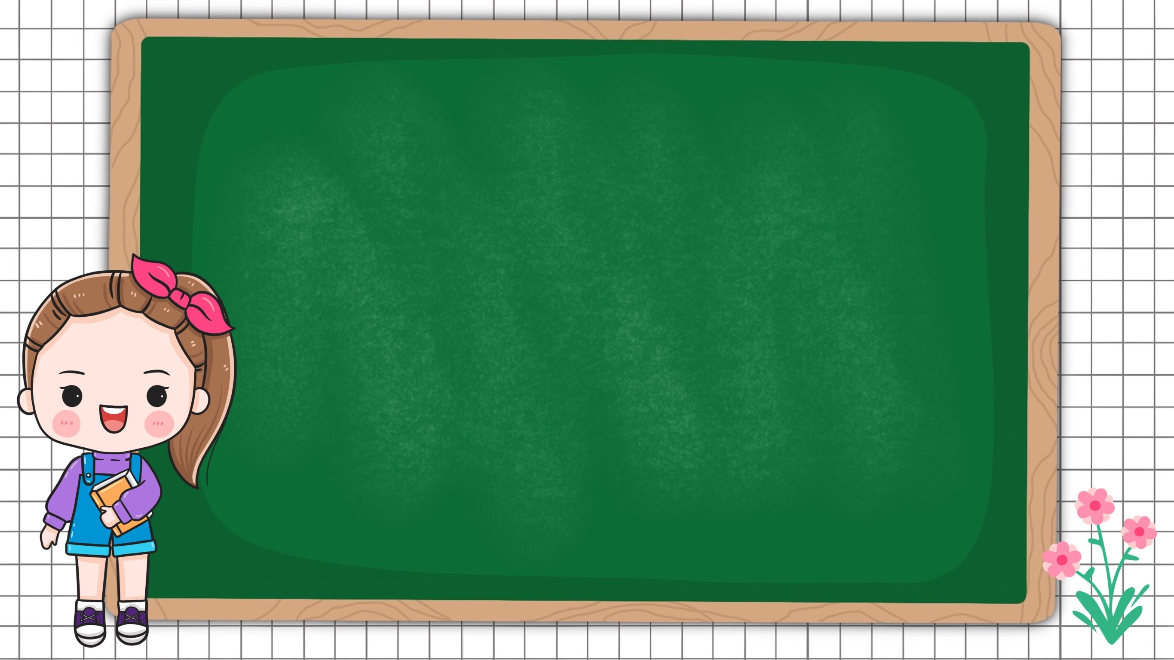

Wednesday, December 8th, 2021
Unit 9: Lesson 3 – p62,63
1. Review
A: What did you see at the zoo?
B: I saw tigers.
A: What did the tigers do when you were there?
B: They roared loudly.

Slide 17
6. Project
Draw your dream zoo.

