Slide 1
Unit 6: Where’s your school?
Lesson 3
Teacher: Ngoc Khue

Slide 2
Objectives
- Use the words and phrases related to the topic School.
- Pronounce the sounds of the letters “sch”, “sk” and “str”.
Mục đích bài học:
Sử dụng các từ và cụm từ liên quan đến chủ đề trường học.
Phát âm chính xác 3 âm sau: “sch”, “sk” và “str”.

Slide 3
Table of contents
01
02
Warm Up
Phonics
03
04
Practice
Homelink

Slide 4
01
Warm up!

Slide 5





Play

Slide 6






1
2
3
4
5
6
7
8
1
2
3
4
5
6
7
8
1
2
3
4
5
6
7
0
8
1
0
2
3
4
5
6
7
8
0
Exit

Slide 7




A
the
B
my
What's ___ name of your school?
C
your
Back

Slide 8
A
are
B
is
Where ___ your school?
C
as
Back

Slide 9
A
He’s in class 4A2.
B
She’s in class 4A2.
What class are you in?
C
I’m in class 4A2.
Back

Slide 10
A
I’m in class 4G.
B
He’s in class 4G.
What class is he in?
C
She’s in class 4G.
Back

Slide 11
A
He’s in class 1E.
B
She’s in class 1E.
What class is she in?
C
I’m in class 1E.
Back

Slide 12
are
XEM ĐÁP ÁN
What class ___ you in?
Back

Slide 13
is
XEM ĐÁP ÁN
What class ____ he in?
Back

Slide 14
is
XEM ĐÁP ÁN
What class _____ she in?
Back

Slide 15
Phonics
02

Slide 16
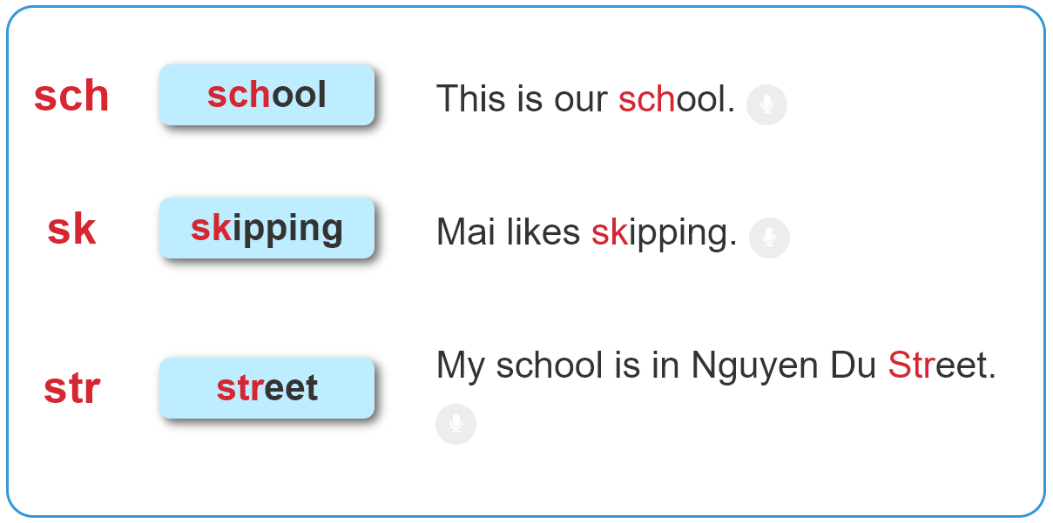

1. Listen and repeat.

Slide 17
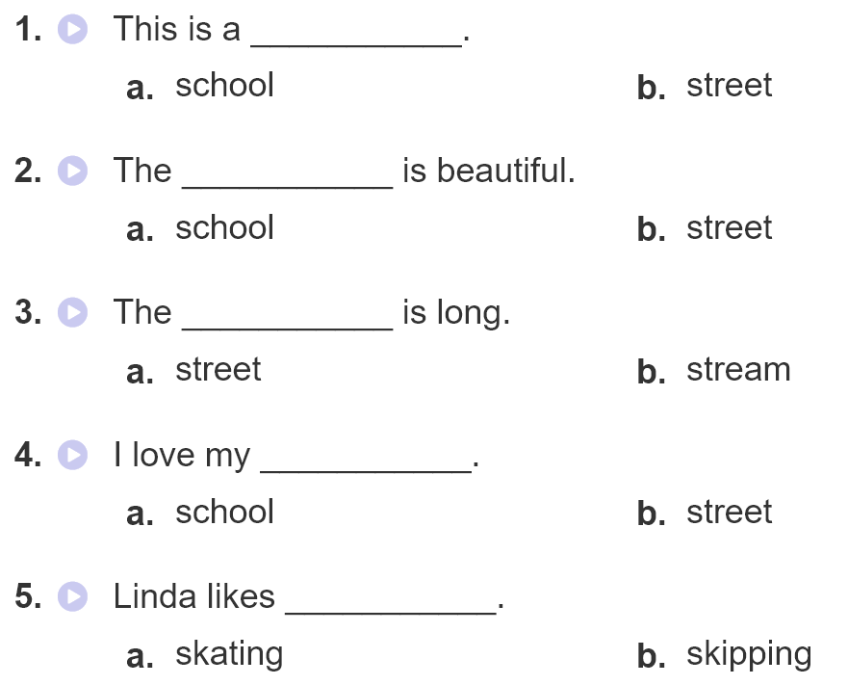
2. Listen and circle. Then write and say aloud

Slide 18
03
Practice

Slide 19


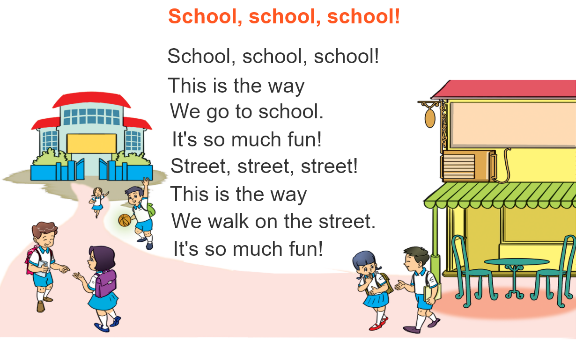

3. Let’s chant

Slide 20
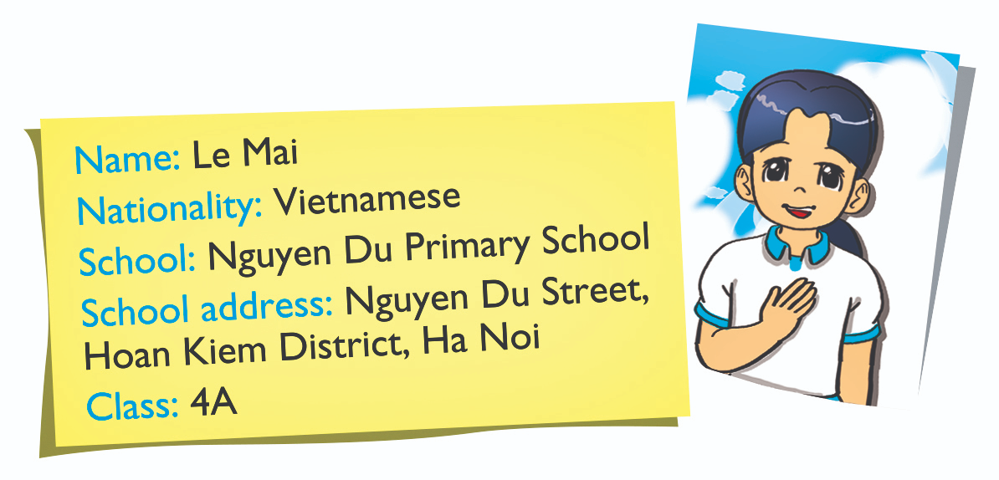
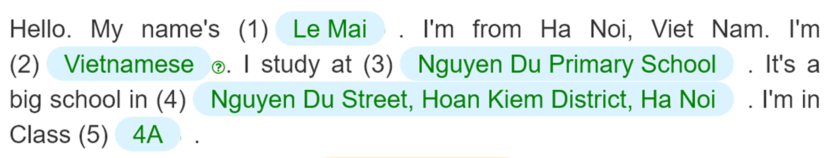
4. Read and complete.
___________
_________________
____________________________________
____________________________________________________________
______

Slide 21
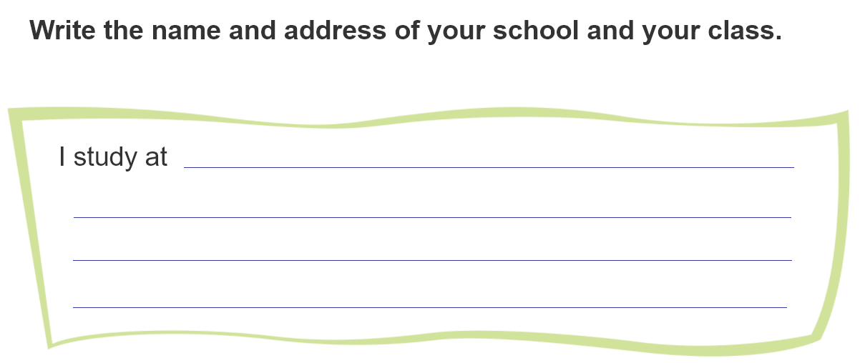
5. Write about your school
Thanh Am Primary School.
It’s in Thanh Am street, Long Bien district, Ha Noi.
I’m in class 4A1.

Slide 22
04
Homelink

Slide 23
Monday, November 7th 2022
Unit 6: Where’s your school?
Lesson 3
2. Homework:
Learn by heart the phonics.
Complete exercise 5 in Student’s book.
Do WB (SBT): part A-1,2 (page 24)
1. Phonics:
sch | school
str | street
sk | skipping

Slide 24
Thanks!
Do you have any questions?
Please keep this slide for attribution

