Slide 1




Welcome to our class!
Book : English 3
Teacher : Miss Linh

Slide 2


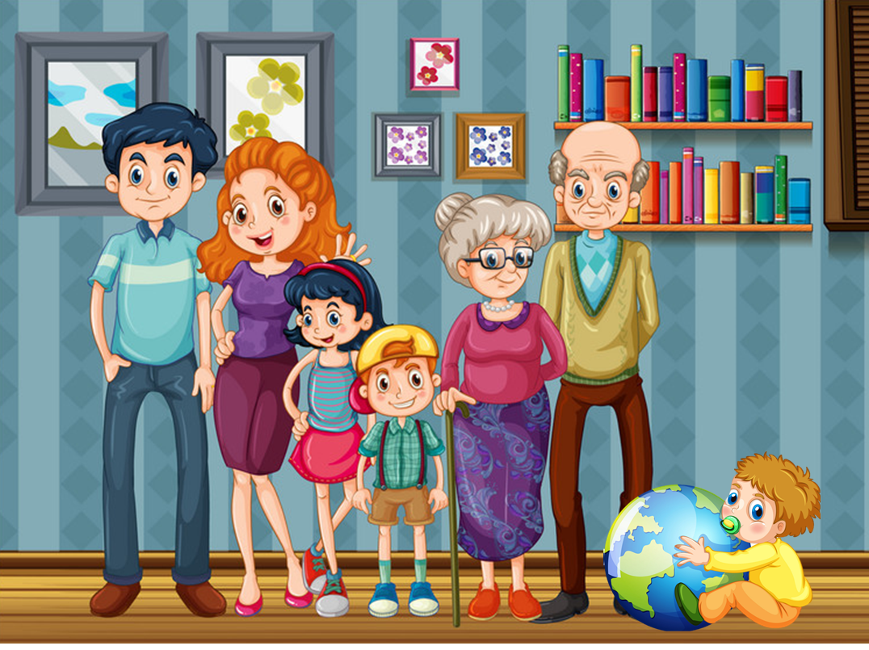
Unit 11
THIS IS MY FAMILY
Lesson 1

Slide 3



Objectives
01 .
Review the last lesson ( Words and Sentences).
02 .
Learn the new words and sentences about topic family.

Slide 4


Review
Unit 10

Slide 5

New words

Slide 6


family
/ˈfæmɪli/
gia đình

Slide 7
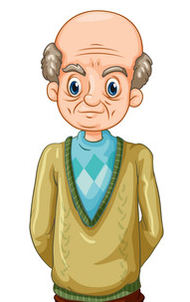
grandfather
/ˈgrændˌfɑːðə/
ông

Slide 8
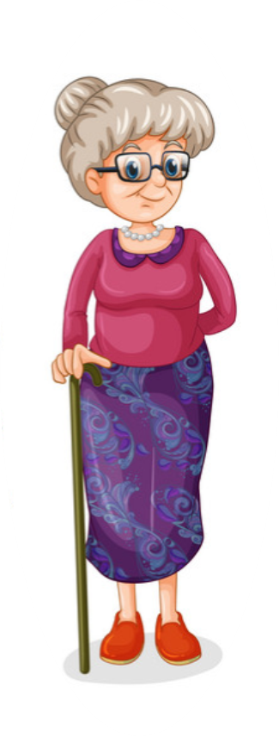
grandmother
/ˈgrænˌmʌðə/
bà

Slide 9
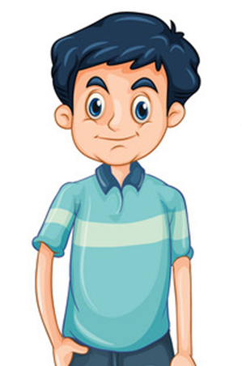
father
/ˈfɑːðə/
bố

Slide 10

mother
/ˈmʌðə/
mẹ

Slide 11

brother
/ˈbrʌðə/
anh trai, em trai

Slide 12
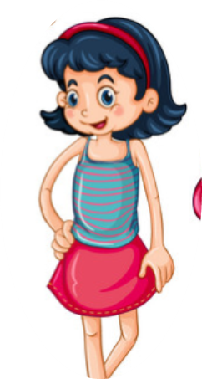
sister
/ˈsɪstə/
chị gái, em gái

Slide 13

Review
family
grandfather
grandmother
father
/ˈfæmɪli/
/ ˈgrændˌfɑːðə/
/ ˈgrænˌmʌðə/
/ ˈfɑːðə/
mother
brother
sister
/ ˈmʌðə/
/ ˈbrʌðə/
/ ˈsɪstə/

Slide 14

Match
4
1
mother
grandfather
5
2
brother
father
3
sister
6
grandmother

Slide 15
Look, read and circle.
mother
grandfather
brother
sister
father
grandmother
grandmother
grandfather
father

Slide 16
Look, read and circle.
sister
mother
father
father
brother
grandfather
grandmother
sister
brother

Slide 17
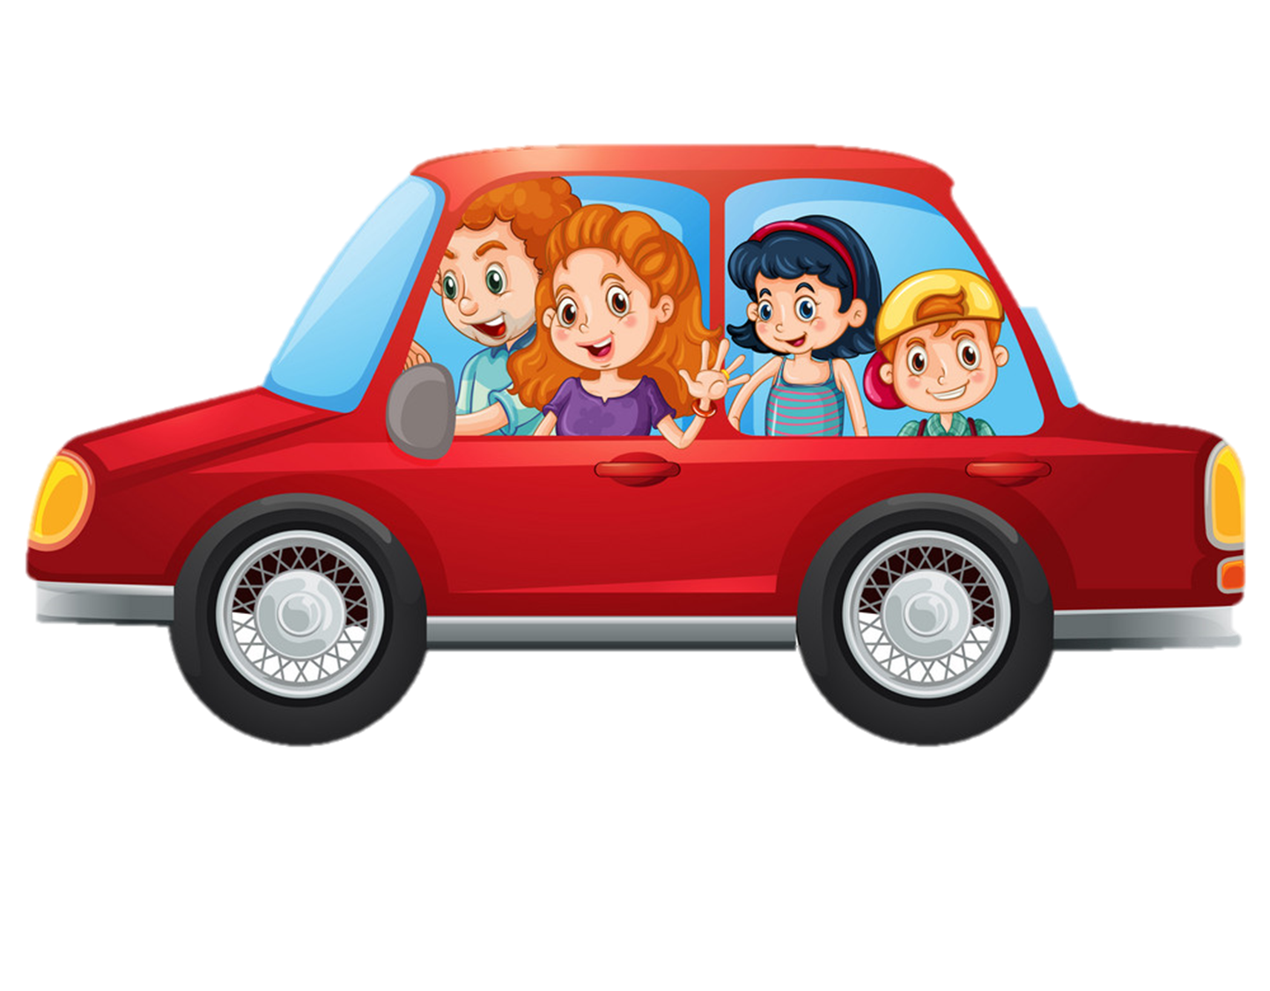

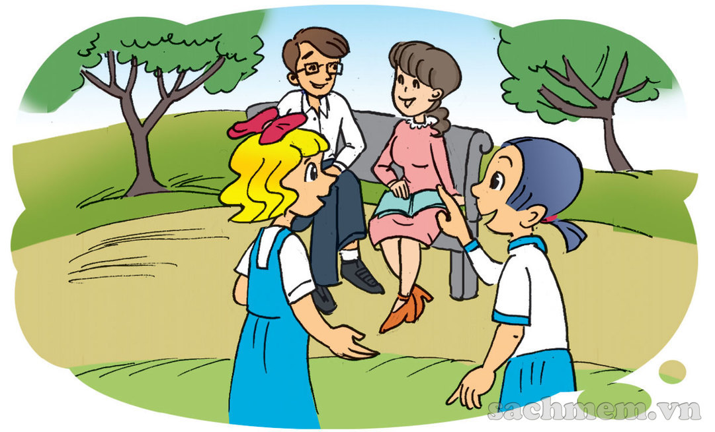
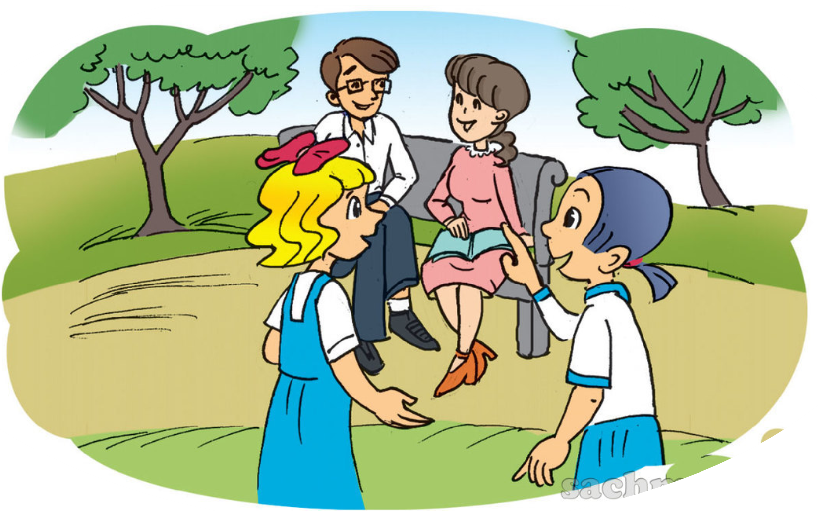

1. Look, listen and read.
And that's my mother
next to him.
a
b
Who's that man?
Really? He's young!
He's my father.
She's nice!

Slide 18
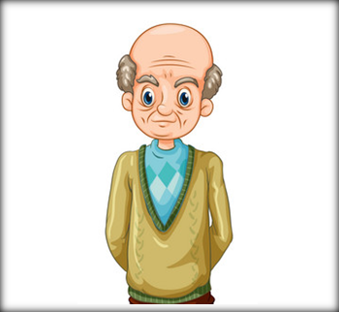





Model sentence
Who’s that?
_____’s my _______.
He
She
mother
She
He
grandfather
She
He
mother
She
brother
father
grandmother
sister

Slide 19

1
Who’s that?
She’s my grandmother.
________________________
2
Who’s that?
He’s my grandfather.
_____________________

Slide 20
3
Who’s that?
He’s my father.
___________
4
Who’s that?
She’s my mother.
_____________

Slide 21
5
Who’s that?
He’s my brother.
_____________
6
Who’s that?
She’s my sister.
_________

Slide 22

















Game
Picking apples
Notes:
Ms Huyền Phạm - 0936.082.789 – YOUTUBE: MsPham. Facebook: Dạy và học cùng công nghệ.

Slide 23
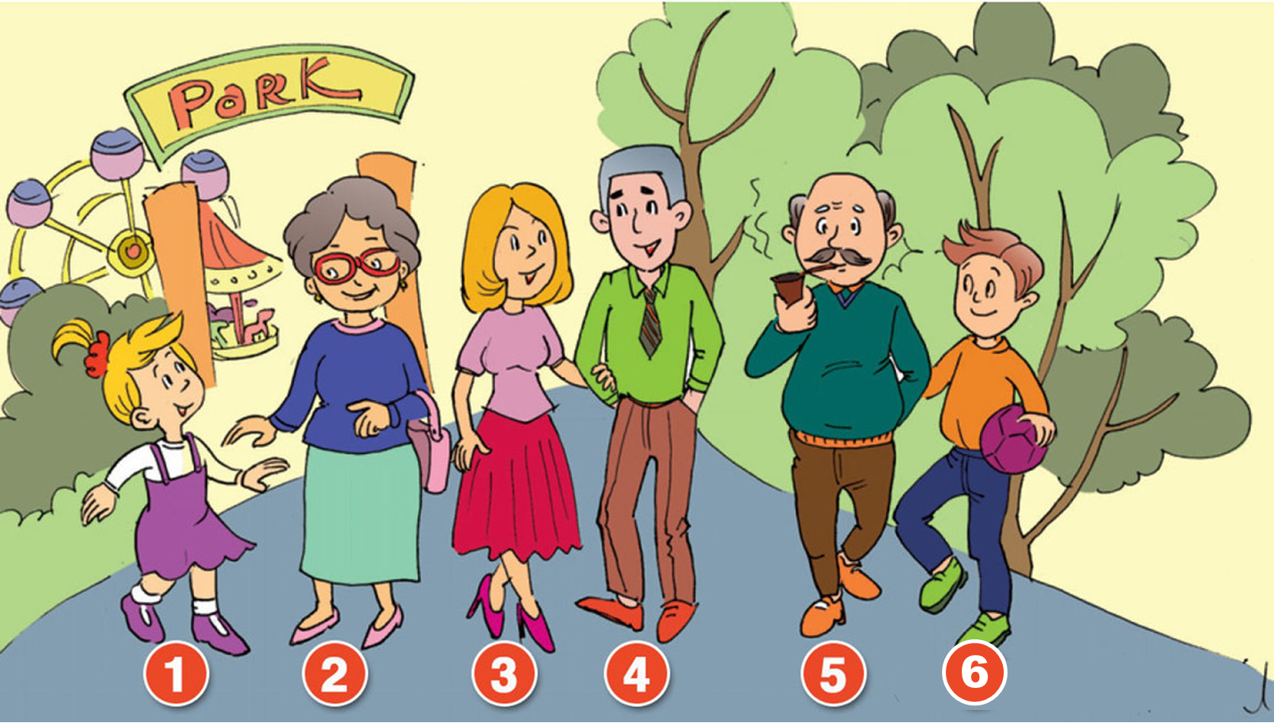

She
Who’s that?
____’s my grandfather.
A
He
B
You
C
Notes:
Ms Huyền Phạm - 0936.082.789 – YOUTUBE: MsPham. Facebook: Dạy và học cùng công nghệ.

Slide 24
Who’s
______ that?
She’s my mother.
A
What’s
B
How’s
C
Notes:
Ms Huyền Phạm - 0936.082.789 – YOUTUBE: MsPham. Facebook: Dạy và học cùng công nghệ.

Slide 25
family
Who’s that?
She’s my _______.
A
grandfather
B
grandmother
C
Notes:
Ms Huyền Phạm - 0936.082.789 – YOUTUBE: MsPham. Facebook: Dạy và học cùng công nghệ.

Slide 26
She’s
Who’s that?
_____ my father.
A
He’s
B
He
C
Notes:
Ms Huyền Phạm - 0936.082.789 – YOUTUBE: MsPham. Facebook: Dạy và học cùng công nghệ.

Slide 27
She
Who’s that?
_____ my sister.
A
He
B
She’s
C
Notes:
Ms Huyền Phạm - 0936.082.789 – YOUTUBE: MsPham. Facebook: Dạy và học cùng công nghệ.

Slide 28
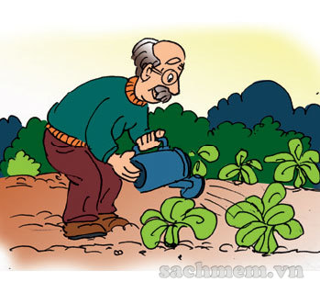
He’s my father.
Who’s that?
A
He’s my brother.
B
He’s my grandfather.
C
Notes:
Ms Huyền Phạm - 0936.082.789 – YOUTUBE: MsPham. Facebook: Dạy và học cùng công nghệ.

Slide 29
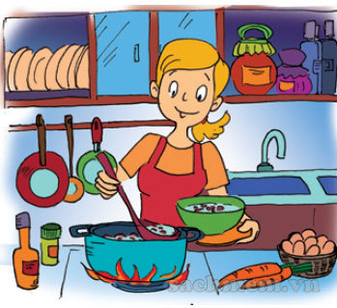
What’s that?
She’s my mother.
A
Who’s that?
B
How’s that?
C
Notes:
Ms Huyền Phạm - 0936.082.789 – YOUTUBE: MsPham. Facebook: Dạy và học cùng công nghệ.

Slide 30
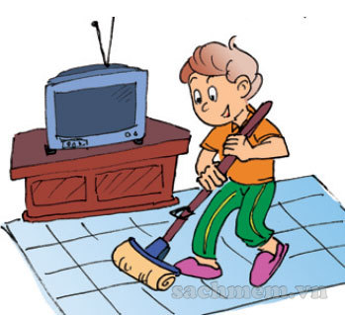
She’s my brother.
Who’s that?
A
He my brother.
B
He’s my brother.
C
Notes:
Ms Huyền Phạm - 0936.082.789 – YOUTUBE: MsPham. Facebook: Dạy và học cùng công nghệ.

Slide 31
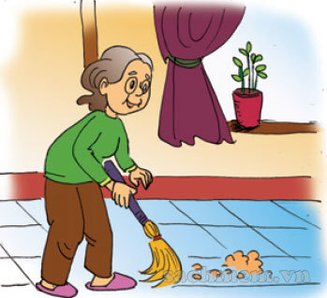
She’s my grandmother.
Who’s that?
_____________.
A
He’s my grandmother.
B
They’re my grandmother.
C
Notes:
Ms Huyền Phạm - 0936.082.789 – YOUTUBE: MsPham. Facebook: Dạy và học cùng công nghệ.

Slide 32
3. Let's talk
Who’s that?
He’s my grandfather.
Who’s that?
She’s my grandmother.
Who’s that?
He’s my brother.
Who’s that?
She’s my sister.
1
2
3
4
5
6
Who’s that?
She’s my mother.
Who’s that?
He’s my father.

Slide 33
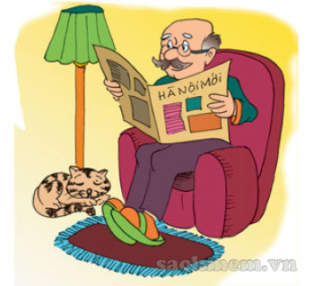
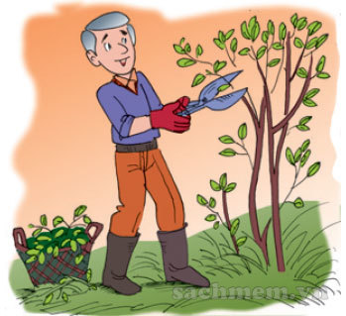

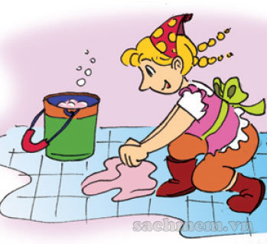
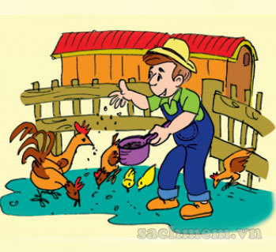

4. Listen
and tick.
1
a.
b.
c.
2
a.
b.
c.
3
a.
b.
c.

Slide 34



1. This is a photo of Mai's family.
2. The man is her father.
3. The woman is her mother.
4. And the boy is her brother.
________.
________.
________.
________.

Slide 35


Using the new words and sentences in the real life .
Home link
Do the homework in WB (SBT): A(1,2,3) page 44
Prepare the new lesson : Unit 11: Lesson 2

Slide 36
Tuesday, January 04 2022
Unit 11: This is my family - Lesson 1
1. New words
- family : gia đình
- grandfather : ông
- grandmother : bà
- father : bố
- mother : mẹ
- brother : anh / em trai
- sister : chị / em gái
2. Sentences
Who’s that?
-> She / He is my ........ (member family)
th

Slide 37

Thank you!

