Slide 1
UNIT 14 - LESSON 2
What happened
in the story?

Slide 2

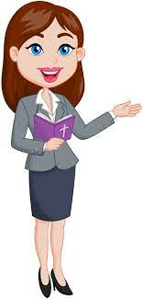
OBJECTIVES
(Mục tiêu của bài học hôm nay)
01
- Learn about some charateristics( Học về một số từ chỉ đặc điểm, tính cách.)
- Ask and answer about what someone is (Hỏi và trả lời về ai đó là người như thế nào.)
02
03
- Practice speaking, listening and reading skills.
(Luyện tập các kĩ năng nói, nghe và đọc hiểu.)
Notes:
Thanh Yến Trần 0967 255 149 zalo/ FB https://www.facebook.com/thanhyentrananhngutaymy/

Slide 3
Vocabulary

Slide 4


Vocabulary
100*2 = 200
intelligent
/ɪnˈtelɪdʒənt/

Slide 5
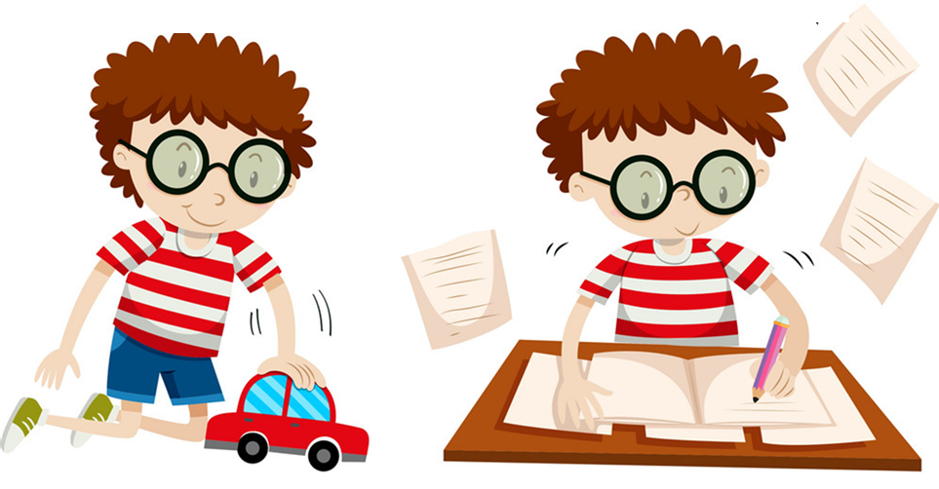
Vocabulary
hard-working
/ˌhɑːrd ˈwɜːrkɪŋ/

Slide 6
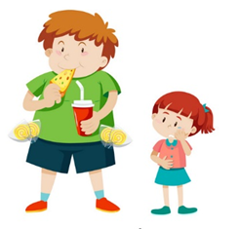
Vocabulary
greedy
/ˈɡriːdi/

Slide 7
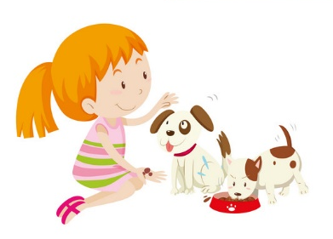
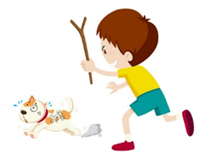
Vocabulary
kind
/kaɪnd/

Slide 8
Vocabulary
kind
greedy
100*2 = 200
hard-working
intelligent

Slide 9
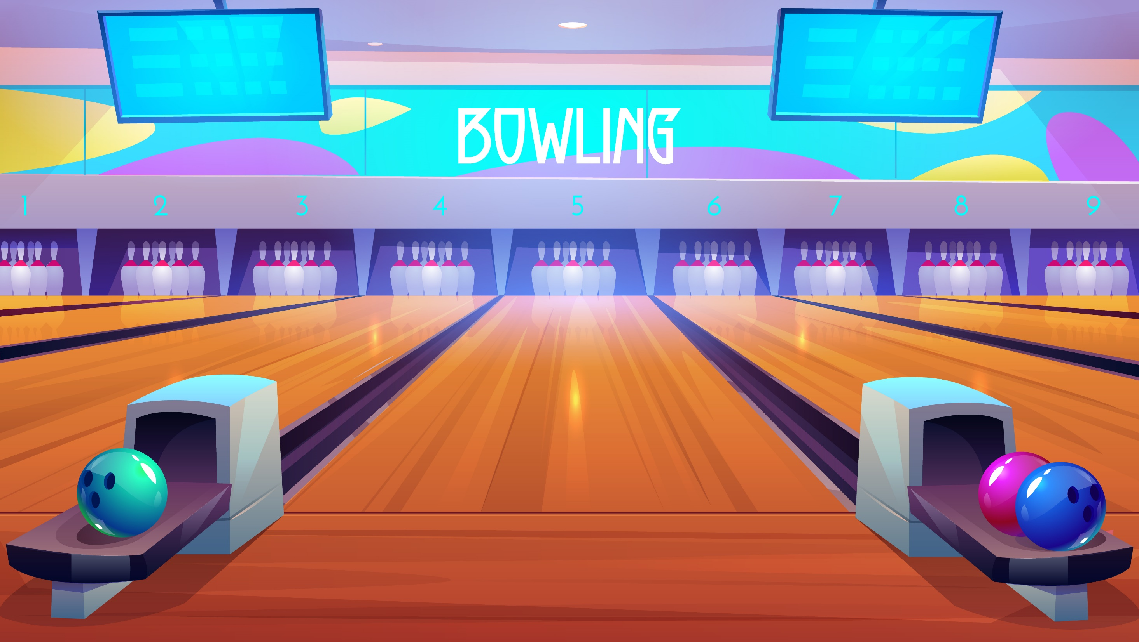



Notes:
Ms Huyền Phạm - 0936.082.789 – YOUTUBE: MsPham. Facebook: Dạy và học cùng công nghệ.

Slide 10
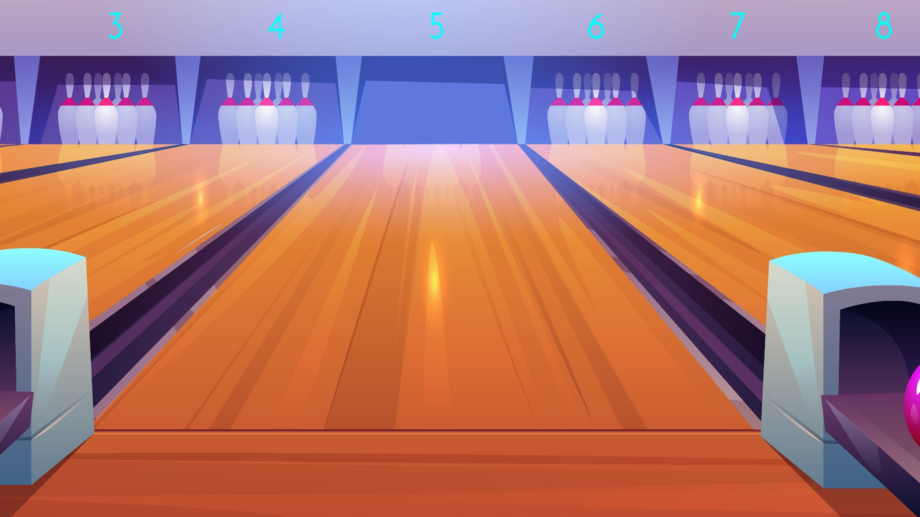
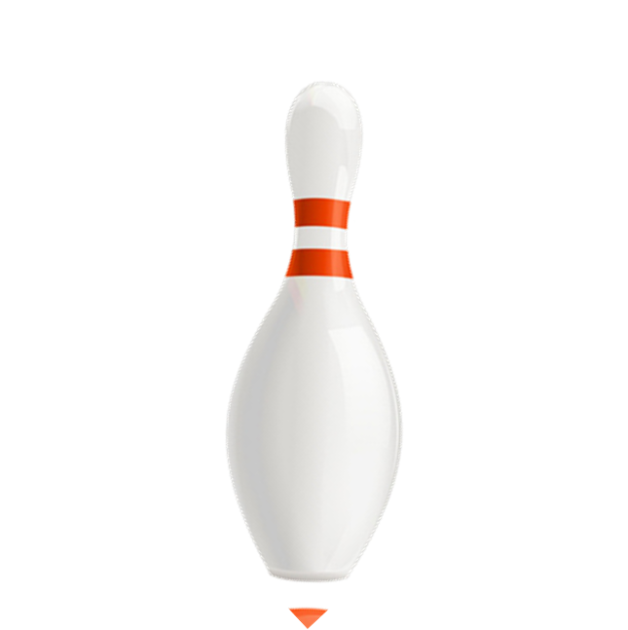


a. kind
b. greedy
Câu hỏi 1
c. intelligent
Notes:
Ms Huyền Phạm - 0936.082.789 – YOUTUBE: MsPham. Facebook: Dạy và học cùng công nghệ.

Slide 11
a. greedy
b. hard-working
Câu hỏi 2
c. kind
Next
Notes:
Ms Huyền Phạm - 0936.082.789 – YOUTUBE: MsPham. Facebook: Dạy và học cùng công nghệ.

Slide 12
a. greedy
b. hard-working
Câu hỏi 3
c. intelligent
Next
Notes:
Ms Huyền Phạm - 0936.082.789 – YOUTUBE: MsPham. Facebook: Dạy và học cùng công nghệ.

Slide 13
a. hard-working
b. intelligent
Câu hỏi 4
100*2 = 200
c. greedy
Next
Notes:
Ms Huyền Phạm - 0936.082.789 – YOUTUBE: MsPham. Facebook: Dạy và học cùng công nghệ.

Slide 14
a. greedy
b. intelligent
Tốt bụng
c. kind
Next
Notes:
Ms Huyền Phạm - 0936.082.789 – YOUTUBE: MsPham. Facebook: Dạy và học cùng công nghệ.

Slide 15
a. Hard- working
b. kind
Chăm chỉ
c. greedy
Notes:
Ms Huyền Phạm - 0936.082.789 – YOUTUBE: MsPham. Facebook: Dạy và học cùng công nghệ.

Slide 16
a. greedy
b. hard-working
Tham Lam
c. kind
Next
Notes:
Ms Huyền Phạm - 0936.082.789 – YOUTUBE: MsPham. Facebook: Dạy và học cùng công nghệ.

Slide 17
a. hard-working
b. greedy
Thông minh
c. intelligent
Next
Notes:
Ms Huyền Phạm - 0936.082.789 – YOUTUBE: MsPham. Facebook: Dạy và học cùng công nghệ.

Slide 18


EXIT
Notes:
Ms Huyền Phạm - 0936.082.789 – YOUTUBE: MsPham. Facebook: Dạy và học cùng công nghệ.

Slide 19
Grammar

Slide 20
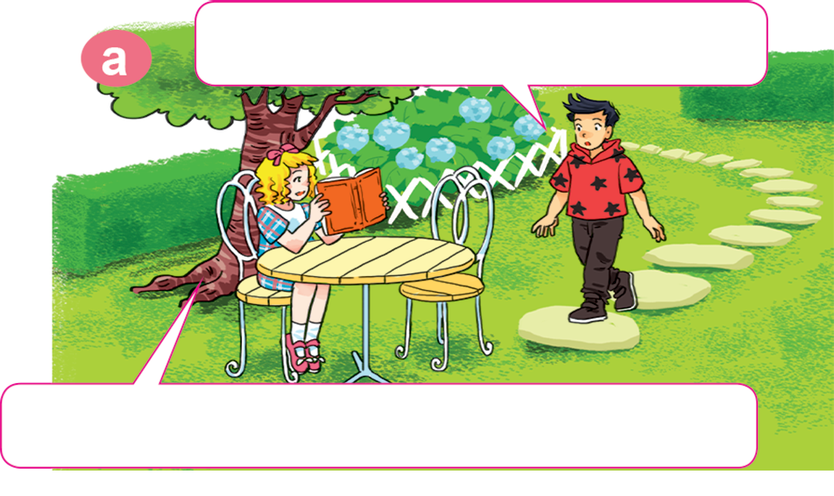
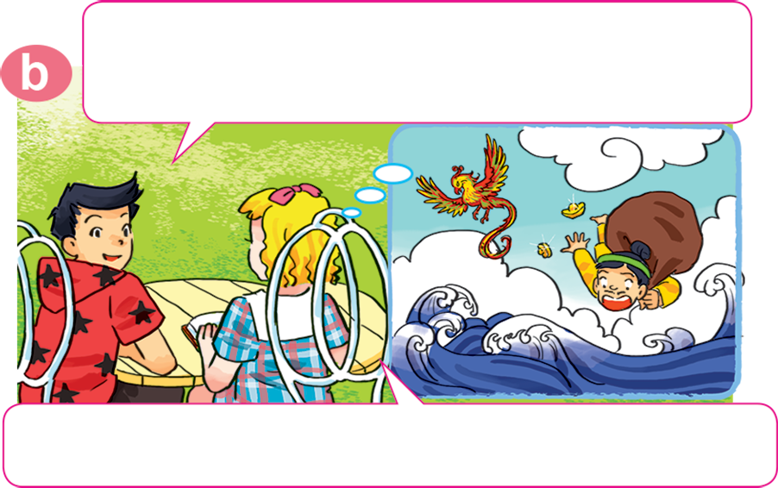
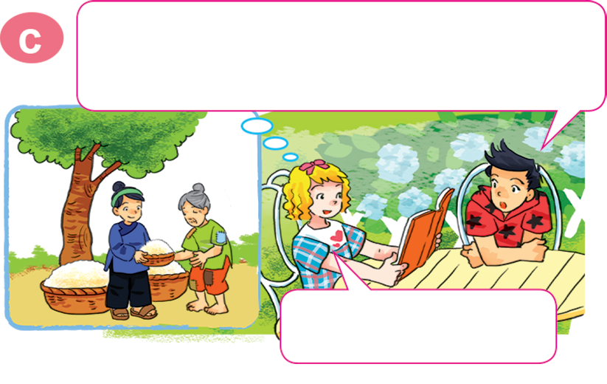
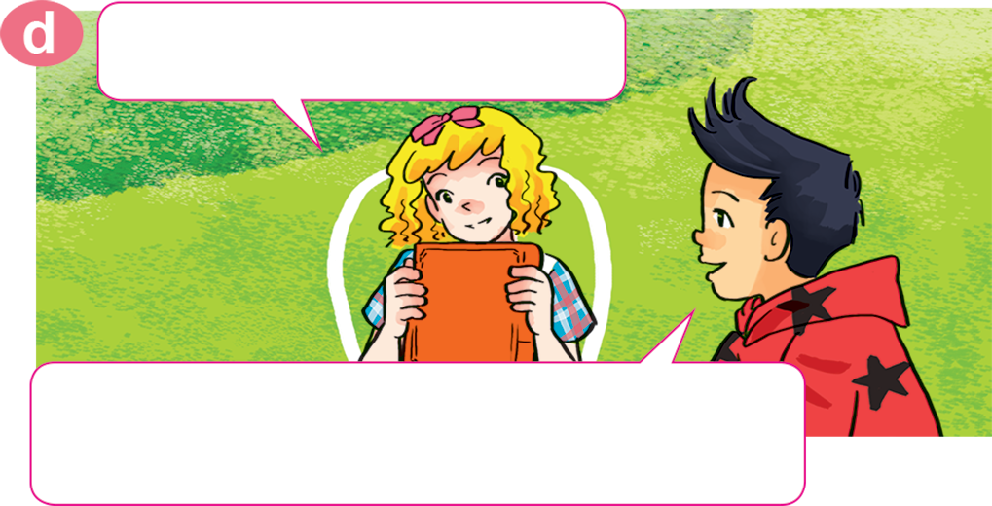
1. Look, listen and repeat.
What are you doing, Linda?
Oh, I read it last week. What do you think of the two brothers?
I'm reading The Golden Starfruit Tree.
I think the older brother is very greedy.
Yeah, you're right. How about the younger one?
Do you like the story?
Yes, I do. We can learn a lesson from it: don't be so greedy!
He's very kind.

Slide 21

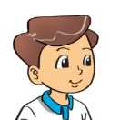
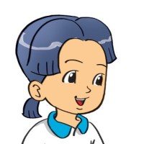
2. Point and say
What do you think of _____________?
I think _____________________.
the mouse
it's intelligent

Slide 22

2. Point and say
What do you think of _____________?
I think _____________________.
An Tiem
he’s hard-working

Slide 23

2. Point and say
What do you think of _______________?
I think _____________________.
the older brother
he’s greedy

Slide 24

2. Point and say
What do you think of _____________?
I think _____________________.
Snow White
she’s kind

Slide 25
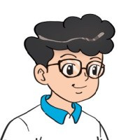
3. Let’s talk.
What kinds of stories do you like?
I like _______________.
What do you think of ?
I think he's/she's/it's__________________.

Slide 26





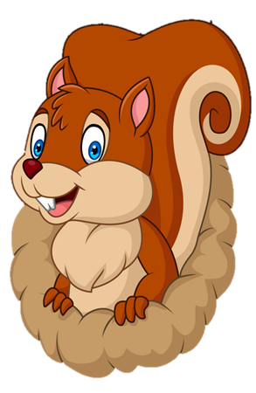
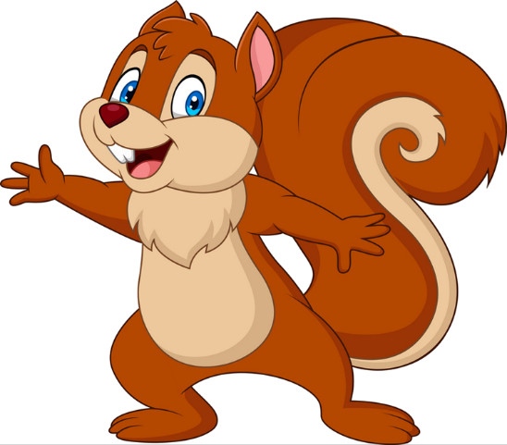
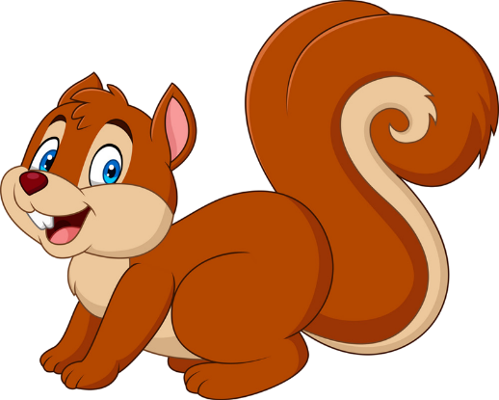
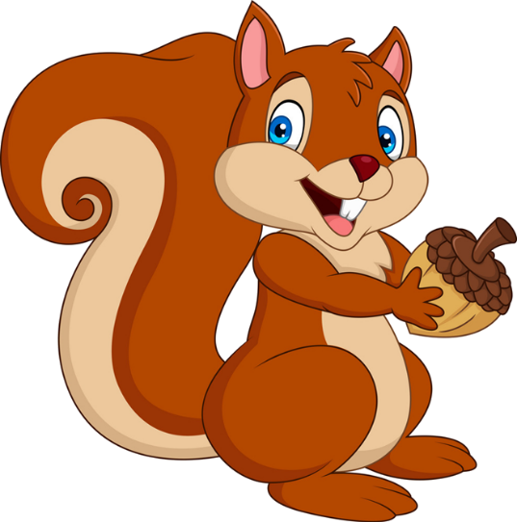


PLAY
NEXT
Brown squirrel
& acorn

Slide 27


What do you think of Tam?
I think _________.
She’s kind.
She’s intelligent.
farm
zoo

Slide 28
What do you think of An Tiem?
I think _________.
He’s hard-working.
She’s hard-working.
farm
zoo

Slide 29
What do you think of Snow White?
I think _________.
She’s greedy.
She’s kind.
farm
farm

Slide 30
What do you think of the mouse?
I think _________.
She’s intelligent.
It’s intelligent.
farm
farm

Slide 31
What _____ you think of the older brother?
I think he’s greedy.
does
do
farm
zoo

Slide 32
What do you think of An Tiem?
I ______ he’s kind.
think
think of
Next
farm
zoo

Slide 33
What do you think ____ Cam?
I think she’s not kind.
about
of
farm
zoo

Slide 34

What do you think of the older brother?
I think _________.
He’s greedy.
He’s kind.
Next
farm
zoo

Slide 35


Good job!

Slide 36


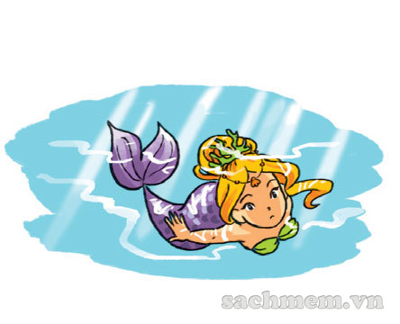
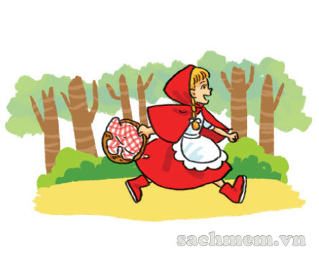
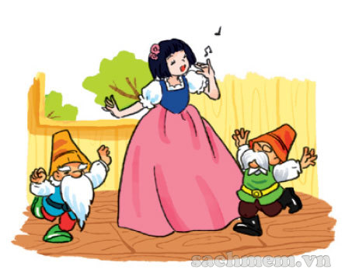
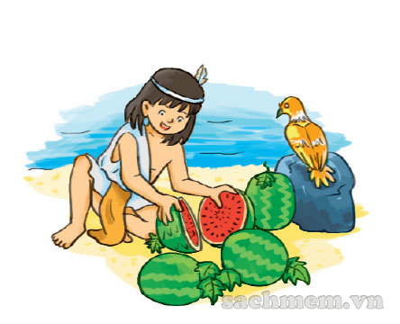
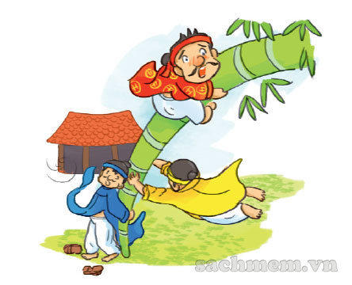
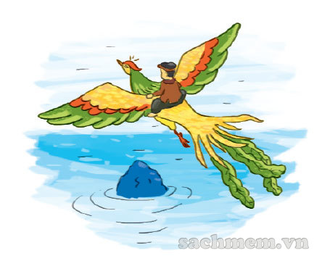
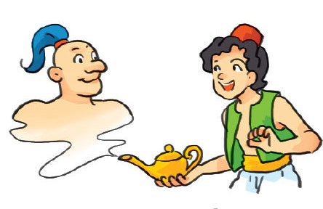
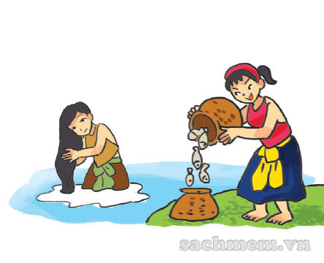
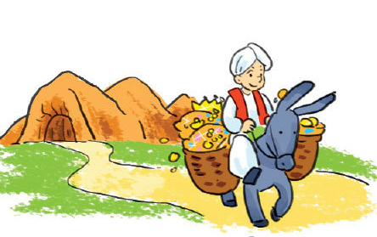
4. Listen and tick.
a
b
c
1
✓
a
b
c
2
✓
a
b
c
3
✓

Slide 37
5. Write about your favourite book.
1. What kinds of books do you like?
2. What is your favourite book?
3. Which character do you like best?
4. Which character don't you like?
5. Why do you like this book?
I like fairy tale/ folk tale / funny story….
My favourite book is _______________.
I like ________________ best.
I don’t like _______________.
Because ______________________.

Slide 38








Let’s remember!
(Cùng ghi nhớ nhé!)
SB (SGK)
Ex5 – p27
WB (SBT) p55-57
Review the words, model sentences and dialogues in Unit 14 – Lesson 2
(Ôn lại từ vựng và mẫu câu trong Bài 14 – Tiết 2)
PREVIEW
(Xem trước)
SB: Unit 14 – Lesson 3

Slide 39
Tuesday, February 22nd , 2022
Unit 14: Lesson 2 – p26,27
Words
Intelligent: thông minh
Kind: tốt bụng
Greedy: keo kiệt, tham lam
Hard – working: chăm chỉ
Think of: suy nghĩ về
2. Model sentence
A: What do you think of An Tiem?
B: I think he’s hard – working.

