Slide 1

Welcome to our class
Teacher: Luong Thanh Lam
Vu Xuan Thieu Primary School
English 3

Slide 2
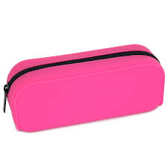
Your School Things
book
pen
Pencil case
Pencil case
ruler
School bag
notebook
rubber
pencil
Click me!

Slide 3

Your School Things
pencil
ruler
Pencil case
pencil
book
rubber
pen
School bag
notebook
Click me!

Slide 4
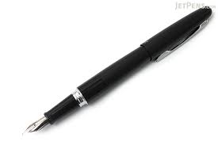
Your School Things
book
ruler
School bag
pen
pen
Pencil case
notebook
pencil
rubber
Click me!

Slide 5
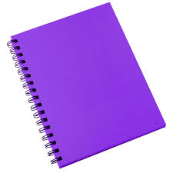
Your School Things
pen
notebook
ruler
notebook
Pencil case
rubber
book
School bag
pencil
Click me!

Slide 6
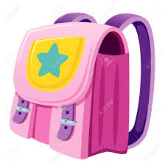
Your School Things
book
ruler
Pencil case
School bag
rubber
pencil
School bag
notebook
pen
Click me!

Slide 7
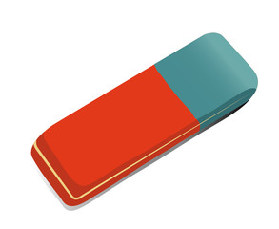

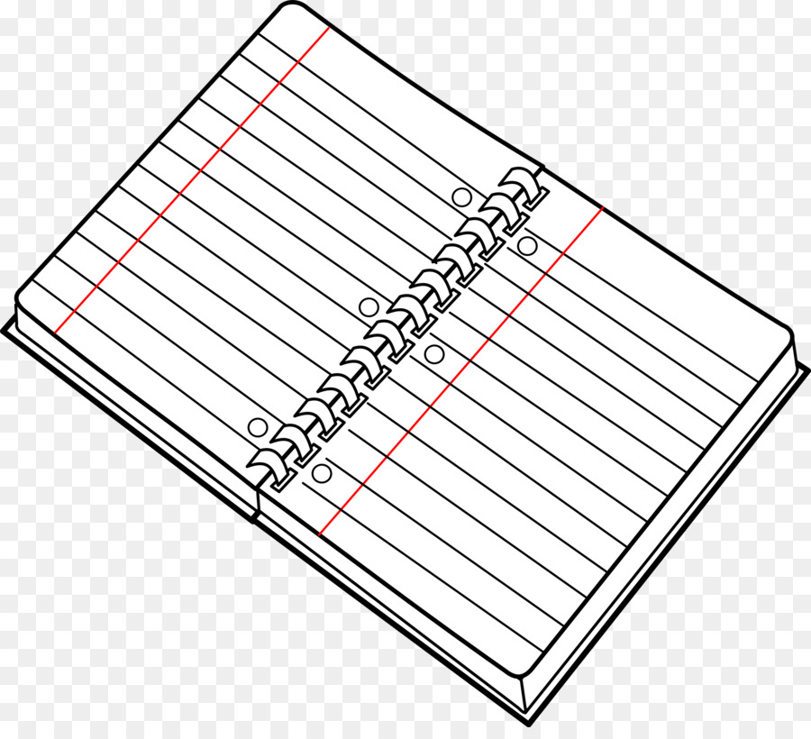


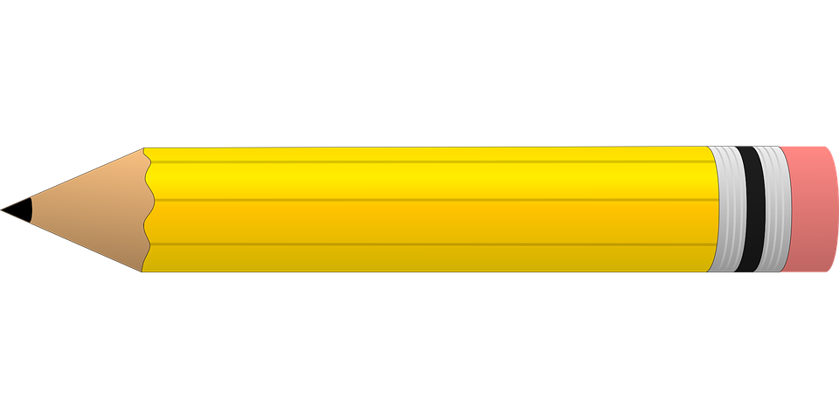

Slide 8


Slide 9

blue

Slide 10
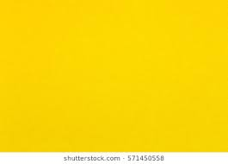

yellow
orange

Slide 11
white
saf

Slide 12


brown
green

Slide 13

UNIT 9 : WHAT COLOUR IS IT ?
LESSON 2

Slide 14
1. Look, listen and repeat.
1. blue
2. white
3. yellow
4. brown
5. green
6. orange
7.Colour

Slide 15
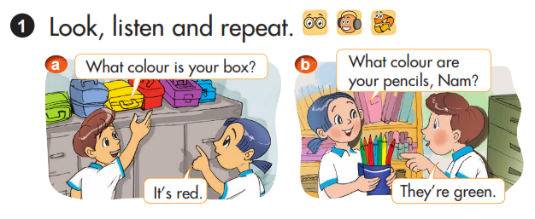


Slide 16
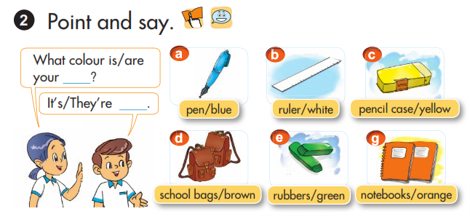

Slide 17
What colour is your
2. Point and say
(số ít)
+ Đồ dùng học tập?
colour.
It’s = It is
It’s +
What colour are your
+ Đồ dùng học tập?
(số nhiều)
colour.
They’re = They are
They’re +

Slide 19

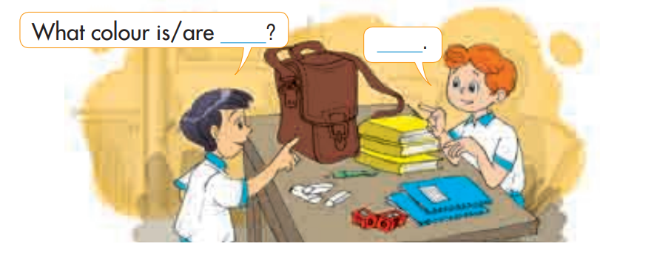
3. LET’S TALK.

Slide 20






Matching
A
1. Blue
2. White
3. Yellow
4. Brown
5. Green
6. Orange
B

Slide 21



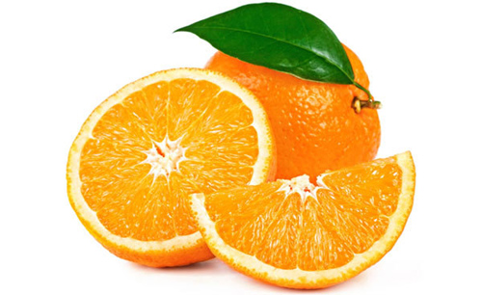

Slide 22
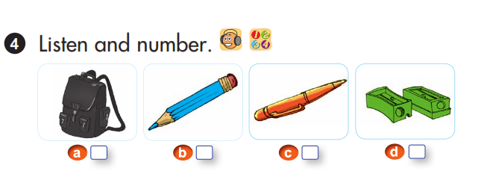
3
2
4
1

Slide 23

Consolidation

Slide 24
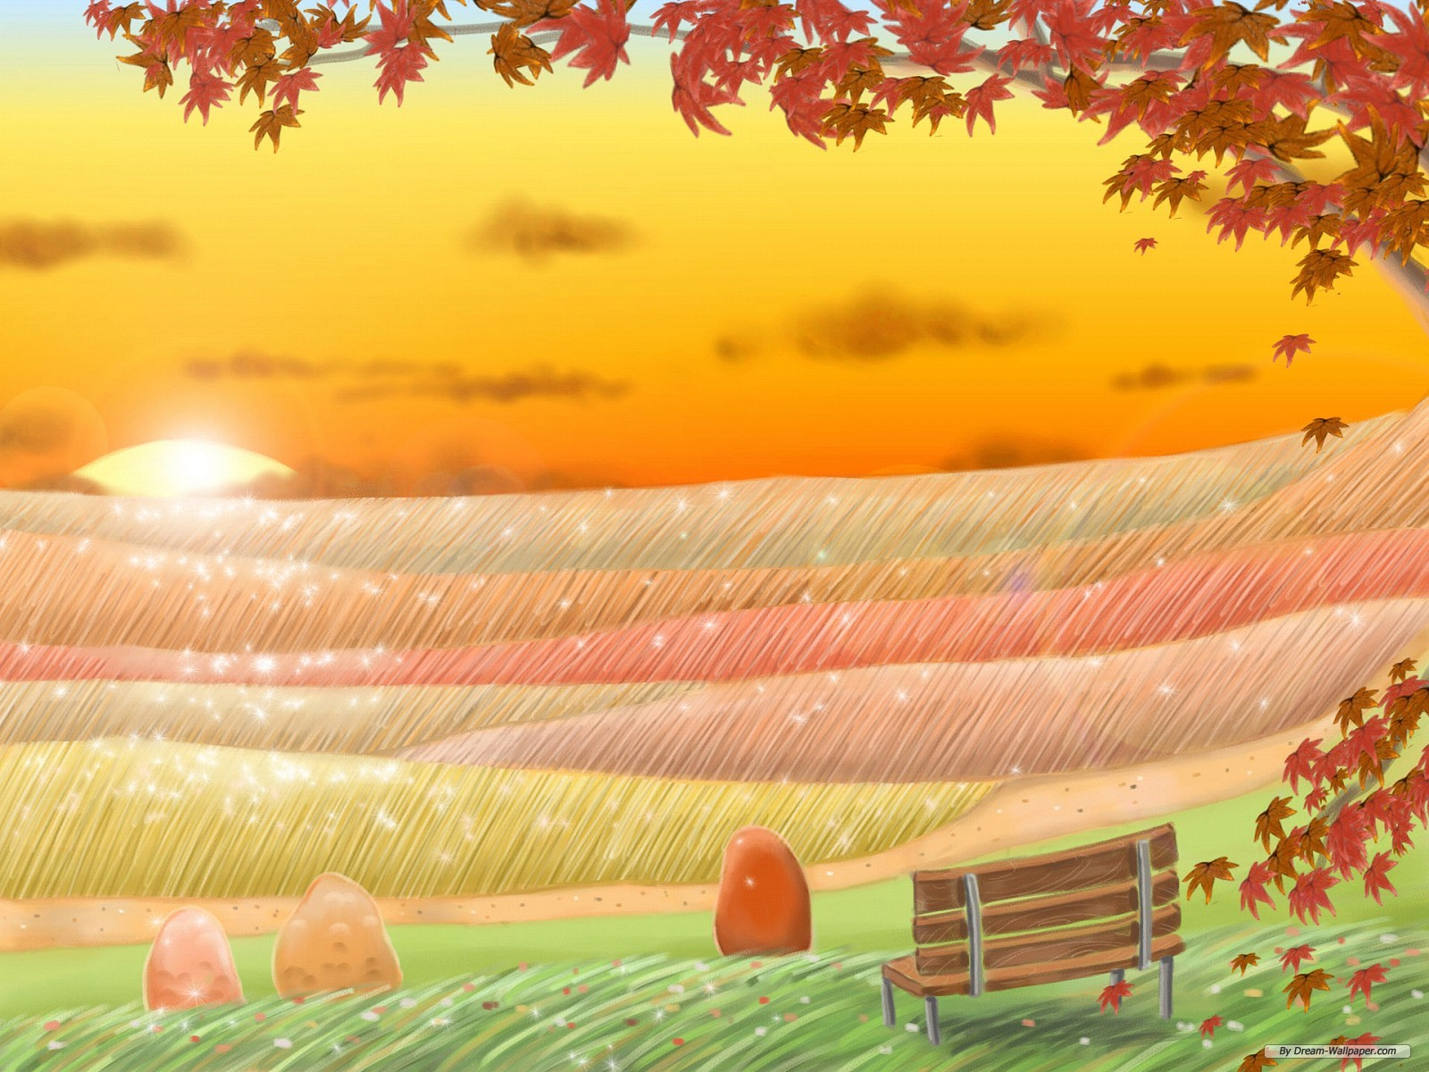

Thank you! Goodbye!

