Slide 1
WELCOME TO OUR CLASS!

Slide 2
TOPIC ANIMALS

Slide 4
Would you like listen a song?

Slide 6
DOG /

Slide 7
PIG

Slide 8
CAT

Slide 9
DUCK /dʌk/

Slide 10
CHICKEN /ˈtʃɪk.ɪn/

Slide 12
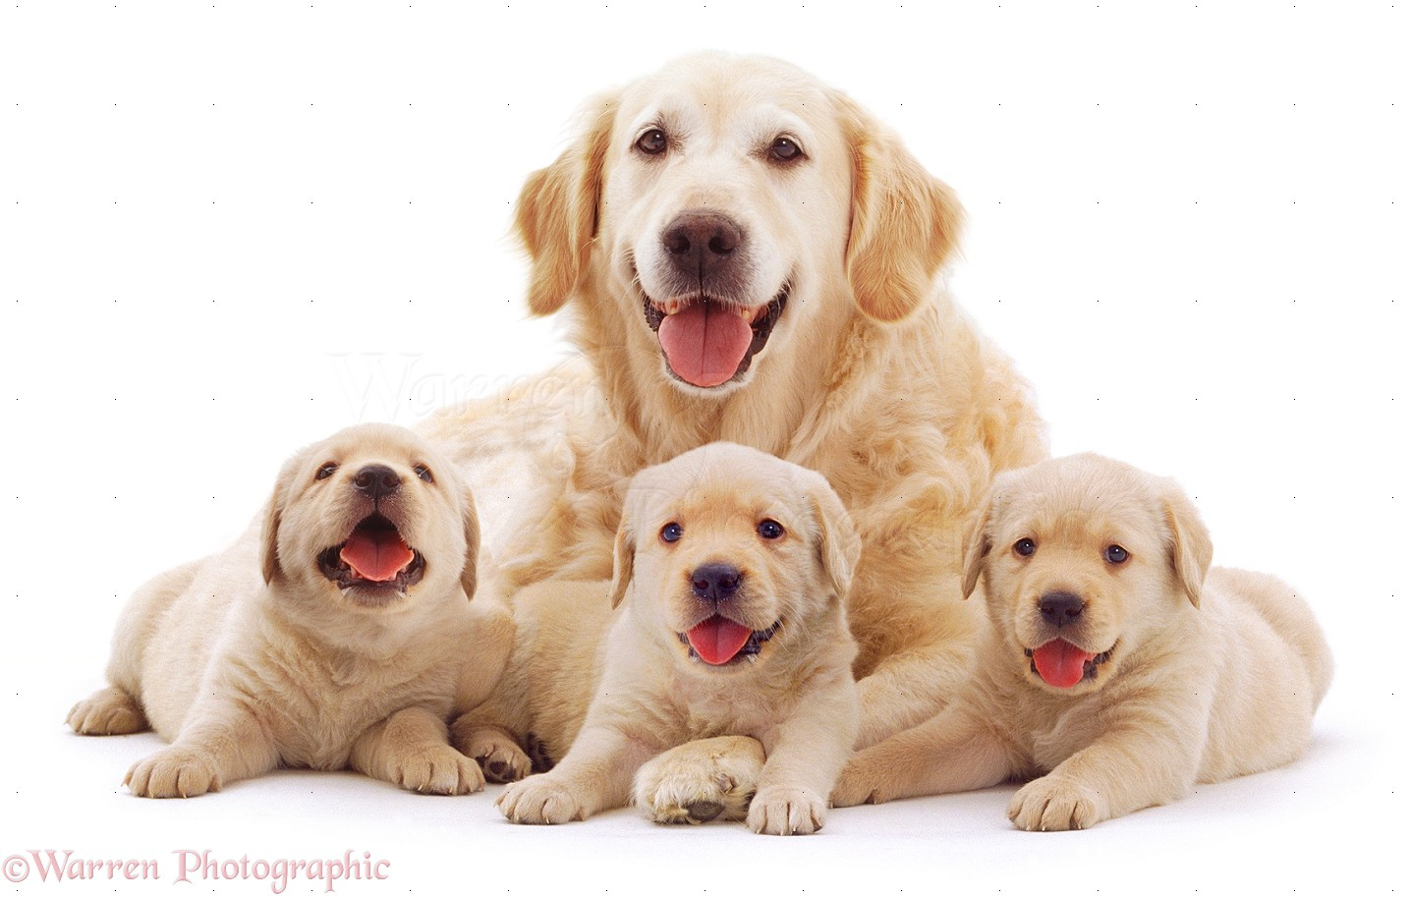

Slide 17
GOOD BYE!

Slide 19
RABBIT

Slide 20
MOUSE /maʊs/

Slide 21
TIGER /ˈtaɪ.gəʳ/

Slide 22
LION /ˈlaɪ.ən/

Slide 23
ELEPHANT /ˈel.ɪ.fənt/

Slide 26
MONKEY /ˈmʌŋ.ki/

Slide 27
BEAR /beəʳ/

Slide 28
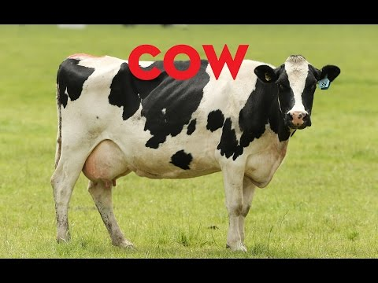
COW /kaʊ/

Slide 29
HORSE /hɔːs/

Slide 30
CRAB /kræb/

Slide 31
SHEEP/ʃiːp/

Slide 32
BEE /biː/

Slide 33
FISH

