Slide 1









Cách xì/ hỉ mũi, lau mũi

Slide 2


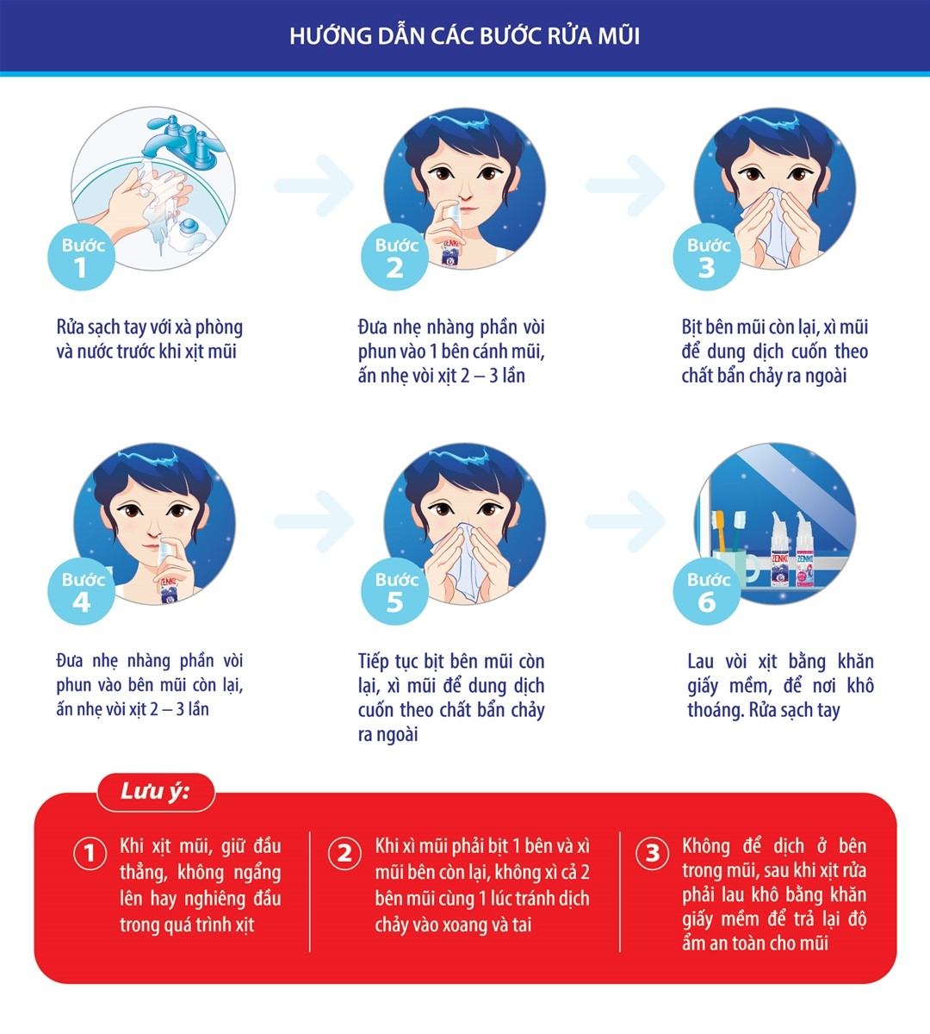




Slide 8
Chúc các bé luôn vui khỏe!

