Slide 1
Unit 4: Travel
Lesson 3.1
Page 54

Slide 2
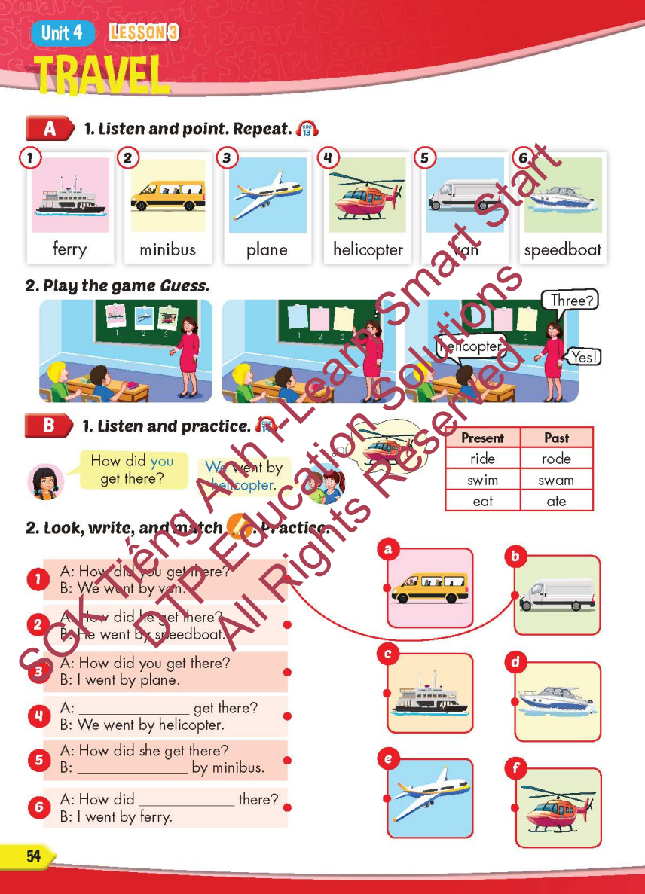
Lesson Outline
Warm-up
Vocabulary
Structure
Consolidation
Wrap-up

Slide 3
Objectives
By the end of this lesson, students will be able to…
Vocabulary: Pronounce and use the words related to the topic properly: ferry, minibus, plane, helicopter, van, speedboat
Structure: How did you get there? - We went by helicopter.

Slide 4
WARM-UP

Slide 5
FIND THE GOLDEN EGGS

Slide 6
Canada
A.
B.

Slide 7
South Korea
A.
B.

Slide 8
Spain
A.
B.

Slide 9
France
A.
B.

Slide 10
Germany
A.
B.

Slide 11
Choose the right word.
A.
B.
Garmany
Germany

Slide 12
Choose the right word.
A.
B.
Spain
Span

Slide 13
Choose the right word.
A.
B.
Brazil
Brazin

Slide 14
GOODBYE

Slide 15
It’s time to learn …

Slide 16
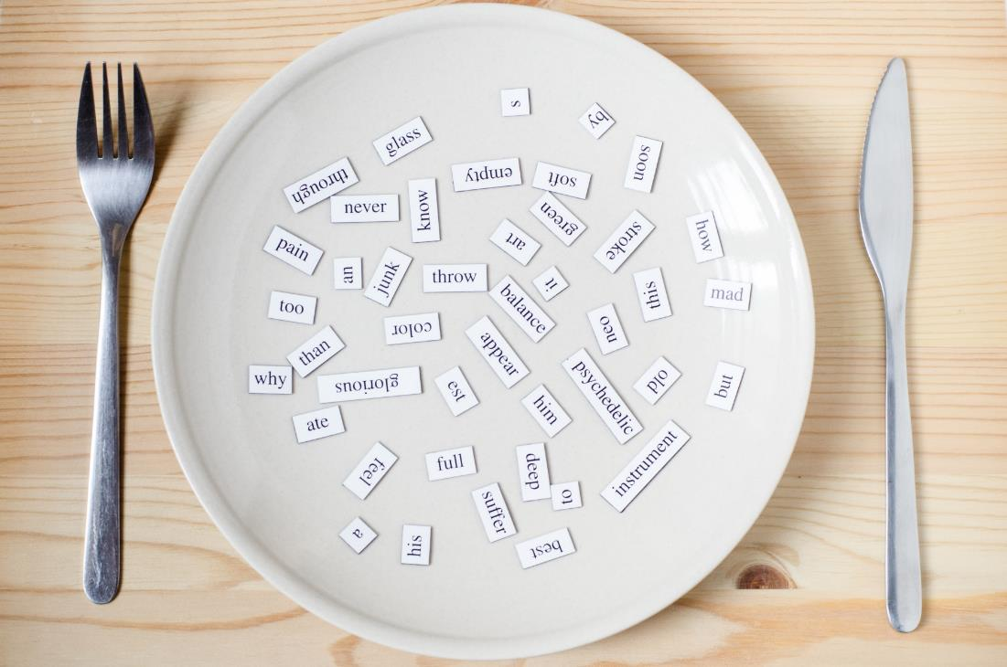
New words
ferry, minibus, plane,
helicopter, van, speedboat

Slide 17
Presentation

Slide 18
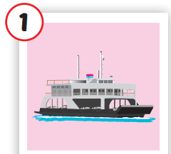
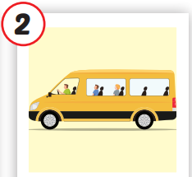
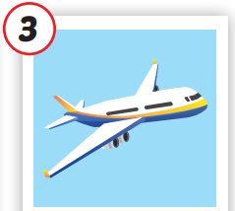
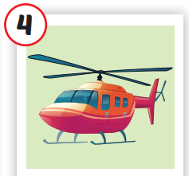
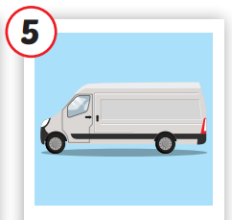
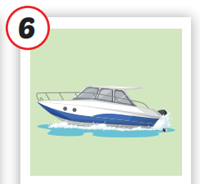
/ˈferi/
phà
/ˈmɪnibʌs/
xe buýt nhỏ
/pleɪn/
má bay
/ˈheləˌkɑːptə/
trực thăng
/væn/
xe tải nhỏ,
có mui
/ˈspiːdboʊt/
tàu thủy cao tốc
Notes:
Click vào hình A. 1. Listen and point. Repeat để cho cả audio full chạy

Slide 19
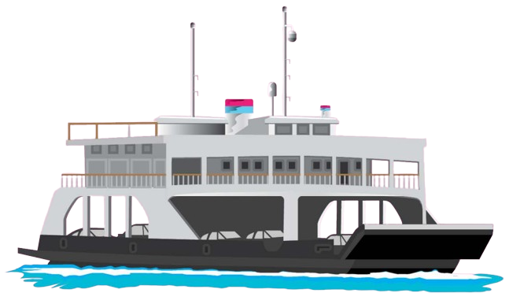
/ˈferi/
phà

Slide 20
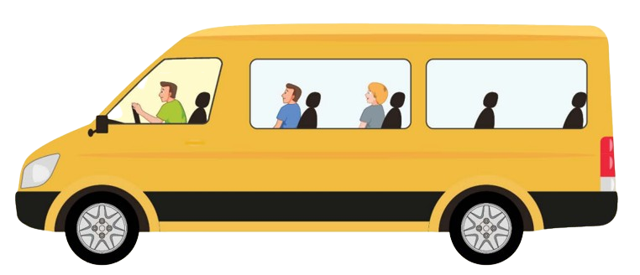
/ˈmɪnibʌs/
xe buýt nhỏ

Slide 21
/pleɪn/
má bay

Slide 22
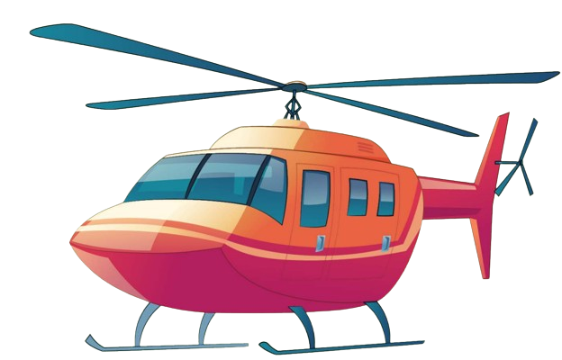
/ˈheləˌkɑːptə/
trực thăng

Slide 23
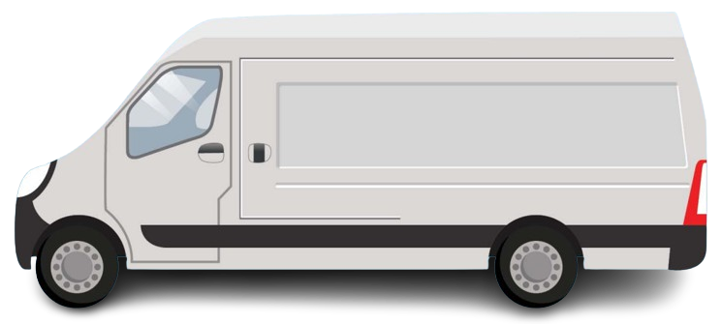
/væn/
xe tải nhỏ,
có mui

Slide 24
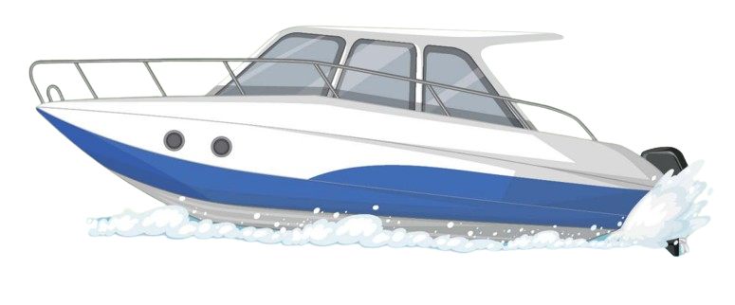
/ˈspiːdboʊt/
tàu thủy cao tốc

Slide 25
Practice

Slide 26
Check your memory
?

Slide 27
ferry
van
speedboat

Slide 28
helicopter
ferry
plane

Slide 29
plane
ferry
van

Slide 30
helicopter
plane
van

Slide 31
plane
minibus
van

Slide 32
plane
van
speedboat

Slide 34
Structure
How did you get there?
- We went by helicopter.

Slide 35
Presentation

Slide 36
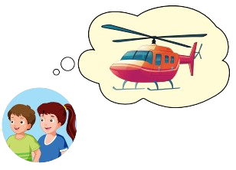
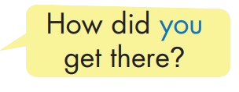
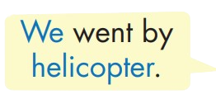
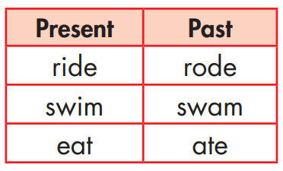
Structure

Slide 37
Practice

Slide 39
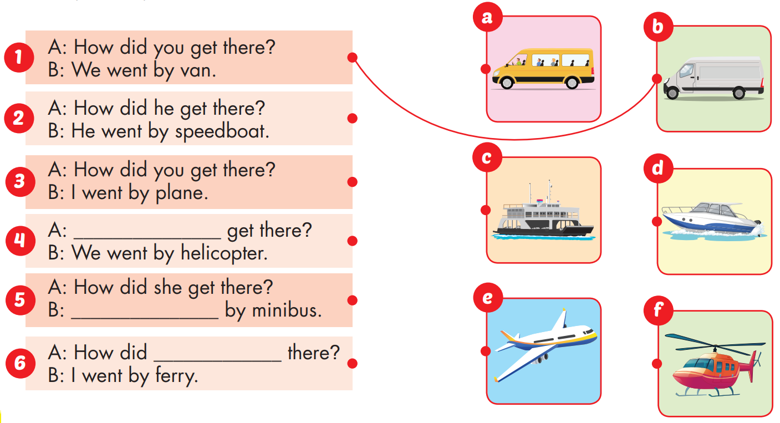
How did you
She went
you get

Slide 40
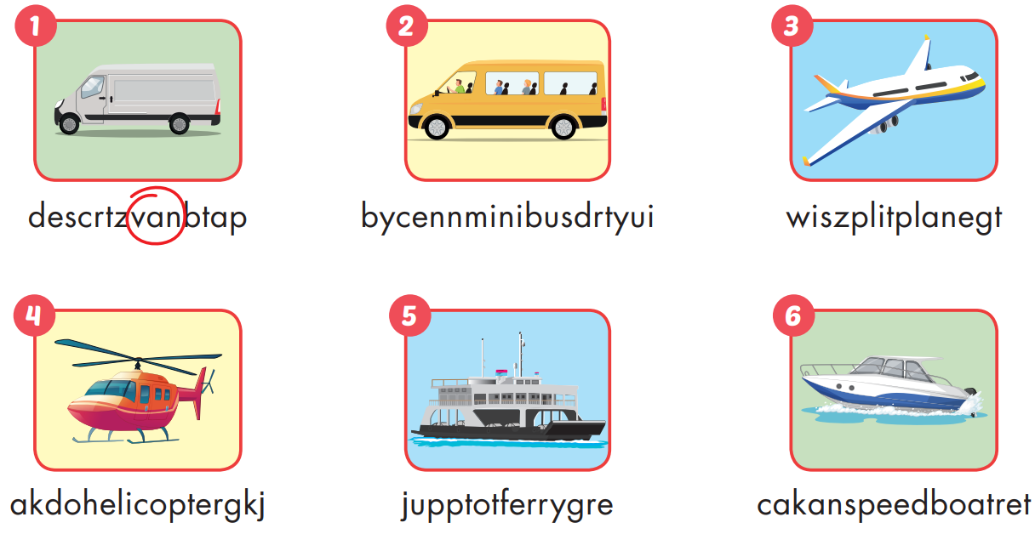
Extra Practice
WB, page 36

Slide 41
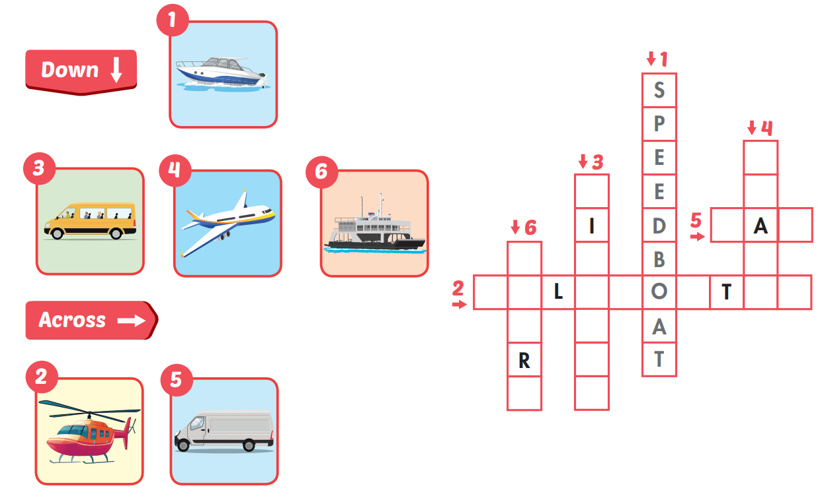
Extra Practice
WB, page 36

Slide 42
Production

Slide 43
CONSOLIDATION

Slide 44
WRAP-UP

Slide 45
Today’s lesson
Vocabularies
ferry, minibus, plane, helicopter, van, speedboat
Structures/ Sentence patterns
How did you get there?
- We went by helicopter.

Slide 46
Homework
Practice the vocabularies and structure, and make sentences using them.
Do the exercises in Tiếng Anh 5 i-Learn Smart Start WB (page 36)
Do the exercises in Tiếng Anh 5 i-Learn Smart Start Notebook (page 24)
Prepare the next lesson (page 55 SB)
Play the consolidation games in Tiếng Anh 5 i-Learn Smart Start DHA App on www.eduhome.com.vn

Slide 47
Enjoy your day!

Slide 48
Lesson 3
Stay positive and have a nice day!

