Slide 1
Unit 11: OUR GREENER WORLD lesson 7: Looking back and project
Grade 6

Slide 2
Objectives
By the end of the lesson, students can be able to:
review the vocabulary and grammar of Unit 11;
apply what they have learnt (vocabulary and grammar) into practice through a project.

Slide 3
List some things that we can reduce, reuse or recycle to save the environment:
Review
rubbish
glass
Plastic bag
paper
clothes
water
Plastic bottles

Slide 4
Part 1: Vocabulary

Slide 5
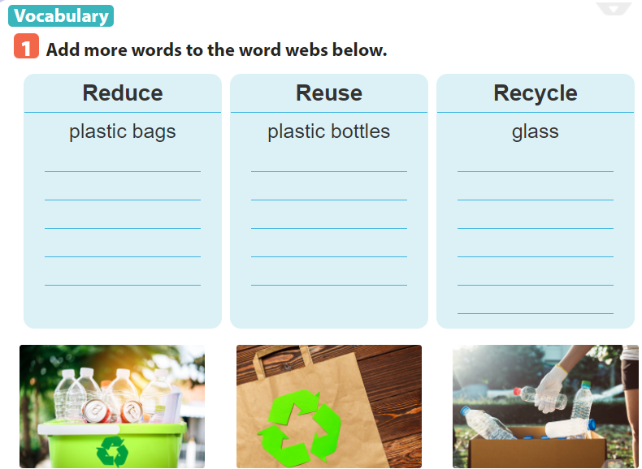
electricity
bottles
plastic boxes
water
envelopes
plastic bags
gas
light bulbs
Old books
paper
plastic bags
cans
rubbish
cans
newspapers

Slide 6

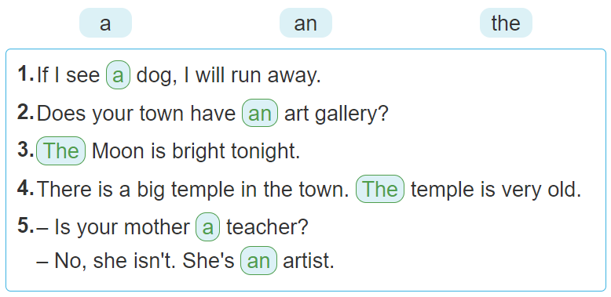

Slide 7
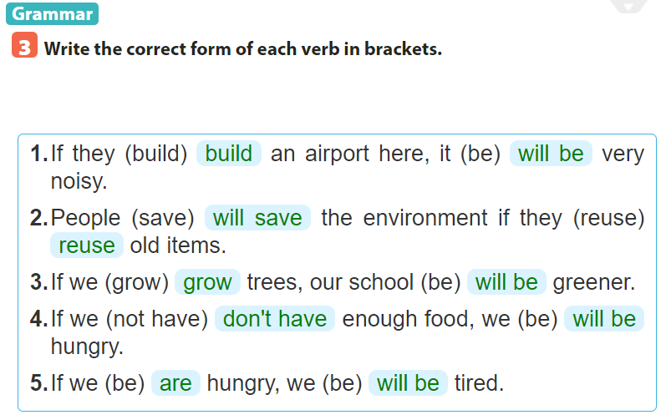

Slide 8
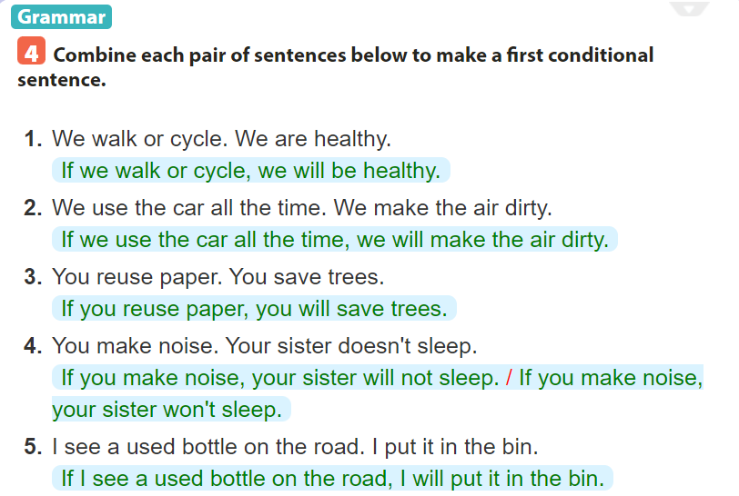
=>
=>
=>
=>
=>

Slide 9
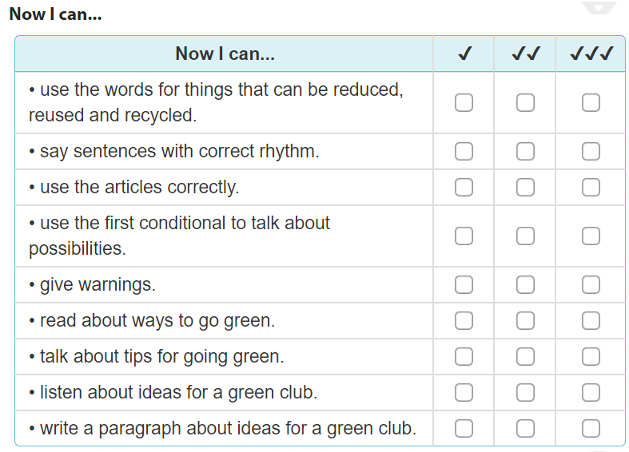

Slide 10
Project

Slide 11
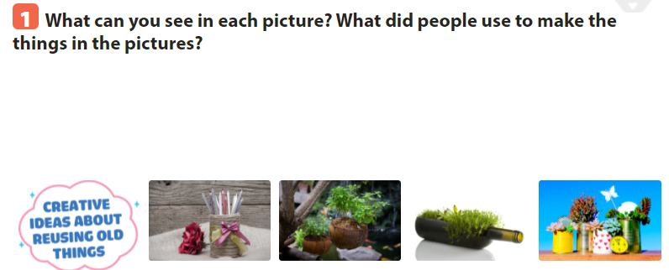

Slide 12
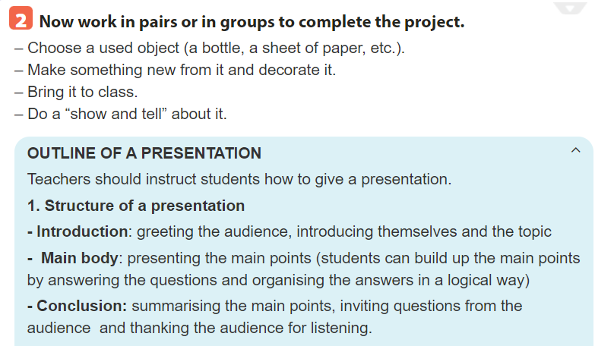

Slide 13
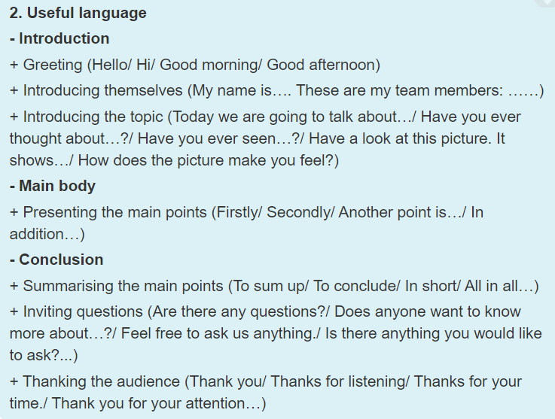

Slide 14
Sample
Hello, everyone. My name is …
Today I’m going to talk about a product I make from recycled paper. As you can see that I make these greeting cards from recycled paper. I use recycled paper, cut it, draw the funny pets or beautiful flowers on it and then I write the greetings on it to make birthday cards and invitation cards. I also decorate the cards to make them beautiful and look nice. I will give these cards as presents to my friends and relatives.
We can make many products from recycled paper so make sure not to
throw any paper into the recycling bin without recycling it.
Thanks for your listening.

Slide 16
SUM UP
By the end of the lesson, students can be able to:
- review the vocabulary and grammar of Unit 11;
- apply what they have learnt (vocabulary and grammar) into practice through a project.
- Do exercise page ……

