Slide 1
Unit 8:
Sports and games
Part 5: SKILLS 1

Slide 2
17th , February , 2023
Period 66 Unit 8: SPORTS AND GAMES
Lesson 5: Skills 1 (p.22)

Slide 3
Objectives
By the end of the lesson, students will be able to:
- develop reading skill for general and specific information about Pelé;
- talk about famous sports people.

Slide 4
17th , February , 2023
Period 66 Unit 8: SPORTS AND GAMES
Lesson 5: Skills 1 (p.22)
* Vocabulary

Slide 5
Vocabulary
Career (n) /kəˈrɪər/
hero (n) /ˈhɪə.rəʊ/
Goal (n,v) /ɡəʊl/
Medal (n) /ˈme.dəl/
Tournament (n) /ˈtʊə.nə.mənt/
Female (a) /ˈfiːmeɪl/
Nghề nghiệp
Người hùng
Điểm, ghi điểm
huy chương
Giải đấu
(Giới tính) nữ

Slide 6
17th , February , 2023
Period 66 Unit 8: SPORTS AND GAMES
Lesson 5: Skills 1 (p.22)
* Vocabulary
I/ Reading
Act 1:

Slide 7
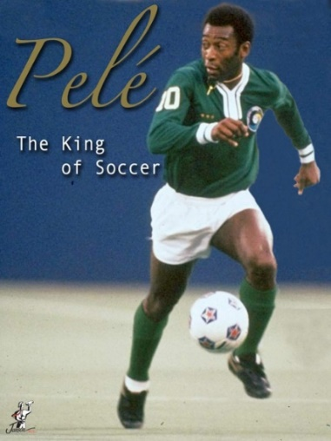
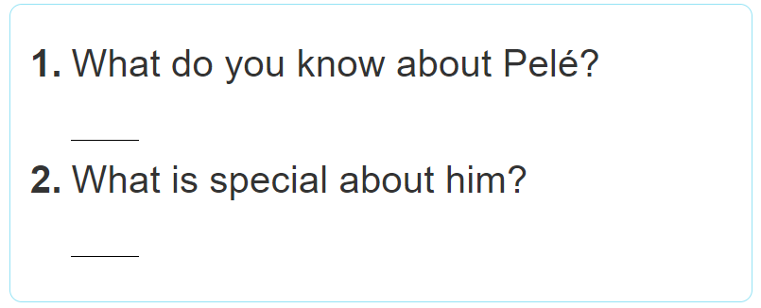
Pele is from Brazil. He plays football very skillfully.
He won the World Cup. He is the King of Football.

Slide 8
17th , February , 2023
Period 66 Unit 8: SPORTS AND GAMES
Lesson 5: Skills 1 (p.22)
* Vocabulary
I/ Reading
Act 1:
Act 2:

Slide 10
17th , February , 2023
Period 66 Unit 8: SPORTS AND GAMES
Lesson 5: Skills 1 (p.22)
* Vocabulary
I/ Reading
Act 1:
Act 2:
Act 3: Answer the questions

Slide 11
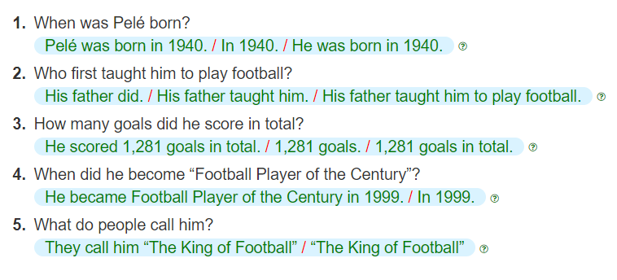
Teacher: Right. He was born in 1940 in Brazil.
Teacher: Right. He was born in 1940 in Brazil. His father taught him to play football at a very young age.
Teacher: Yes, and he’s known around the world as “The King of football”.
Teacher: 1,281 goals in total, I think.
Teacher: And he became “Football Player of the Century” in 1999.

Slide 12
17th , February , 2023
Period 66 Unit 8: SPORTS AND GAMES
Lesson 5: Skills 1 (p.22)
* Vocabulary
I/ Reading
Act 1:
Act 2:
Act 3: Answer the questions
II/ Speaking

Slide 13
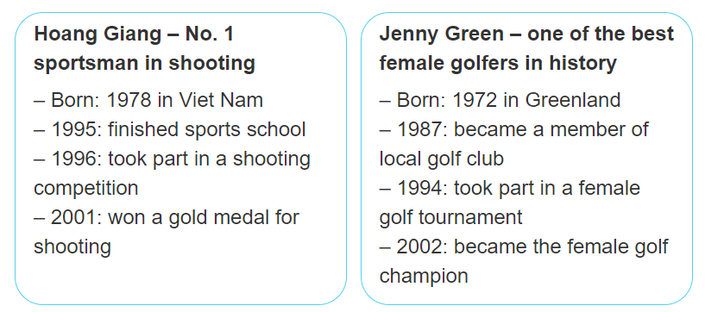

Slide 14
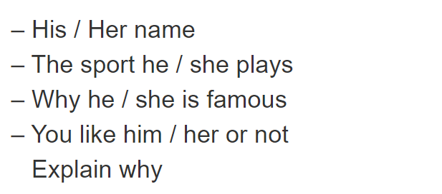

Slide 15
SUGGESTED ANSWER
1. Hoang Giang is number 1 sportsman in shooting. He was born in 1978 in Viet Nam. In 1995, he finished sports school. In 1996, he took part in a shooting competition. He won a gold medal for shooting in 2001.
2. Jenny Green is one of the best female golfers in history. She was born in 1972 in Greenland. In 1987, she became a member of local golf club. In 1994, she took part in a female golf tournament. She became the female golf champion in 2002.

Slide 16
Sum up
By the end of the lesson, students will be able to:
- develop reading skill for general and specific information about Pelé;
talk about famous sports people.
HOMEWORK
- Do exercise in workbook
- Prepare “ Skills 2” part.

