Slide 1
Good morning class !!!
English 7
Song Ve Secondary School

Slide 2
WARM-UP
Sentence puzzling
1. He / although/ it is/ goes out/ raining.
→ He goes out although it is raining.
2. She / is / good/ though /marks /gets /she /lazy.
→ She gets good marks though she is lazy.
3. He /failed / he /studied hard /. However,/ the exam.
→ He studied hard. However, he failed the exam.
4.The movie/ very interesting / . However, /is not/ /people/ like to watch still /it.
→ The movie is not very interesting. However, people still like to watch it.

Slide 3
WARM-UP
Sentence puzzling
1.→ He goes out although it is raining.
2.→ She gets good marks though she is lazy.
3.→ He studied hard. However, he failed the exam.
4.→ The movie is not very interesting. However, people still like to watch it.

Slide 4
Unit
8
FILMS
LESSON 3: A CLOSER LOOK 2
Grammar: Connectors of contrast
however
although/ though
Unit
HOBBIES

Slide 5
* Grammar: Connectors of contrast
We use although/ though or however to connect 2 contrasting ideas.
however
connect 2 contrasting ideas
in 2 sentences
although/ though
connect 2
contrasting ideas
in the same sentence
Although / Though John Peters is an amateur actor, he gave a great performance in his film.
John Peters is an amateur actor. However, he gave a great performance in his film.

Slide 6
* PRACTICE
1
Combine the two sentences, using although/ though.
1. The questions were very difficult. He solved them easily.
2. He was a great actor. He never played a leading role in a film. 3. They spent a lot of money on the film. The film wasn't a big success 4. The film was a comedy. I didn't find it funny at all.
5. We played well. We couldn't win the match.

Slide 7
* PRACTICE
1
Combine the two sentences, using although/ though.
1. The questions were very difficult. He solved them easily.
→ Although/ Though the questions were very difficult, he solved them easily.
or He solved the questions easily although/though they were very difficult.
2. He was a great actor. He never played a leading role in a film.
→ Although/ Though he was a great actor, he never played a leading role in a film.
or He never played a leading role in a film although/though he was a great actor.
3. They spent a lot of money on the film. The film wasn't a big success
→ Although/ Though they spent a lot of money on the film, it wasn’t a big success.
or The film wasn’t a big success although/though they spent a lot of money on it.

Slide 8
* PRACTICE
1
Combine the two sentences, using although/ though.
4. The film was a comedy. I didn't find it funny at all.
→ Although/ Though the film was a comedy, I didn’t find it funny at all.
or I didn’t find the film funny at all although/though it was a comedy.
5. We played well. We couldn't win the match.
→ Although/ Though we played well, we couldn’t win the match.
or We couldn’t win the match although/though we played well.

Slide 9
2
Complete the sentences, using although/ though or however.

Slide 10
2
Complete the sentences, using although/ though or however.
1. _________________ the acting in the film was good, I didn’t like its story. 2. I felt really tired. _____________, I went to see the film. 3. I really enjoyed the new film ________________ most of my friends didn’t like it. 4. He studied hard for the exam. ______________, he failed it. 5. Mai speaks English very well _______________ her native language is Vietnamese.
Although/ Though
However
although/ though
However
although/ though
Notes:
Wordwall game: https://wordwall.net/resource/27225435

Slide 11
3
Use your own ideas to complete the following sentences.
1. I don’t really like the film though ______. 2. He felt very well. However, ______. 3. The film was a great success. However, ______. 4. Although it rained all day, ______. 5. The music in the film was terrible. However, ______.

Slide 12
3
Use your own ideas to complete the following sentences.
1. I don’t really like the film though ______. 2. He felt very well. However, ______. 3. The film was a great success. However, ______. 4. Although it rained all day, ______. 5. The music in the film was terrible. However, ______.
my sister likes it.
he didn’t go to work.
it wasn’t given any prizes.
my clothes were dry.
the visual effect was wonderful.

Slide 13
4
Choose the correct answer (A, B, or C) to complete each sentence.
1.Mary overslept this morning ______ she went to bed early last night. A. although B. because C. so 2. ______ the sun is shining, it isn’t very warm. A. Because B. However C. Though 3. I don’t like running, ______ I like swimming. A. but B. so C. however 4. ______ the film was exciting, Jim fell asleep in the cinema. A. However B. Because C. Although 5. The story of the film is silly. ______, many people still enjoyed it. A. However B. Though C. But
6. ______ it is a comedy, I don't find it funny.
A. although B. because C. so
GAME
Notes:
Wordwall game https://wordwall.net/resource/27224858

Slide 14
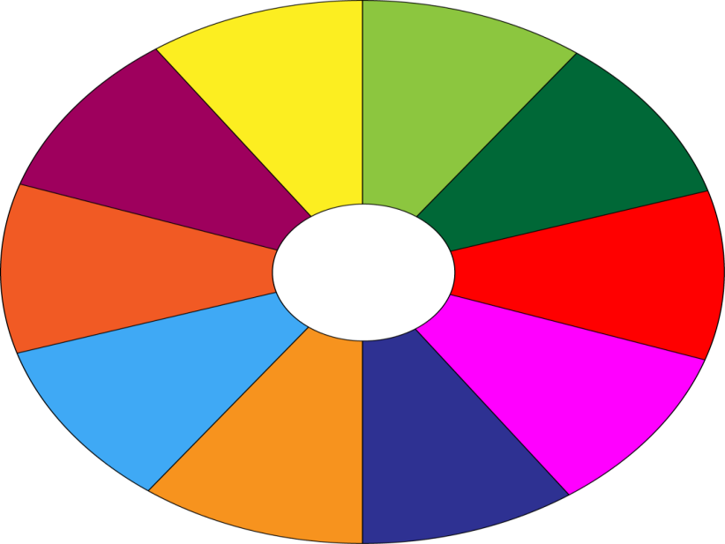
THE BIG WHEEL GAME
QUESTIONS
10
40
1
2
30
50
SPIN
4
10
3
20
-15
-20
5
6
05
60

Slide 15
4
Choose the correct answer (A, B, or C) to complete each sentence.
1. Mary overslept this morning ______ she went to bed early last night. A. although B. because C. so
Notes:
Wordwall game https://wordwall.net/resource/27224858

Slide 16
4
Choose the correct answer (A, B, or C) to complete each sentence.
2. ______ the sun is shining, it isn’t very warm. A. Because B. However C. Though
Notes:
Wordwall game https://wordwall.net/resource/27224858

Slide 17
4
Choose the correct answer (A, B, or C) to complete each sentence.
3. I don’t like running, ______ I like swimming. A. but B. so C. however
Notes:
Wordwall game https://wordwall.net/resource/27224858

Slide 18
4
Choose the correct answer (A, B, or C) to complete each sentence.
4. ______ the film was exciting, Jim fell asleep in the cinema. A. However B. Because C. Although
Notes:
Wordwall game https://wordwall.net/resource/27224858

Slide 19
4
Choose the correct answer (A, B, or C) to complete each sentence.
5. The story of the film is silly. ______, many people still enjoyed it. A. However B. Though C. But
Notes:
Wordwall game https://wordwall.net/resource/27224858

Slide 20
4
Choose the correct answer (A, B, or C) to complete each sentence.
6. ______ it is a comedy, I don't find it funny.
A. although B. because C. so
Notes:
Wordwall game https://wordwall.net/resource/27224858

Slide 21
PRODUCTION
5
Game – Chain story with although/ though
A: Although/ Though it rained yesterday, we went shopping. B: Although/ Though we went shopping, we didn’t buy anything.
C: ________________

Slide 22
* CONSOLIDATION
1
Wrap-up
Grammar: Connectors of contrast
however
although/ though

Slide 23
HOMEWORK
Do more exercises in workbook.
Prepare: Unit 4: Communication

Slide 24
Goodbye.
See you again.

