Slide 2
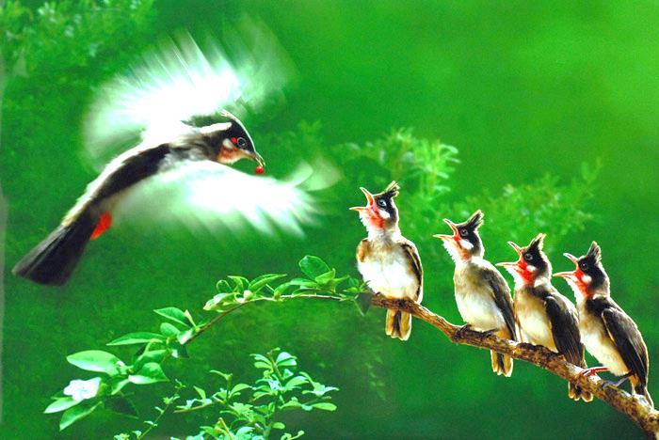
Welcome to our class !

Slide 3
UNIT 3: MY FRIENDS
LESSON 3

Slide 4
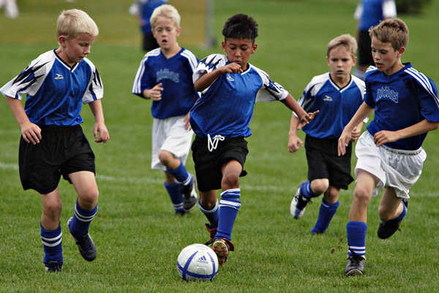
They are playing football.
What are they doing?

Slide 5
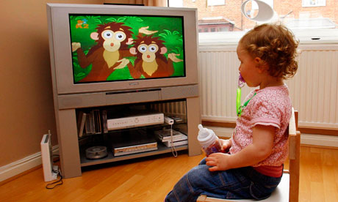
He is watching T.V

Slide 6
They are riding a bike

Slide 7
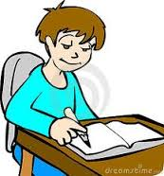
Yes. She is writing

Slide 8
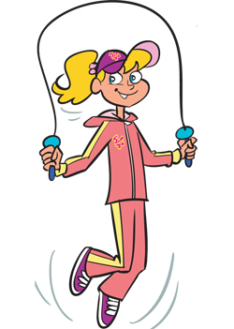
No,she isn’t. She is skipping

Slide 9
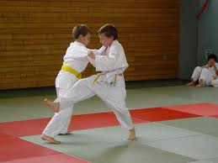
Actions now
THE PRESENT
CONTINUOUS
TENSE

Slide 10
* Grammar:
The present continuous
(Thì hiện tại tiếp diễn)
We use the present continuous for actions happening now.
Example: - She’s talking.
- They’re not talking.
* Form: S + am/ is/ are + V-ing
We can use the present continuous with now, at present, or at the moment.
Example: - I’m doing my homework at present.
- A: Are you reading now?
B: Yes, I am.

Slide 11
Put the verbs in brackets in the present continuous.
1.
Nam (read)
is reading
a book now.
2.
They (play)
are playing
football at the moment.
3.
My sister (not make)
isn’t making
a sandwich at present.
I (go) to the supermarket at the moment.
4.
am going
5.
Are
talking
they (talk) about their new friends?

Slide 12
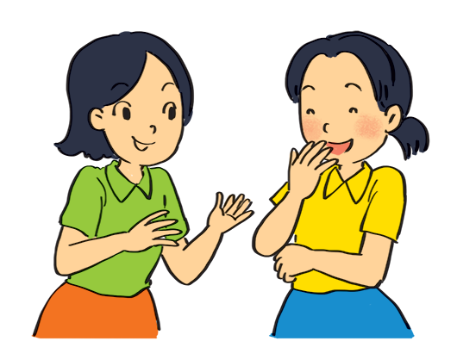
Look at the pictures. Write sentences like the example. Use positive or negative present continuous verbs.
Example:
She’s talking to Mai. (talk)

Slide 13
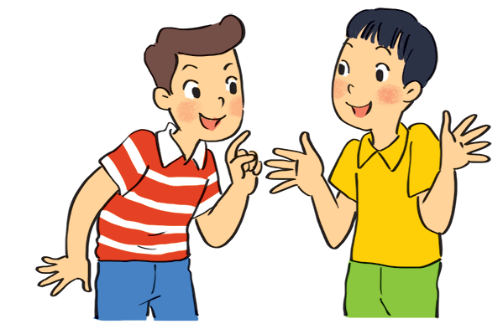
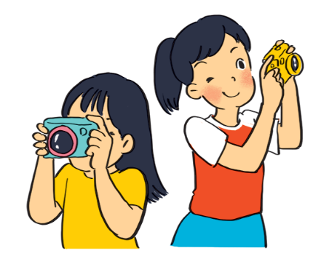
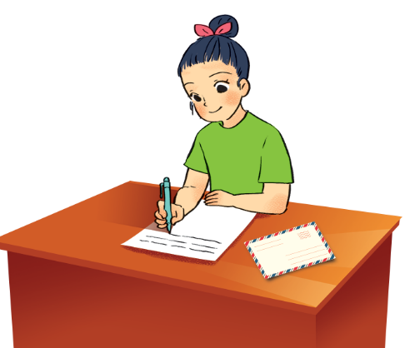
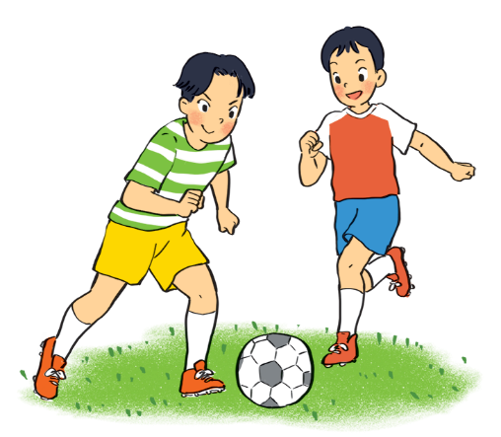
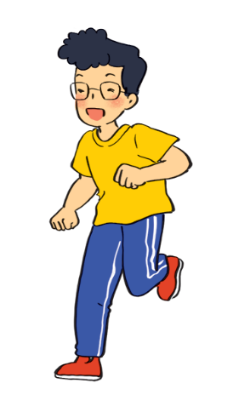
.
1.
Nam and Ba
(eat ice cream)
are not / aren’t eating ice cream.
2.
are taking photos.
Lan and Trang
(take photos)
.
3.
Ha
(write a letter)
is / Ha’s writing a letter.
.
4.
Duong and Hung
(play badminton)
are not / aren’t playing badminton.
.
is not / isn’t drawing a picture.
5.
.
Phong
(draw a picture)

Slide 14
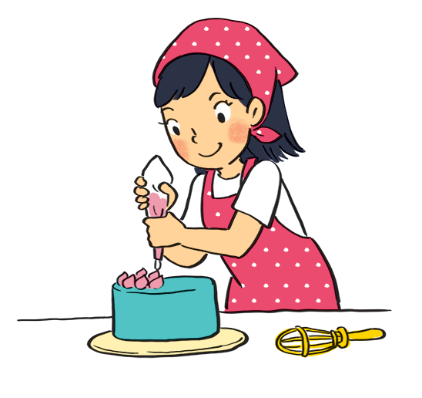
Work in pairs. Look at the pictures. Ask and answer.
Example:
A: your sister / make a cake?
Is your sister making a cake?
B: Yes, she is.

Slide 15
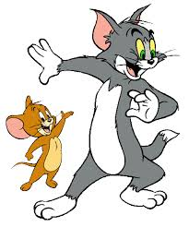
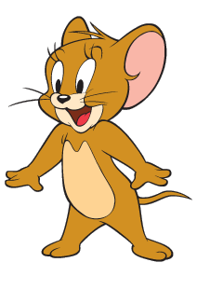
Game: Lucky numbers
1
2
3
4
5
6
7
8

Slide 16
LUCKY NUMBER!

Slide 17
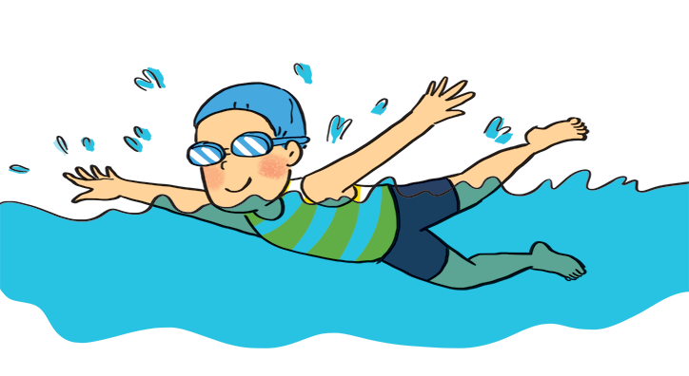
1
A: your friend / swim?
B:
Is your friend swimming?
Yes, he is.

Slide 18
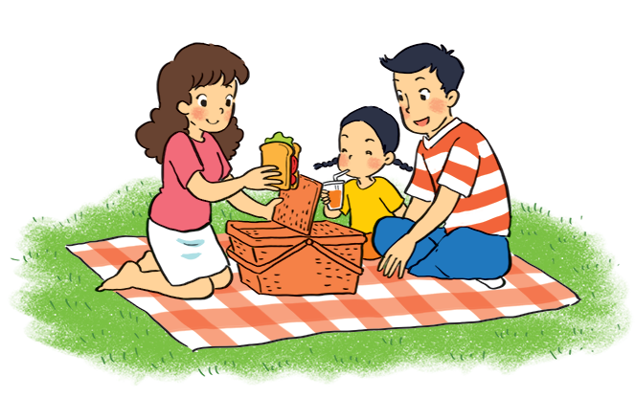
2
A: they / listen to music?
B:
Are they listening to music?
No, they aren’t.
(They’re / They are having a picnic.)

Slide 19
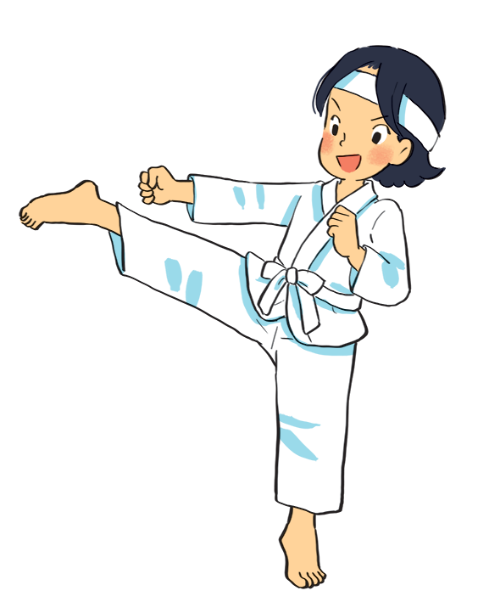
3
A: Mi / play the piano?
B:
Is Mi playing the piano?
No, she isn’t.
(She’s / She is doing karate.)

Slide 20
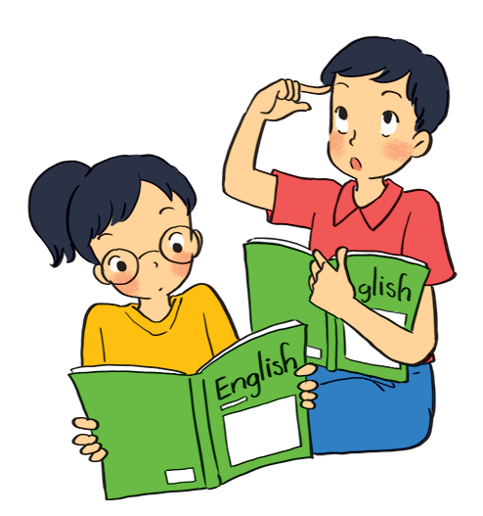
4
A: they / learn English?
B:
Are they learning English?
Yes, they are.

Slide 21
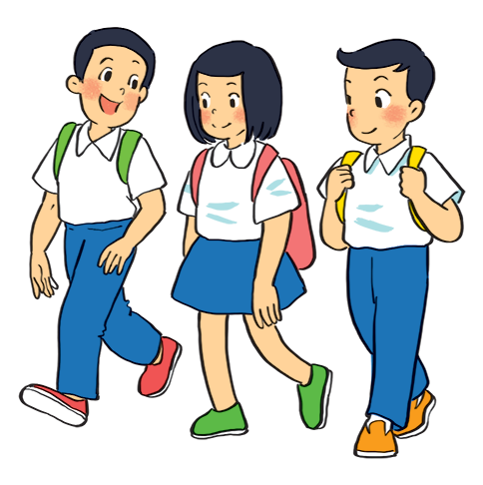
5
A: your friends / cycle to school?
B:
Are your friends cycling to school?
No, they aren’t.
(They’re / They are walking to school.)

Slide 22
LUCKY NUMBER!

Slide 23
LUCKY NUMBER!

Slide 24
Grammar
The present continuous
When something often happens or is fixed, we use the present simple.
When something is happening now, we use the present continuous.
+ Khi một điều gì đó thường xảy ra hoặc đã được xác định( chắc chắn), chúng ta sử dụng thì hiện tại đơn.
+ Khi một điều gì đó đang xảy ra ở hiện tại, chúng ta sử dụng thì hiện tại tiếp diễn.

Slide 25
Put the verbs in brackets in the present simple or present continuous.
My best friend (not walk)
Sometimes she (cycle) .
1.
doesnot / doesn’t walk
to school every day.
cycles
2.
he (play) ?
is
playing
Look! What
your friends (study)
study
every afternoon?
3.
Do
in the library
4.
I (write)
am / ‘m writing
an email to my friend now.
5.
He (not do)
He (read)
is / ‘s reading
his homework now.
is not / isn‘t doing.
.

Slide 26
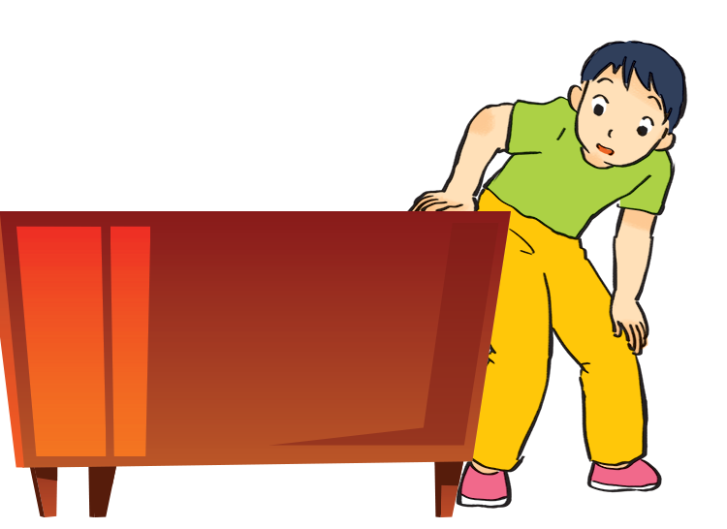
Charades
Take turns to mime different actions.
Others guess what you are doing.
Example:
A: Are you dancing?
B: No, I’m not.
C: Are you looking for something?
B: Yes, I am.

Slide 27
Ex 2.Chia động từ trong ngoặc ở thì Hiện Tại Tiếp Diễn:
They (meet) ____________their teacher at the moment.
We (visit) _____________the museum next week.
What______you (do) ________ tonight?
Silvia (not listen) ________ to music at the moment.
Maria (sit) ________ next to Paul right now.
He_______always (make) ________ noisy at night.
My children (be)___ upstairs now. They (play)____ games.
Your father (repair)______________your bike at the moment?
Listen! The teacher (explain) ________a new lesson to us.
Look! The bus (come)________.

Slide 28
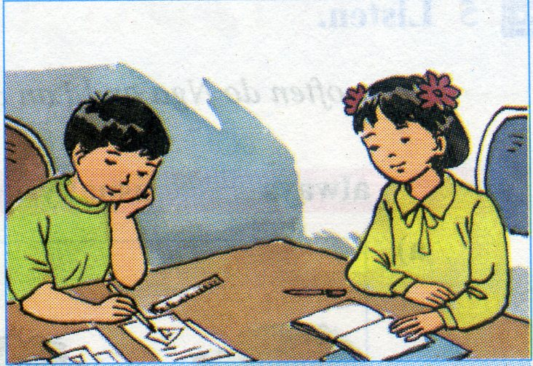
* Wrap – up:
What have you learnt in this lesson?

Slide 29
* Home work
Learn by heart grammar.
Do exercise A in workbook.
Prepare new lesson:
Lesson 4. Communication

Slide 30
Goodbye – See you again.

